Slide 1
Da WORD a PowerPoint
Esperimenti di una novellina

Slide 2
BBC News: Welcome to the programme, we have had a summer break from AI
decoded but if like me you were on the British beaches sheltering from the rain there
may be you were scaling your mobile Weather app to see if the sun might ever
reappear which God is thinking what about AI and the weather how do you predict
climate when it is changing so fast how do you process that incredible amount of

Slide 3
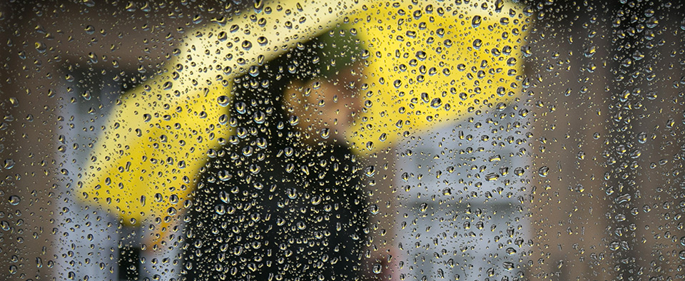
computerized data that is now being generated well you model it and that is where AI
is making huge advances there is a forecasting Revolution underway so accurate
says the Guardian and now in much more accessible format that very soon
governments around the world will be able to save lives and protect livelihoods

Slide 4
before extreme events even occur well hear from the team at Oxford University who
were filling in the gaps with AI and making it more readily available through cloud
computing or how about this from the EU destination Earth a digital copy of our
planet and we&#39;ve scientists are running complex simulations to predict natural
phenomena AI combined with climate science powered by supercomputers a digital

Slide 5
twin if you will that will help scientists predict the evolution of climate change with me
as ever a regular commentator and colleague as Stephanie Harris here also in the
studio the very well known meteorologist Florence Fabia Dr abié director general of
the European centre for medium range weather forecast and joining is also on zoom
Professor Stephen Belcher who is chief of Science and Technology at the UK Met

Slide 6
Office welcome to you all Force we&#39;re going to start with you and the Earth&#39;s digital
twin that you and your team have built in collaboration with the the AI industry so
let&#39;s get view for the viewers let&#39;s just show the viewers what it entails and we&#39;ll talk
off the back when you come face to face with a process that&#39;s .....

