Slide 1
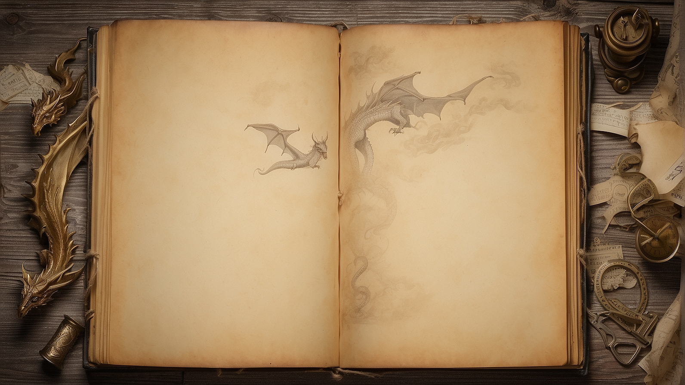

https://vk.com/olga_pavlova_games
Present Simple
or
Present Continuous

Slide 2

