Slide 1
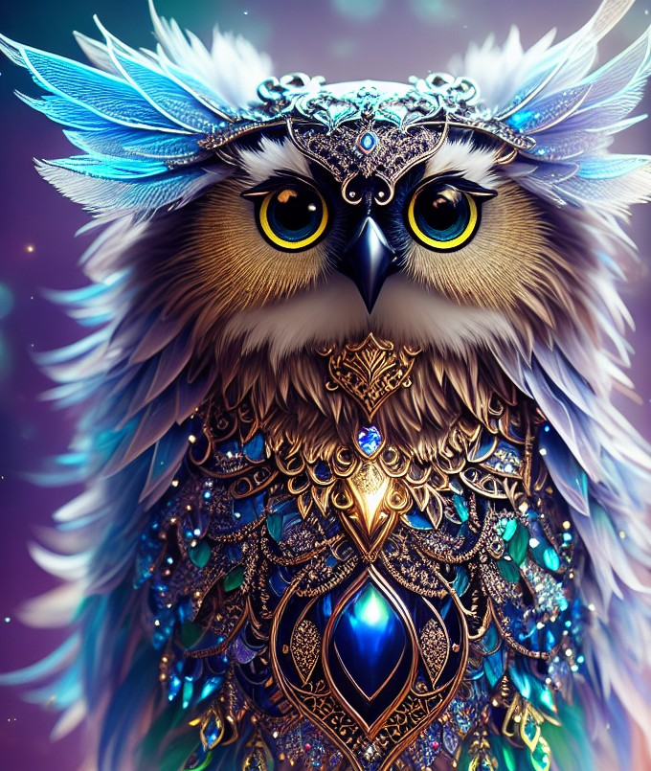

Present Perfect
vs
Past Simple
by Olga Pavlova
https://vk.com/olga_pavlova_games

Slide 2
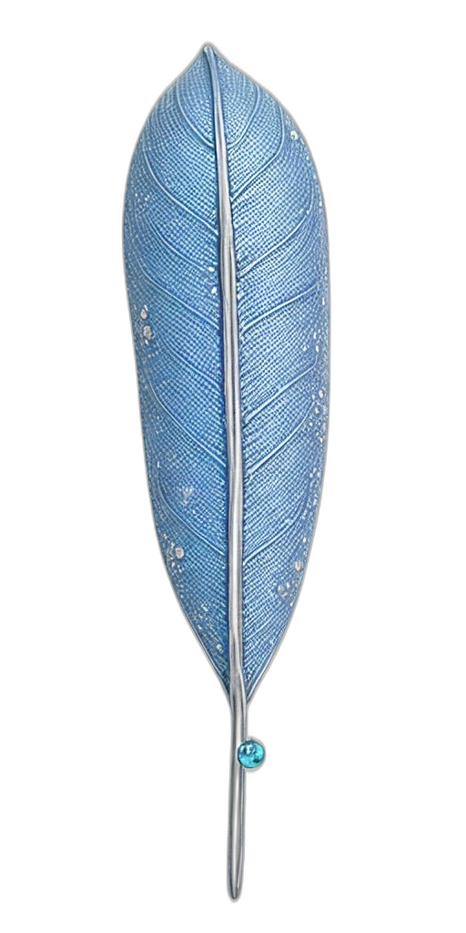
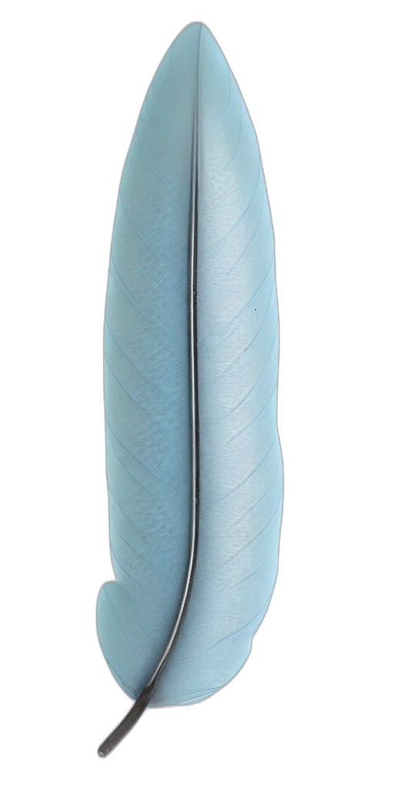
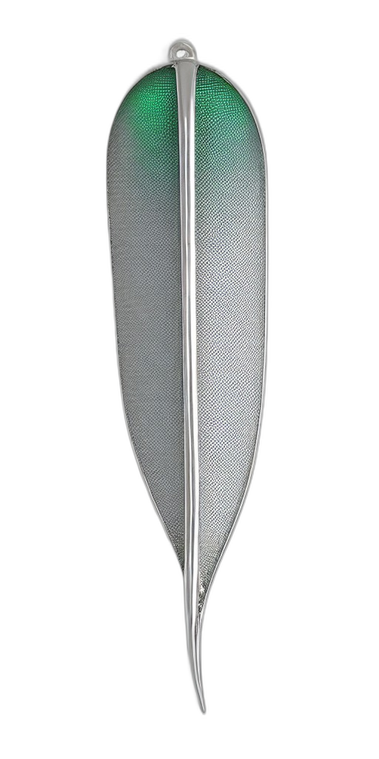
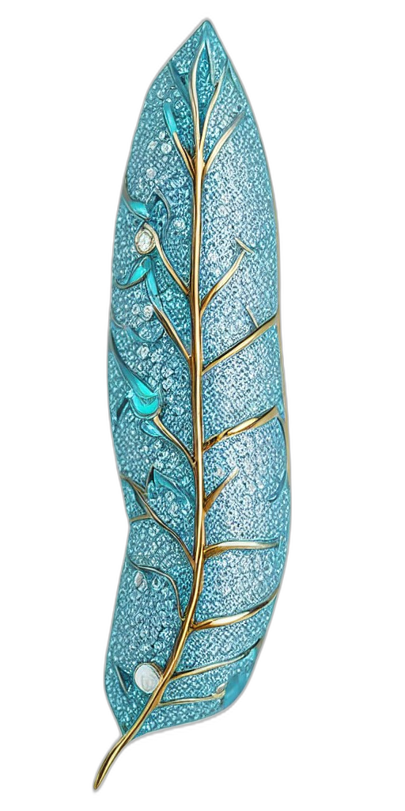
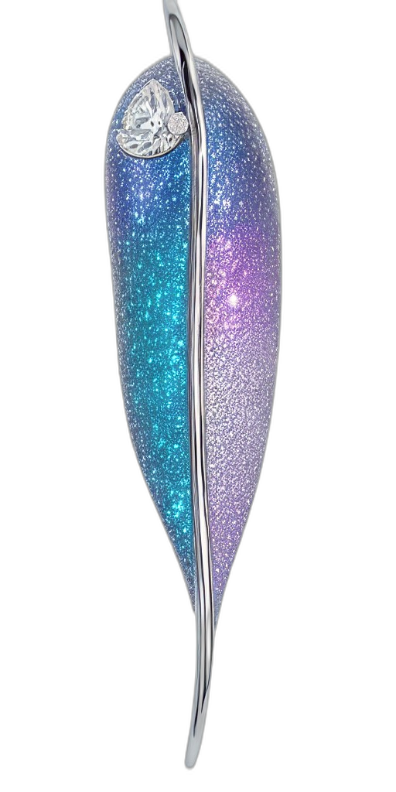
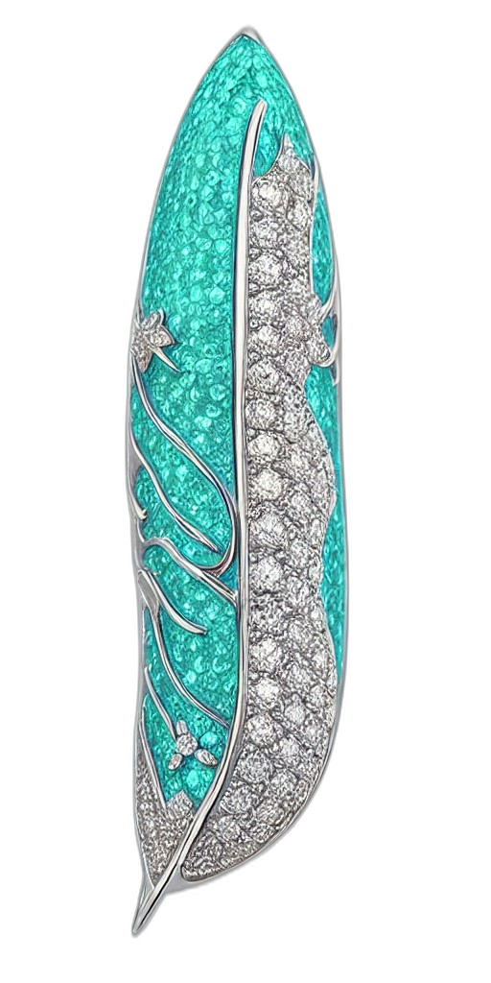
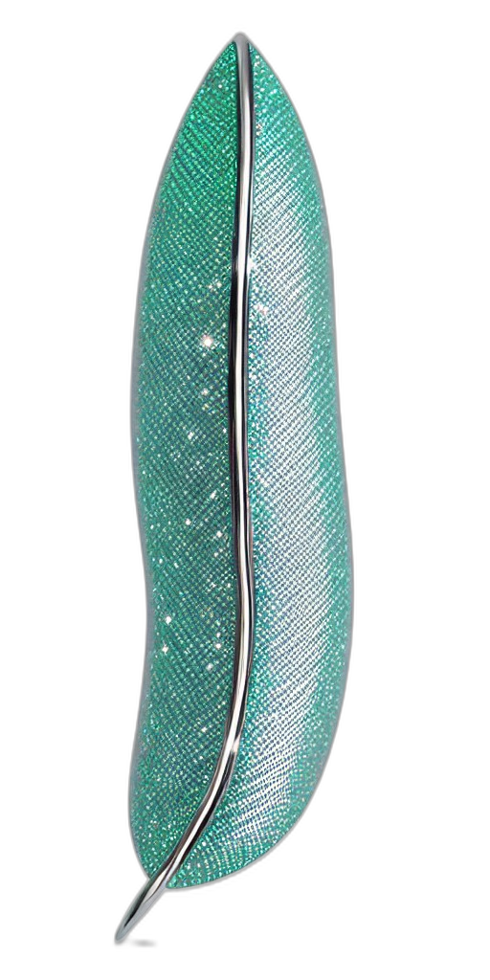
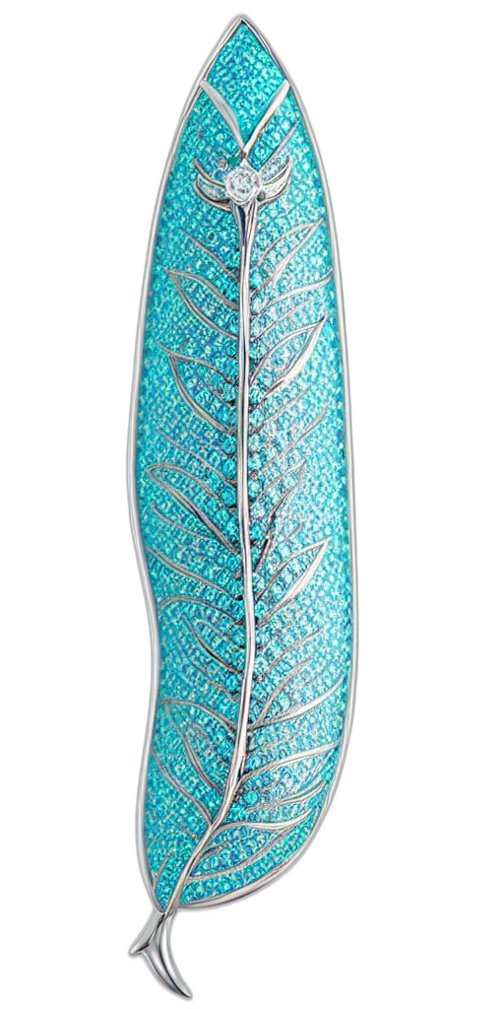



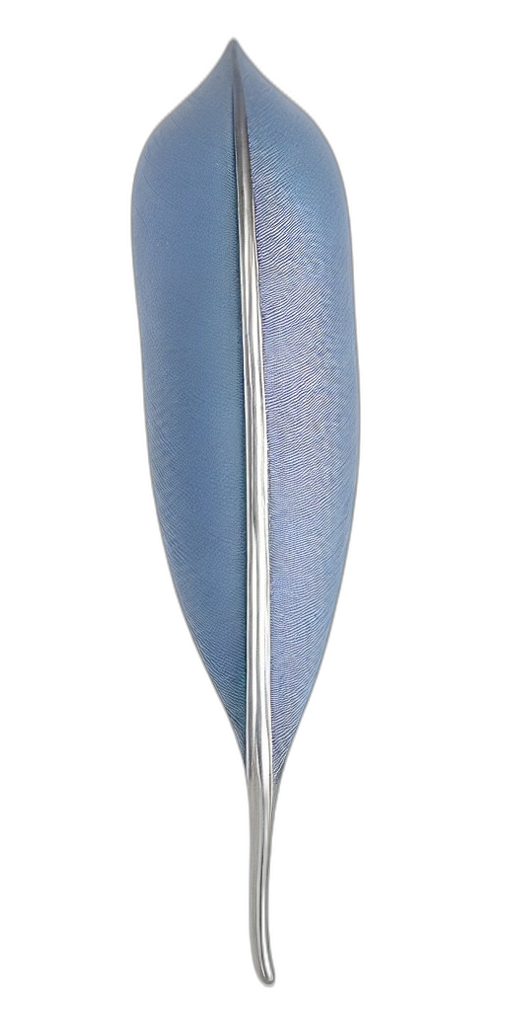
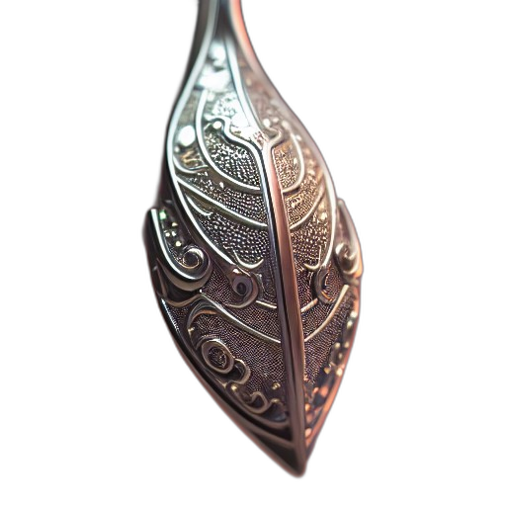
buy a cool T-shirt
Click on the owl twice and make sentences with random words.
visit my granny
read a fantasy novel
write an essay
yesterday
never
play online games
already
tidy my room
last week
last week
eat pizza
break my mobile phone
yet
do my homework
walk my dog
just
2 days ago
in January
cook dinner
for 2 hours
go to school
last month
an hour ago
lose my house key
watch a new film
drink hot chocolate
text my best friend
help my parents

