Slide 1
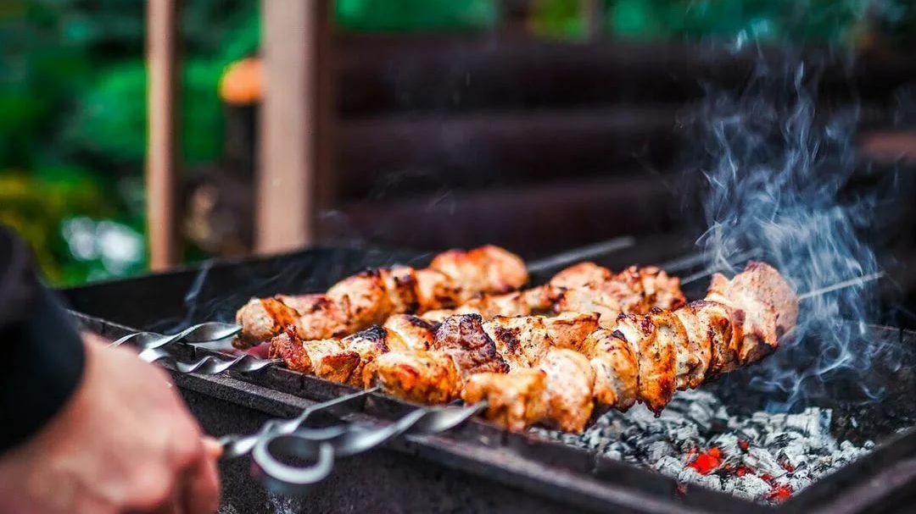

Go_Getter 1 Unit 6
(My Day)
by Olga Pavlova

Slide 2
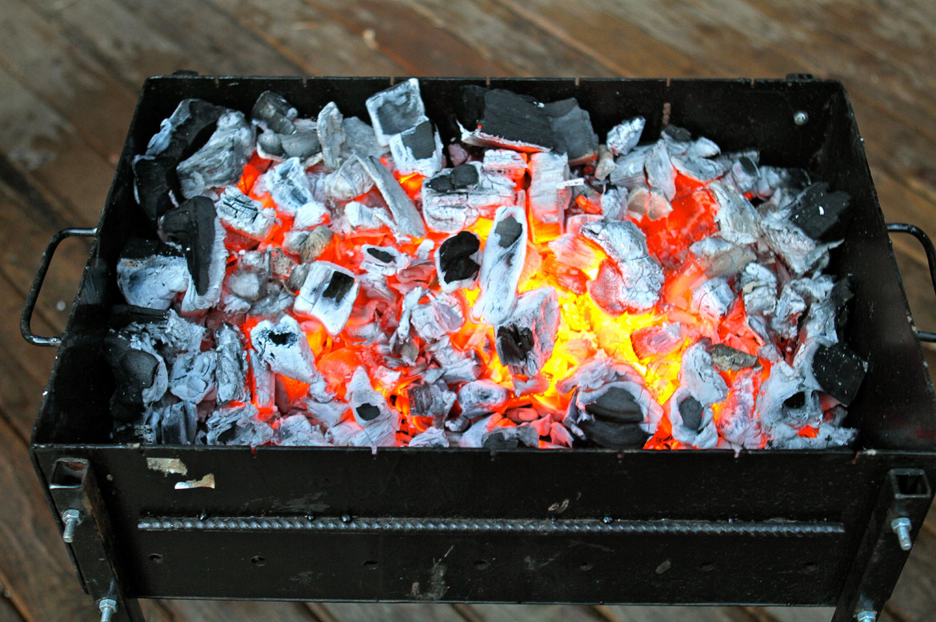
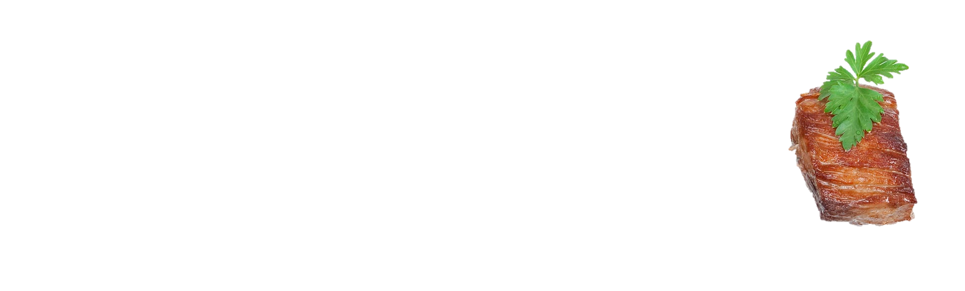
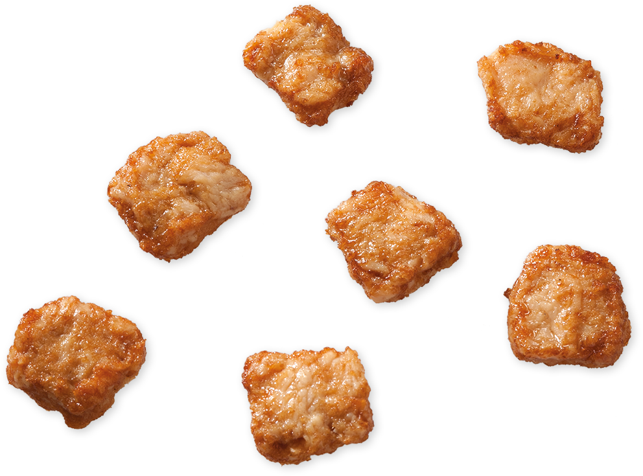
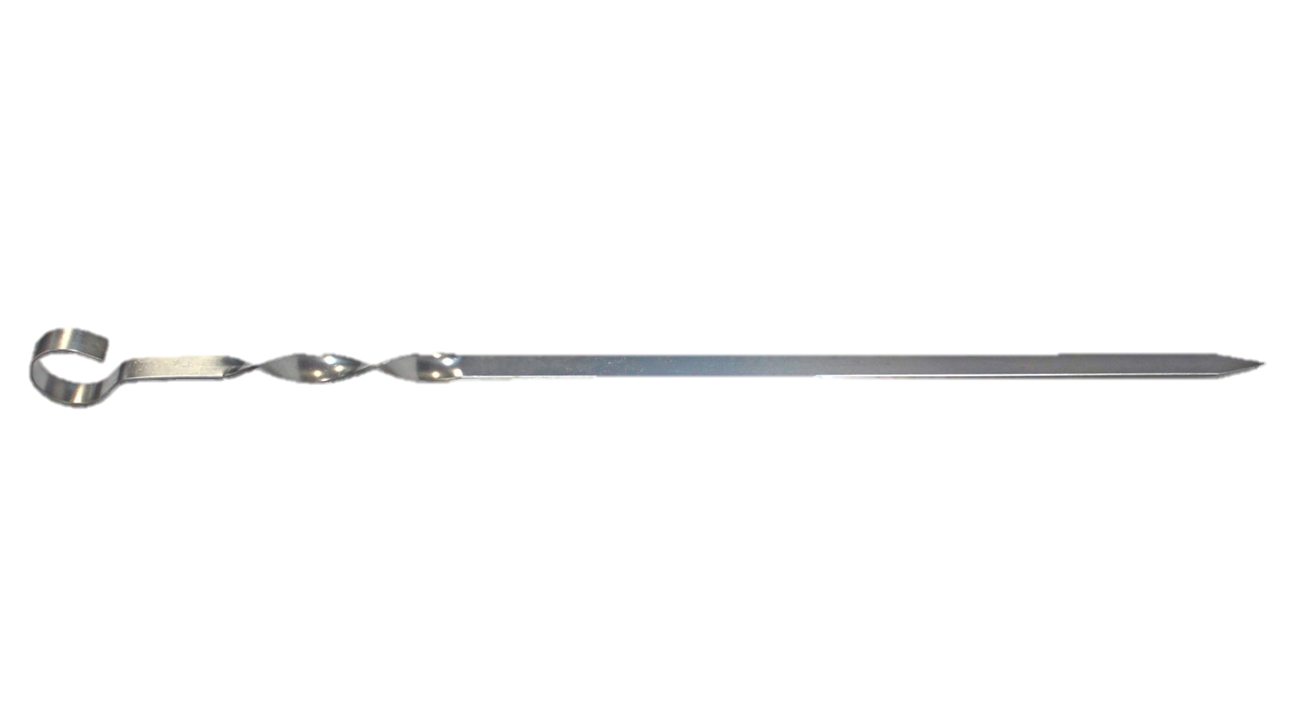
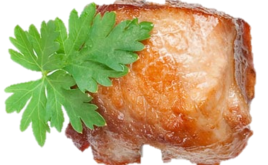

have lunch
watch TV
do my homework
go to school
have breakfast
hang out with my friends
have dinner
listen to music
write
get up
go to bed
have lessons
tidy my room
play computer games
have a shower

