Slide 1
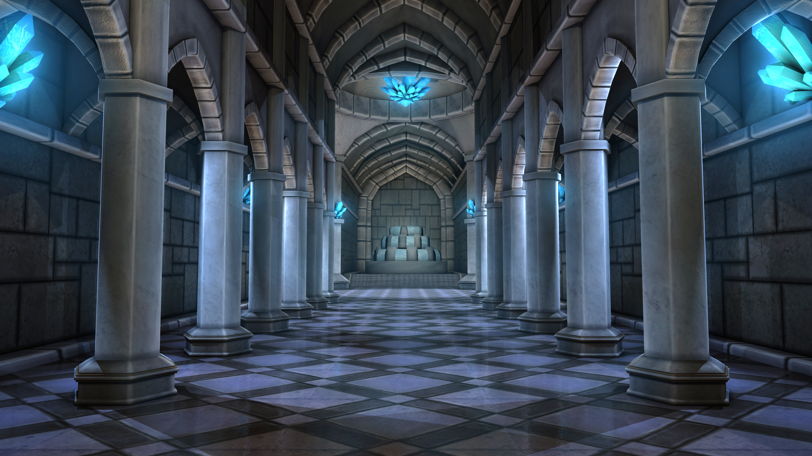
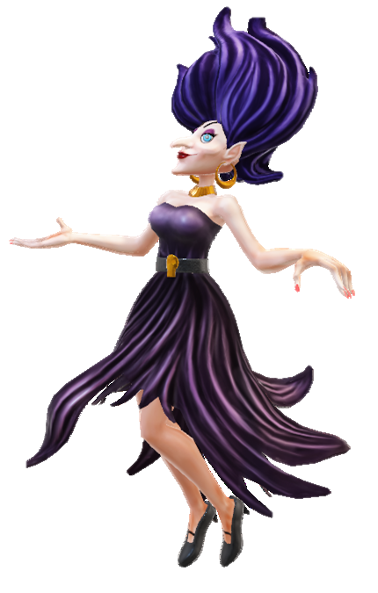
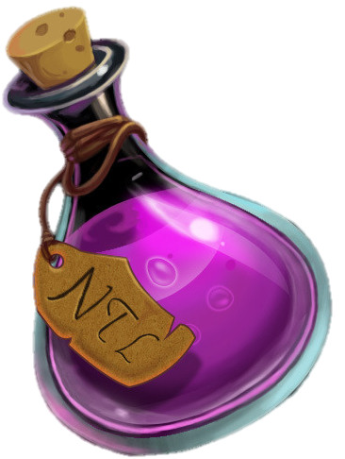
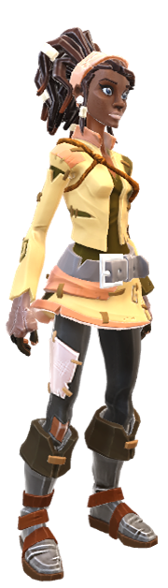
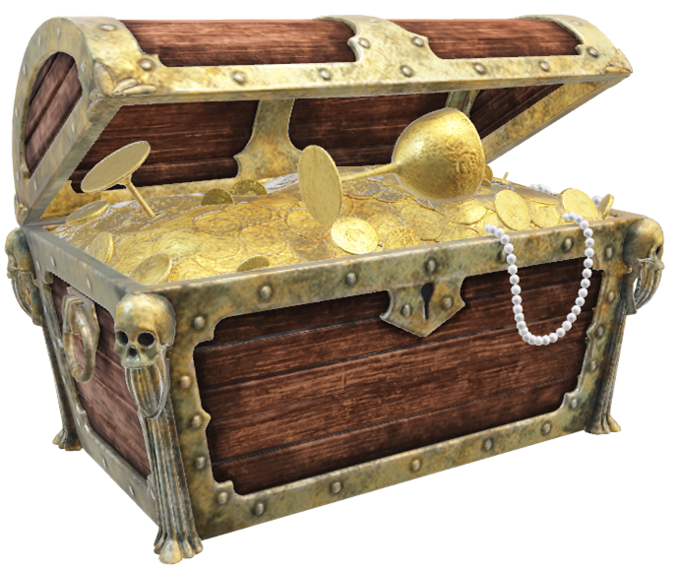
Present Simple
vs
Present Continuous
PLAY
https://vk.com/olga_pavlova_games

Slide 2

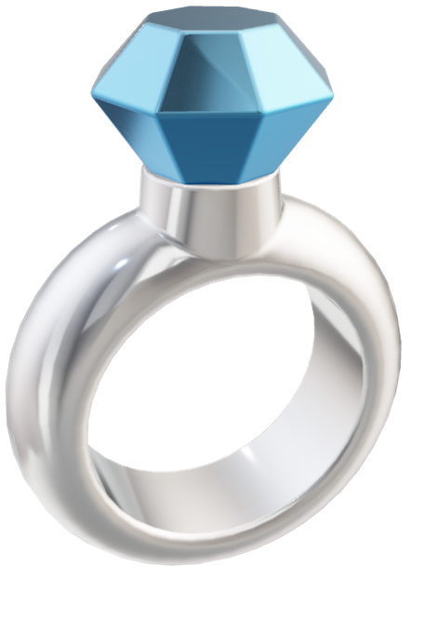
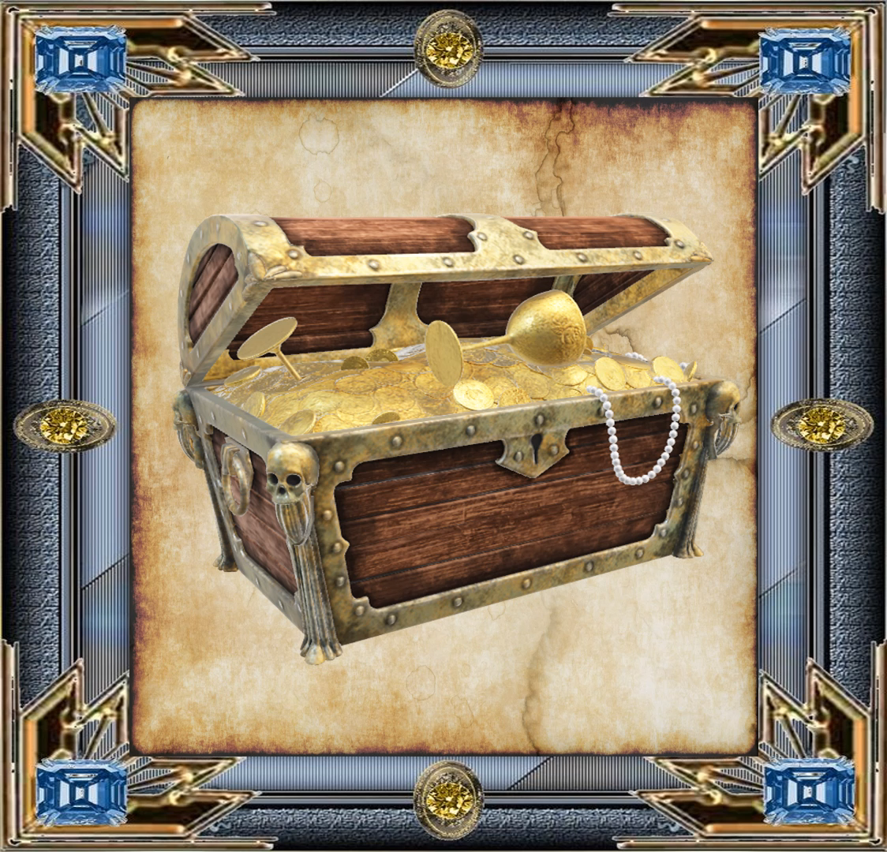

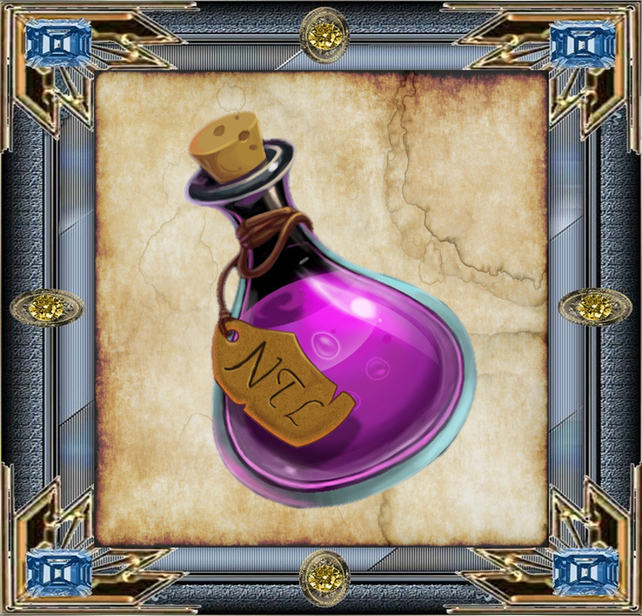
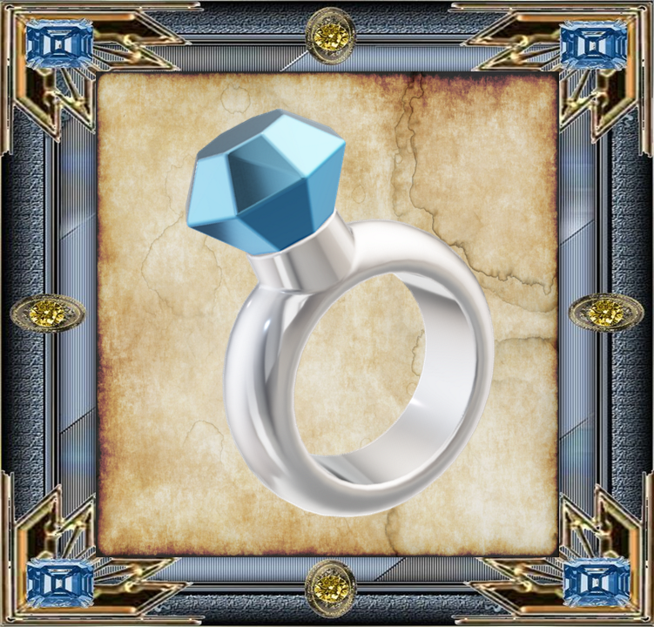

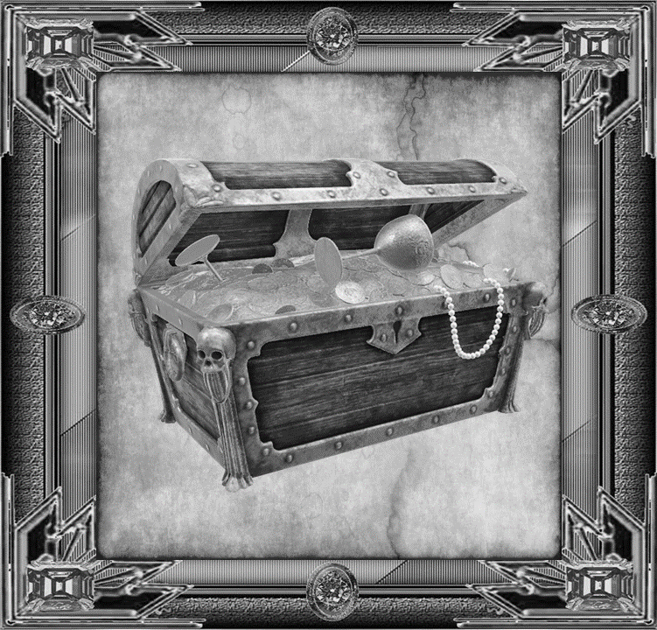

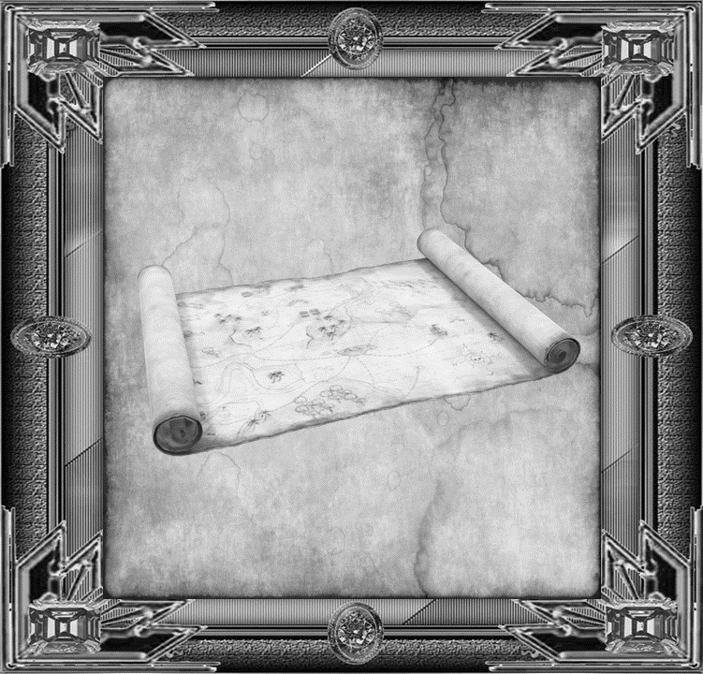
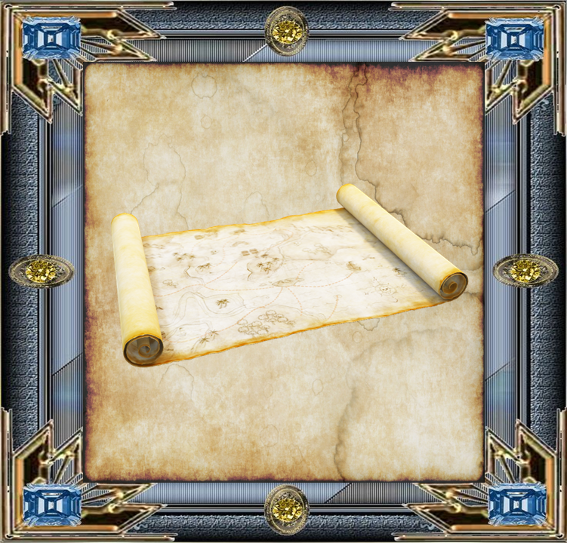
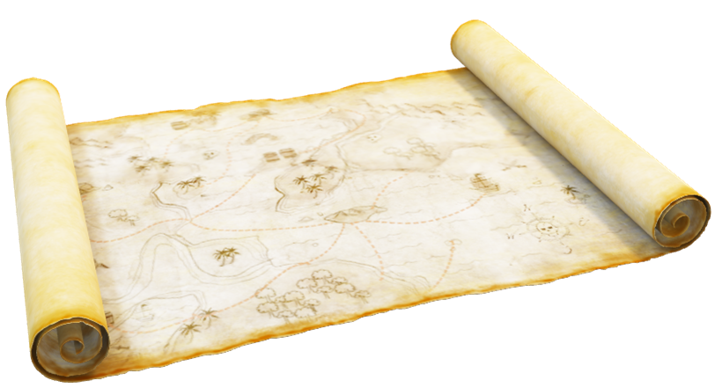
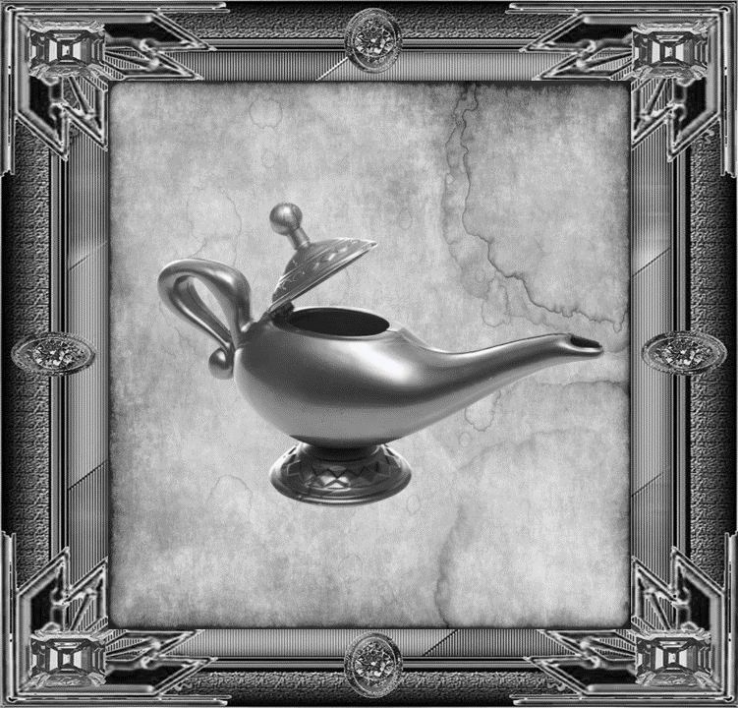
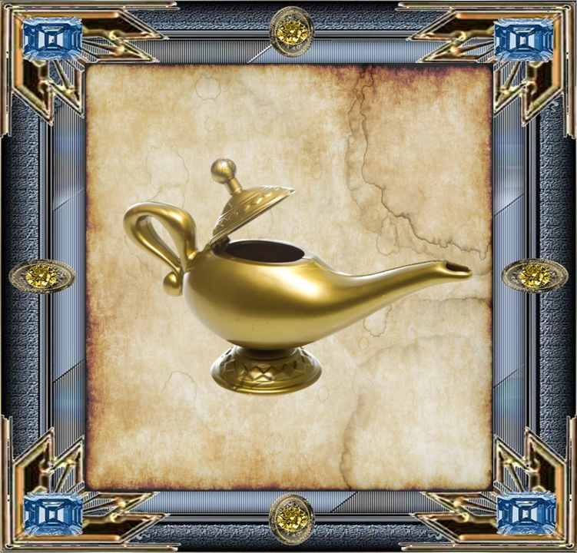
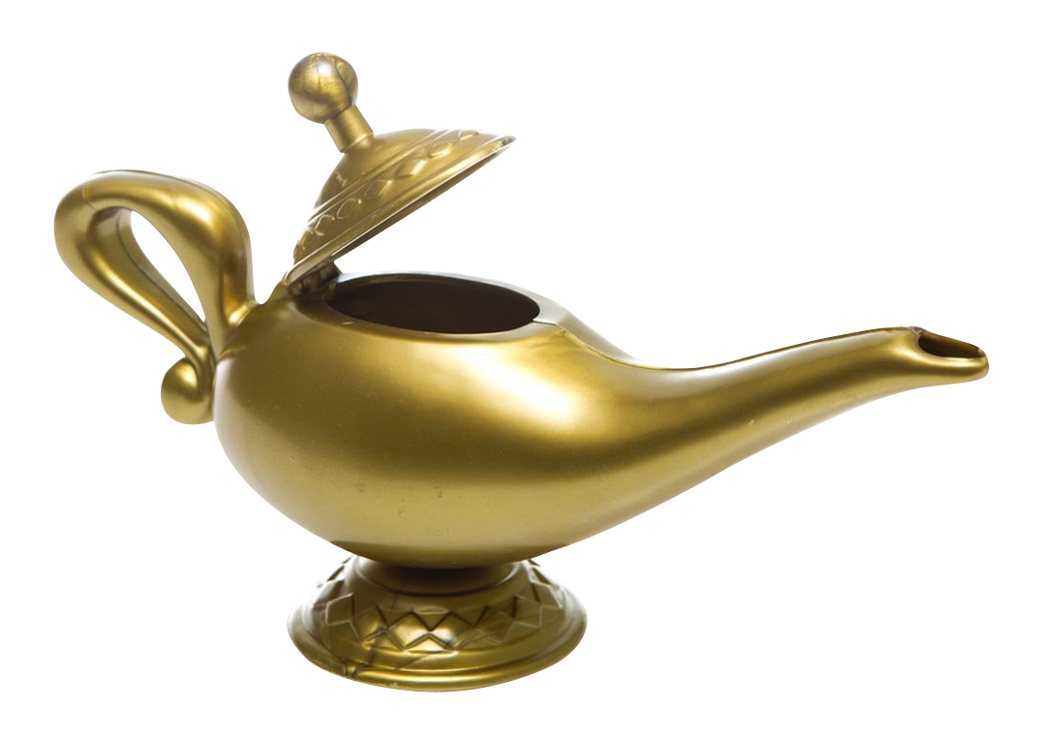

My brother ___ (tidy) his room now.
I usually ___ (stay) at home on Mondays.
My mum ___ (sleep) now.
Her parents ___ (do) the shopping at the moment.
My brother often ___ (tidy) his room after school.
Look! He ____ (sing).
My mum usually ___ (get up) at 7 a.m.
Her parents ___ (drink) coffee every morning.
He usually ___ (wear) white socks.
I never ___ (do) my homework before school.
He ___ (wear) a hat today.
Lucy ___ (write) her blog every day.
I ___ (do) my homework at the moment.
My mum always ___ (cook) dinner.
She never ___ (play) online games.
Right now, she ___ (chat) online.
My mum ___ (cook) dinner now.
My sister ___(try) to do her homework now.
My friends always ___ (play) computer games.
She ___(go) to school every day.
I ____ (watch) TV now.
We ____ (have) lunch at school today.
She ___ (listen) to music now.
I usually___ (watch)TV.
We sometimes ____ (have) lunch at school.
My friends ___ (play) computer games now.
They ___ (listen) to music now.

Slide 3
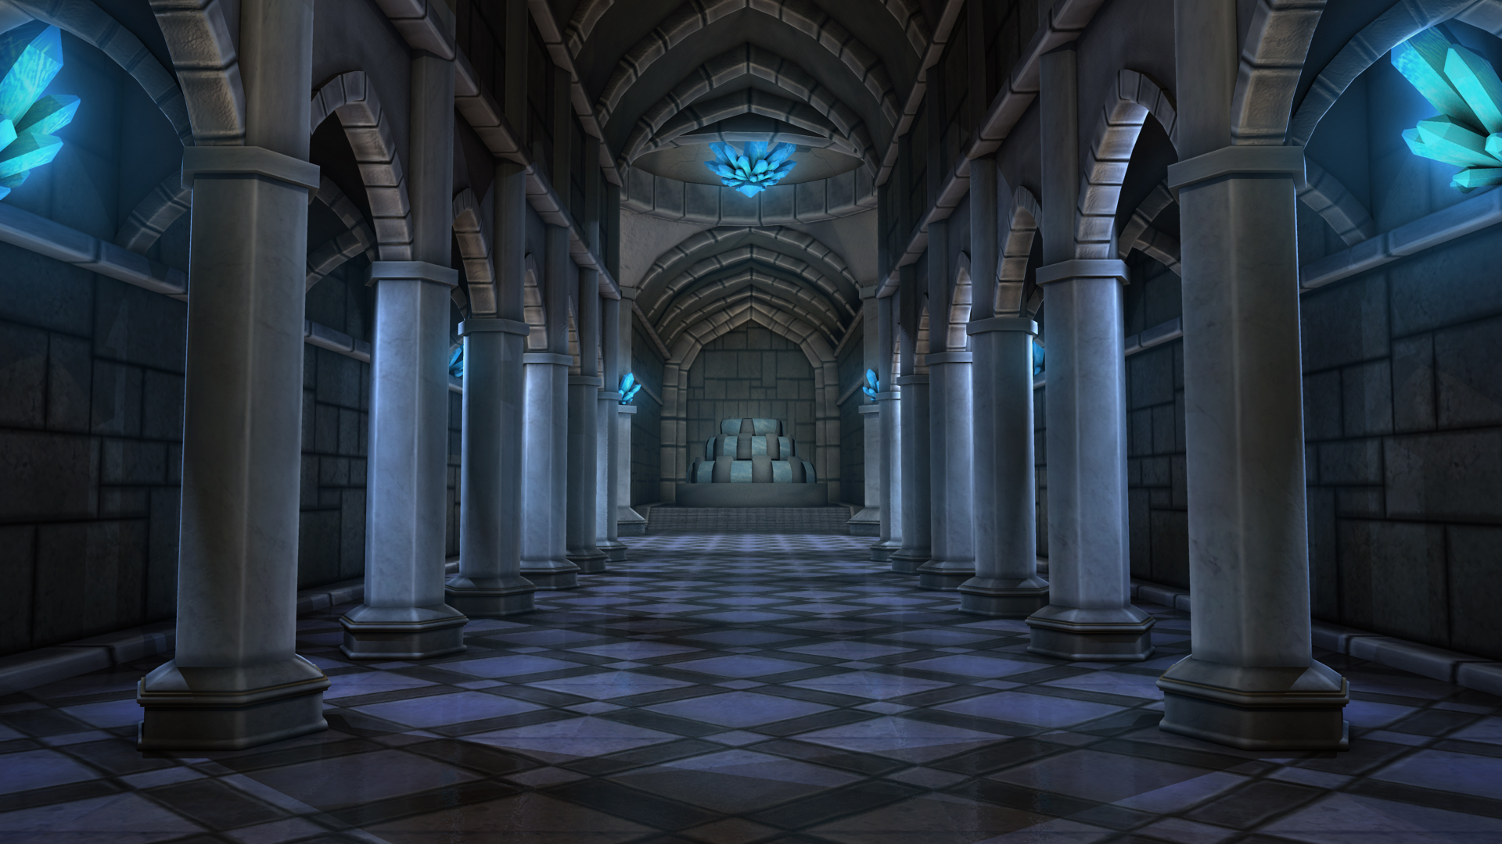
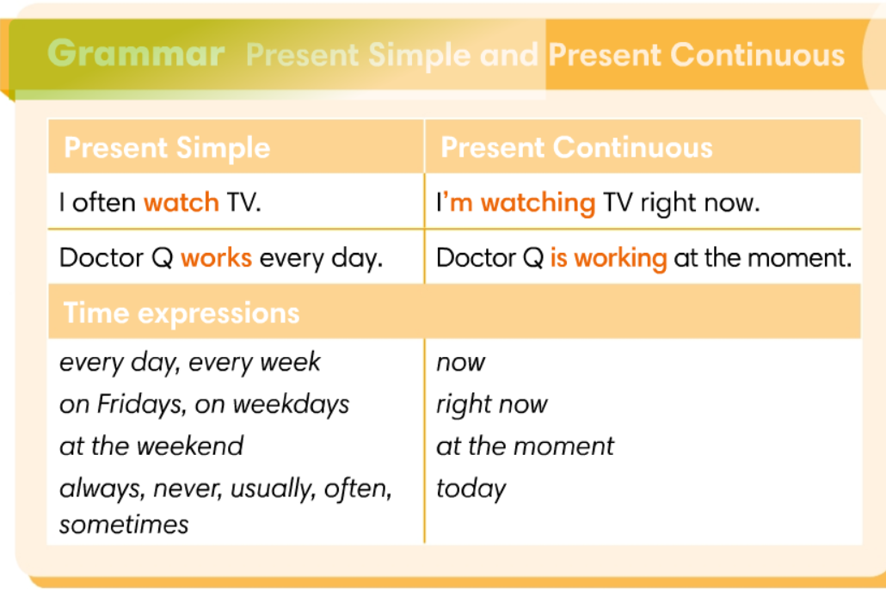
BACK

