Slide 1
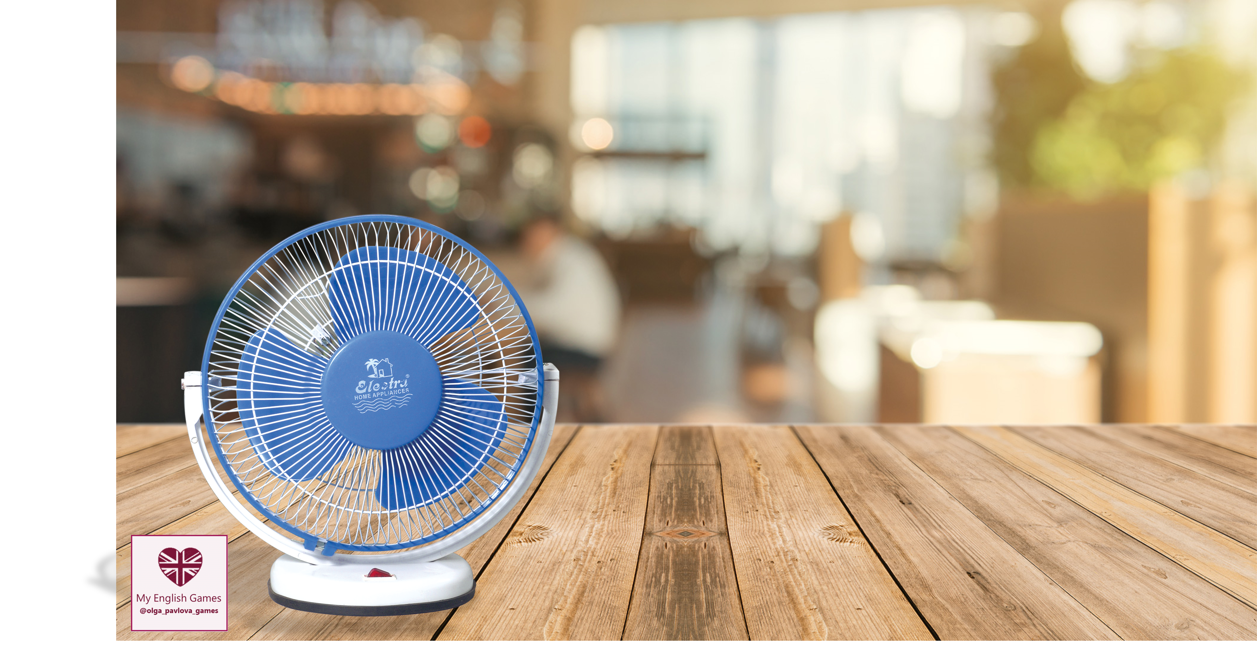
Present Continuous
vs
Present Simple
https://vk.com/olga_pavlova_games
play

Slide 2
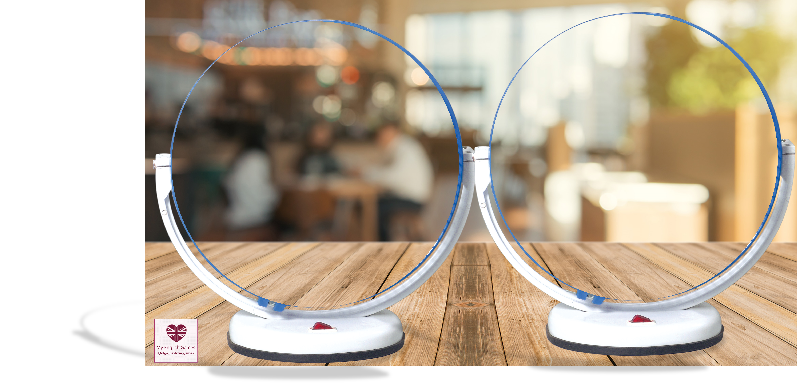

today
draw the picture
ride a bike
tidy my room
always
usually
help my mum
do my homework
walk the dog
hand out with my friends
every week
now
have lunch
play computer games
listen to music
on Mondays
at the moment
read a book
sometimes
watch TV
CLICK

