Slide 3
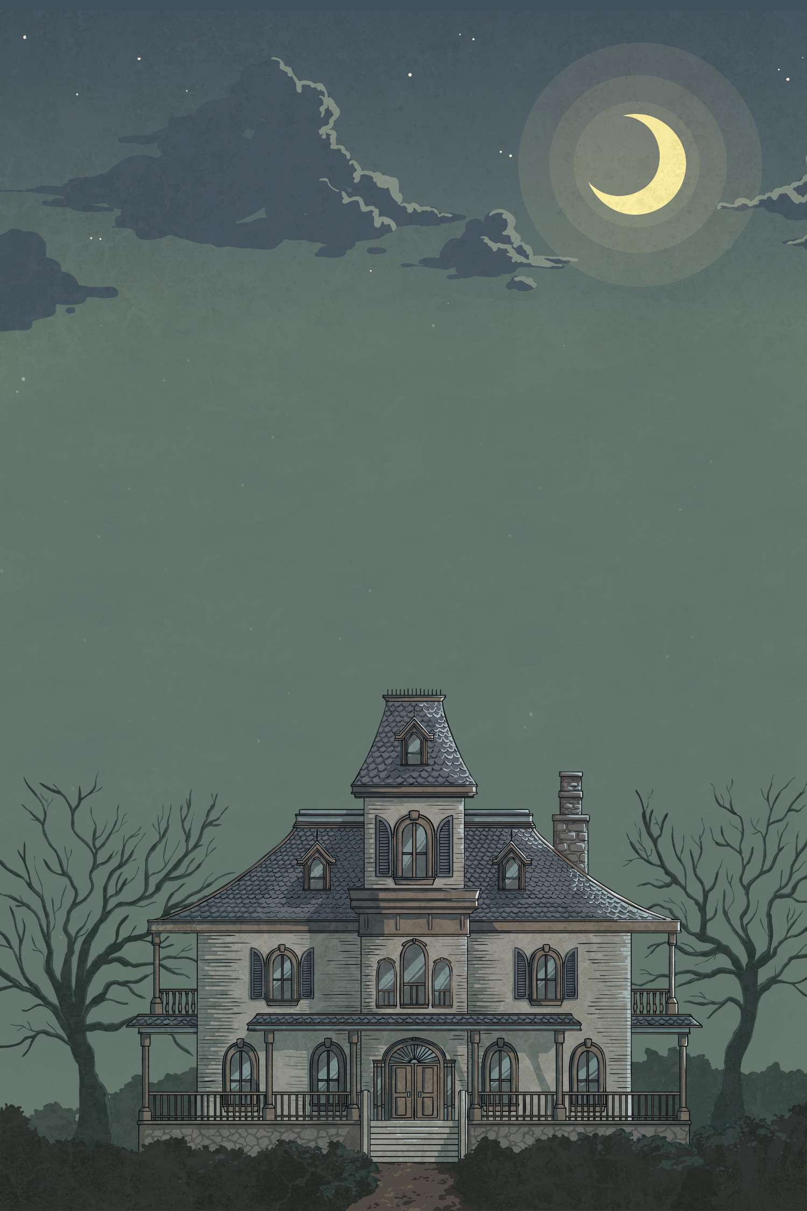

twinkl.com
Help us!
We’re stuck in the house!
Your friends tell you that they are going to a haunted house but later that day, you get a message that your friends are stuck in the house.
You go and try to find them.
While in the house you discover some interesting clues.
Read the questions and click the most correct answer to get out of the
spooky house.
Careful! If you make a mistake, you
might get lost!

Slide 4


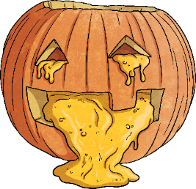
Enter the House

Slide 5
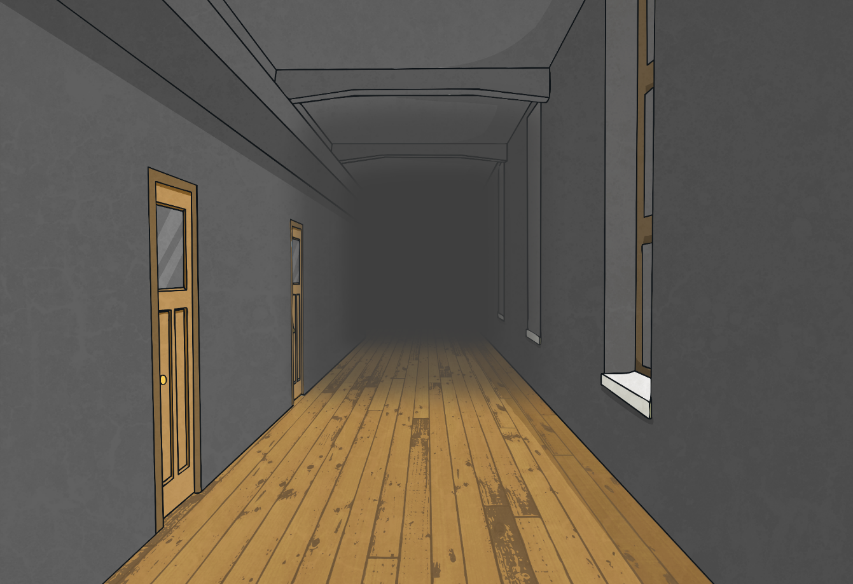
What is Halloween?
It’s a monster.
A celebration.
A haunted house.

Slide 6
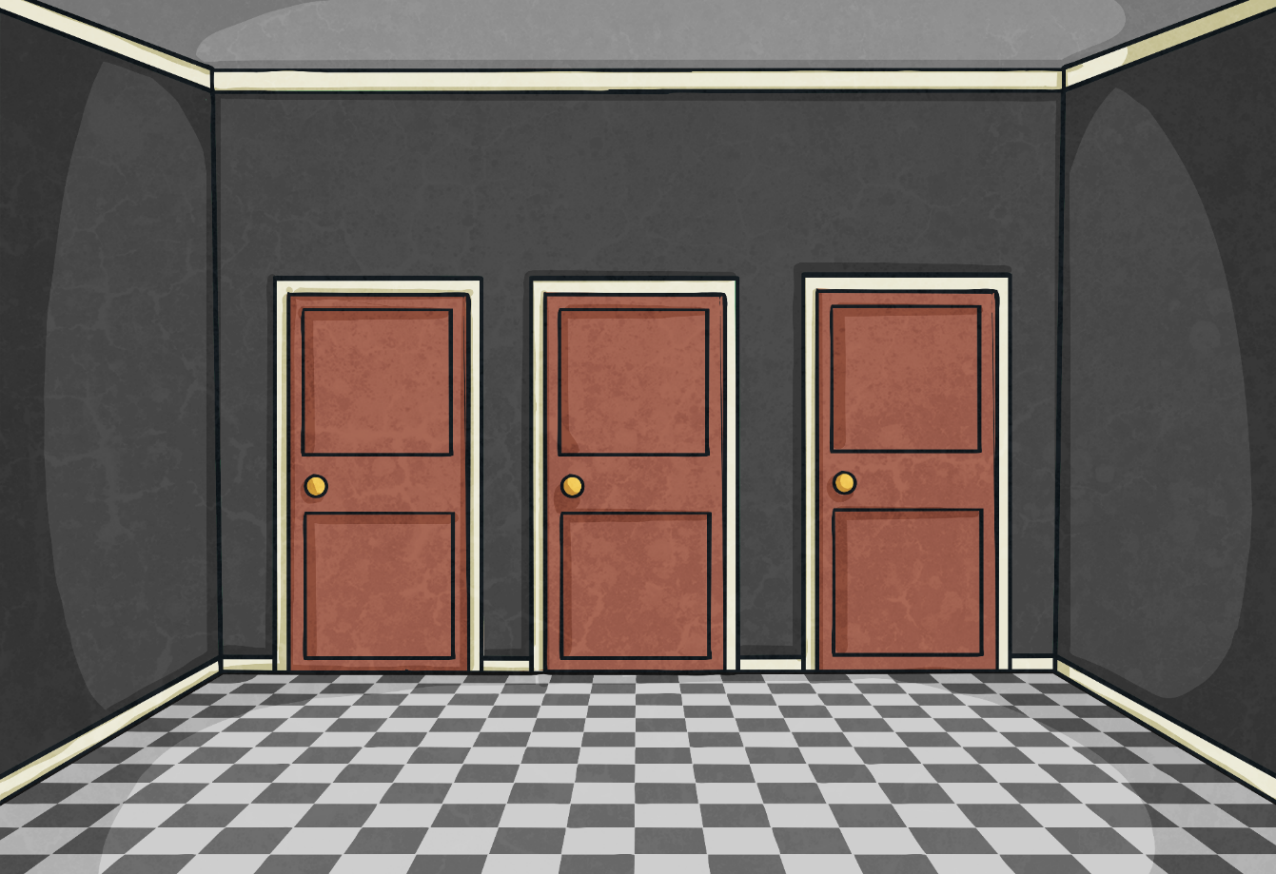
What are the colours
for Halloween?
Black and orange.
It is scary.
A green pumpkin.

Slide 7
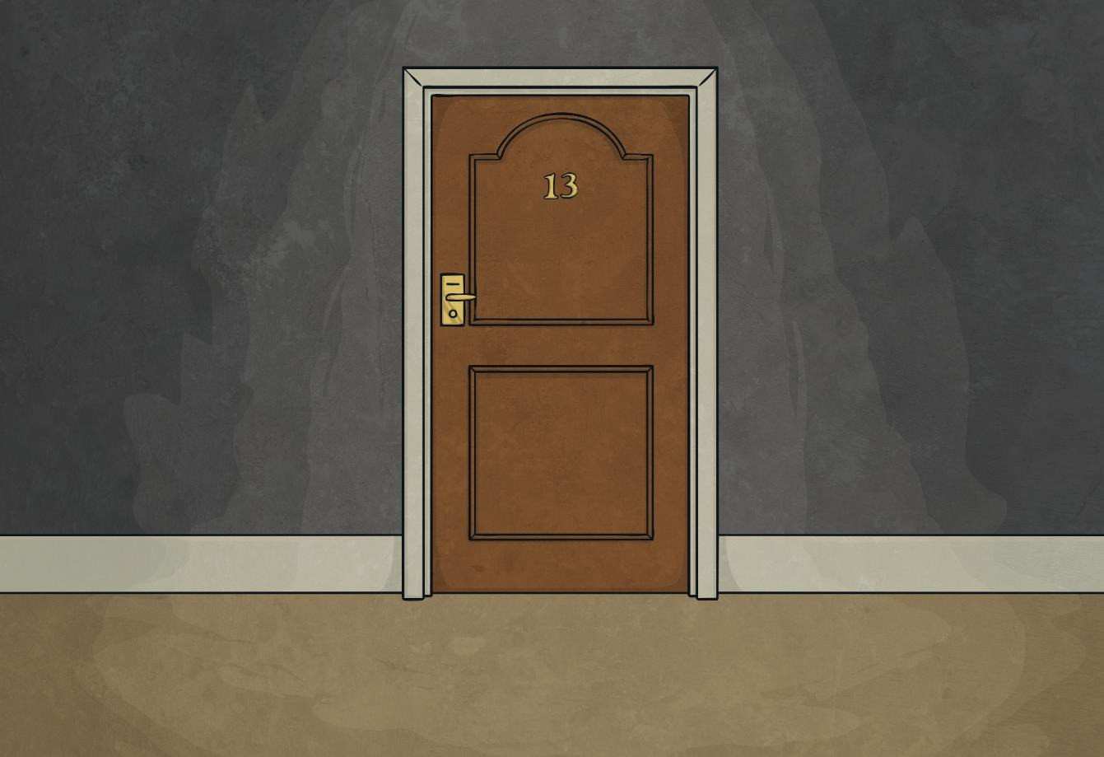
How is Halloween usually celebrated?
People dress up in fun and scary costumes.
People read and write letters.

Slide 8

Do you believe in ghosts?
Yes, like.
No, I don’t.

Slide 9
Has anything spooky ever happened to you on Halloween?
Yes, it has.
Yes, it ever has before.
No, I don’t.

Slide 10
What are you scared of?
Yes, I am.
Spiders.
I scared of you.

Slide 11
Do you like watching horror films?
Yes, I do.
Not liking.

Slide 12
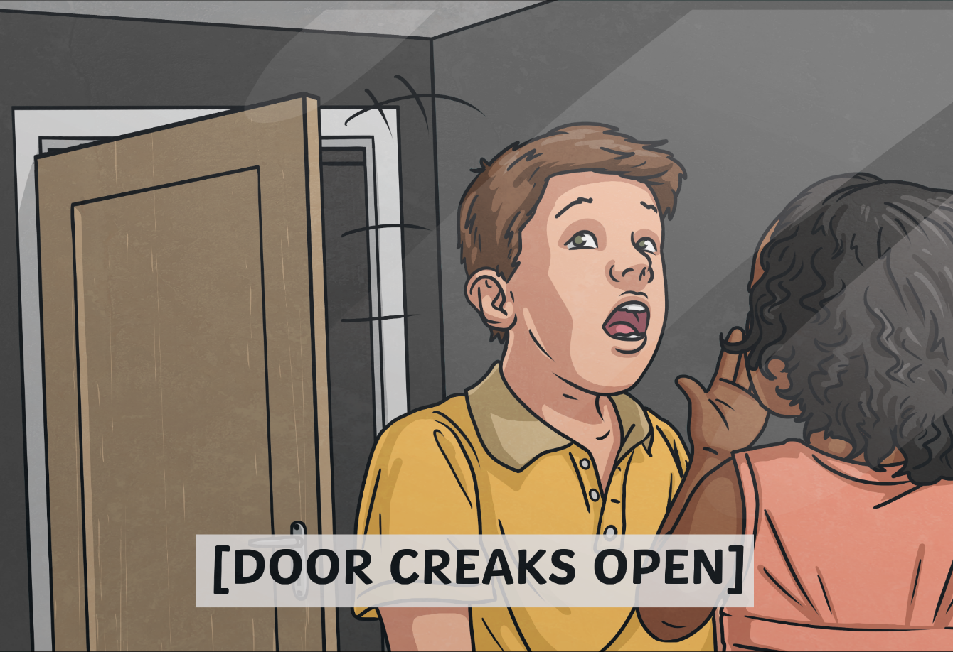
What costume did you wear last year?
I wore a superhero costume.
I wears
a mask.
I did do a vampire.

Slide 13
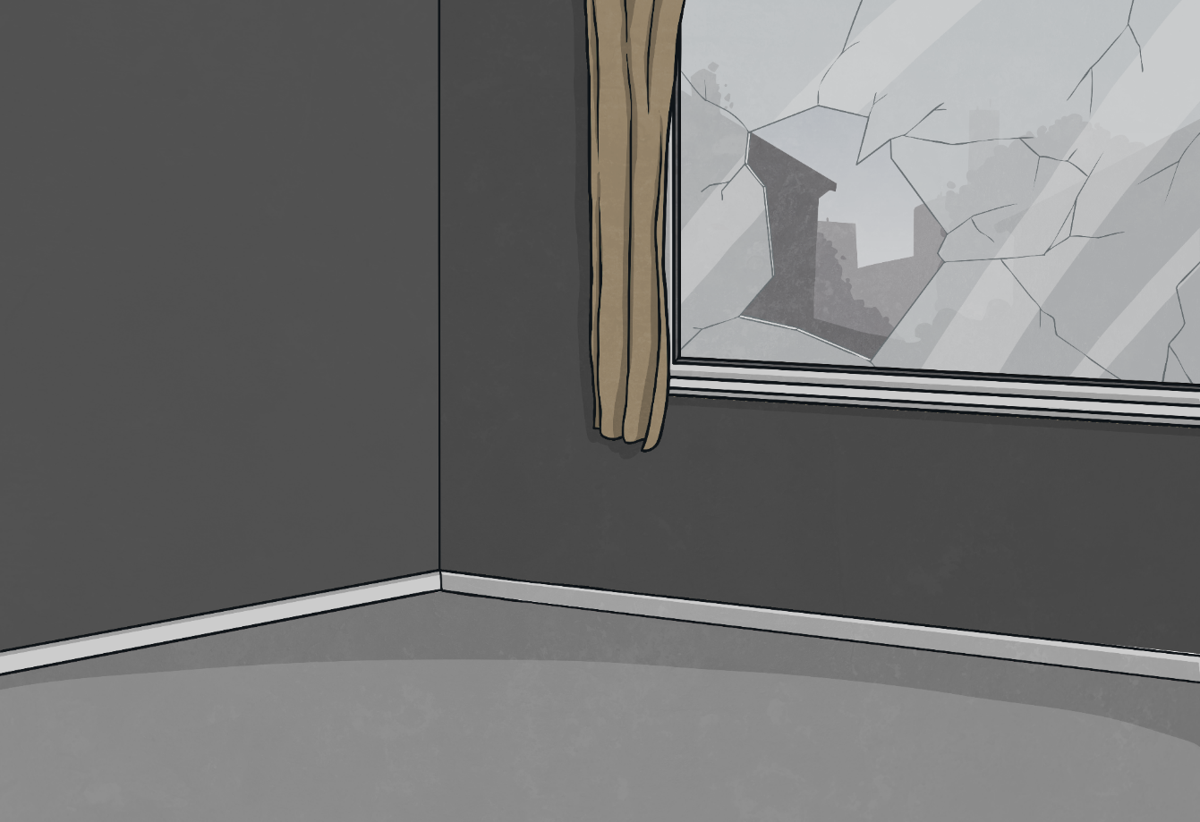

Oh no! A dead end.
Click here to start again

Slide 14
Oh no! A dead end.
Click here to start again

Slide 15
Oh no! A dead end.
Click here to start again

Slide 16
Oh no! A dead end.
Click here to start again

Slide 17
Oh no! A dead end.
Click here to start again

Slide 18
Oh no! A dead end.
Click here to start again

Slide 19
Oh no! A dead end.
Click here to start again

Slide 20
Oh no! A dead end.
Click here to start again

Slide 21
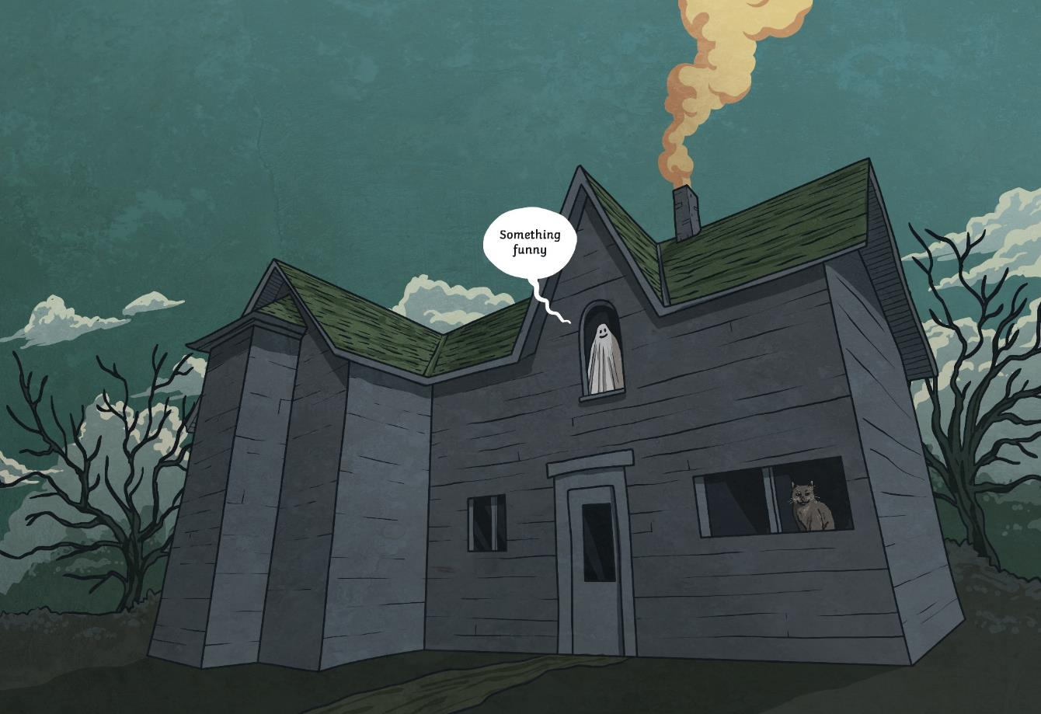
Congratulations!
You and your friends made it out of the house!

