Slide 1
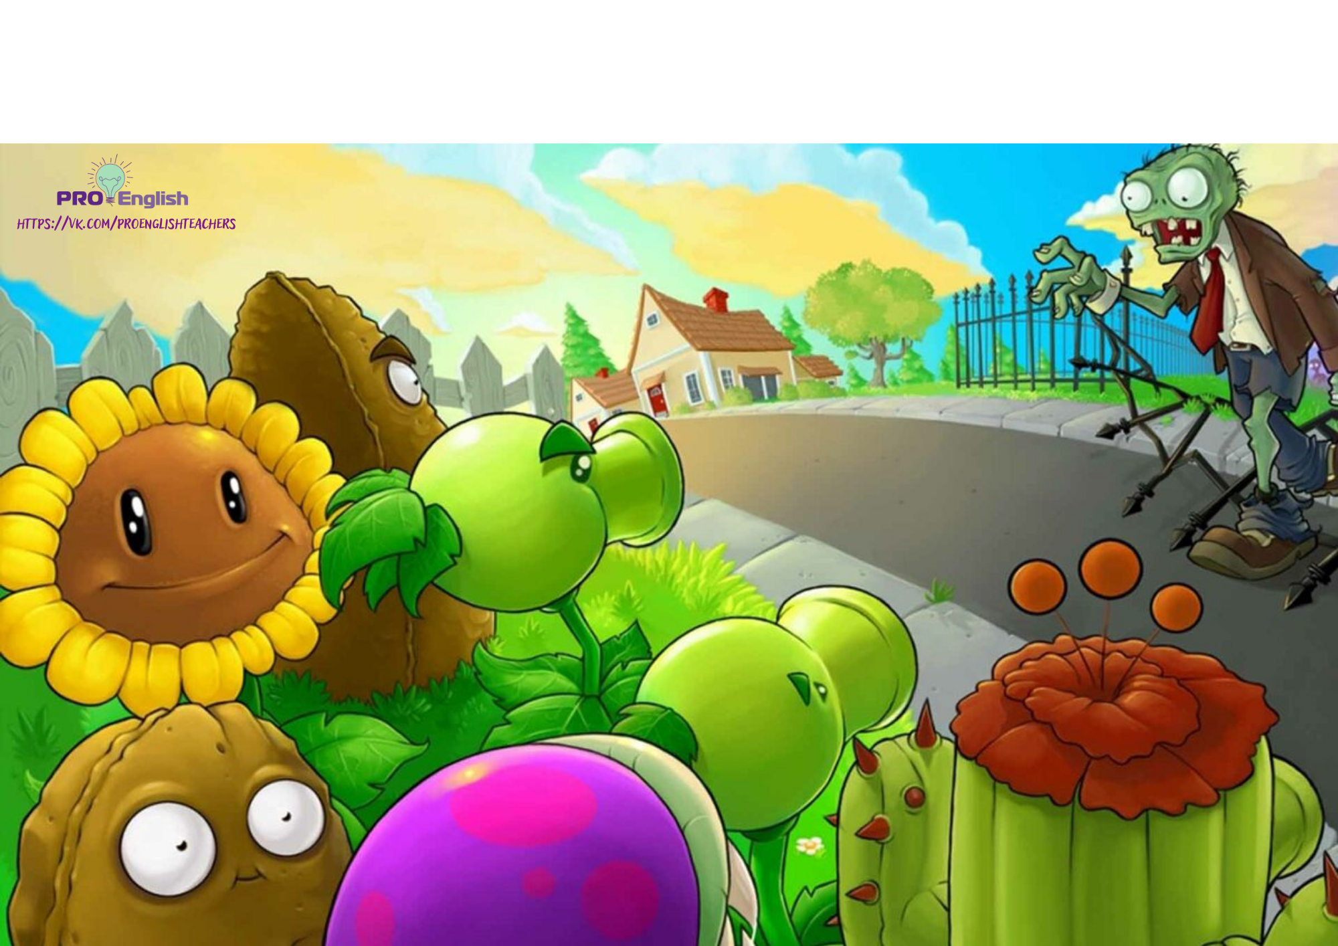

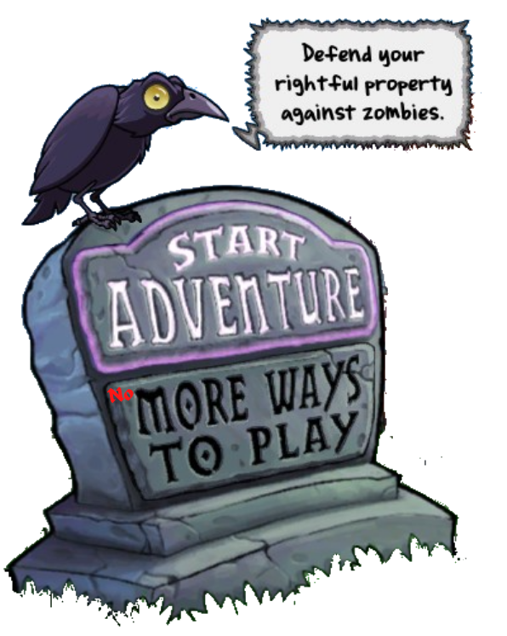


Slide 2
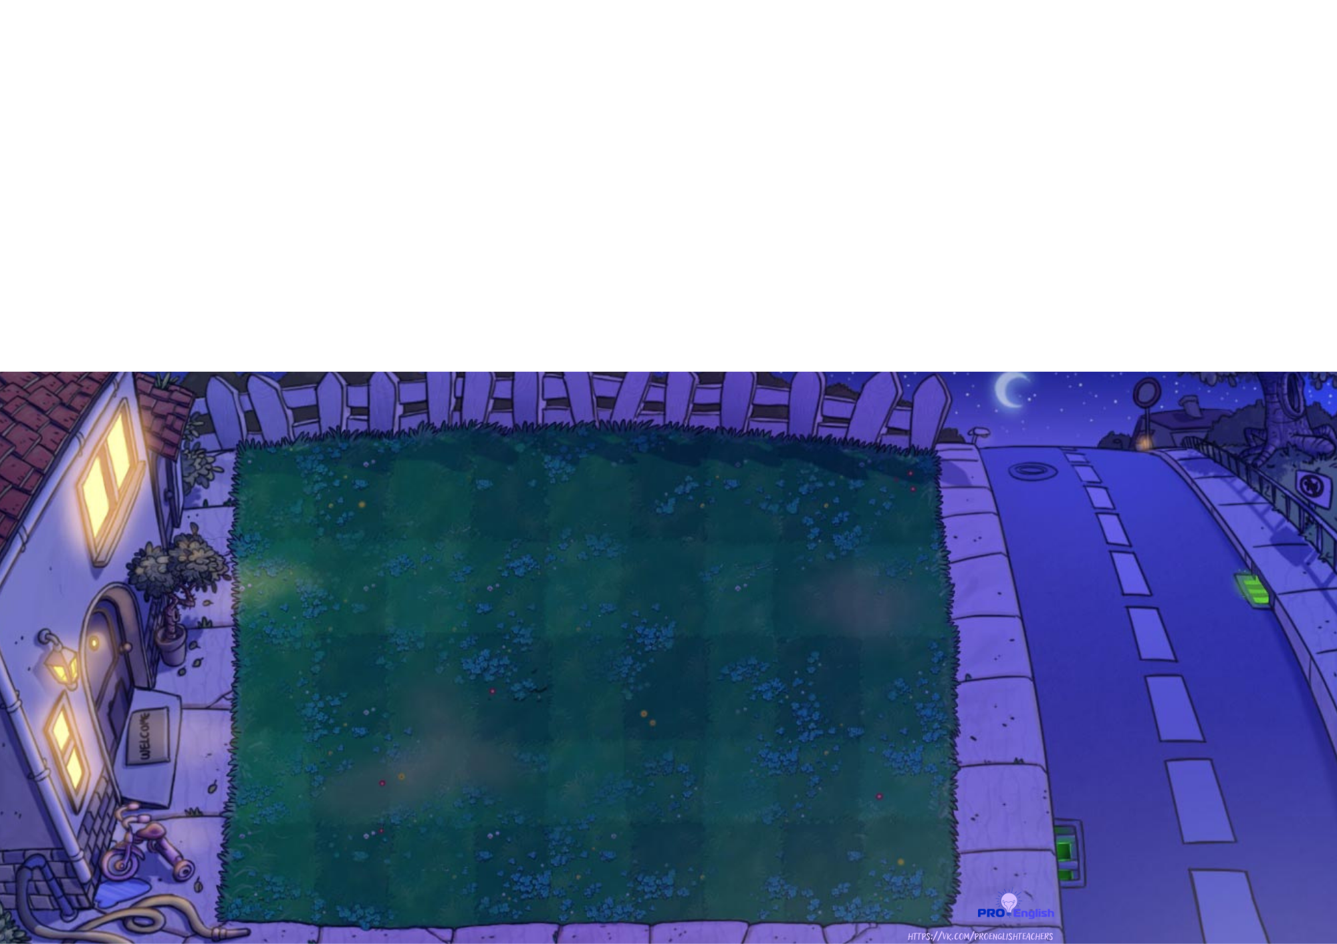

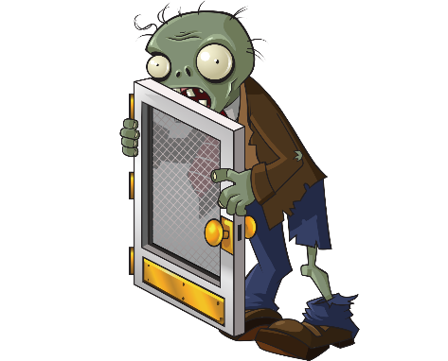
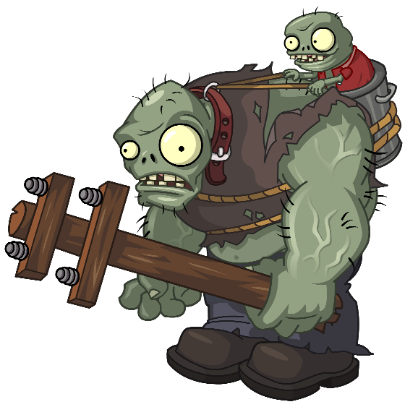
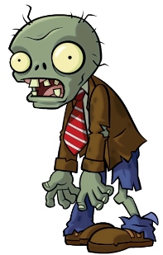
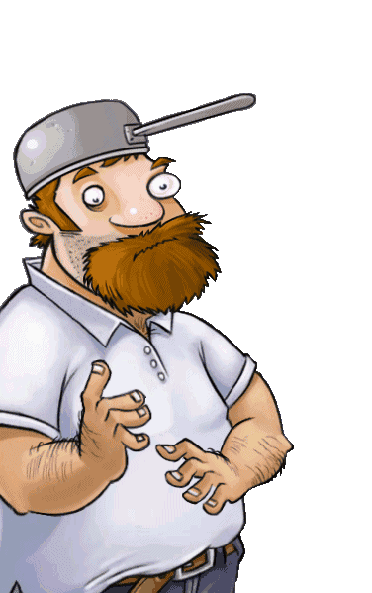
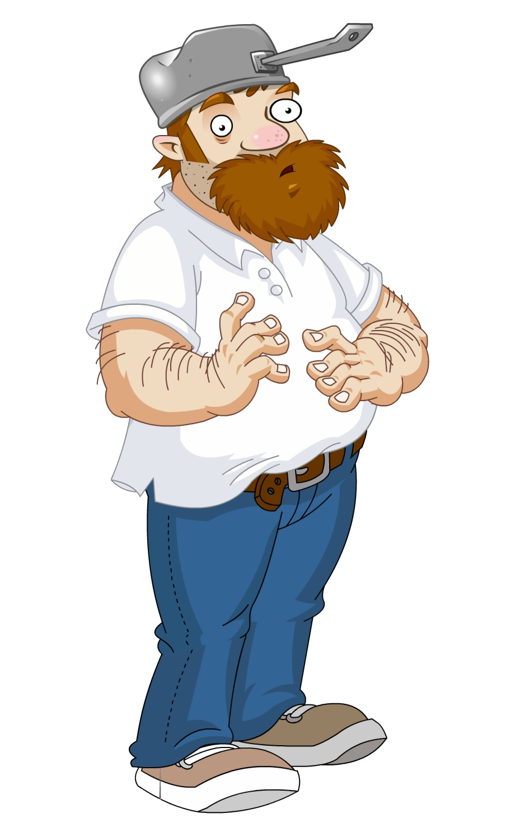
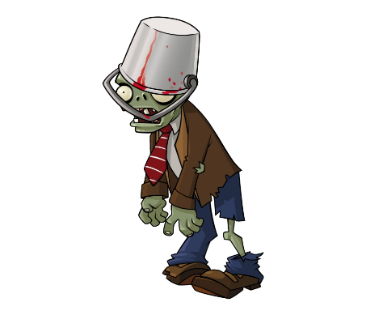
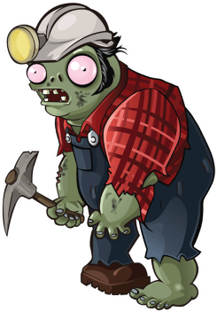
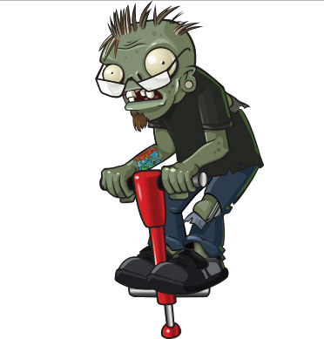
Zombies are coming for your brains!
Choose the right plant to fight them!

Slide 3

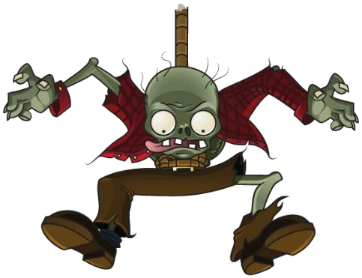




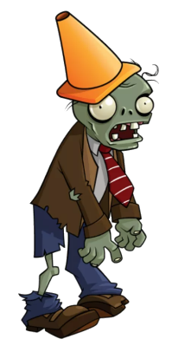
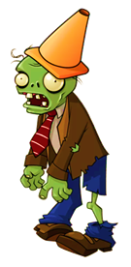
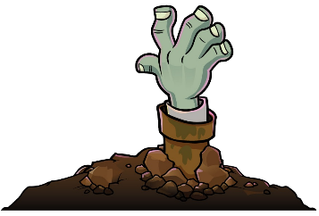




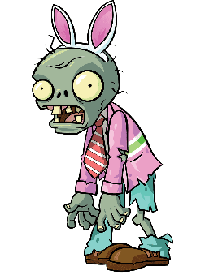





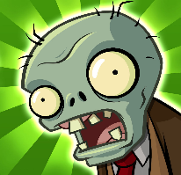

We ... a Halloween party when it started to rain.
She ... a cool ghost costume when I saw her at the party.
The cat was sleeping when it ... off the sofa.
We were decorating the garden with pumpkins when dad ... .
I ... Halloween pies when somebody knocked on the door.
were having
was having
had
were wearing
was wearing
wore
fell
was falling
were falling
was cooking
cooked
were cooking
was coming
were coming
came

Slide 4
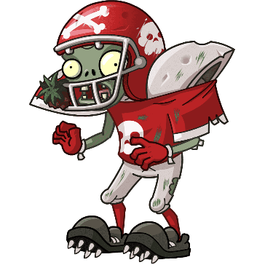

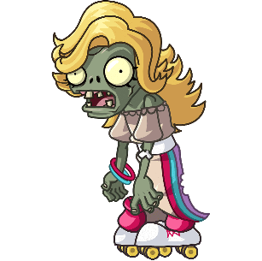
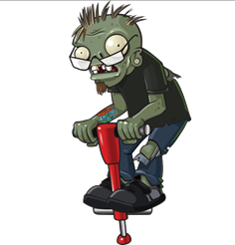
Mum ... creepy Halloween biscuits while I was watching a scary film.
Dan ... a picture while Tom was watching TV.
They were going to the party on Sunday when they ... about the present!
She ... home when she saw a black cat.
I ... you when I was walking in the shopping centre yesterday.
was cooking
cooked
were cooking
remembered
was remembering
were remembering
drove
were driving
was driving
drew
was drawing
were drawing
was seeing
saw
were seeing

Slide 5
