Slide 1

Online Spell Caster
Get a services of real magic spells that really work and resolve every troubles by Online Spell Caster. He is a famous Spells King providing all spells casting services.

Slide 2

Breakup spells
If you want to bring back your lost love then get 100% effective Break Up Spells. It is a amazing technique which work fast and resolve every love matters.

Slide 3

Money Spells
For Money Related Issues Our Spells King offering the Services of Money Spells. It is a amazing spells that work immediately to get rich and make money.

Slide 4
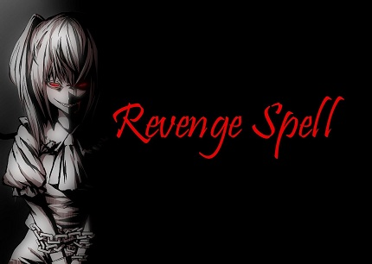
Enemy Revenge Spells
Punish your enemies with using great powerful Enemy Revenge Spells. It helps help you get the ultimate revenge from your enemies.

Slide 5

Online Spell Caster

