Slide 1

Black Magic for Girl
Get the most effective services black magic for girl by Famous Black Magic Specialist Baba Ji. He will give you black magic astrology tricks that help you to control anyone girl.

Slide 2

Extra Marital Affair
Get suggestions and solutions for all husband wife issues regarding Extra Marital Affair , Husband wife disputes, Family issues etc. Spells King give you spells that remove all your issues permanently.

Slide 3
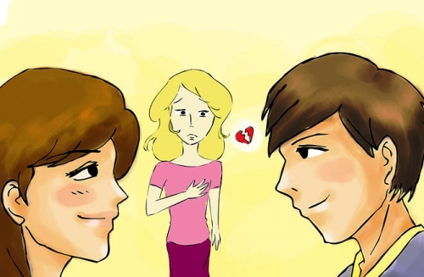
How to Get Revenge from Ex
If you want to get revenge from your ex boy friend or girl friend then consult with spellsking. He will provide you best revenge spells to get revenge from ex.

Slide 4

Contact Us

