Slide 1

Spells King

Slide 2

Online Spell Caster
Spellsking is a best online spell caster in India offering different kinds of spells that resolve all types of issues. Millions of people are got spells casting services by online spell caster.

Slide 3

Online Spell Caster
Spells King offering the different kinds of spell services like Romance Spells, Black Magic Spells, Love Spells, Gambling Spells, Money Spells etc.

Slide 4

Online Spell Caster

Slide 5
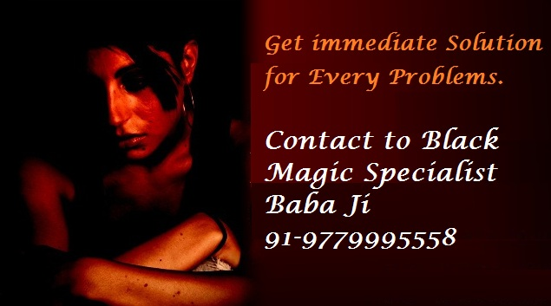
Online Spell Caster
Spells King also famous as known as Black Magic Specialist Baba Ji because he know complete method of black magic astrology and provides immediate solution for all issues.

Slide 6

Online Spell Caster
Contact to Spells King for any kinds of relationship problem solution. He helps you to resolve you’re all issues.

Slide 7

Online Spell Caster

