Slide 1
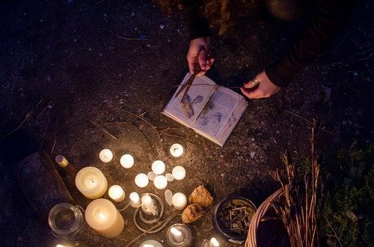
Online Spell Services by Spells King
Famous Spells King providing the all types of spell casting services. Our Spells King can help you to resolve your love relationship troubles with real and powerful love spells.

Slide 2
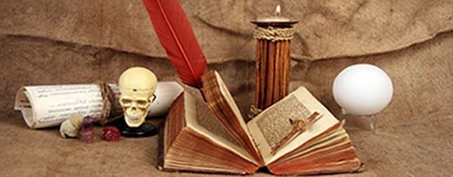
Voodoo Spells by Spells King
Our Spells King providing the Voodoo Spells and Voodoo Ritual Spell Services which overcome every types of problems to life. It is a powerful method which work fast.

Slide 3

Vashikaran Mantra by Spells King
For resolve Love relationship problems we are providing the effective vashikaran mantra for love. It is a best astrological way which work instantly.

Slide 4

Enemy Revenge Spells by Spells King
We are also providing method and procedure how to use enemy revenge spells for remove negative effects forever and permanently in your life. With using enemy spells you can easily take revenge from your enemies.

Slide 5

Online Spell Services by Spells King

