Slide 1

Gambling Spells
There are some tricks that use in Gambling Spells and lottery spells. Get Simple and easy to use Money Spells and Wealth Spells by SpellsKing.

Slide 2
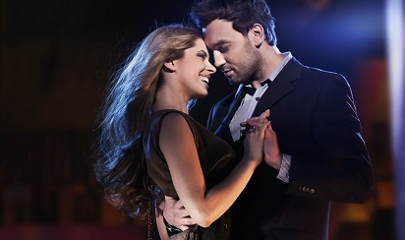
Black Magic For Girl
Get powerful and effective black magic for girl and boy. Black magic helps you to attain desired girl or boy in life.

Slide 3

Breakup Spells
Break up spells that fast and resolve every love matters. BreakUp spells is a one of the best method to heal a lost love relationship.

Slide 4

How to Cast a Love Spells
Are you thinking about How to cast a love spells then meet with spellsking. He is a expert in love spells and give you complete guidelines to use love spells.

Slide 5

Online Spell Caster

