Slide 2

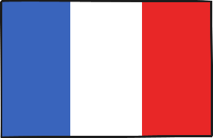

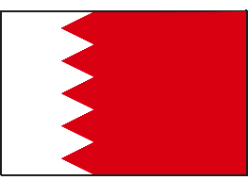

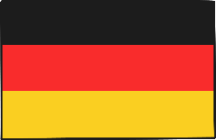
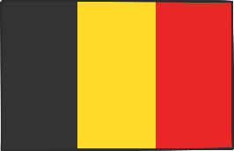
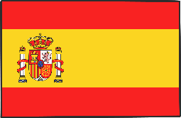
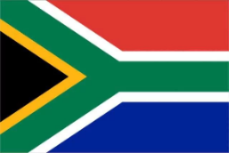
What Is the Tour de France?
The Tour de France is one of the world’s biggest bicycle races.
Cyclists from all over the world join in.
Team Sky
Great Britain
AG2R La Mondiale
France
Astana Pro Team
Kazakhstan
Bahrain – Merida
Bahrain
BMC Racing Team
USA
Bora – Hansgrohe
Germany
Lotto Soudal
Belgium
Movistar Team
Spain
Team Dimension Data
South Africa
Click on the flags to find out the names of some of the countries that will take part.

Slide 3
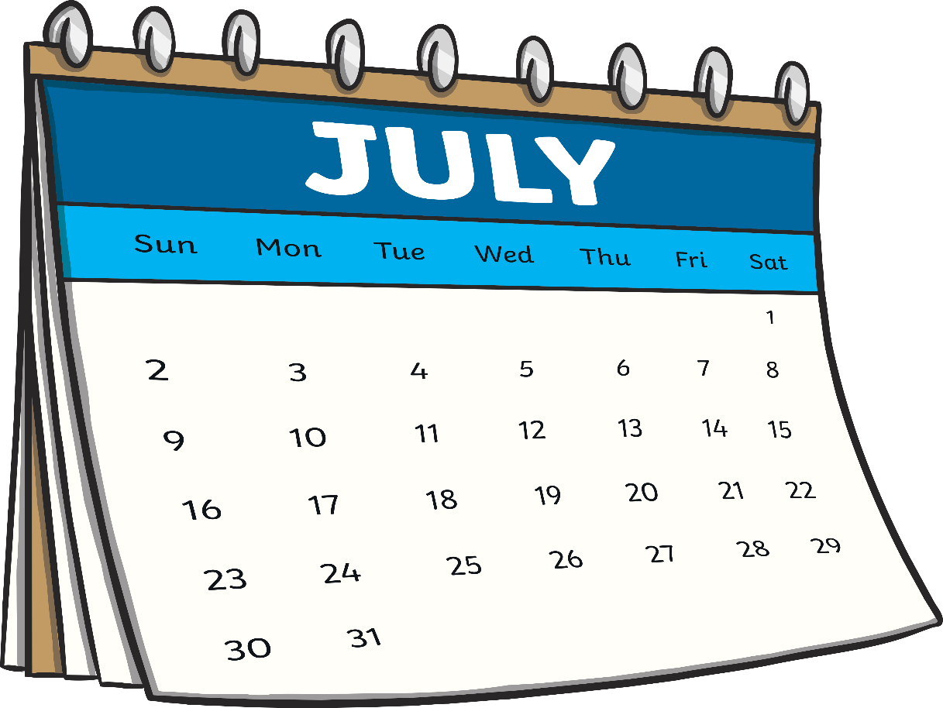
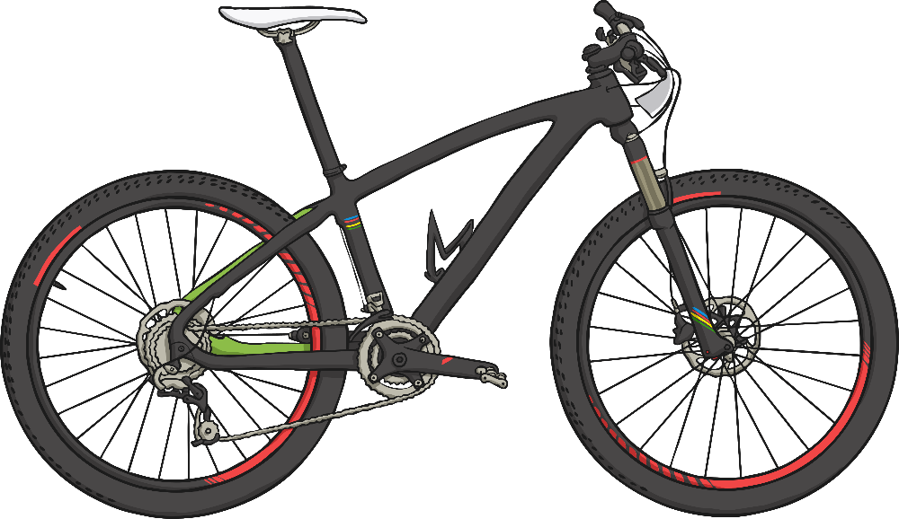
When Does It Happen?
It usually starts in July, and lasts for 3 weeks.

Slide 4
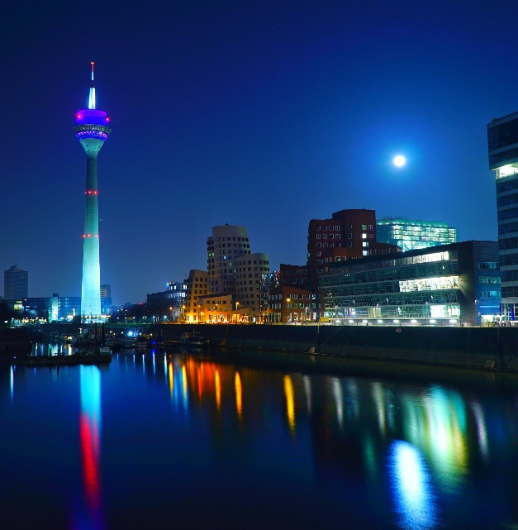
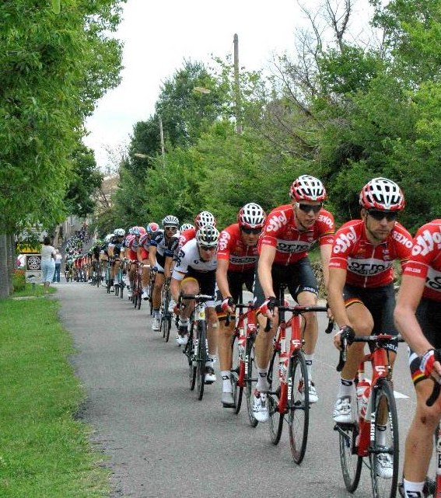
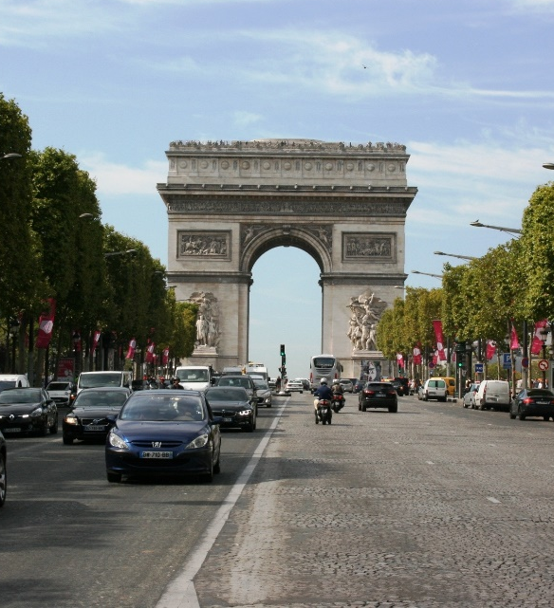
Where Does It Happen?
It starts in a different country every year.
It finishes at the Champs-Élysées, in Paris.

Slide 5

Where Does It Happen?
The race usually finishes at the Champs-Élysées in Paris. Paris is the capital city of France.
Watch this clip to see the excitement when the riders arrive in Paris!
Photo courtesy of Les Vandales (@vimeo.com) - granted under creative commons licence – attribution

Slide 6
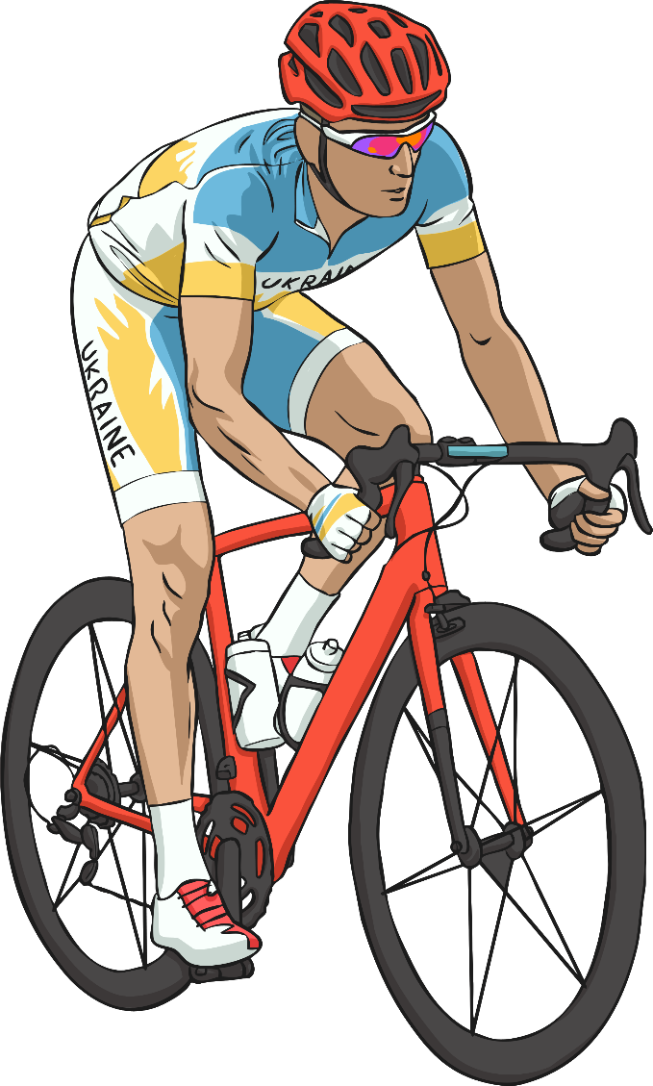
How Do They Choose a Winner?
Every day they choose the person who was the fastest
to be the winner of that stage.
At the end, the person who was the fastest overall is the winner of the whole race.
The race is very hard. The cyclists even have to cycle up some mountains in France!

Slide 7
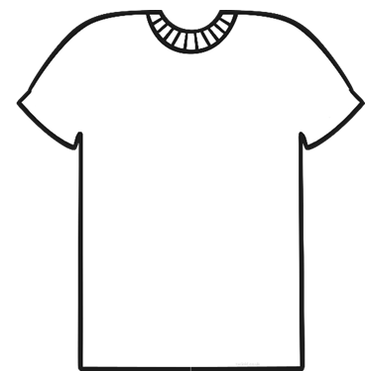

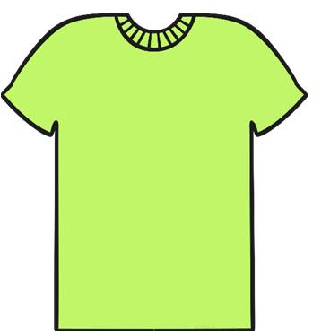
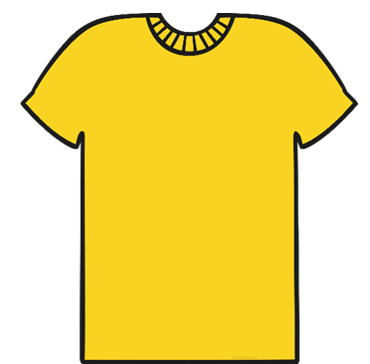
What Is the Prize?
Instead of winning medals or awards, the cyclists win different-coloured jerseys to wear whilst they are cycling.
The White Jersey
The Polka-Dot Jersey
The Green Jersey
The Yellow Jersey
The white jersey is awarded to the best young rider.
The polka-dot jersey is awarded to the best climber.
The green jersey is awarded to the best sprinter.
The yellow jersey is awarded to the leader.
Click on the jerseys to find out more.

