Slide 1
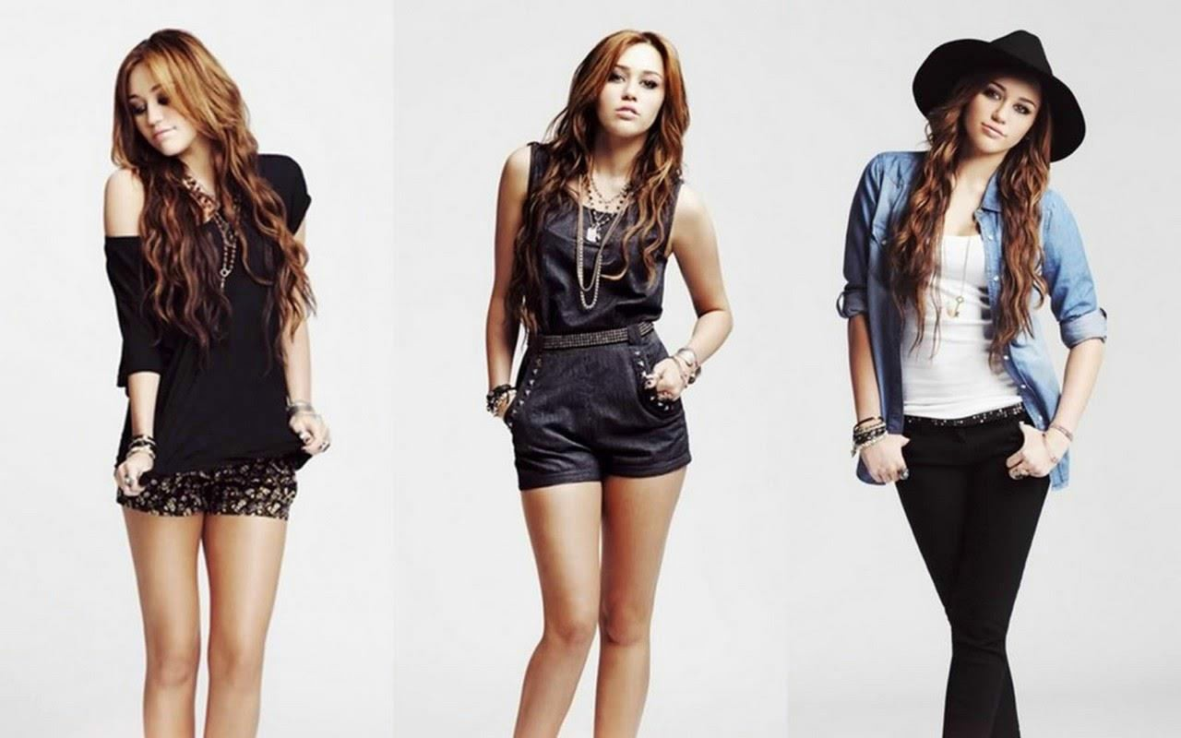
Fashion PR in its modern outlook
With the accelerating technological advancements hitting the fashion industry like many others, the restrictions on entrance avenues have eased out quite a lot giving the budding independent designers an easy entry scope. Affordable small-scale manufacturing options and e-commerce solutions are the main two things responsible for individuals taking up fashion entrepreneurship in high numbers.
The continuously rising digital ecosystem has not just created opportunities but has also led the steep competition to enter the marketplace. And, with all this digitalization going on, people are arguing people are arguing whether digital age has killed Public Relations (PR) industry or has made it strong in the market like never before.PR is an integral part of brand promotion has always played a primary role in the fashion world. And, ever since the content became powerful and entry barriers in the line of media and fashion crumbled, the role of fashion PR in the industry has intensified beyond an extent.
Traditional way of doing Fashion PR

Slide 2
The traditional approach is followed by most of the PR professionals working mainly in PR companies of Delhi focused on maintaining the relationship with media and stylists and generating media coverage’s along with social media mentions. The administrative operations around these things traditionally require individual transactions; hence the majority of the PR agency resources get engaged in these activities. But with an enormous amount of media to pitch, content overload and quickly evolving media channels the traditional approach will not work out.
It’s true to the fact that PR is a long-term investment and needs time to gain exposure and momentum towards brand awareness. However, traditional processes involving editorial engagement are outdated because neither are they cost- effective nor are they scalable in this excessively evolving media scenario. Although PR is a long-term investment and it definitely takes the time to build exposure and momentum.
Fashion PR in its new outlook
There are a few PR companies in Delhi that are taking the help of technology and automating many of the administrative tasks related to media and blogger relations. These global online solutions are promoting productivity, consistency and scalability of PR campaigns. The PR firms in Delhi that have adopted these platforms are leading the industry. This has not only eased out their work but has also allowed them to produce incredibly customised and proactive communication programs for their clients. There is a need for the other PR consultants in Delhi to realise that it isn’t the administrative work that will keep their business alive. These administrative PR processes need to evolve with the growth of media industry along with giving way to PR creativity and originality.
What This Shift Brings in for Independent Designers
If you are new in the design and fashion industry, then it's really important to understand the main idea behind what actually you need from a PR agency. If contact lists and PR applications to facilitate media placement is all you need then it is widely available on the online platforms. But, if you are looking for an agency that can craft strategic programs to generate calculative results then make sure the PR agency in Delhi that you go with don’t just follow the traditional

Slide 3
product placement project but instead has immense expertise in getting a customised PR program done.

