Slide 1
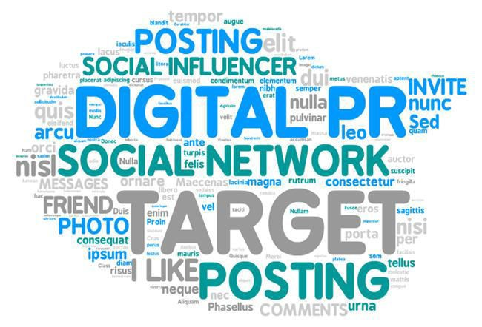
What are the Advantages of Digital PR
Digital marketing requires your business to widen its audience reach as much as possible before working so as to gradually turn these fans or followers into loyal customers of your brand. This is an effort that takes countless amounts of time, money and effort, but the results are measurable by the increased amount of sales you will have when it’s done right. While public relations are incredibly important in real world scenarios, it is now growing in significance online. In fact, it is probably fair to say that a majority of businesses with an online presence now believe digital PR should be a priority, as more and more people are going on the internet to find out information about a company or purchase goods and services.
Let’s talk about how digital PR is bringing about positive changes in the world of PR. Increase visibility - One of the most obvious benefits of digital PR is that it can markedly enhance your business’ visibility online. Not only will numerous outlets distribute press releases and news stories, your search engine performance is bound to improve as well. This is beneficial and is working in favour for most PR companies in Delhi.
Enhance Reputation - The only reason a consumer will go online to submit a product review or to comment on a company’s customer service is that they have had a bad experience. Negative feedback can be counteracted with press releases or an article that explains and apologies for the problem. To fully take advantage of the reputation enhancing benefits of startup PR agency, you may consider releasing exclusive information or a prototype product to generate positive hype and favourable reactions.
Build brand identity - By giving valuable insights into what is going on at the company with an informative yet personal tone, the brand’s identity is sure to gain notoriety.

Slide 2
Numerous organisations use digital PR as a platform to become a leading and authoritative voice in their industry. From knowledge, expertise and honesty come a great deal of respect. You’ll probably steal a march on your competitors too.
In case, you haven’t already boarded the Digital PR bandwagon, it’s high time to do it. Reap all the benefits of the digital world!!

