Slide 1
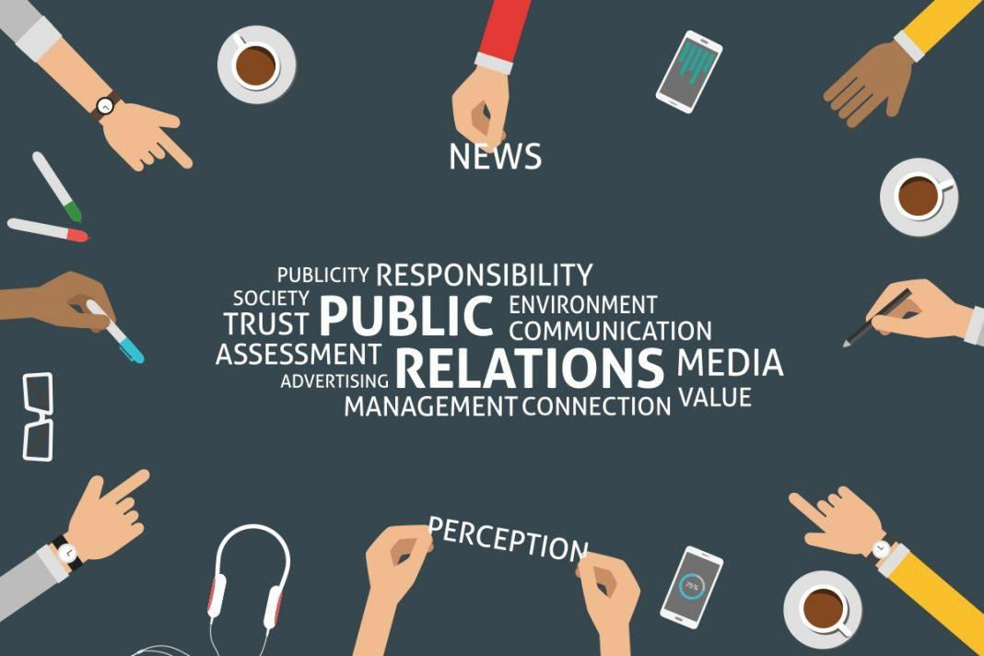
Why Entrepreneurs of 2017 cannot Ignore Public Relations
The overall way of communication has gone through an incredible transformation over the past few years. To stay ahead of the game, businesses must continuously adapt and evolve – be it how they operate, motivate their team, manage finances or conduct communications with their target audience.
Advertising and traditional ways of communication are as it is losing consumer’ trust and interest. That is why businesses that master the new modes of connecting with their audience will continue to grow in the future.
Therefore entrepreneurs cannot ignore Public Relations in todays time and age. In 2017 a company/ start-up needs the services of PR firms. PR being one of the most sought after professions is really booming in Delhi and help Delhi is mushrooming with PR firms these days. Few of the main reasons why PR cannot be ignored are –
PR firms brings the power of personal branding and thought-leadership - To earn that trust, brands need to start tailoring the information when addressing their particular key audience as well as be knowledgeable, experienced, and useful in everything that they share. Bearing this in mind, one of the newest PR trends, in particular for those who operate in the B2B sphere, is to become a “thought leader.” Top executives can get noticed and respected by showing that they are an authority on a particular subject.
Visual Storytelling – nowadays our lives are more digitally affected than ever before. People are more into reading less and consuming information in a more visual way. This is one of the reasons to start paying more attention to developing visual content in 2017—be it graphs, diagrams, images, slideshows or video clips.

Slide 2
Influencers vs Media - While consumers’ trust in advertising has dropped significantly, any other media that doesn’t innovate will start losing its influence as well. The new generation of “prosumers” or proactive consumers tend to trust someone who is more like them or relatable. Eight in ten global respondents say they completely or somewhat trust word-of-mouth as well as the recommendations of friends and family. Thus, influencers and bloggers become a new, more efficient alternative to traditional media and an integral part of any marketing campaign.
This means that if brands don’t consider including an influencer marketing program into their communication plans for 2017, they risk being left behind.
Digital is the new king - Brochures, catalogs, and informational sheets about your company are becoming a thing of the past. The ‘era of mobile first’ dictates its rules with mobile, apps, the Internet, and social media to be the first touch points and a way of life for many people. As communication evolves and transforms, it’s important for brands to understand how the digital world is organized and to take benefits of the latest technologies to transfer messages to their key audience. Keep your website running.
These are just a few reasons why businesses in todays world need PR. Especially PR Companies in Delhi are so authentic and efficient in their work that start up companies need to worry about their public image at all if they hire one of the pr firms! So jump on board and hire PR and get digitalized for more business profits.

