Slide 1
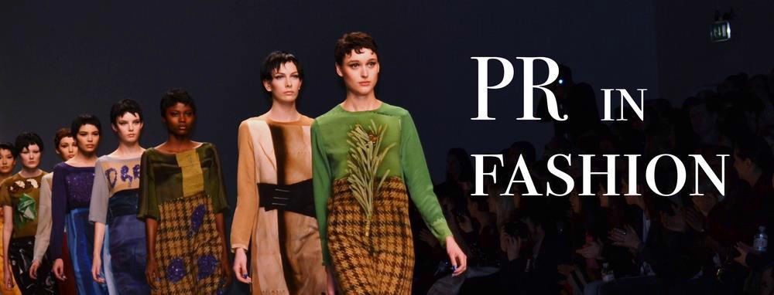
Gaining a deep insight into the world of Fashion PR
Public Relations (PR) has been there in the marketing and business arena since long, but it was only in the 2000s that people in India widely started looking it as an essential business element. It was then only that a whole sector named Public Relation sector was dedicated to this essential function. Since then the industry has gone through many changes which have resulted in separate specialised departments being formed for Digital PR, Fashion PR, Corporate PR, and PR for Startups and many others.
Among the various sub-departments available in the PR companies of Delhi, it is the Fashion PR department that attracts fresher’s the most. When asking for a reason, it is mostly found that it is the glamour quotient of attending cool parties, meeting major celebrities and designers and working closely with the designers. But what these young newcomers are unaware of is the stress and hard work that goes into the overall working. It might look like Fashion Public Relation is all about meeting celebrities, but in actuality it’s about handling the media relations of the particular brand, ensuring proper coverage's and interviews of the celebrity guests rather than enjoying the event.
The professionals looking out to try their luck in the Fashion Public Relation department of any of the top PR consultants in Delhi need to make sure that they always reflect an air of professionalism even when all sorts of glamour, celebrity meetings and high-end parties are happening around them. Other jobs can be once in a while be restricted to 8 to 9 hours job but

Slide 2
when opting for a career in PR, especially in Fashion PR make sure to be chipper and ready to go 24*7.
Persistence is the key to rising above in the realm of Fashion PR. In starting, it might be possible that the entry-level jobs will result only in doing media and celebrity registrations which might demoralize the fresher a bit. But, what they don’t see is that this exposure is helping them with the opportunity of being sociable and interacting with the fashion fraternities along with handling their clients and associates.
Journalists involved the fashion world, are much more honest than those working for other respective fields. If thinking to get into the Fashion PR world offered by Public Relation agenciess in Delhi, then it’s a must to have excellent writing skills. Your job involves corresponding in writing with journalists via press releases and pitch notes. The ones dealing with the fashion world are a tough nut to crack as they ought to reject the story even for one single mistake in writing a line as they have lines of events happening in the city. So, it ’s suggested to develop excellent writing skills before entering the world of Fashion PR.

