Slide 1

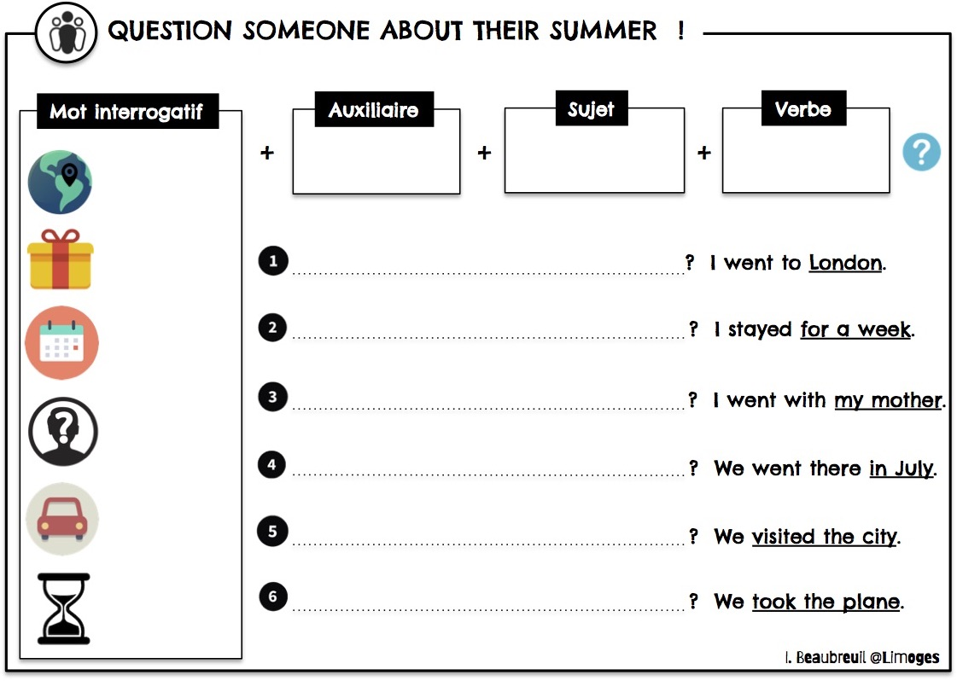
Séance 3

Slide 2
Séance 4
WHERE DID YOU GO
HOW LONG DID YOU STAY
WHO DID YOU GO WITH
WHEN DID YOU GO THERE
WHAT DID YOU DO THERE
HOW DID YOU GO THERE

Slide 3









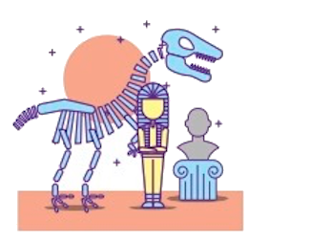





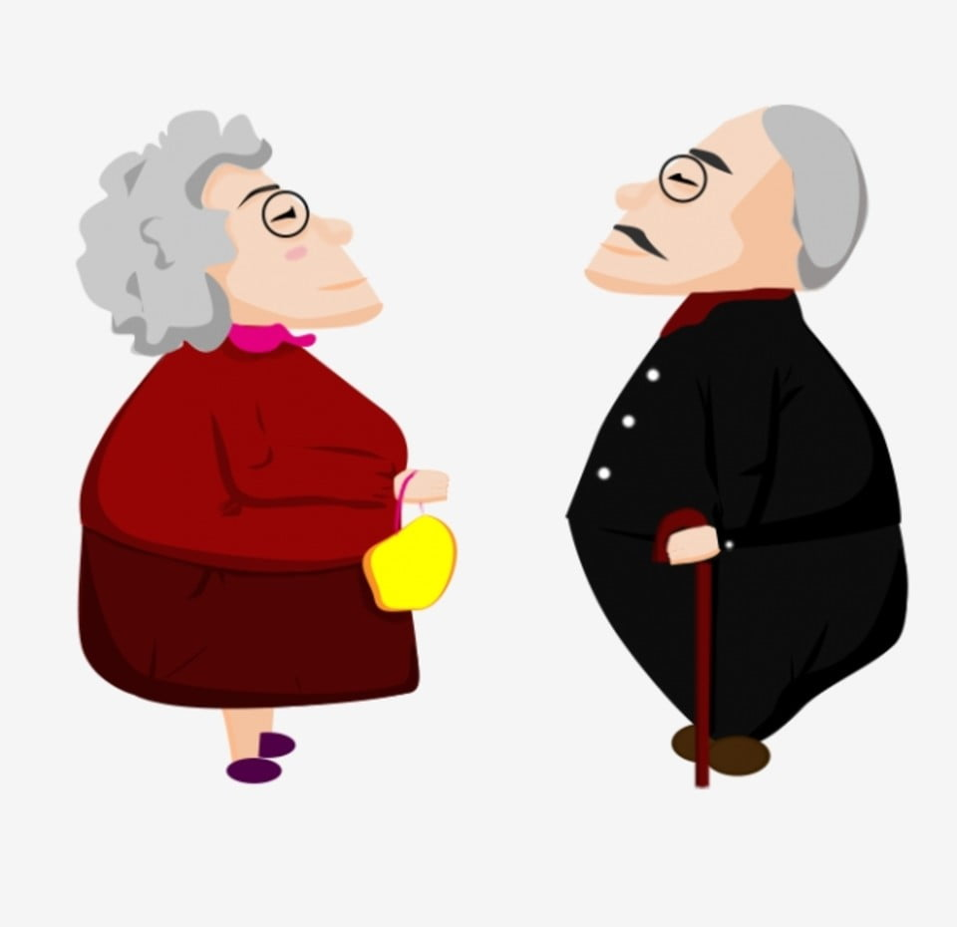


IMAGINE A DIALOGUE
PERSON A
PERSON B
LONDON
London
4 days

