Slide 1

How important is your pronunciation?
During lessons,
When on holiday,
During your internship abroad,
For a job interview,
Etc.

Slide 2
In your experience, what is the easiest thing about English pronunciation? and the most difficult?
Make two lists with your partner.

Slide 3
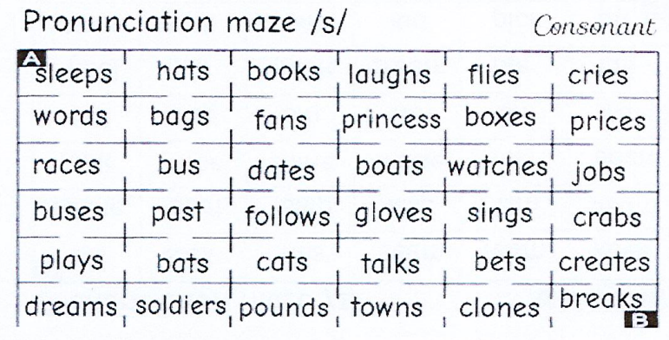

Slide 4
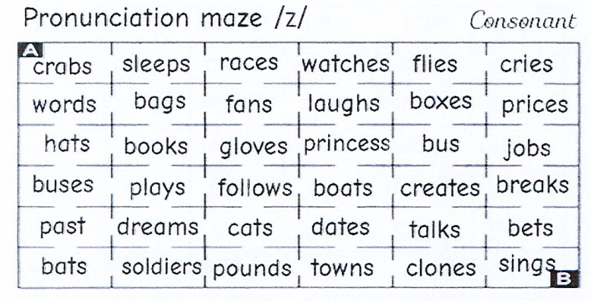

Slide 5

Watch and… enjoy!

Slide 6
The /h/ sound plays an important role in the difference between the paired words below.
Listen to each pair, paying attention to how the first word differs from the second.
ear | hear
it | hit
add | had
eye | high,hi
heal | eel
ate | hate
hell | ‘l’ (the letter)
art | heart
head | Ed (short for Edward)
old | hold

Slide 7
/h/ can appear at the beginning or in the middle of a word:
habit
how
hitchhike
hack
helpful
hurt
hedgehog
happiness
hair spray
horrible
hardest
holiday

Slide 8
Listen to how each tongue twister is pronounced.
Be sure to note the sounds or words that might be challenging for you, and how many times you will pronounce /h/.
Half the harmony he has is high.
Groundhogs hate horseradish. Groundhogs hate horseradish.

Slide 9
Pronunciation practice is even more effective in a meaningful context. Here are several sentences with /h/ that you may find yourself saying frequently.
Listen to how each sentence is pronounced.
Which word(s) include /h/?
Would you mind giving me a hand?
How can I help you?
Let’s hear His Majesty King Charles III’s heartfelt message.
Who has helped Harry with his homework?

Slide 10
The /s/ sound plays an important role in the difference between the paired words below.
Listen to each pair, paying attention to how the first word differs from the second.
sheen | seen
think | sink
maze | mace
eyes | ice
ship | sip
save | shave
show | so
sofa | chauffeur
short | sort

Slide 11
Listen to how each word is pronounced, focusing on /s/.
Notice how /s/ can appear at the beginning, middle, or end of a word.
sample
stocks
past
race
slip
strong
crisps
horses
dates
resources
worse

Slide 12
Listen to how each tongue twister is pronounced.
Be sure to note the sounds or words that might be challenging for you, and how many times you will pronounce /s/.
The thin sink sank.
Strange sayings stop crazy scams.
Salsa tastes so scrumptious and salty and sweet.

Slide 13
Pronunciation practice is even more effective in a meaningful context. Here are several sentences with /s/ that you may find yourself saying frequently.
Listen to how each sentence is pronounced.
Which word(s) include /s/?
Excuse me. [x=ks]
Steven’s sister hasn’t sent him a message for weeks.
I’d like to speak with human resources, please.

Slide 14
PRACTICE AT HOME!!!
https://tfcs.baruch.cuny.edu/h/
https://tfcs.baruch.cuny.edu/s/

Slide 15
Practise in pairs (one person can play both bosses)
Secretary - Gentlemen, Jean-François Charles is next.
Boss #1- Please show him in.
Boss #2- If he drops an 'S' I get a point. If he drops an 'H' you get a point.
Candidate - Hello!
Boss #1 - Please sit down.
Boss #2 - Were there many candidates before you?
Candidate - There were two candidates.
Boss #1 - What was your previous job?
Candidate - I have worked 3 year in human resource.
Boss #2 - What does your previous company make?
Candidate - It makes many things.
Hair pins,
hair creams,
hairbrushes.
Boss #1 - What makes you happy in life?
Candidate - We'll agree money can't buy happiness.
After school, I went to India
looking for happiness.
Sitting on the beach in Goa,
I realised:
I have happiness.
Boss #2 - Of course.
Boss #2 - Who would be your ideal boss?
Candidate - He knows what he wants.
He appreciates his employees.
Boss #1 - Bingo!

