Slide 1
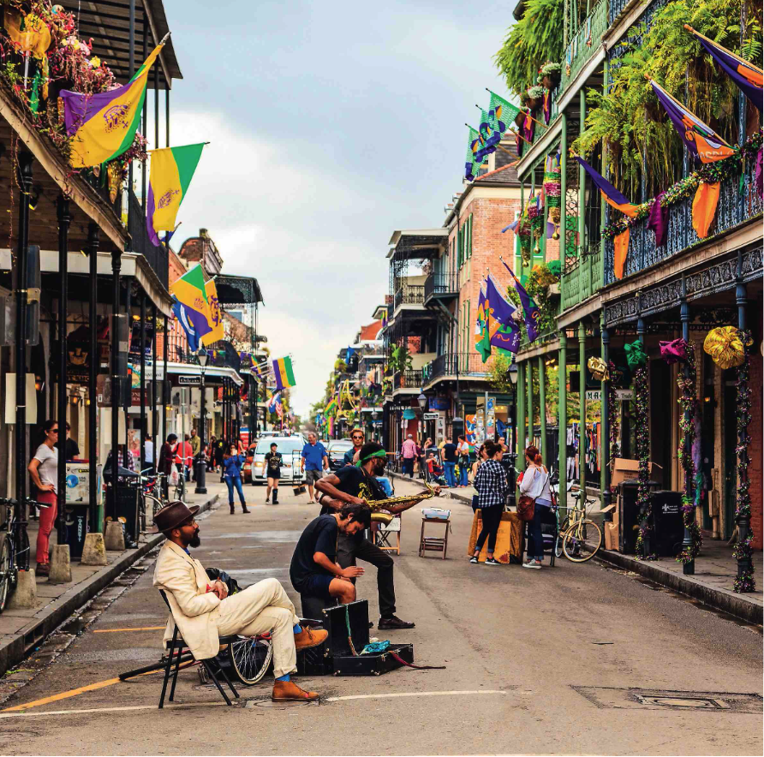

Slide 2


UNIT 3 – New Orleans (NOLA)
How has history shaped a multicultural New Orleans?
Study lines:
Territory and Memory
Diversity and Inclusion
STEP 1 : The Louisiana Purchase
STEP 2 : The History and architecture of New Orleans and its link with slavery
STEP 3 : A multicultural city?
STEP 4 : Final task
Final Task ✍️
Situation : You are a museum curator for the Historic New Orleans Collection
Task : Write a text panel for one corner of the exhibition

Slide 3

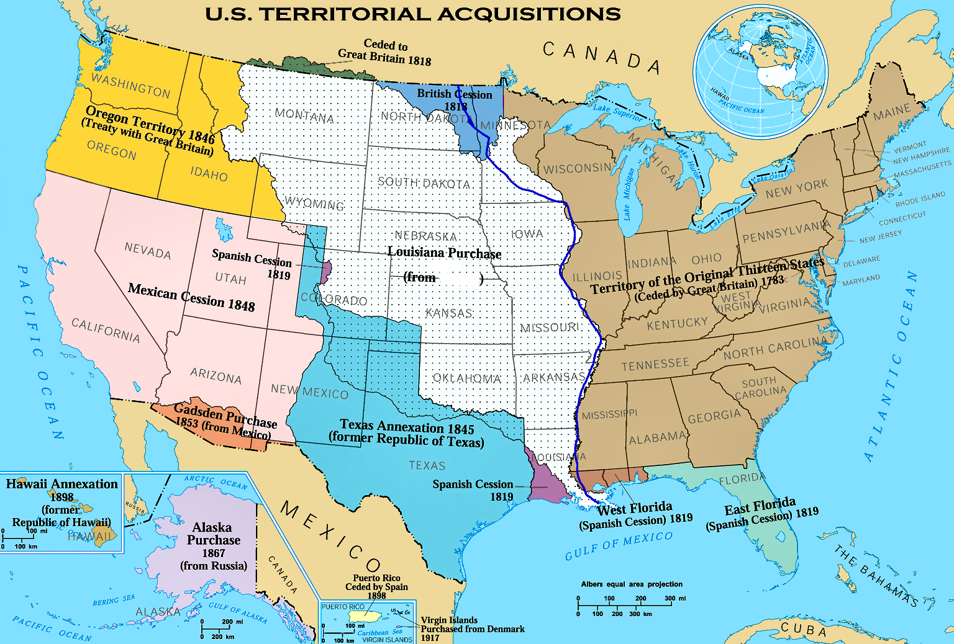
I – The Louisiana Purchase
🎯 Explain how Louisiana became American
https://ladigitale.dev/digiview/#/v/68a721ae9fb5c
Watch and complete the map (boxes on the map + table)
Share with your groupmates and complete missing information
Get ready to explain the Louisiana Purchase (What? Where? When? Why? How? )
Date | Country that owned Louisiana territory
1718
1762
1802
1803
Reason for purchasing Louisiana Territory
(country) from _ _ _ _ _ _
(date)_ _ _ _

Slide 4

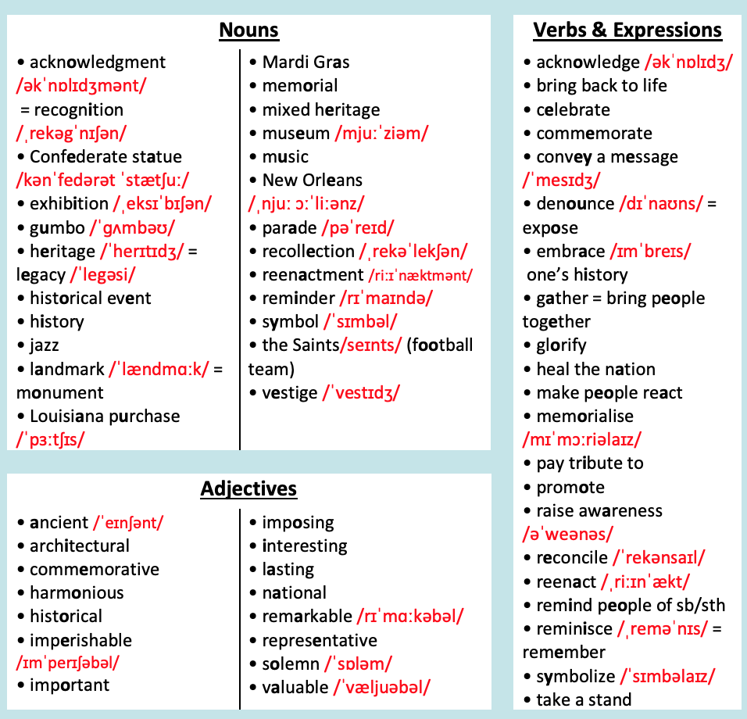


HOMEWORK
Highlight all the words or expressions you DON’T know.
Find their meaning or translation in a dictionary.
Memorize at least 3 NEW words and/or expressions from each box.
Cambridge dictionary
wordreference

Slide 5

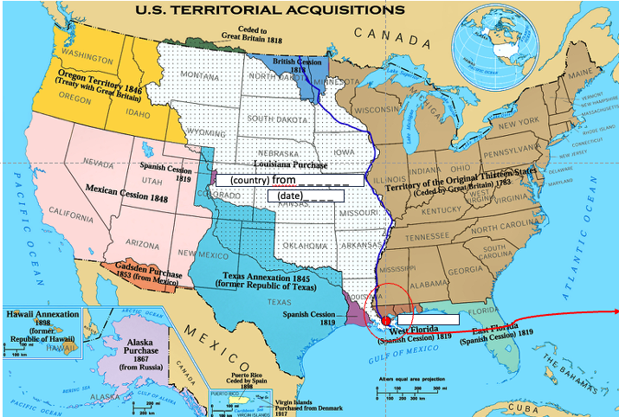
How has history shaped a multicultural New Orleans?
What do you remember?

Slide 6
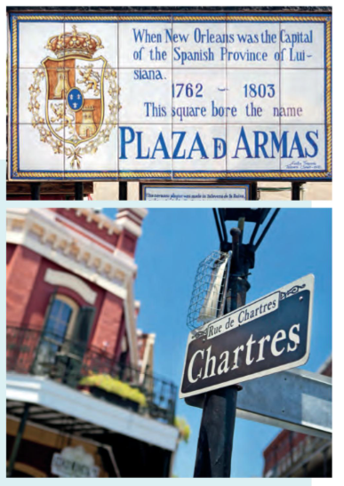
II – The History and architecture of New Orleans and its link with slavery
🎯#1 : Explain the roots of multiculturalism in New Orleans p.286
Read the paratext (title, date, type of document) and look at the images.
What do you think the text is about?
The World That Made New Orleans: From Spanish Silver to Congo Square, Ned Sublette, 2008

Slide 7
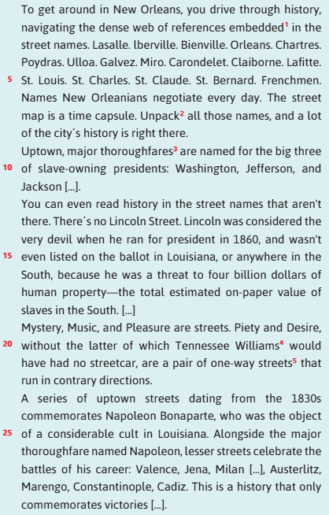

II – The History and architecture of New Orleans and its link with slavery
🎯#1 : Explain the roots of multiculturalism in New Orleans p.286
2. Read the text (l.1 to 29) and list words with capital letters. What do they refer to?

Slide 8
II – The History and architecture of New Orleans and its link with slavery
🎯#1 : Explain the roots of multiculturalism in NOLA
3. Classify the street names in this table
Origins
Street names
4. What can you guess about the history of New Orleans according to this variety of origins?

Slide 9
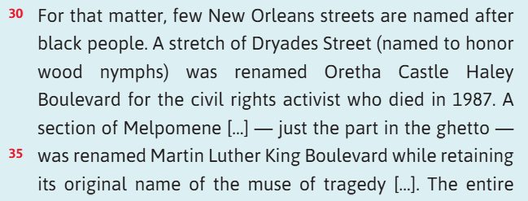
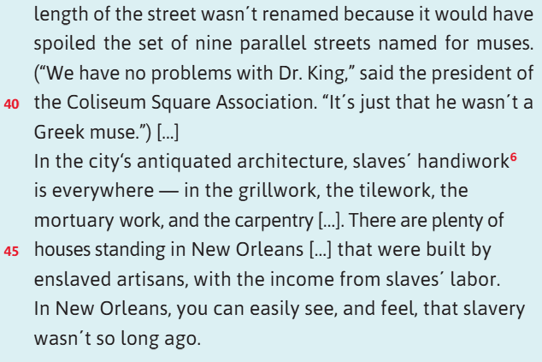
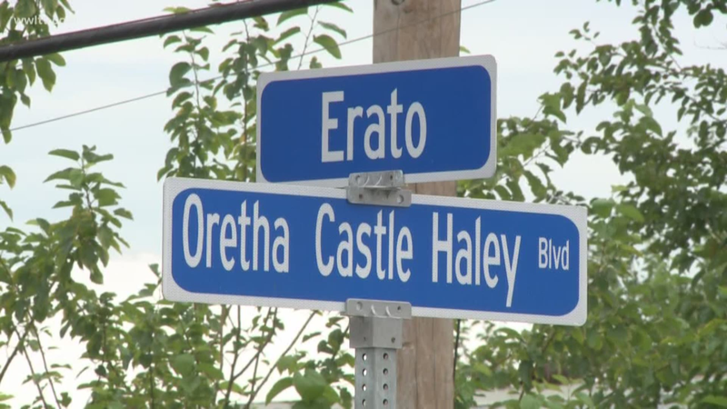
II – The History and architecture of New Orleans and its link with slavery
🎯#1 : Explain the roots of multiculturalism in NOLA
5. One origin is missing, try to find it out by reading the rest of the text (l.30 to 48) and complete the table.
Older street names
Newer street names
6. What do you think about the sentence “We have no problems with Dr. King,” said the president of the Coliseum Square Association. “It’s just that he wasn’t a Greek muse” (l.39 to 41) ➜ 🗣️ share your opinion about the importance of street names.

Slide 10

GRAMMAR
The Passive Voice
1. Translate these sentences into French
  Plenty of houses standing in New Orleans […] were built by enslaved artisans (l.45)
  ➜ …………………………………………………………………………………………………………………………….………………………………………………..….……………
  A stretch of Dryades Street was renamed Oretha Castle Haley (l.32)
  ➜ …………………………………………………………………………………………………………………………….………………………………………………..….……………
  The entire length of the street wasn’t renamed (l.36-37)
  ➜ …………………………………………………………………………………………………………………………….………………………………………………..….………….
2. What do you notice for b. & c. : what French pronoun did you use to translate the passive voice?
3. Watch the lesson and write these sentences in the passive voice:
  a. The French colonized Louisiana in 1718. ➜ …………………………………………………………………………………….………………………………………….
  b. The Americans bought Louisiana in 1803. ➜ ……………………………………………………………….……………………………………………………………..
  c. Immigrants from France, Spain and Africa enriched the city’s cultural diversity.
  ➜ …………………………………………………………………………………………………………………………….………………………………………………..….……………
  d. The Creole community blended African, European, and Native American influences into daily life.
  ➜ ……………………………………………………………….……………………………………………………………………………………………….………………………………
  People, in New Orleans, celebrated multiculturalism with many festivals. ➜ ……………………………………………………………….………………………

Slide 11
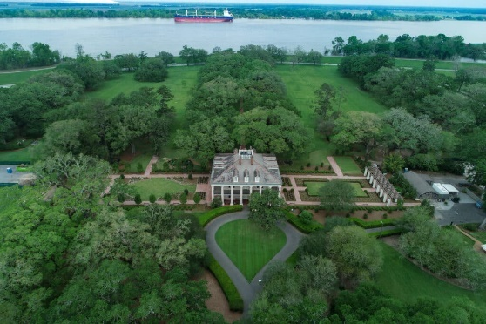
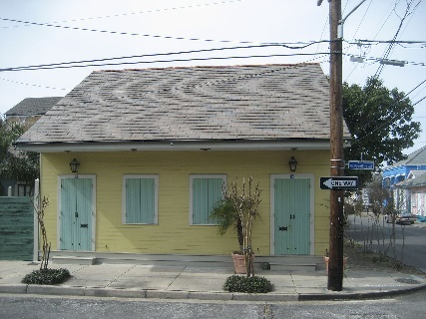
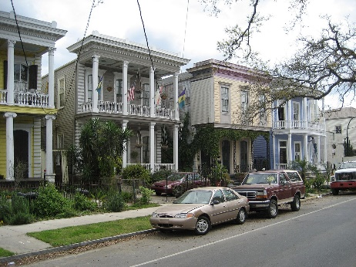
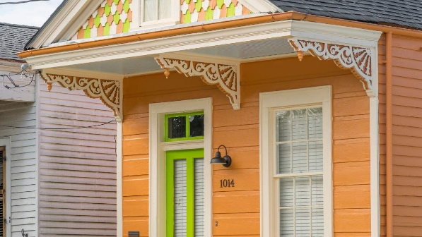
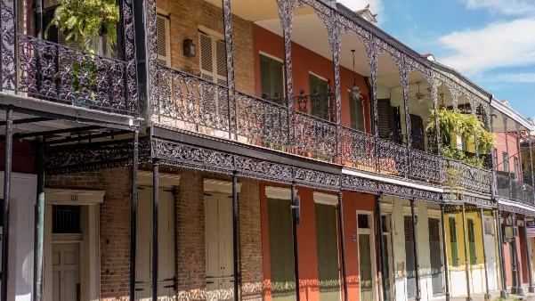
🎯 : Discover NOLA’s architecture
1. Read the descriptions of the different architectures in New Orleans
2. Label the pictures thanks to the descriptions
The buildings and architecture of New Orleans reflect its history and multicultural heritage, from Creole cottages to historic mansions on St. Charles Avenue, from the balconies of the French Quarter to an Egyptian Revival U.S. Customs building and a rare example of a Moorish revival church.
Creole cottage Creole cottages are scattered throughout the city of New Orleans, with most being built between 1790 and 1850. The majority of these cottages are found in the French Quarter, the surrounding areas of Faubourg Marigny, the Bywater, and Esplanade Ridge. Creole cottages are 1½-story, set at ground level. They have a steeply pitched roof, with a symmetrical four-opening façade wall and a wood or stucco exterior. They are usually set close to the property line.
Shot gun House Found all over New Orleans, these long and narrow single-story homes have a wood exterior and are easy to spot. Many feature charming Victorian embellishments beneath the large front eve. Some have a camelback – a second story set at rear of house. The term “shotgun” originates from the idea that when standing in the front of the house, you can shoot a bullet clear through every room in the house.
Creole Townhouses Found in the French Quarter and surrounding neighborhoods, Creole Townhouses often have shops below and homes above, brick or stucco exteriors and arched windows. Built after the Great Fires of 1788 and 1794, these two to four-story structures have a strong Spanish influence in the details.
Double-gallery houses on Esplanade Avenue Double-gallery houses were built in New Orleans between 1820 and 1850. Double-gallery houses are two-story houses with a side-gabled or hipped roof. The house is set back from the property line, and it has a covered two-story gallery which is framed and supported by columns supporting the entablature. The façade has an asymmetrical arrangement of its openings. These homes were built as a variation on the American townhouses built in the Garden District, Uptown, and Esplanade Ridge, areas which in the 19th century were thought of as suburbs.
Plantations in Louisiana showcase an intricate mix of European, African, and Caribbean architectural influences, adapted to local climate and needs. This unique blend reflects both the diversity and complexity of Louisiana’s colonial past.
Plantation house
Creole Cottage
Shot gun house
Double Gallery houses
Creole Townhouses
https://www.cajunencounters.com/blog/how-louisiana-plantation-architecture-tells-a-unique-story-of-the-past
https://www.neworleans.com/things-to-do/architecture/architectural-styles/
https://en.wikipedia.org/wiki/Buildings_and_architecture_of_New_Orleans

Slide 12
How has history shaped a multicultural New Orleans?
What do you remember?

Slide 13
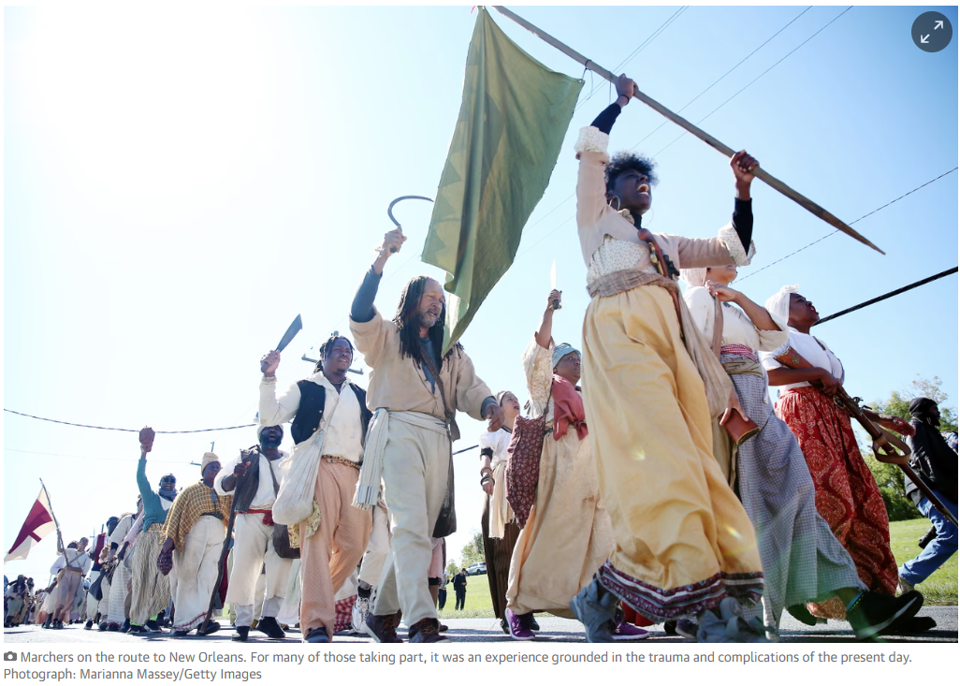
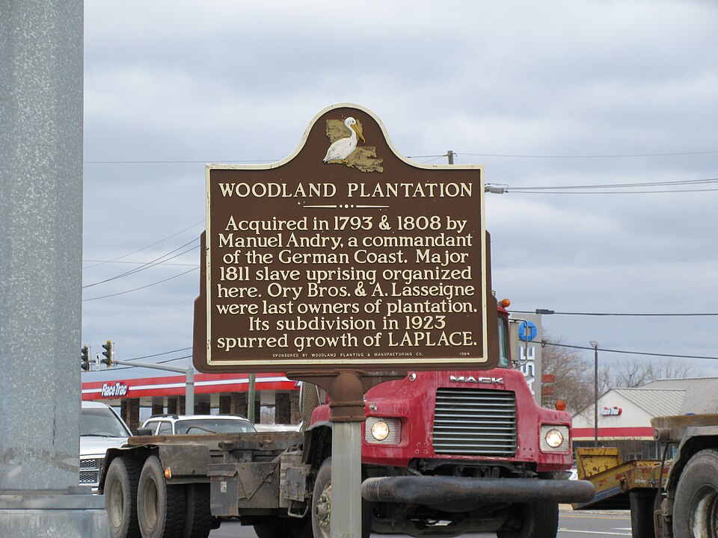
II – The History and architecture of New Orleans and its link with slavery
Observe, describe and guess what the video could be about.

Slide 14
II – The History and architecture of New Orleans and its link with slavery
🎯#2 : Watch and explain how NOLA is keeping memory of the past p.285
2. Watch the video and list information.
People
Place
Time periods
Actions
Reasons
Feelings of the people
“I heard (that)…”
“I understood (that)…”
“What about you?”
3. 🗣️ Share with your group, ✏️ complete any missing parts
4. “How is NOLA keeping memory of the past?” ➜ Using your table, ✍️ write a summary of the video.
https://youtu.be/v2to3S0iabE?si=euoSfm6Z9ODvngmM

Slide 15
Phonetics ➜ -ion
1. Listen to the words taken from the video and try to identify the stressed syllable
rebellion | attention | emancipation | Subdivision | oppression
o O o
2. What can you deduce about the words ending in -ion?
There are two exceptions: do you know them ?
3. Listen and try to find the correct phonetical transcription of these 3 words, as well as the stressed syllable.
A rebel (n) | To rebel (v) | A rebellion (n)
/r…….bl/ | /r……….../ | /r………………jən/

Slide 16
How has history shaped a multicultural New Orleans?
What do you remember?

Slide 17
5. REACT : pick a role card and react to the reenactment accordingly.
☐ share your opinion
☐ speak about your feelings
☐ refer to the history of NOLA (➛ use the passive voice)
☐ use at least 5 words or expressions from your vocab list.
“As it wound along the streets of LaPlace, the reenactment drew a visceral reaction from a group of onlookers.” extract from the article ‘hundreds march to re-enact 1811 Louisiana slave rebellion’ by Olivier Laughland, for The Guardian
Role 1
Claudine Hebert, 64, stood outside her house in her bathrobe, photographing the reenactors on her phone.
Role 2 & 3: a teacher and a child
At an elementary school along the route, dozens of children had been brought outside to watch the marchers go by. Afterwards, Toni Robinette, the principal, wiped her eyes.
Role 4:
Kurt Falterman, 50, stood by his garage and watched, angry that the re-enactment caused traffic delays.
➜ 🗣️🎭 Play your role for your groupmates (and if you wish, for the whole class.)

Slide 18


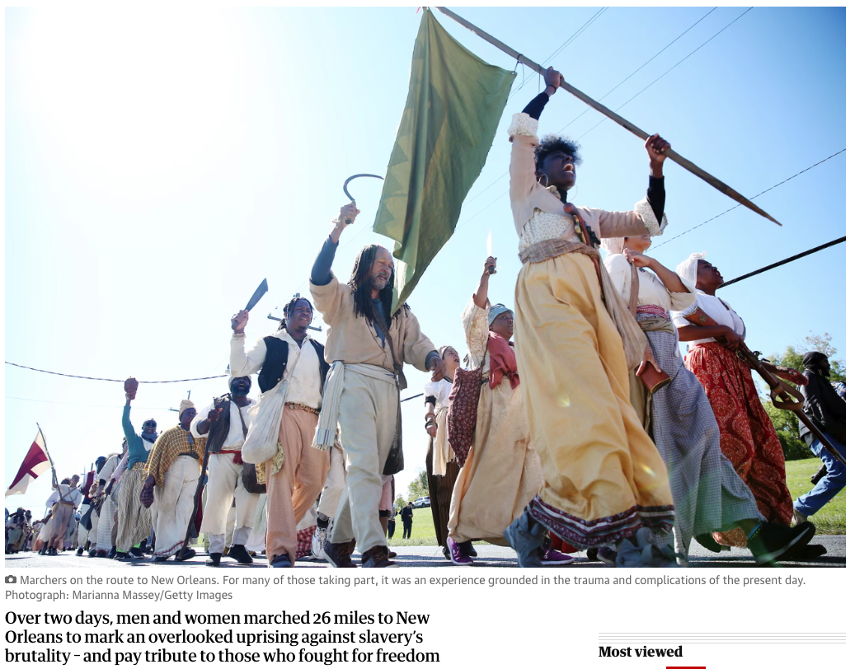
As it wound along the sparse streets of LaPlace, the re-enactment drew a visceral reaction from a group of onlookers.
At an elementary school along the route, dozens of children had been brought outside to watch the marchers go by. Afterwards, Toni Robinette, the principal, wiped her eyes and asked them: “Y’all understand what slavery was?”
“Slavery was tragedy,” she said. “People were stolen, taken from their homeland. Taken here to do what?”
“Work,” the students called. Robinette said later that the students are only beginning to study the history of enslavement in Louisiana.
Claudine Hebert, 64, stood outside in her house in her bathrobe, photographing the re-enactors on her phone.
“It makes it real,” Hebert said. “You can see things or read things, but to actually see it live makes a difference. I”m hoping white people will stop this thinking that they’re better than black people, because they’re not.”
But in this red state that voted overwhelmingly to elect Donald Trump in 2016 and in 1989 elected a former Klan wizard to the state house, racist criticism was not far away.
Kurt Falterman, 50, stood by his garage and watched, angry that the re-enactment caused traffic delays.
“That’s history. Why don’t they let that be?” he said. “I think it’s a bunch of bullcrap myself. We let them have what they want. They get their way.”
Who did he mean by “they”?
“The black folk.”
Had anyone ever called him a racist?
“Not to me personally. But I imagine a few of them probably would.”
HOMEWORK
Read and check the onlookers’ reactions.
Compare them to what YOU had imagined.
Full article:
https://www.theguardian.com/us-news/2019/nov/11/louisiana-slave-rebellion-reenactment-artist-dread-scott

Slide 19
III – A multicultural city?
🎯 Exchange information about NOLA’s heritage.
Multiculturalism in NOLA
Spanish heritage
French heritage
African heritage
INSTRUCTIONS
1) Go through your set of documents
2) As a group, share and summarize your ideas in a list of max. 10 points. No sentences are allowed.
3) Create a set of 5 questions about your topic to quiz your classmates.
4) Be ready to present your topic to other classmates.

Slide 20

TG1
🎯 Exchange information about NOLA’s heritage.
STEP 1
1) 📖🎧👀 Go through your set of documents
2) As a group, 🗣share and ✏️ summarize your ideas in a list of max. 10 points. ⛔️ no sentences ⛔️
3) Create a set of 5 multiple-choice questions about your topic to quiz your classmates in STEP 2.
4) 🗣Be ready to present your topic to other groupmates.
STEP 2
🗣 Present your set of documents to your groupmates
👂Listen to your groupmates and ✏️ complete your table.
❓ Quiz your groupmates.
French heritage | African heritage | Spanish heritage | Multiculturalism
Trinity Lisa Marais Orane Alizée M | Timothée Enola Lisa Marchel Yves Marion | Edgard Louna Océane Justin | Léo P Auriane Chloé L Anaïs
Léo LC Chloé C Clara | Lou-Ana Mathéo Teiva | Nina Paul Gabin | Isaline Céline Evan
Trinity Timothée Yves Edgard Léo P | Lisa Marais Enola Louna Auriane | Orane Lisa Marchel Justin Anaïs | Alizée M Marion Paul Céline
Léo LC Lou-Ana Nina Chloé L | Chloé C Teiva Océane Isaline | Clara Mathéo Gabin Evan

Slide 21
TG5
🎯 Exchange information about NOLA’s heritage.
STEP 1
1) 📖🎧👀 Go through your set of documents
2) As a group, 🗣share and ✏️ summarize your ideas in a list of max. 10 points. ⛔️ no sentences ⛔️
3) Create a set of 5 multiple-choice questions about your topic to quiz your classmates in STEP 2.
4) 🗣Be ready to present your topic to other groupmates.
STEP 2
🗣 Present your set of documents to your groupmates
👂Listen to your groupmates and ✏️ complete your table.
❓ Quiz your groupmates.
French heritage | African heritage | Spanish heritage | Multiculturalism
Maël Andréa Anouk Loup | Louna Inès Léa Lenny | Enzo M Rose M Sohan Mathéo | Lony Tom Lily Enzo H
Jeanne Rosie Chahinez | Chirine Louisiane Rose B | Alexandre Léona Timéo | Méline Quincy Lucas
Maël Inès Rose M Lony | Andréa Léa Alexandre Lucas | Anouk Lenny Enzo M Lily | Loup Louna Sohan Tom
Jeanne Chirine Léona Méline | Rosie Rose B Timéo Lucas | Chahinez Louisiane Alexandre Quincy

Slide 22
TG6
🎯 Exchange information about NOLA’s heritage.
STEP 1
1) 📖🎧👀 Go through your set of documents
2) As a group, 🗣share and ✏️ summarize your ideas in a list of max. 10 points. ⛔️ no sentences ⛔️
3) Create a set of 5 multiple-choice questions about your topic to quiz your classmates in STEP 2.
4) 🗣Be ready to present your topic to other groupmates.
STEP 2
🗣 Present your set of documents to your groupmates
👂Listen to your groupmates and ✏️ complete your table.
❓ Quiz your groupmates.
French heritage | African heritage | Spanish heritage | Multiculturalism
Guilhem Solenn Luna Killian | Louison Inès Lenny Constance | Maïa Louise François Naely | Jules Gabriel M Gabriel PM Juline
Alwena Hugo Lily | Nuriya Joachim Suzanne | Jonatan Romane Marcus | Marie Tobias Elina
Guilhem Constance Naely Jules | Solenn Inès Maïa Juline | Luna Louison Louise Gabriel PM | Killian Lenny Romane Gabriel M
Alwena Joachim Marcus Marie | Hugo Nuriya François Elina | Lily Suzanne Jonatan Tobias

Slide 23







French Heritage in NOLA
What is French about New Orleans?
  https://www.whereyat.com/french-new-orleans
  https://www.neworleans.com/things-to-do/multicultural/cultures/french/
Website (French 1)
Website (French 2)
Multiculturalism in NOLA
To what extent is NOLA a successful melting pot?
https://education.nationalgeographic.org/resource/multicultural-stew/
Gumbo
The Saints
Website (Multiculturalism)
Spanish Heritage in NOLA
What did the Spanish era bring to New Orleans and how does it live on today?
  https://www.neworleans.com/things-to-do/multicultural/cultures/spanish/
  https://ladigitale.dev/digiview/#/v/68a71f1e6aaeb
Spanish Heritage Month in NOLA
Website (Spanish)

Slide 24
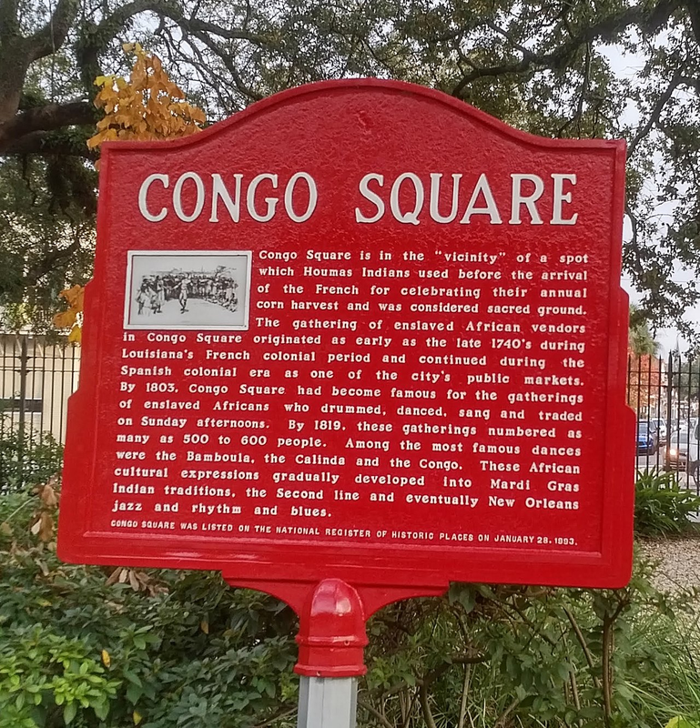


African Heritage in NOLA
Focus on the history of Africans in New Orleans and how African culture lives on in NOLA today.
https://www.neworleans.com/things-to-do/multicultural/cultures/african-american/
Website (African)
Jazz
Jazz

Slide 25
HOMEWORK
Take the quiz (pronote) to test your knowledge about multiculturalism

Slide 26

Oral Comprehension (assessment)

Slide 27
How has history shaped a multicultural New Orleans?
What do you remember?

Slide 28

III – A multicultural city?
🎯 Brainstorm on the limits of multiculturalism
Limits of multiculturalism in NOLA

Slide 29


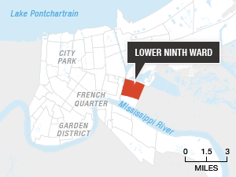
III – A multicultural city?
🎯 Compare 2 points of view
Group A
Restoring the musical city of New Orleans after Katrina, Smithsonian (2015)
Group B
https://ladigitale.dev/digiview/#/v/697e30e37d66f
1. Watch the video and take notes about:
  The problems brought by Katrina
  Landmarks still standing after the hurricane
  Reconstruction of the Ninth Ward
2. 🗣️ Be ready to explain your document to other classmates.
1. Read and:
  List the difficulties & improvements in the city after Katrina.
  Explain the reasons of the differences between NOLA neighbourhoods
2. 🗣️ Be ready to explain your document to other classmates.
🗣️Explain the vision of the city given in your document.

Slide 30

Hurricane Katrina made landfall in Louisiana on August 29, 2005. While “only” a Category 3 hurricane when it hit the coast, Katrina and its aftermath resulted in 1,863 deaths. Although 90 percent of New Orleans’s pre-storm population is back and much of the city has been rebuilt, neighborhoods such as the Lower Ninth Ward have not had the same amount of post-Katrina growth. The historically low-income, African American area boasted a 14,000-strong population back in 2000, but the community was hit the hardest by the storm. During the hurricane, a barge broke into the levee protecting the ward, causing the area to be overrun with 12 feet of water, which destroyed homes in a matter of minutes. That single failure was the source of 80 percent of New Orleans’s flooding.
Hurricane Katrina is often cited as not being an “equal opportunity storm” due to the fact that minority populations were hit the hardest. They also received the least amount of funding in the rebuilding process. Not only was the area ill-prepared for a massive storm, but funding afterwards was often unreliable and inadequate for the damage the hurricane inflicted. While many organizations came into the area following the immediate aftermath of Katrina, most notably Brad Pitt’s celebrity project, The Make It Right organization, the storm and its effects soon lost national attention. And along with national attention went the public support to try and piece back together the remains of the Lower Ninth Ward.
The rebuilding of New Orleans, 14 years after the hurricane's landfall, is still a work in progress. (…)
Although communities are trying to get back on their feet and return to pre-hurricane conditions, some of the disaster's impacts will likely never be fully erased from the city. Driving around the Lower Ninth Ward, a community just east of the French Quarter, I was taken aback by the empty plots that still break up the community. Houses that used to stand right next to one another are now spaced haphazardly away from each other, separated by empty land that is overgrown with weeds and brush. Trash piles on the corners of the streets and signs warning against loitering further accentuate the impression that things haven't improved. Businesses are staying away as well. A single grocery store, Burnell’s Lower Ninth Ward Market, holds the sole responsibility of providing a small range of packaged foods and fresh produce to the 1,200 people who live in the community. (…)
https://www.eesi.org/articles/view/fourteen-years-later-new-orleans-is-still-trying-to-recover-from-hurricane-katrina

Slide 31
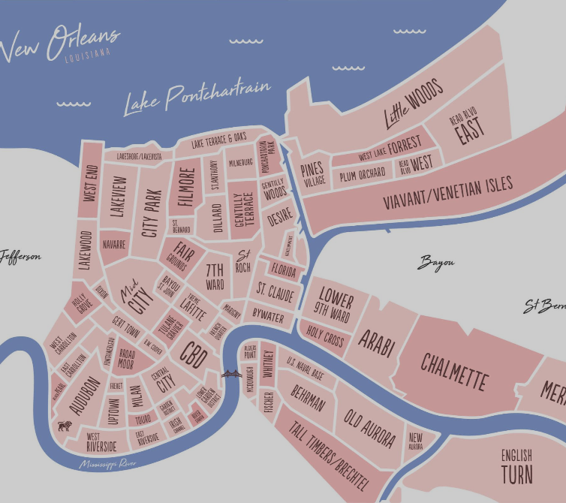
5. 🗣️ Action! In pairs.
Situation: Imagine you’re part of the city council.
Task: Present what has already been done and what you plan to do for the city.
☐ Mention hurricane Katrina and its aftermath
☐ Present actions that have been implemented to repair NOLA
☐ Introduce 1 or 2 persisting issues
☐ Present your plan for the future of NOLA
☐ use your vocab sheet
☐ use the passive voice

Slide 32
How has history shaped a multicultural New Orleans?
What do you remember?

Slide 33
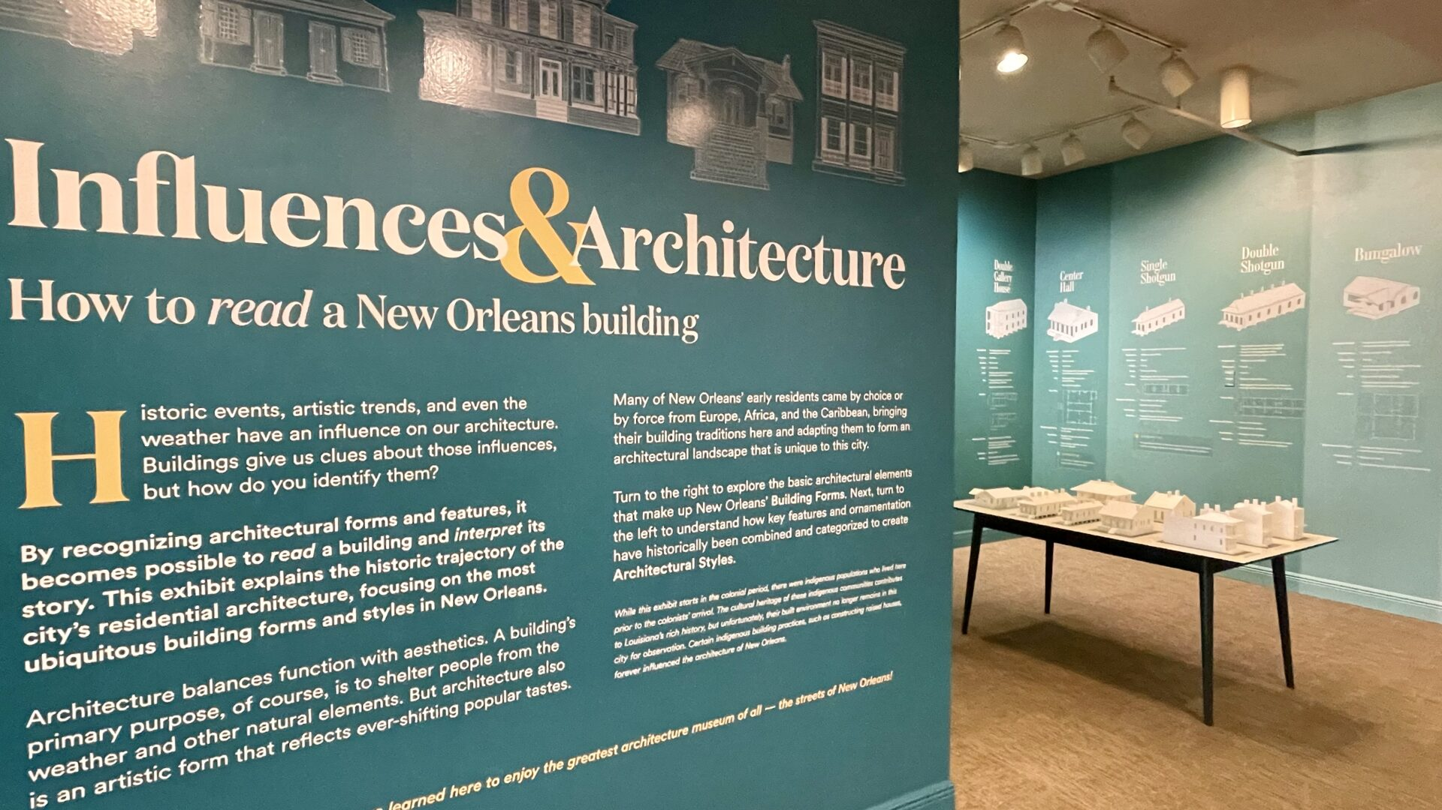
IV – Get ready for the final task
Situation : You are a museum curator for the Historic New Orleans Collection
Task : Write a text panel for one corner of the exhibition
Methodology ➜ label the exhibition panel
Checklist to succeed:
  answer your key issue / defend your given argument about New Orleans’ heritage.
  use historical facts from class
  explain cultural influences clearly
  Use argument and counter argument ( to show both sides of your argument) (➜ link words)
  respect the methodology of a panel
  organize your ideas.
  write about 200 words.
  Use grammar and vocab from the unit

Slide 34
Label the different parts of an exhibition panel
Title of the exhibition – objective of the exhibition or section – key issue
- introduction –
description and explanation

Slide 35
Arguments given to students for the final task
African Heritage: African culture did not simply influence New Orleans; it survived slavery and became the foundation of its cultural identity.
Multiculturalism in New Orleans : multicultural identity was created through inequality as much as through cultural exchange.
French Heritage: French heritage remains central to New Orleans’ identity, even though French political control was short-lived.
Spanish Heritage: Spanish rule transformed New Orleans more deeply than its short duration suggests.

Slide 36
Vocab challenge
Highlight all the words or expressions you DON’T know.
Find their meaning or translation in a dictionary.
Memorize as many words and expressions as you can
In groups, write as many CORRECT sentences as possible using the vocab.
Cambridge dictionary
wordreference

Slide 37
Vocab challenge
HOMEWORK
Highlight all the words or expressions you DON’T know.
Find their meaning or translation in a dictionary.
Memorize at least 5 NEW words and expressions from each box and be able to use them in a sentence.
In groups, write as many CORRECT sentences as possible using words from the list.
Cambridge dictionary
wordreference
IN CLASS

Slide 38
II – The History and architecture of New Orleans and its link with slavery
🎯#3 : Discover NOLA’s architecture
1. Read the descriptions of the different architectures in New Orleans
2. Label the pictures thanks to the descriptions
The buildings and architecture of New Orleans reflect its history and multicultural heritage, from Creole cottages to historic mansions on St. Charles Avenue, from the balconies of the French Quarter to an Egyptian Revival U.S. Customs building and a rare example of a Moorish revival church.
Creole cottage Creole cottages are scattered throughout the city of New Orleans, with most being built between 1790 and 1850. The majority of these cottages are found in the French Quarter, the surrounding areas of Faubourg Marigny, the Bywater, and Esplanade Ridge. Creole cottages are 1½-story, set at ground level. They have a steeply pitched roof, with a symmetrical four-opening façade wall and a wood or stucco exterior. They are usually set close to the property line.
Shot gun House Found all over New Orleans, these long and narrow single-story homes have a wood exterior and are easy to spot. Many feature charming Victorian embellishments beneath the large front eve. Some have a camelback – a second story set at rear of house. The term “shotgun” originates from the idea that when standing in the front of the house, you can shoot a bullet clear through every room in the house.
Creole Townhouses Found in the French Quarter and surrounding neighborhoods, Creole Townhouses often have shops below and homes above, brick or stucco exteriors and arched windows. Built after the Great Fires of 1788 and 1794, these two to four-story structures have a strong Spanish influence in the details.
Double-gallery houses on Esplanade Avenue Double-gallery houses were built in New Orleans between 1820 and 1850. Double-gallery houses are two-story houses with a side-gabled or hipped roof. The house is set back from the property line, and it has a covered two-story gallery which is framed and supported by columns supporting the entablature. The façade has an asymmetrical arrangement of its openings. These homes were built as a variation on the American townhouses built in the Garden District, Uptown, and Esplanade Ridge, areas which in the 19th century were thought of as suburbs.
Plantations in Louisiana showcase an intricate mix of European, African, and Caribbean architectural influences, adapted to local climate and needs. This unique blend reflects both the diversity and complexity of Louisiana’s colonial past.
Plantation house
Creole Cottage
Shot gun house
Double Gallery houses
Creole Townhouses
https://www.cajunencounters.com/blog/how-louisiana-plantation-architecture-tells-a-unique-story-of-the-past
https://www.neworleans.com/things-to-do/architecture/architectural-styles/
https://en.wikipedia.org/wiki/Buildings_and_architecture_of_New_Orleans

Slide 39
UNIT 3 – New Orleans (NOLA)
How has history shaped a multicultural New Orleans?
Study lines:
Territory and Memory
Diversity and Inclusion
STEP 1 : The Louisiana Purchase
STEP 2 : The History and architecture of New Orleans and its link with slavery
STEP 3 : A multicultural city?
STEP 4 : Final task
Final Task ✍️
Situation : You are a museum curator for the Historic New Orleans Collection
Task : Write a text panel for one corner of the exhibition

Slide 40
UNIT 3 – New Orleans (NOLA)
How has history shaped a multicultural New Orleans?
Study lines:
Territory and Memory
Diversity and Inclusion
STEP 1 : The Louisiana Purchase
STEP 2 : The History and architecture of New Orleans and its link with slavery
STEP 3 : A multicultural city?
STEP 4 : Final task
Final Task ✍️
Situation : You are a museum curator for the Historic New Orleans Collection
Task : Write a text panel for one corner of the exhibition

Slide 41
UNIT 3 – New Orleans (NOLA)
How has history shaped a multicultural New Orleans?
Study lines:
Territory and Memory
Diversity and Inclusion
STEP 1 : The Louisiana Purchase
STEP 2 : The History and architecture of New Orleans and its link with slavery
STEP 3 : A multicultural city?
STEP 4 : Final task
Final Task ✍️
Situation : You are a museum curator for the Historic New Orleans Collection
Task : Write a text panel for one corner of the exhibition

Slide 42
UNIT 3 – New Orleans (NOLA)
How has history shaped a multicultural New Orleans?
Study lines:
Territory and Memory
Diversity and Inclusion
STEP 1 : The Louisiana Purchase
STEP 2 : The History and architecture of New Orleans and its link with slavery
STEP 3 : A multicultural city?
STEP 4 : Final task
Final Task ✍️
Situation : You are a museum curator for the Historic New Orleans Collection
Task : Write a text panel for one corner of the exhibition

Slide 43
UNIT 3 – New Orleans
UNIT 3 – New Orleans

Slide 44
I – The Louisiana Purchase
https://ladigitale.dev/digiview/#/v/68a721ae9fb5c
Watch and complete the map (boxes on the map + table)
Share with your groupmates and complete missing information
Get ready to explain the Louisiana Purchase (What? Where? When? Why? How? )
Date | Country that owned Louisiana territory
1718
1762
1802
1803
Reason for purchasing Louisiana Territory
(country) from _ _ _ _ _ _
(date)_ _ _ _

Slide 45
GRAMMAR
The Passive Voice
1. Translate these sentences into French
  Plenty of houses standing in New Orleans […] were built by enslaved artisans (l.45)
  ➜ …………………………………………………………………………………………………………………………….………………………………………………..….……………
  A stretch of Dryades Street was renamed Oretha Castle Haley (l.32)
  ➜ …………………………………………………………………………………………………………………………….………………………………………………..….……………
  The entire length of the street wasn’t renamed (l.36-37)
  ➜ …………………………………………………………………………………………………………………………….………………………………………………..….………….
2. What do you notice for b. & c. : what French pronoun did you use to translate the passive voice?
3. Watch the lesson and write these sentences in the passive voice:
  a. The French colonized Louisiana in 1718. ➜ …………………………………………………………………………………….………………………………………….
  b. The Americans bought Louisiana in 1803. ➜ ……………………………………………………………….……………………………………………………………..
  c. Immigrants from France, Spain and Africa enriched the city’s cultural diversity.
  ➜ …………………………………………………………………………………………………………………………….………………………………………………..….……………
  d. The Creole community blended African, European, and Native American influences into daily life.
  ➜ ……………………………………………………………….……………………………………………………………………………………………….………………………………
  People, in New Orleans, celebrated multiculturalism with many festivals. ➜ ……………………………………………………………….………………………

Slide 46
GRAMMAR
The Passive Voice
1. Translate these sentences into French
  Plenty of houses standing in New Orleans […] were built by enslaved artisans (l.45)
  ➜ …………………………………………………………………………………………………………………………….………………………………………………..….……………
  A stretch of Dryades Street was renamed Oretha Castle Haley (l.32)
  ➜ …………………………………………………………………………………………………………………………….………………………………………………..….……………
  The entire length of the street wasn’t renamed (l.36-37)
  ➜ …………………………………………………………………………………………………………………………….………………………………………………..….………….
2. What do you notice for b. & c. : what French pronoun did you use to translate the passive voice?
3. Watch the lesson and write these sentences in the passive voice:
  a. The French colonized Louisiana in 1718. ➜ …………………………………………………………………………………….………………………………………….
  b. The Americans bought Louisiana in 1803. ➜ ……………………………………………………………….……………………………………………………………..
  c. Immigrants from France, Spain and Africa enriched the city’s cultural diversity.
  ➜ …………………………………………………………………………………………………………………………….………………………………………………..….……………
  d. The Creole community blended African, European, and Native American influences into daily life.
  ➜ ……………………………………………………………….……………………………………………………………………………………………….………………………………
  People, in New Orleans, celebrated multiculturalism with many festivals. ➜ ……………………………………………………………….………………………

Slide 47
Phonetics ➜ -ion
Phonetics ➜ -ion
1. Listen to the words taken from the video and try to identify the stressed syllable
1. Listen to the words taken from the video and try to identify the stressed syllable
rebellion | attention | emancipation | Subdivision | oppression
o O o
rebellion | attention | emancipation | Subdivision | oppression
o O o
2. What can you deduce about the words ending in -ion?
There are two exceptions: do you know them ?
2. What can you deduce about the words ending in -ion?
There are two exceptions: do you know them ?
3. Listen and try to find the correct phonetical transcription of these 3 words, as well as the stressed syllable.
A rebel (n) | To rebel (v) | A rebellion (n)
/r…….bl/ | /r……….../ | /r………………jən/
A rebel (n) | To rebel (v) | A rebellion (n)
/r…….bl/ | /r……….../ | /r………………jən/
Phonetics ➜ -ion
Phonetics ➜ -ion
1. Listen to the words taken from the video and try to identify the stressed syllable
1. Listen to the words taken from the video and try to identify the stressed syllable
rebellion | attention | emancipation | Subdivision | oppression
o O o
rebellion | attention | emancipation | Subdivision | oppression
o O o
2. What can you deduce about the words ending in -ion?
There are two exceptions: do you know them ?
2. What can you deduce about the words ending in -ion?
There are two exceptions: do you know them ?
A rebel (n) | To rebel (v) | A rebellion (n)
/r…….bl/ | /r……….../ | /r………………jən/
A rebel (n) | To rebel (v) | A rebellion (n)
/r…….bl/ | /r……….../ | /r………………jən/

Slide 48
The buildings and architecture of New Orleans reflect its history and multicultural heritage, from Creole cottages to historic mansions on St. Charles Avenue, from the balconies of the French Quarter to an Egyptian Revival U.S. Customs building and a rare example of a Moorish revival church.
Creole cottage Creole cottages are scattered throughout the city of New Orleans, with most being built between 1790 and 1850. The majority of these cottages are found in the French Quarter, the surrounding areas of Faubourg Marigny, the Bywater, and Esplanade Ridge. Creole cottages are 1½-story, set at ground level. They have a steeply pitched roof, with a symmetrical four-opening façade wall and a wood or stucco exterior. They are usually set close to the property line.
Shot gun House Found all over New Orleans, these long and narrow single-story homes have a wood exterior and are easy to spot. Many feature charming Victorian embellishments beneath the large front eve. Some have a camelback – a second story set at rear of house. The term “shotgun” originates from the idea that when standing in the front of the house, you can shoot a bullet clear through every room in the house.
Creole Townhouses Found in the French Quarter and surrounding neighborhoods, Creole Townhouses often have shops below and homes above, brick or stucco exteriors and arched windows. Built after the Great Fires of 1788 and 1794, these two to four-story structures have a strong Spanish influence in the details.
Double-gallery houses on Esplanade Avenue Double-gallery houses were built in New Orleans between 1820 and 1850. Double-gallery houses are two-story houses with a side-gabled or hipped roof. The house is set back from the property line, and it has a covered two-story gallery which is framed and supported by columns supporting the entablature. The façade has an asymmetrical arrangement of its openings. These homes were built as a variation on the American townhouses built in the Garden District, Uptown, and Esplanade Ridge, areas which in the 19th century were thought of as suburbs.
Plantations in Louisiana showcase an intricate mix of European, African, and Caribbean architectural influences, adapted to local climate and needs. This unique blend reflects both the diversity and complexity of Louisiana’s colonial past.

Slide 49
The buildings and architecture of New Orleans reflect its history and multicultural heritage, from Creole cottages to historic mansions on St. Charles Avenue, from the balconies of the French Quarter to an Egyptian Revival U.S. Customs building and a rare example of a Moorish revival church.
Creole cottage Creole cottages are scattered throughout the city of New Orleans, with most being built between 1790 and 1850. The majority of these cottages are found in the French Quarter, the surrounding areas of Faubourg Marigny, the Bywater, and Esplanade Ridge. Creole cottages are 1½-story, set at ground level. They have a steeply pitched roof, with a symmetrical four-opening façade wall and a wood or stucco exterior. They are usually set close to the property line.
Shot gun House Found all over New Orleans, these long and narrow single-story homes have a wood exterior and are easy to spot. Many feature charming Victorian embellishments beneath the large front eve. Some have a camelback – a second story set at rear of house. The term “shotgun” originates from the idea that when standing in the front of the house, you can shoot a bullet clear through every room in the house.
Creole Townhouses Found in the French Quarter and surrounding neighborhoods, Creole Townhouses often have shops below and homes above, brick or stucco exteriors and arched windows. Built after the Great Fires of 1788 and 1794, these two to four-story structures have a strong Spanish influence in the details.
Double-gallery houses on Esplanade Avenue Double-gallery houses were built in New Orleans between 1820 and 1850. Double-gallery houses are two-story houses with a side-gabled or hipped roof. The house is set back from the property line, and it has a covered two-story gallery which is framed and supported by columns supporting the entablature. The façade has an asymmetrical arrangement of its openings. These homes were built as a variation on the American townhouses built in the Garden District, Uptown, and Esplanade Ridge, areas which in the 19th century were thought of as suburbs.
Plantations in Louisiana showcase an intricate mix of European, African, and Caribbean architectural influences, adapted to local climate and needs. This unique blend reflects both the diversity and complexity of Louisiana’s colonial past.

Slide 50
Multiculturalism in NOLA
Spanish heritage
French heritage
African heritage
INSTRUCTIONS
1) Go through your set of documents
2) As a group, share and summarize your ideas in a list of max. 10 points. No sentences are allowed.
Create a set of 5 questions about your topic to quiz your classmates.
3) Be ready to present your topic to other classmates.

Slide 51
The Louisiana Purchase
https://ladigitale.dev/digiview/#/v/68a721ae9fb5c
Explain the Louisiana Purchase (What? Where? When? Why? Who? How? ):
The Louisiana Purchase was the 1803 land deal in which the United States acquired a huge territory from France, effectively doubling the size of the nation. It's considered one of the most significant events in U.S. history. President Jefferson sent two men to negotiate with the French to acquire NOLA or to obtain access to the Mississippi river port for $10 million. The French were not in a favourable position in America, so they offered the US a deal: $15 million dollar for the entire Louisiana Territory.
Date | Country that owned Louisiana territory
1718 | France
1762 | Spain
1802 | France
1803 | The USA
Reason for purchasing Louisiana Territory
NOLA was a good trading location as it was at the end of Mississippi river
(country) from FRANCE
1803
New Orleans

Slide 52
II – The History and architecture of New Orleans and its link with slavery
🎯#1 : Explain the roots of multiculturalism in NOLA
2. Read the text (l.1 to 29) and list words with capital letters. What do most of them refer to?
New Orleans
Lasalle
Iberville
Bienville
Orleans
Chartres
Poydras
Ulloa
Galvez
Miro
Carondelet
Clairborne
Lafitte
St.Louis
St. Charles
St. Claude
St. bernard
Frenchmen
New Orleanians
Washington
Jefferson
Jackson
Lincoln Street
Lincoln
Louisiana
South
Mystery
Music
Pleasure
Piety
Desire
Tennessee Williams
Napoleon Bonaparte
Valence
Jena
Milan
Austerlitz
Marengo
Constantinople
Cadiz

Slide 53
II – The History and architecture of New Orleans and its link with slavery
🎯#1 : Explain the roots of multiculturalism in NOLA
3. Classify the street names in this table
Origins | French | Spanish | American
Street names | Lasalle Iberville Bienville Orleans Chartres Carondelet Lafitte St.Louis St. Charles St. Claude St. bernard Frenchmen | Poydras Ulloa Galvez Miro | Washington Jefferson Jackson Clairborne
Related to Napolean Bonaparte:
Valence
Jena
Milan
Austerlitz
Marengo
Constantinople
Cadiz

Slide 54
II – The History and architecture of New Orleans and its link with slavery
🎯#1 : Explain the roots of multiculturalism in NOLA
5. One origin is missing, try to find it out by reading the rest of the text (l.30 to 48) and complete the table.
Older street names | Greek muses
Newer street names | Black people
Date
6. What do you think about the sentence “We have no problems with Dr. King,” said the president of the Coliseum Square Association. “It’s just that he wasn’t a Greek muse” (l.39 to 41) ➜ 🗣️ share your opinion.

Slide 55
II – The History and architecture of New Orleans and its link with slavery
🎯#2 : Watch and explain how NOLA is keeping memory of the past p.285
2. Watch the video and list information.
People | Reenactors, artists
Place | In Louisiana (from Laplace to New Orleans)
Time periods | 1811 / today (2019)
Actions | Marching (a 26 miles walk) Dressing up as slaves chanting (demanding freedom)
Reasons | LA has memorialized the largest slave rebellion of the USA with a simple road sign -> not enough. Show the liberatory aspect of the people trying to free themselves at the time. To make people aware of this significant event in US history, that has been buried.
Feelings of the people | Having a whole experience with a bunch of Black people -> a sense of belonging Feeling the spirit of freedom and emancipation Releasing energy and turning it into positive

Slide 56
The buildings and architecture of New Orleans reflect its history and multicultural heritage, from Creole cottages to historic mansions on St. Charles Avenue, from the balconies of the French Quarter to an Egyptian Revival U.S. Customs building and a rare example of a Moorish revival church.
Creole cottage Creole cottages are scattered throughout the city of New Orleans, with most being built between 1790 and 1850. The majority of these cottages are found in the French Quarter, the surrounding areas of Faubourg Marigny, the Bywater, and Esplanade Ridge. Creole cottages are 1½-story, set at ground level. They have a steeply pitched roof, with a symmetrical four-opening façade wall and a wood or stucco exterior. They are usually set close to the property line.
Shot gun House Found all over New Orleans, these long and narrow single-story homes have a wood exterior and are easy to spot. Many feature charming Victorian embellishments beneath the large front eve. Some have a camelback – a second story set at rear of house. The term “shotgun” originates from the idea that when standing in the front of the house, you can shoot a bullet clear through every room in the house.
Creole Townhouses Found in the French Quarter and surrounding neighborhoods, Creole Townhouses often have shops below and homes above, brick or stucco exteriors and arched windows. Built after the Great Fires of 1788 and 1794, these two to four-story structures have a strong Spanish influence in the details.
Double-gallery houses on Esplanade Avenue Double-gallery houses were built in New Orleans between 1820 and 1850. Double-gallery houses are two-story houses with a side-gabled or hipped roof. The house is set back from the property line, and it has a covered two-story gallery which is framed and supported by columns supporting the entablature. The façade has an asymmetrical arrangement of its openings. These homes were built as a variation on the American townhouses built in the Garden District, Uptown, and Esplanade Ridge, areas which in the 19th century were thought of as suburbs.
Plantations in Louisiana showcase an intricate mix of European, African, and Caribbean architectural influences, adapted to local climate and needs. This unique blend reflects both the diversity and complexity of Louisiana’s colonial past.
Plantation house
Double Gallery Houses
Creole Townhouses
Creole cottage
Shot gun house

Slide 57
Checklist for the final task
Take your key issue into account
Speak about the history of NOLA (how it became US)
Speak about multiculturalism in NOLA (and its limits) – give examples.
make sure your panel allows the visitors to question the heritage of NOLA

