Slide 1
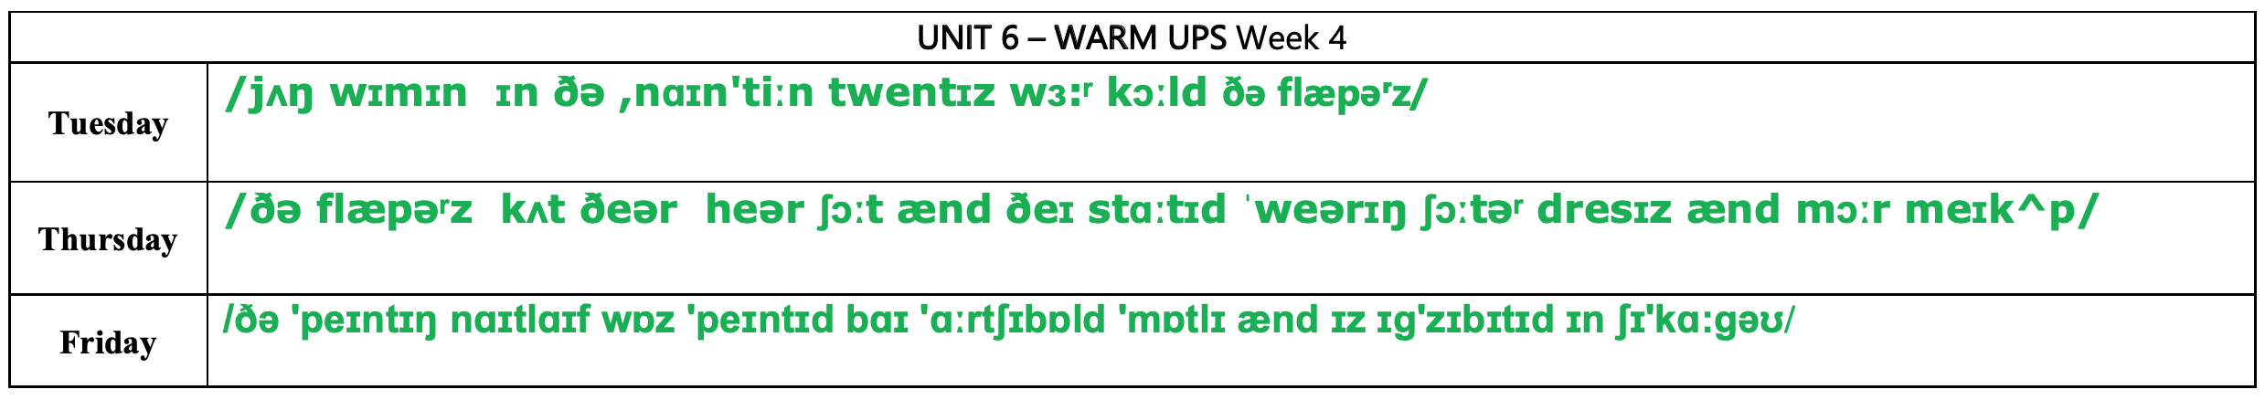

Slide 2
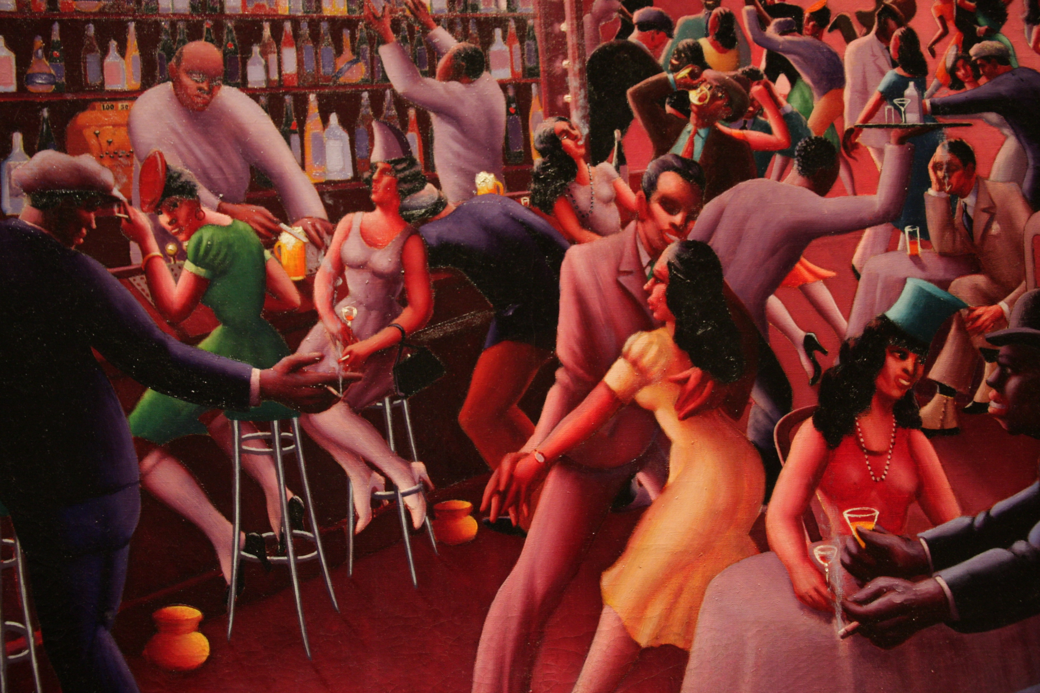
Today’s menu
Guess: what was the Harlem Renaissance?
Watch a video and select information
Exchange information
Be able to 👂listen and ✅ understand information in a video.

Slide 3
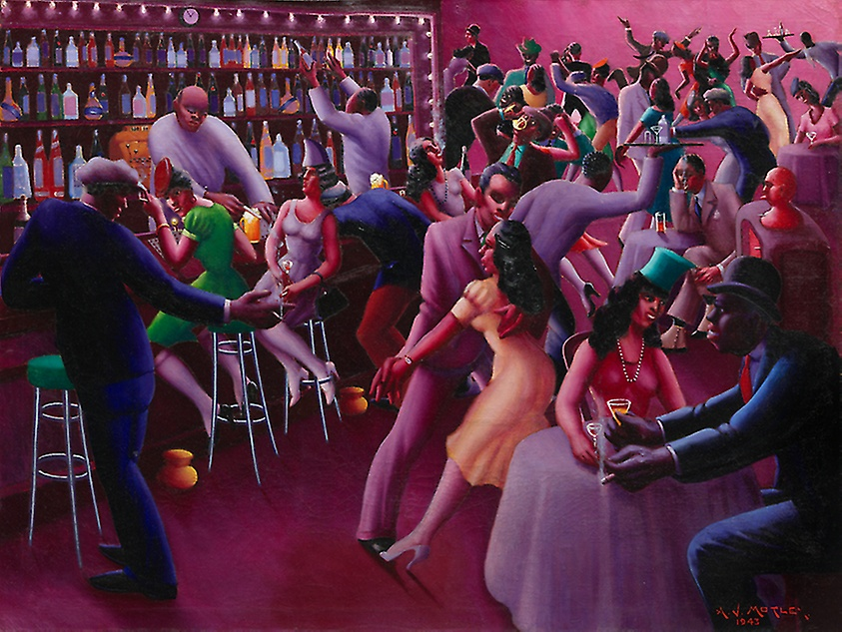

Slide 4
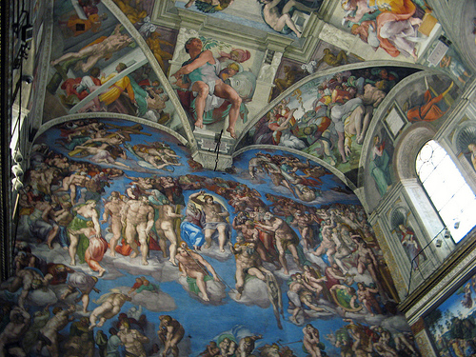
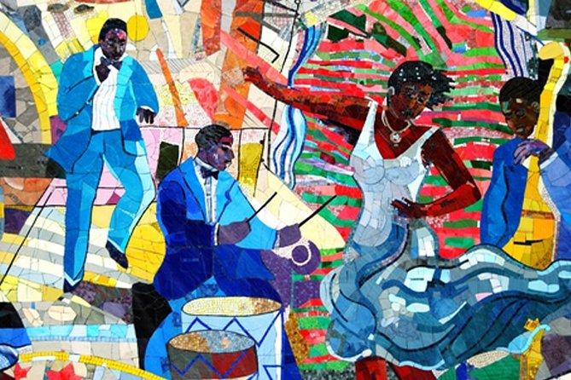
The Renaissance: the period of new development of interest and activity in the areas of art, literature, and ideas in Europe during the 15th and 16th centuries.
The Harlem Renaissance:

Slide 5
1. Watch your part of the video and take notes of everything your understand.
Part 1 0’00 to 0’50 | Part 2 0’50 to 1’19 | Part 3 1’20 to 2’06
Characteristics of Harlem Why Harlem? | Music and musicians | The impacts of the Harlem Renaissance
Lilou Gaspard Léanne Jules Célya Séréna Quentin Yann Coline Kolya | Elouan Louisa Lucie Albane Téo Alexis Noé Loan Théa | Terry Lucas Emma Mairon Gabrielle Maelle Noa Alicia Manishpal Lohan T
2. Use your notes to complete your worksheet.
3. Prepare questions for the missing elements of the worksheet.
4. Exchange information and complete the worksheet.

Slide 6
1. Watch your part of the video and take notes of everything your understand.
Part 1 0’00 to 0’50 | Part 2 0’50 to 1’19 | Part 3 1’20 to 2’06
Characteristics of Harlem Why Harlem? | Music and musicians | The impacts of the Harlem Renaissance
Léa B Hana Maxence Léa E. Axel Kévin Sarah Loic Capucine | Thibaud Emilien Baptiste Myrtille Loïne Mariella Mathis Barre Sonia Aaron | Kailyah Zoé Anouk Alix Léonie Lucas Théo Mathis Bouillard Evan
2. Use your notes to complete your worksheet.
3. Prepare questions for the missing elements of the worksheet.
4. Exchange information and complete the worksheet.

Slide 7
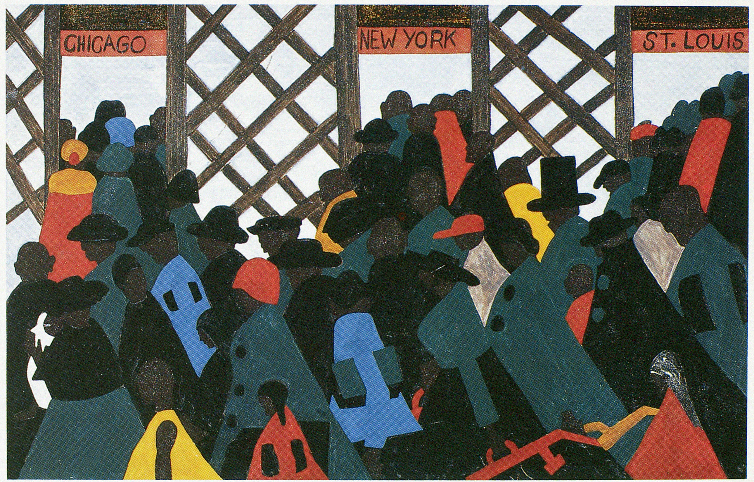
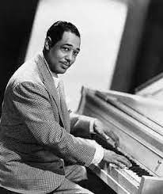
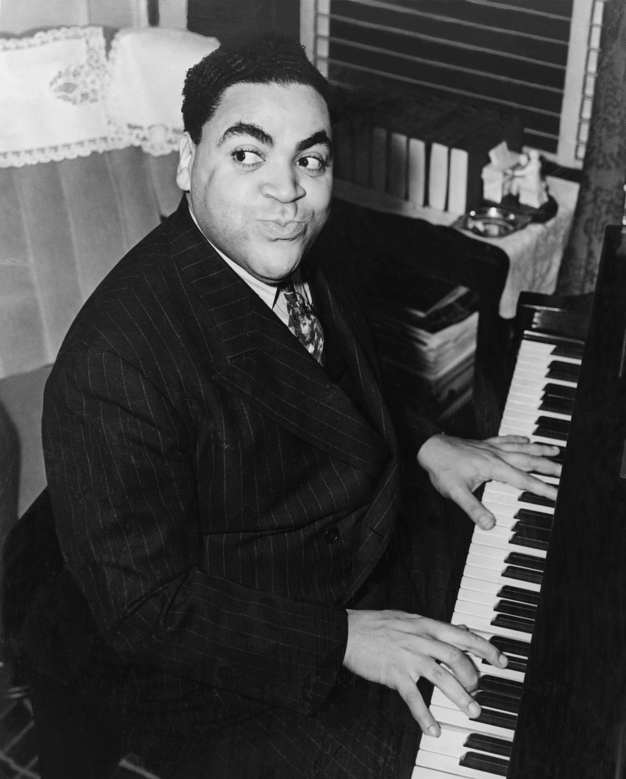
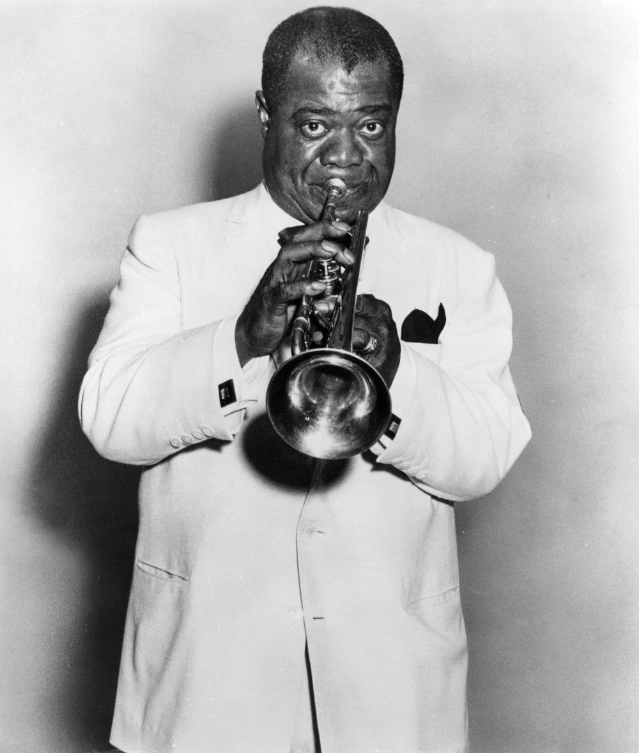
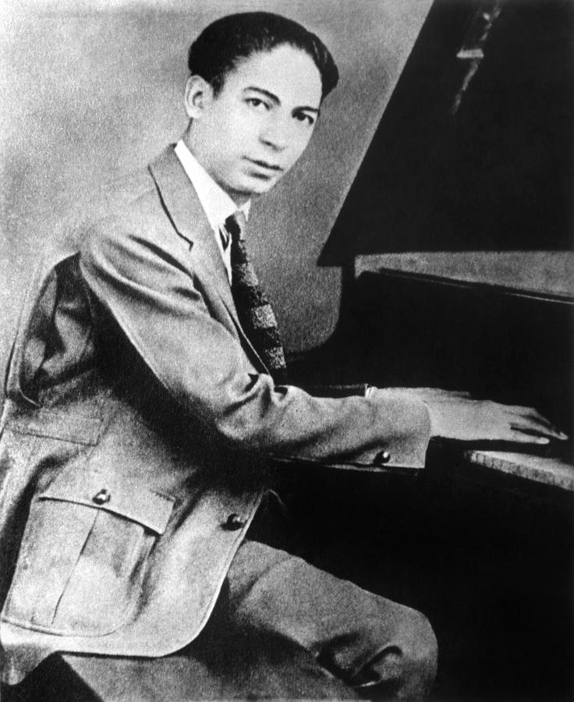
Throughout the 19_ _s, Harlem experienced a c_ _ _ _ _ _ _ and i _ _ _ _ _ _ _ _ _ _ _ explosion that became known as the H_ _ _ _ _ R_ _ _ _ _ _ _ _ _ _.
Characteristics of Harlem Why Harlem? | Music and musicians | The impacts of the Harlem Renaissance
Where? .......................................................... Who? (communities) ..................................... African-American people migrated to Harlem in (time period) .................... Harlem became famous as ................................ Types of professionals involved in movement: - - - - - | (type of music) ...................... became very famous and (type of audience) ............................. listened to it. New instrument: ............................... Traditional instruments: ............................................................... | Where? ......................... and ..................... African American a_ _ _ _ _ _, m_ _ _ _ _ _ _ _, and w_ _ _ _ _ _ began to be respected on an international level. Changes in music practices: - - The world’s perception of African-Americans: before 1920: ......................................... ................................................................... after 1920: ......................................... ...................................................................
1
2
3
4

Slide 8
Throughout the 1920s, Harlem experienced a cultural and intellectual explosion that became known as the HARLEM RENAISSANCE.
Characteristics of Harlem Why Harlem? | Music and musicians | The impacts of the Harlem Renaissance
Where? .Harlem is a neighbourhood of Manhattant, NYC, USA Who? (communities) .Many African Americans live in Harlem. African-American people migrated to Harlem in (time period) the 1900s. Harlem became famous as African American cultural centre. Types of professionals involved in movement: - Musicians - artists - writers - philosophers - poets | (type of music) ...Jazz... became very famous and (type of audience) ....white people.. listened to it. New instrument: ....the piano was introduced to the Jazz bands Traditional instruments: .Jazz was played with brass instruments | Where? .The Harlem Renaissance large impacts ...in the USA..... and .around the world...... African American artists_, musicians, and writers began to be respected on an international level. Changes in music practices: - White musicians integrated jazz rythms into their music. - White people listened and enjoyed jazz The world’s perception of African-Americans: before 1920: They were considered as uneducated farmers. after 1920: the world considered African Americans as sophisticated and intellection people.
1
2
Duke Ellington
Fats Waller
3
4
Louis Armstrong
Jelly Roll Morton

Slide 9
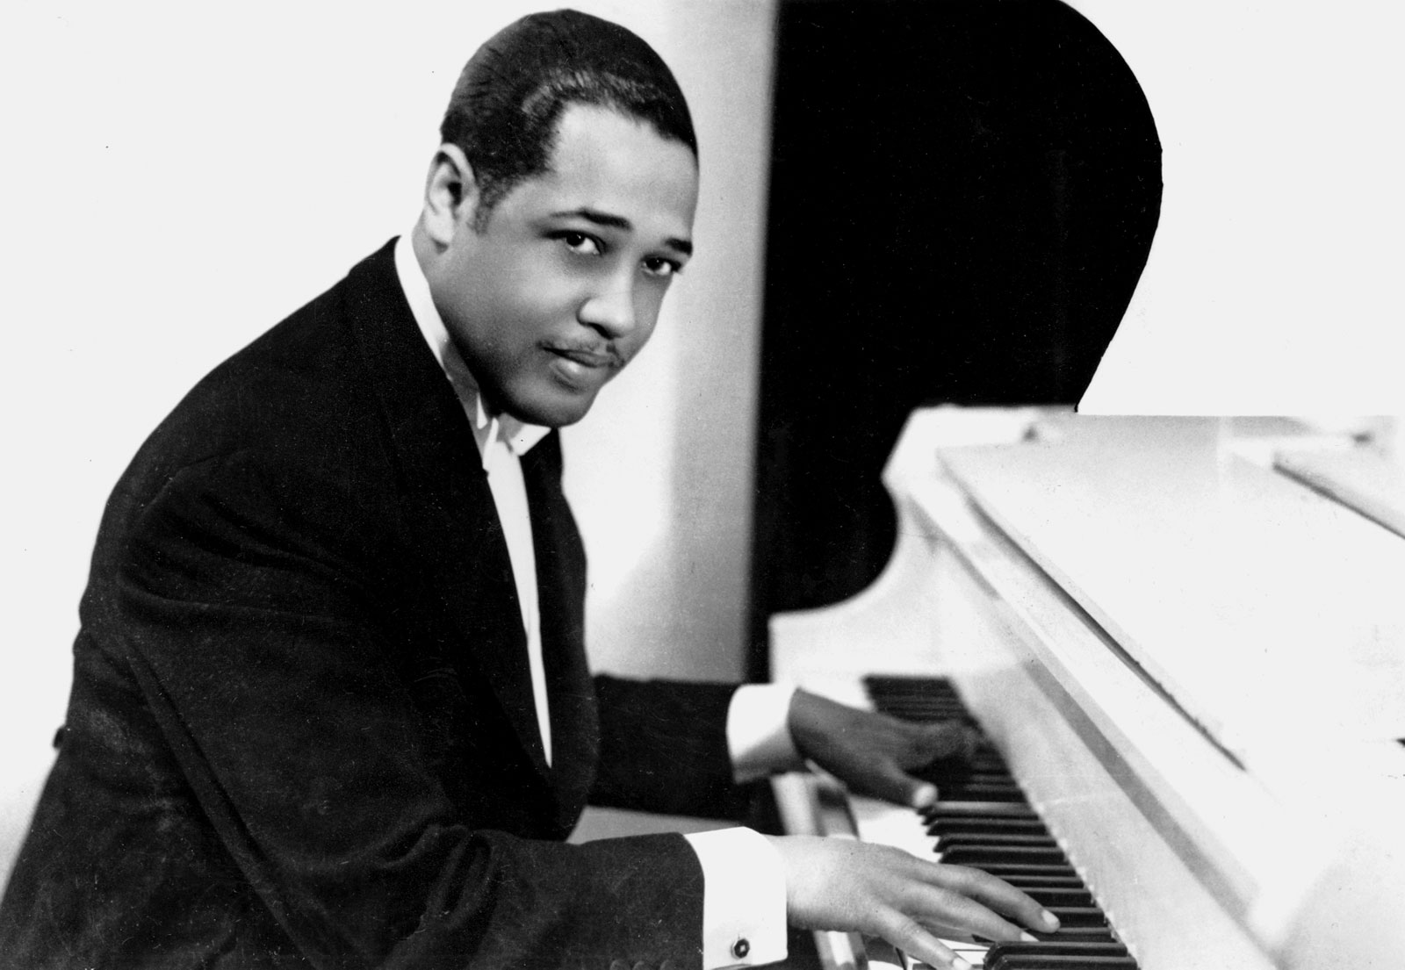
Observe the pictures and identify clues.
What types of artists were there in Harlem in the 1920s and 30s?
Picture #d | EXAMPLE
Person’s description (clothes, attitude…) | A man is wearing a blacksuit. He is sitting and he is playing the playing.
Objects I can see | We can see a piano.
My conclusion | He must be pianist.
d
MIGHT
MAY
MUST
COULD
Ces modaux expriment la probabilité.
MIGHT + BV ➔ le moins certain, MUST+BV ➔ le plus certain.

Slide 10
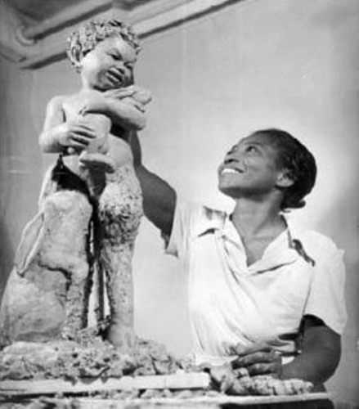
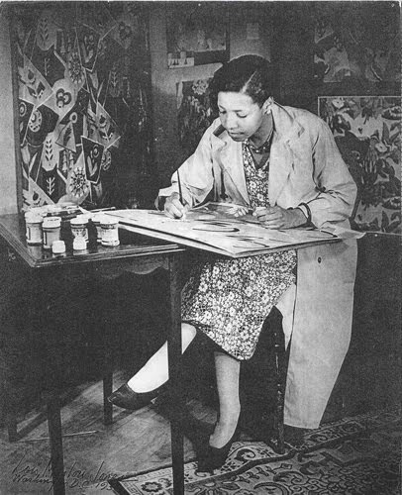
Types of artists in the 1920s and 1930s in Harlem
Picture #....
Person’s description (clothes, attitude…)
Objects I can see
My conclusion
Picture #....
Person’s description (clothes, attitude…)
Objects I can see
My conclusion
a
b
Picture #....
Person’s description (clothes, attitude…)
Objects I can see
My conclusion
c

