Slide 1

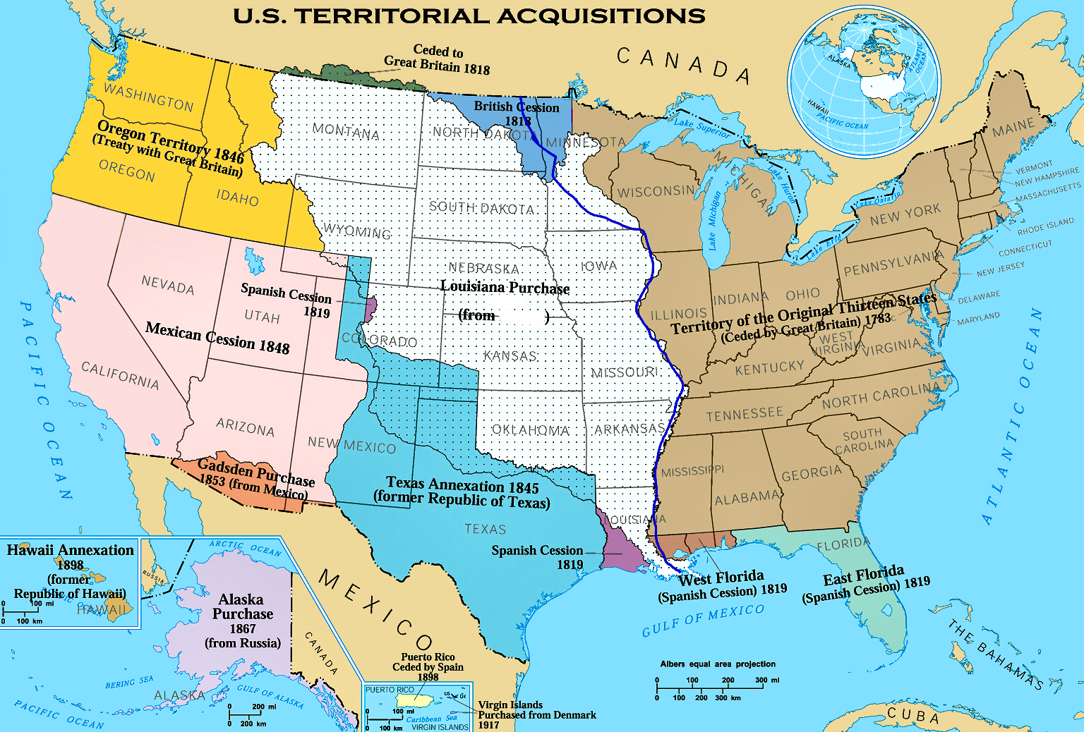
The Louisiana Purchase
https://ladigitale.dev/digiview/#/v/68a721ae9fb5c
Watch and complete the map (boxes on the map + table)
Share with your groupmates and complete missing information
Get ready to explain the Louisiana Purchase (What? Where? When? Why? How? )
Date | Country that owned Louisiana territory
1718
1762
1802
1803
Reason for purchasing Louisiana Territory
(country) from _ _ _ _ _ _
(date)_ _ _ _

Slide 2
The Louisiana Purchase
https://ladigitale.dev/digiview/#/v/68a721ae9fb5c
Explain the Louisiana Purchase (What? Where? When? Why? Who? How? ):
The Louisiana Purchase was the 1803 land deal in which the United States acquired a huge territory from France, effectively doubling the size of the nation. It's considered one of the most significant events in U.S. history. President Jefferson sent two men to negotiate with the French to acquire NOLA or to obtain access to the Mississippi river port for $10 million. The French were not in a favourable position in America, so they offered the US a deal: $15 million dollar for the entire Louisiana Territory.
Date | Country that owned Louisiana territory
1718 | France
1762 | Spain
1802 | France
1803 | The USA
Reason for purchasing Louisiana Territory
NOLA was a good trading location as it was at the end of Mississippi river
(country) from FRANCE
1803
New Orleans

