Slide 1
NUMBERS
HOW TO COUNT FROM 1 TO 99

Slide 2
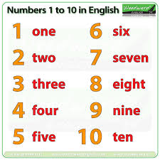
From 1 to 12
11
eleven
12
twelve

Slide 3
13 thir
14 four
15 fif
teen
16 six
17 seven
19 nine
18 eight
From 13 to 19

Slide 4
-one 21
-two 22
-three 23
twenty
20
-four 24
-five 25
-six 26
-seven 27
-eight 28
-nine 29
Family 20

Slide 5
-one 31
-two 32
-three 33
thirty 30
-four 34
-five 35
-six 36
-seven 37
-eight 38
-nine 39
Family 30

Slide 6
-one 41
-two 42
-three 43
fourty 40
-four 44
-five 45
-six 46
-seven 47
-eight 48
-nine 49
Family 40

Slide 7
-one 51
-two 52
-three 53
-four 54
fifty 50
-five 55
-six 56
-seven 57
-eight 58
-nine 59
Family 50

Slide 8
-one 61
-two 62
-three 63
-four 64
sixty 60
-five 65
-six 66
-seven 67
-eight 68
-nine 69
Family 60

Slide 9
-one 71
-two 72
-three 73
seventy 70
-four 74
-five 75
-six 76
-seven 77
-eight 78
-nine 79
Family 70

Slide 10
-one 81
-two 82
-three 83
eighty 80
-four 84
-five 85
-six 86
-seven 87
-eight 88
-nine 89
Family 80

Slide 11
-one 91
-two 92
-three 93
ninety 90
-four 94
-five 95
-six 96
-seven 97
-eight 98
-nine 99
Family 90

