Slide 1

Séance 8

Slide 2


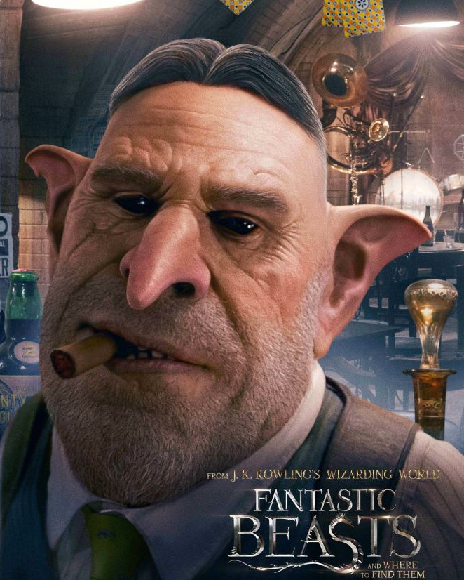

COMPARE THE CHARACTERS
NEWT
PORPENTINA
GNARLAK
QUEENIE
29 years old 28 years old 56 years old 25 years old
Who
is older than Porpentina ?
Newt is older than Porpentina.
Gnarlak is older than Porpentina.

Slide 3
COMPARE THE CHARACTERS
NEWT
PORPENTINA
GNARLAK
QUEENIE
29 years old 28 years old 56 years old 25 years old
Who
is younger than Newt ?
Porpentina is younger than Newt.
Queenie is younger than Newt.

Slide 4
COMPARE THE CHARACTERS
NEWT
PORPENTINA
GNARLAK
QUEENIE
1m 90 1m 70 1m 32 1m 76
Who
is taller than Porpentina ?
Newt is taller than Porpentina.
Queenie is taller than Porpentina.

Slide 5
COMPARE THE CHARACTERS
NEWT
PORPENTINA
GNARLAK
QUEENIE
1m 90 1m 70 1m 32 1m 76
Who
is smaller than Queenie ?
Porpentina is smaller than Queenie.
Gnarlak is smaller than Queenie.

Slide 6

COMPARE THE CHARACTERS
NEWT
PORPENTINA
GNARLAK
QUEENIE
Who
is nicer than Porpentina ?
Newt is nicer than Porpentina.
Queenie is nicer than Porpentina.

Slide 7

COMPARE THE CHARACTERS
NEWT
PORPENTINA
GNARLAK
QUEENIE
Who
is grumpier than Newt ?
Porpentina is grumpier than Newt.
Gnarlak is grumpier than Newt.

Slide 8

COMPARE THE CHARACTERS
NEWT
PORPENTINA
GNARLAK
QUEENIE
Who
is more courageous than Gnarlak ?
Newt is more courageous than Gnarlak.
Queenie is more courageous than Gnarlak.

Slide 9
COMPARE THE CHARACTERS
NEWT
PORPENTINA
GNARLAK
QUEENIE
Who
is more optimistic than Porpentina ?
Newt is more optimistic than Porpentina.
Queenie is more optimistic than Porpentina.

Slide 10
COMPARE THE CHARACTERS
NEWT
PORPENTINA
GNARLAK
QUEENIE
Who
is more impatient than Queenie ?
Porpentina is more impatient than Queenie.
Gnarlak is more impatient than Queenie.

Slide 11
RECAP!
OLD / YOUNG
29 28 56 25
TALL / SMALL
1m 90 1m 70 1m 32 1m 76
NICE
GRUMPY
COURAGEOUS
OPTIMISTIC
IMPATIENT

