Slide 1
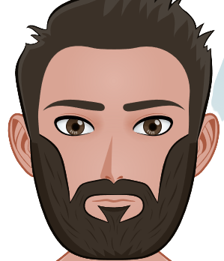
WHAT
DO I LOOK
LIKE
?

Slide 2

QUESTION 1
I have
blue eyes
brown eyes
green eyes

Slide 3

QUESTION 1
I have
blue eyes
brown eyes
green eyes

Slide 4
QUESTION 2
I have
long, straight hair
short, curly hair
short, straight hair

Slide 5
QUESTION 2
I have
long, straight hair
long, curly hair
short, straight hair

Slide 6
QUESTION 3
I have
a long grey beard
a short dark beard
a dark goatee

Slide 7
QUESTION 3
I have
a long grey beard
a short dark beard
a dark goatee

Slide 8
QUESTION 4
I don't have
brown hair
freckles
white teeth

Slide 9
QUESTION 4
I don't have
brown hair
freckles
white teeth

Slide 10

QUESTION 5
I am
short
of medium height
tall

Slide 11
QUESTION 5
I am
short
of medium height
tall

Slide 12
QUESTION 6
I have
thin dark eyebrows
thick dark eyebrows
bushy red eyebrows

Slide 13
QUESTION 6
I have
thin dark eyebrows
thick dark eyebrows
bushy red eyebrows

Slide 14
QUESTION 7
I am
chubby
slim
thin

Slide 15
QUESTION 7
I am
chubby
slim
thin

Slide 16
NOW
IT'S YOUR TURN !

Slide 17
I have
Yeux, cheveux,
visage
I am
Taille, corpulence

