Slide 1






Guessing Game
Superlative
Adjectives
PLAY

Slide 2
What is a superlative adjective?
Definition
A superlative adjective is a form of an adjective used to compare three or more things, showing which one has the highest degree of a particular quality. In English, superlative adjectives are typically formed by adding the suffix "-est" to the base form of the adjective or by using the word "most" before the adjective.

Slide 3
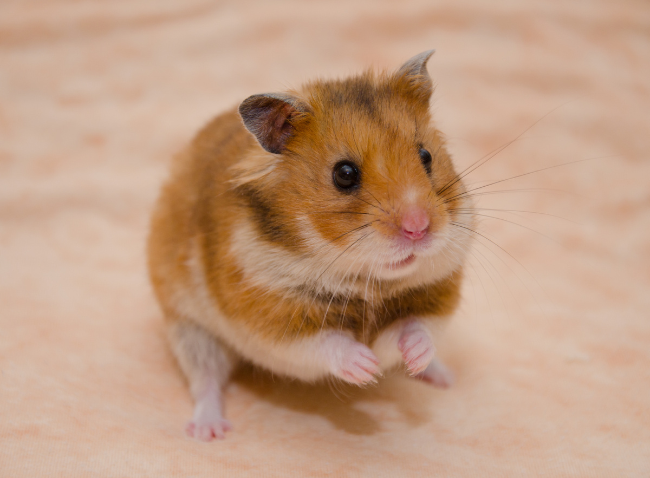

Examples
Suffix -est
  She is the tallest person in the classroom.
  That is the smallest hamster I have ever seen!
Most
  What is the most dangerous animal in the world?
  This is the most challenging puzzle.

Slide 4
Guessing Game
Are you ready to play?
START

Slide 5
Please read the following rules.
Game Rules
Each correct answer earns one point. The team that has the most points will win the game.
Read the questions and compare the pictures given.
Choose your answer by using the given superlative adjective in a sentence.

Slide 6

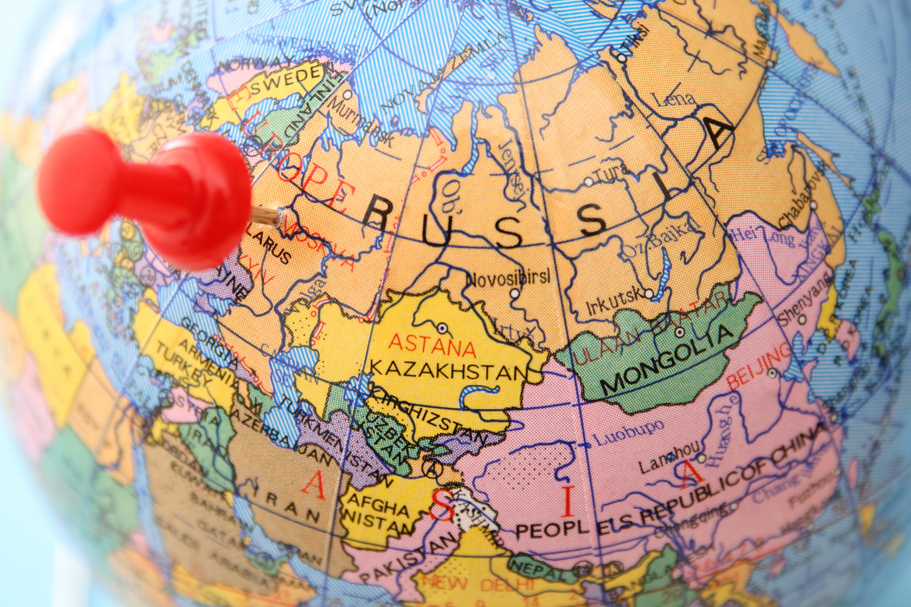

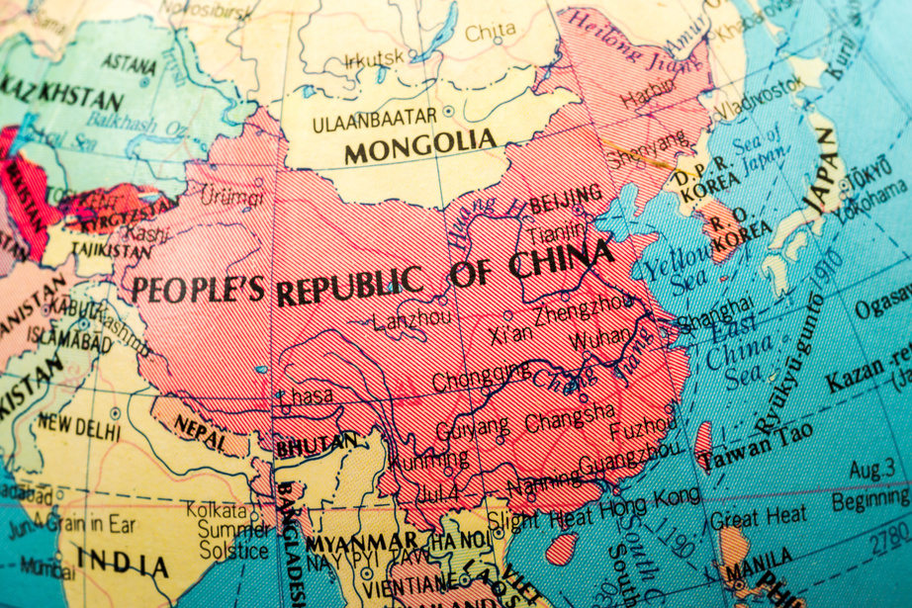
Which country is the largest in the world?
Russia
The U.S.A
China

Slide 7
Answer
Russia is the largest country in the world.

Slide 8
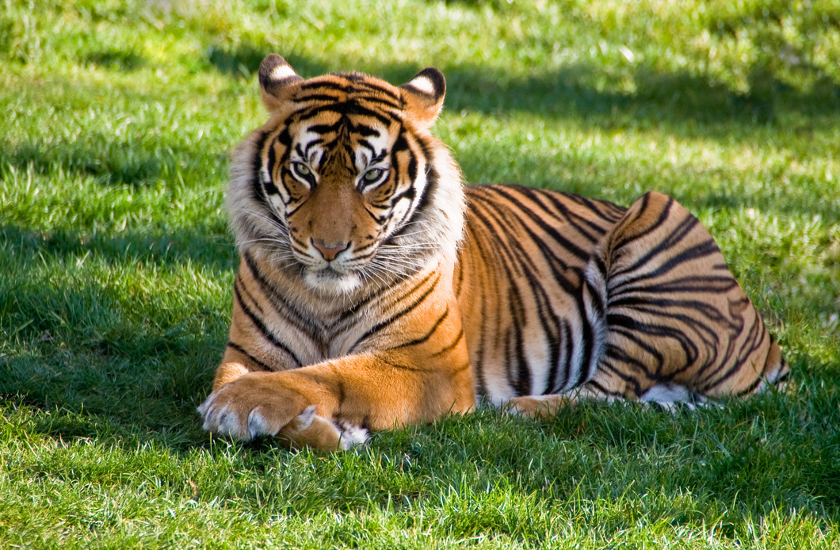
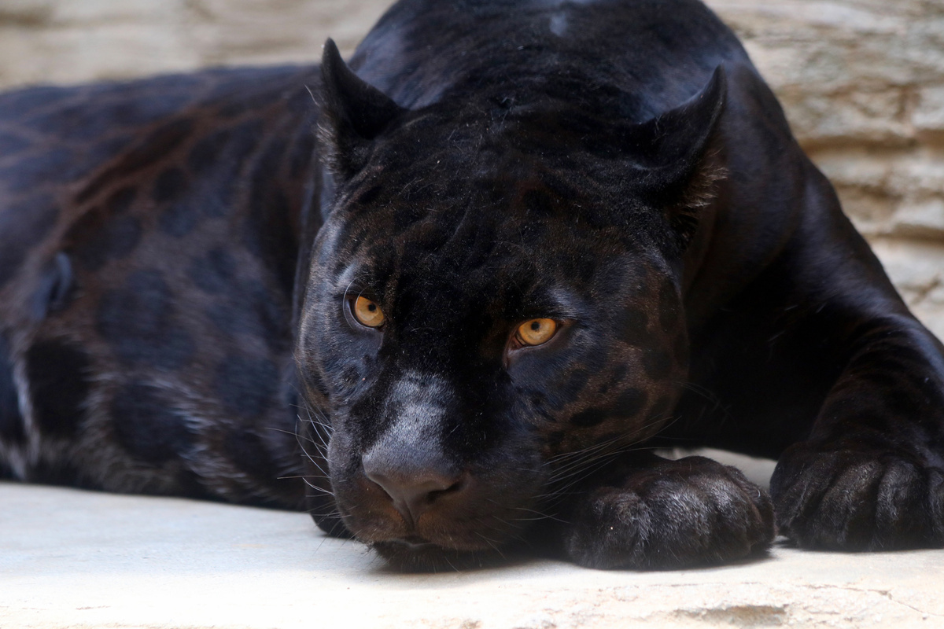
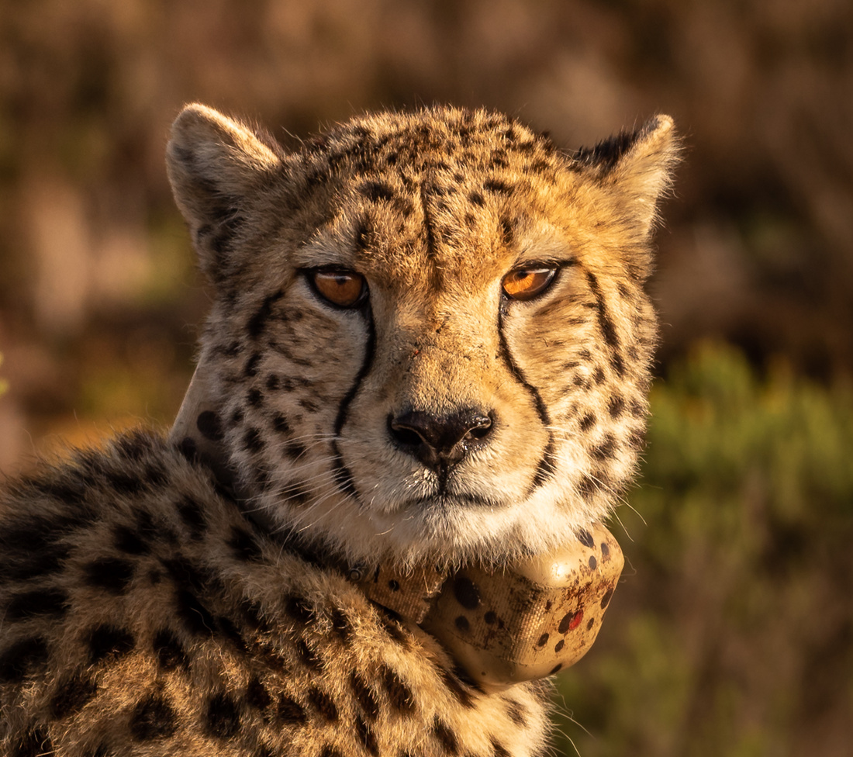
Which is the fastest land animal?
tiger
panther
cheetah

Slide 9
Answer
The cheetah is the fastest land animal.

Slide 10
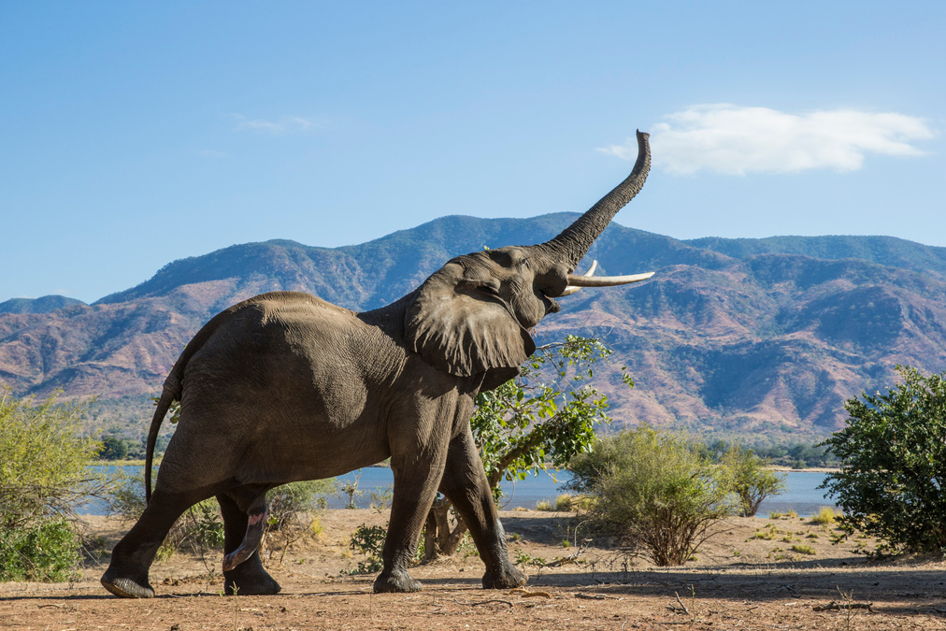
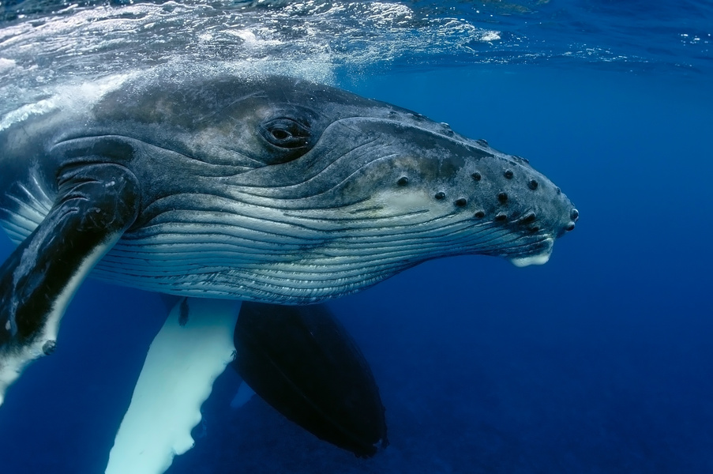
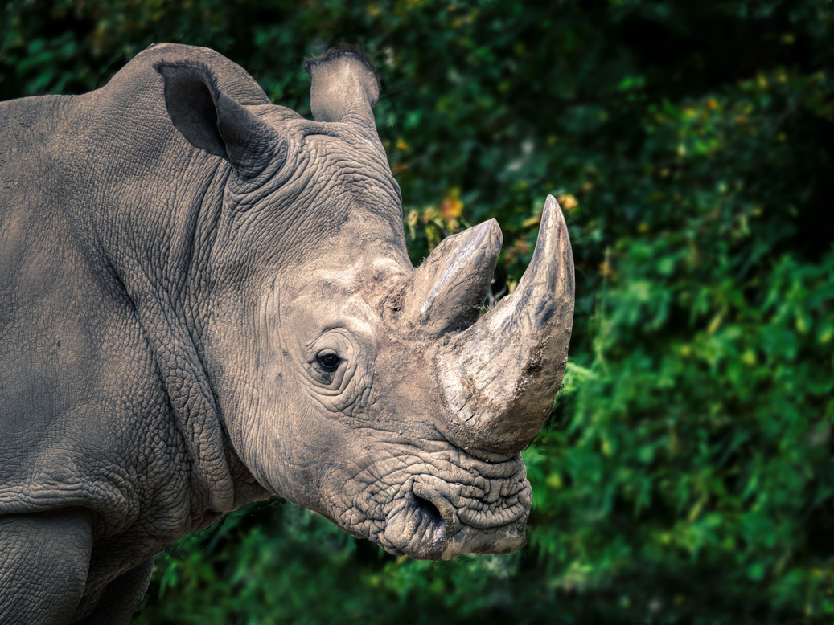
Which animal is the heaviest?
elephant
blue whale
rhinoceros

Slide 11
Answer
The blue whale is the heaviest.

Slide 12
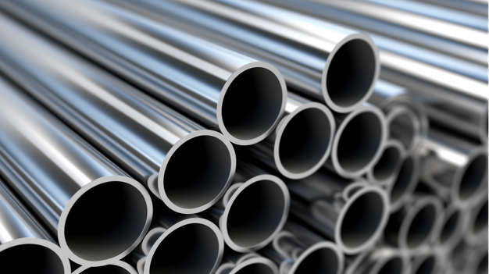
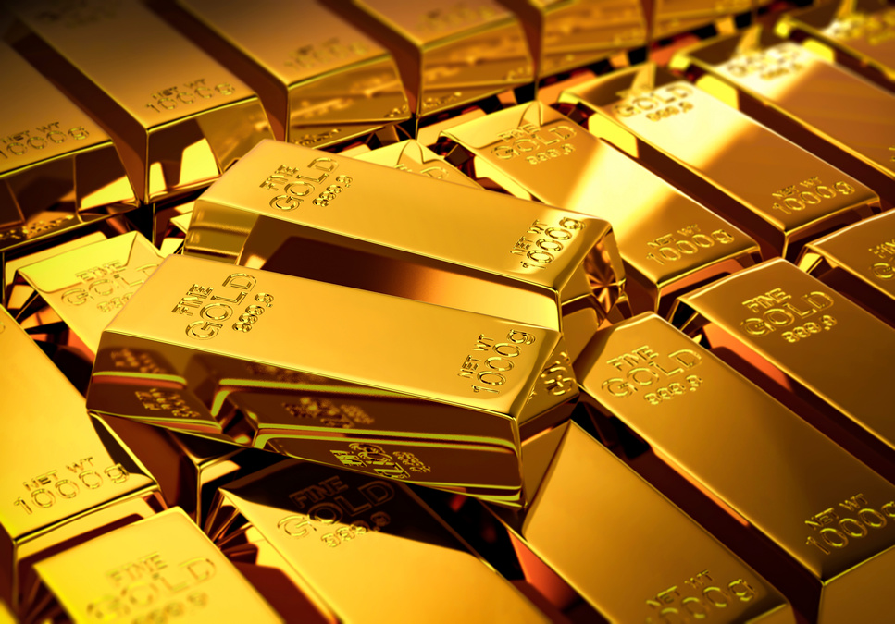
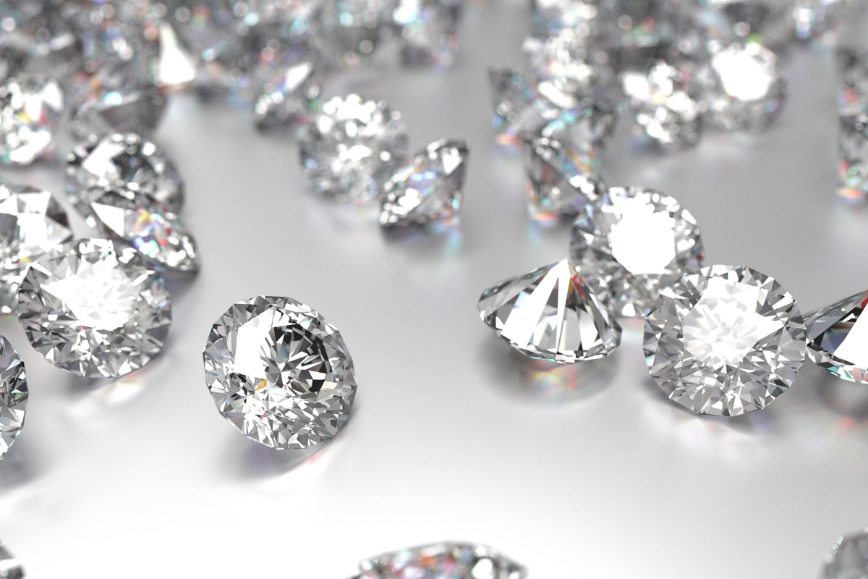
Which material is the hardest in the world?
steel
gold
diamond

Slide 13
Answer
The diamond is the hardest material in the world.

Slide 14
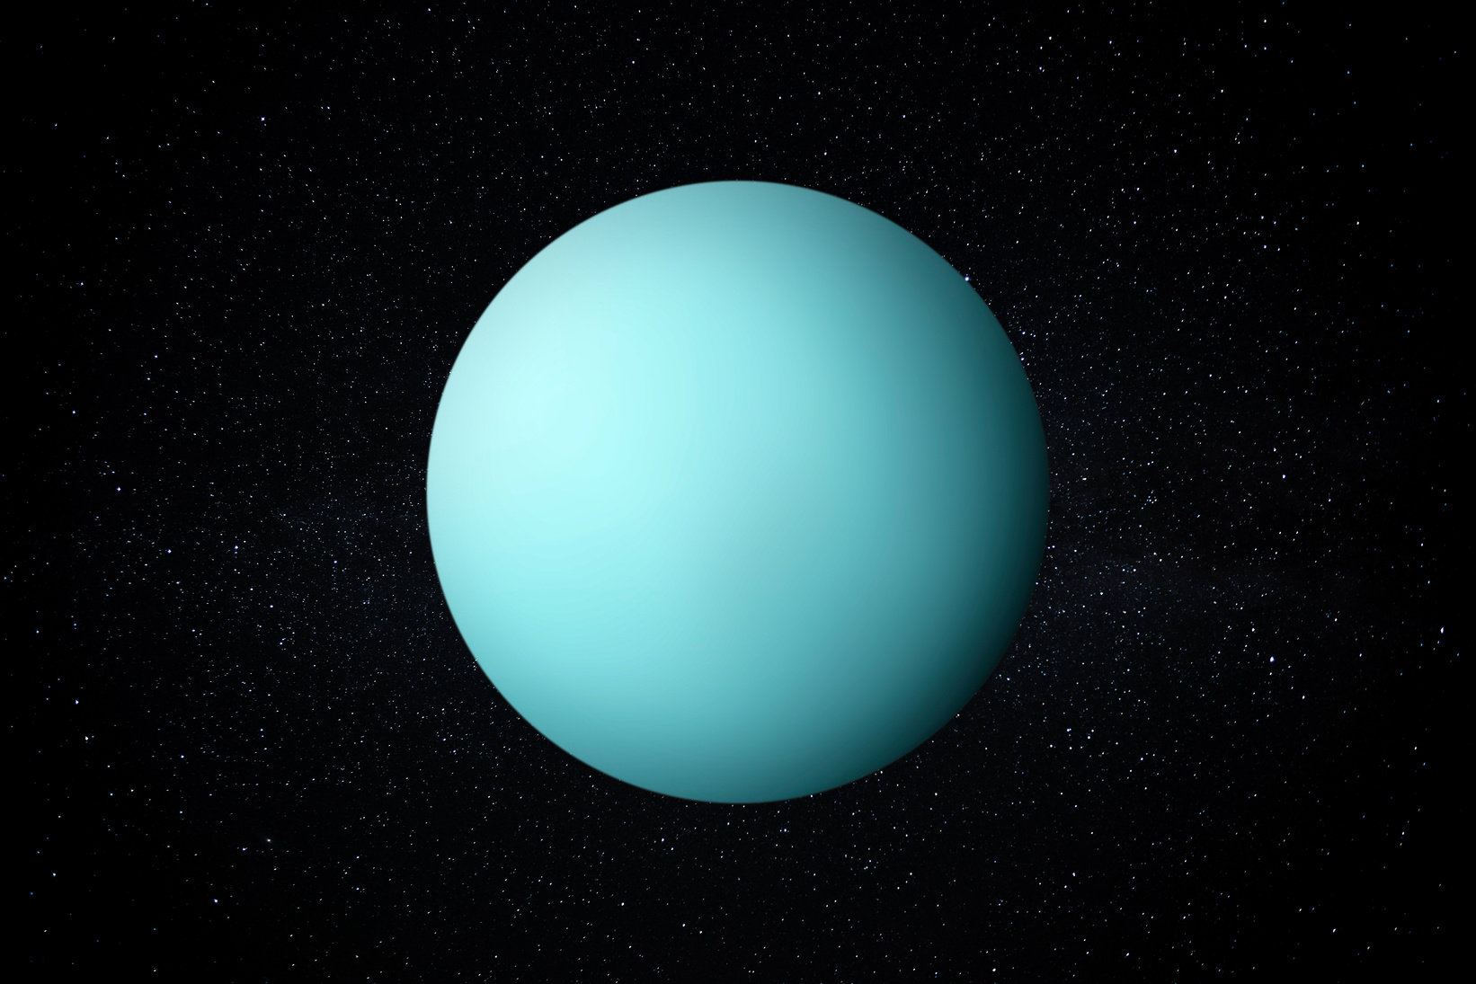
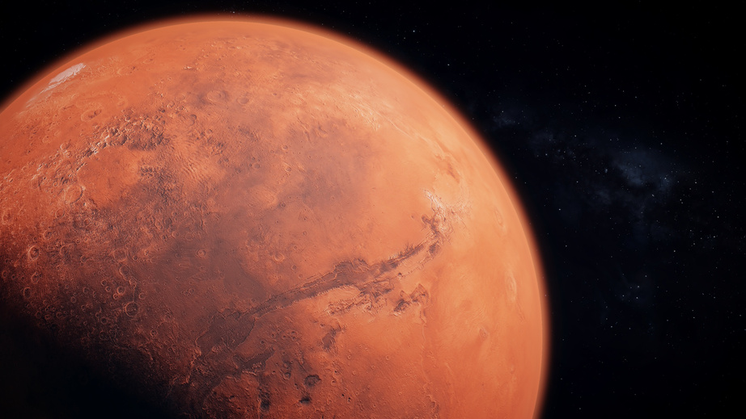
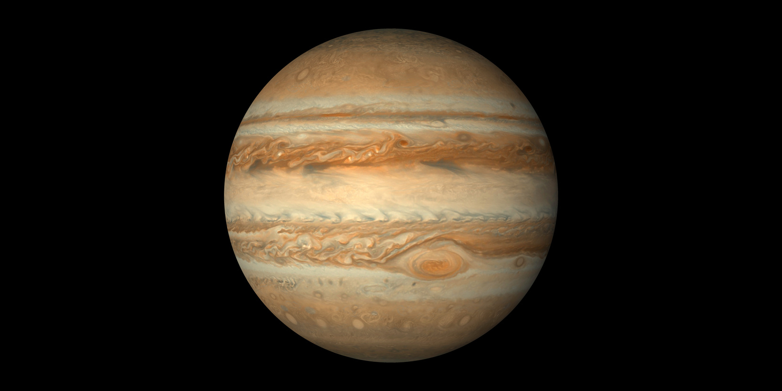
Which planet is the coldest in the solar system?
Uranus
Mars
Jupiter

Slide 15
Answer
The Uranus is the coldest planet in the solar system.

Slide 16
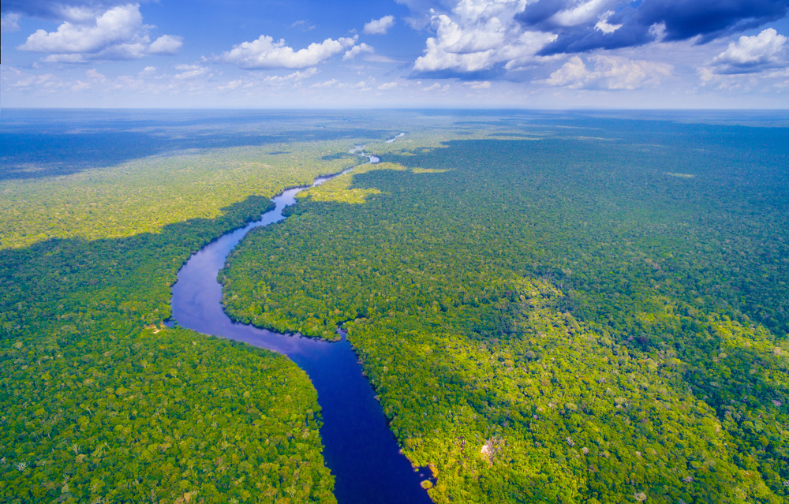
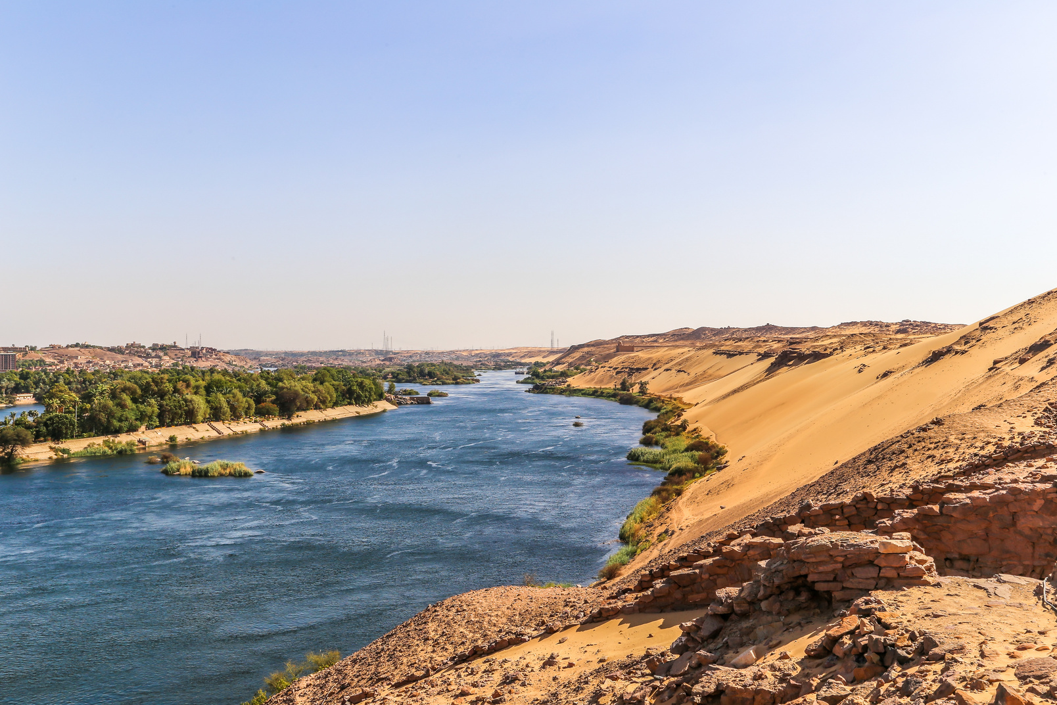
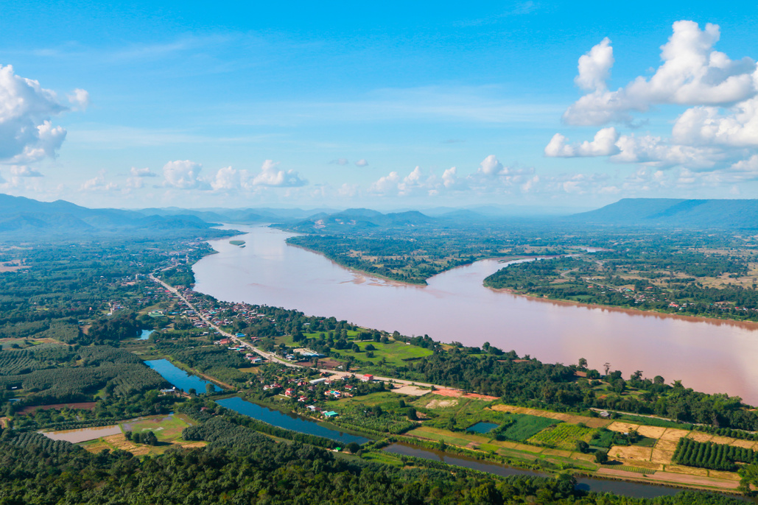
Which river is the longest?
Amazon River
Nile River
Mekong River

Slide 17
Answer
The Nile River is the longest.

Slide 18
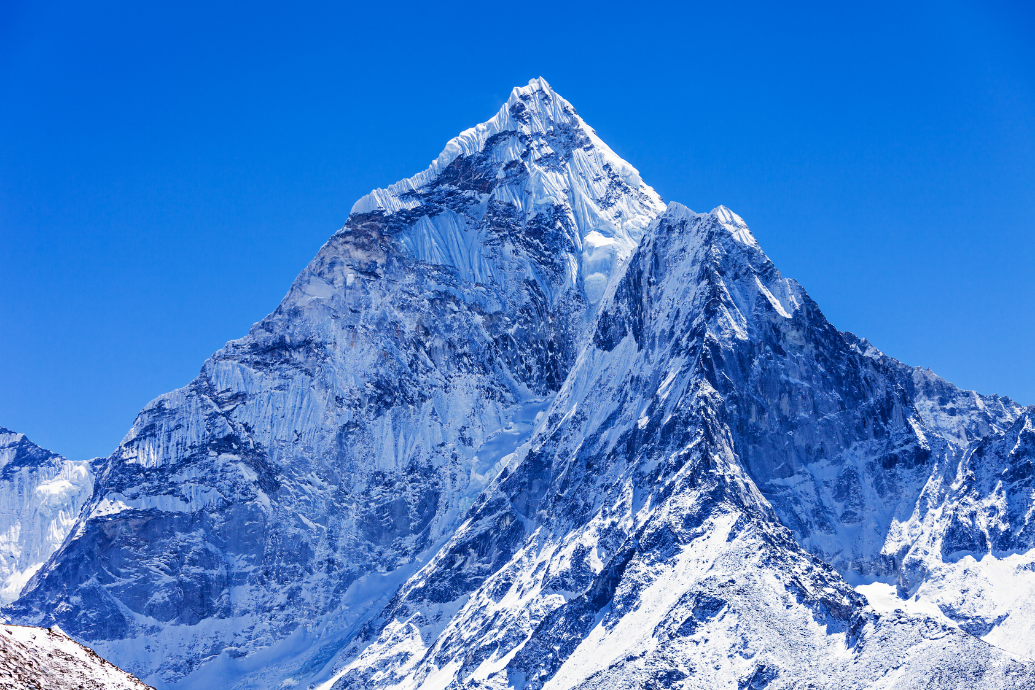
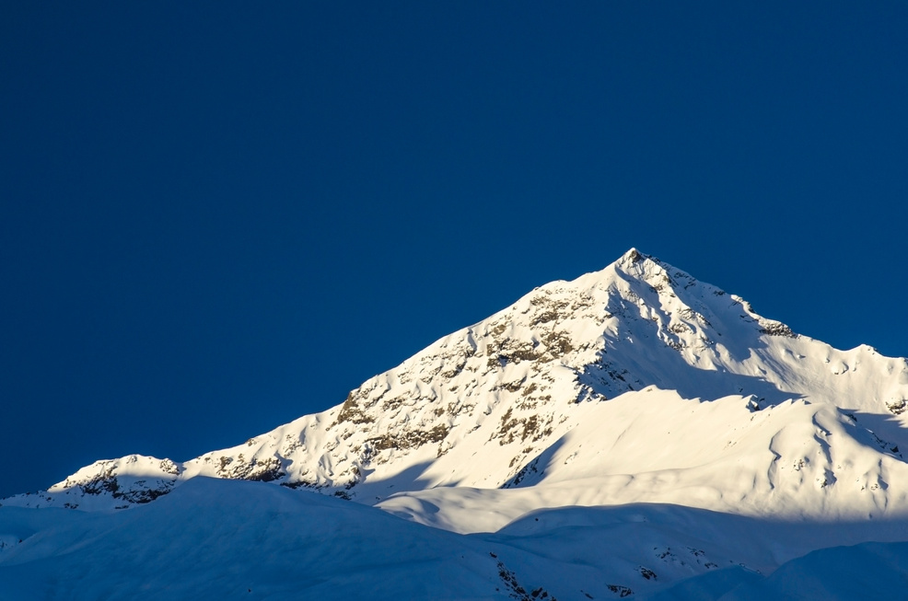
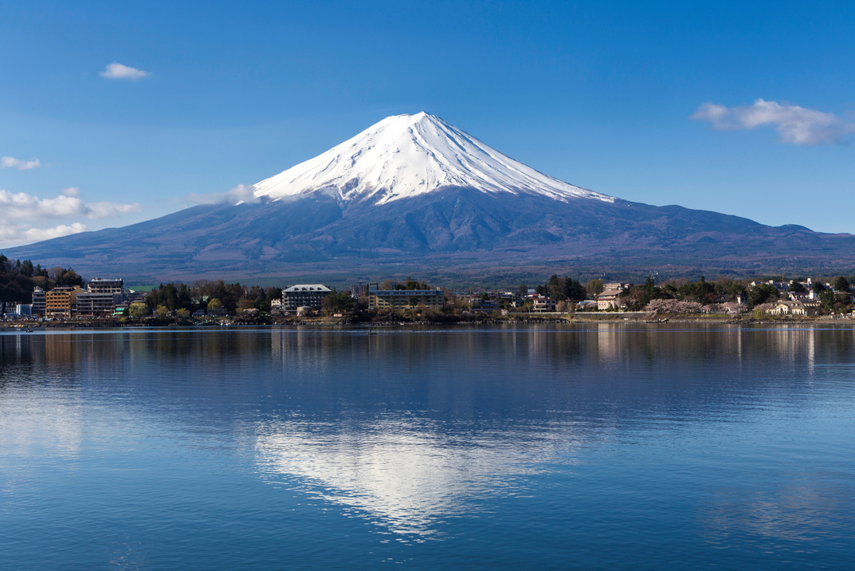
Which mountain is the highest?
Everest
Himalayas
Fuji

Slide 19
Answer
Mount Everest is the highest mountain.

Slide 20
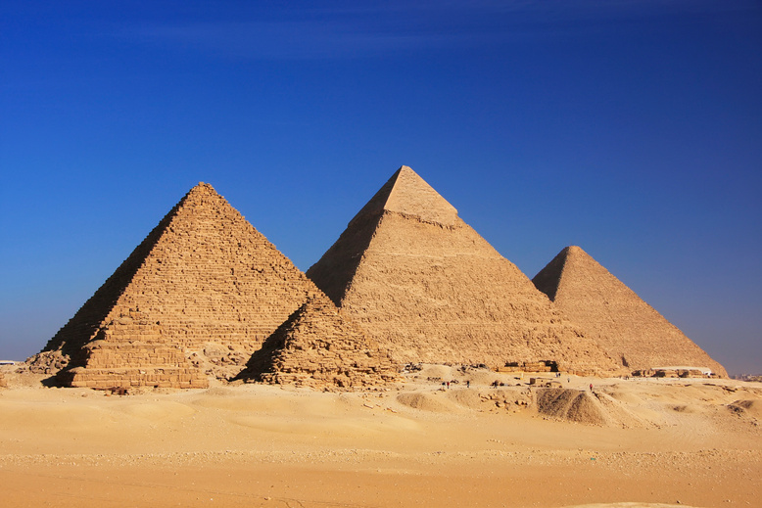
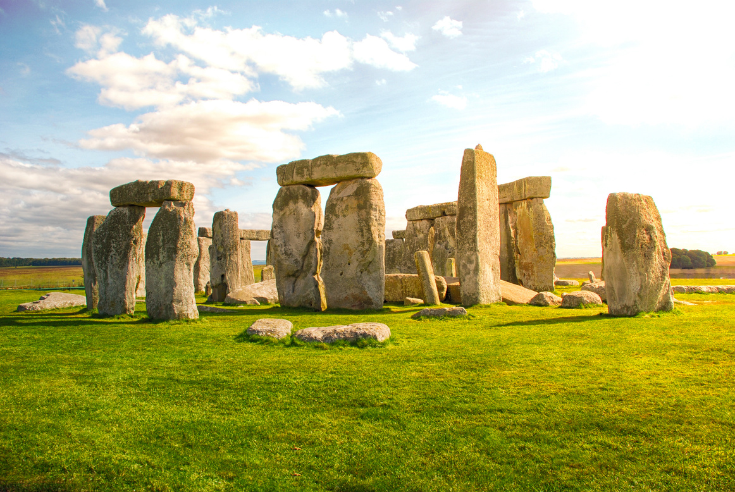
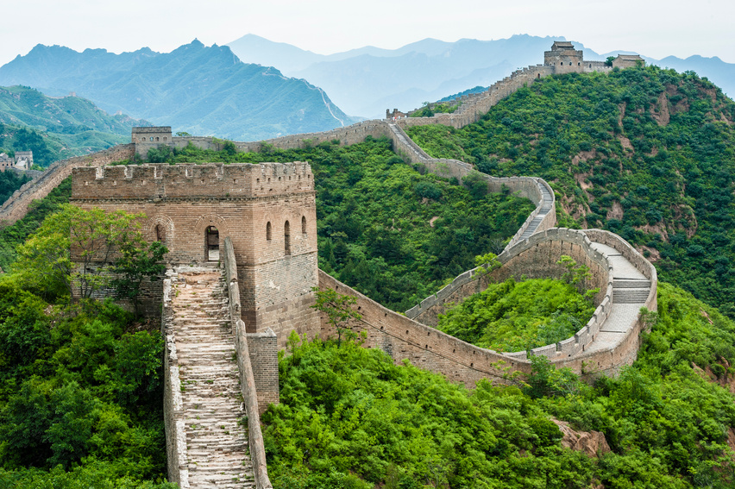
Which landmark is the oldest?
Pyramids of Giza
Stonehenge
Great Wall

Slide 21
Answer
Stonehenge is the oldest landmark.

Slide 22
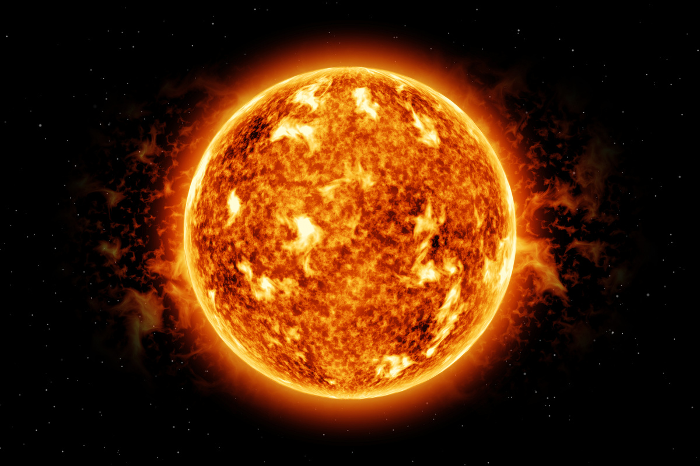
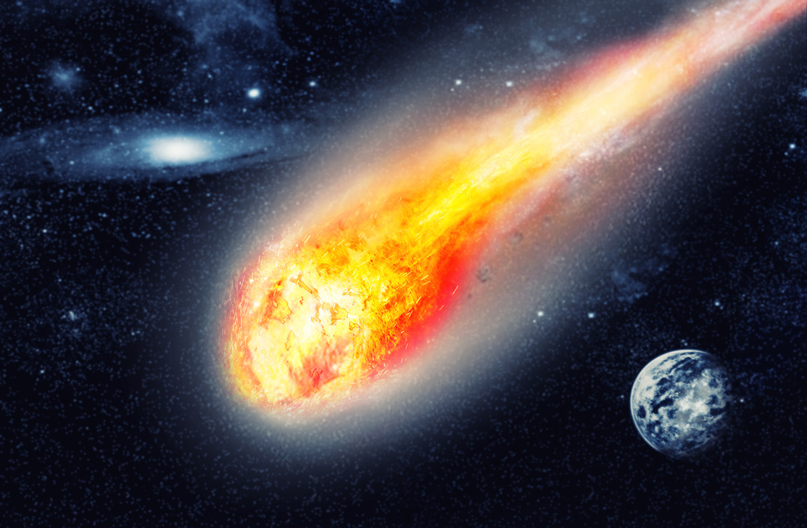
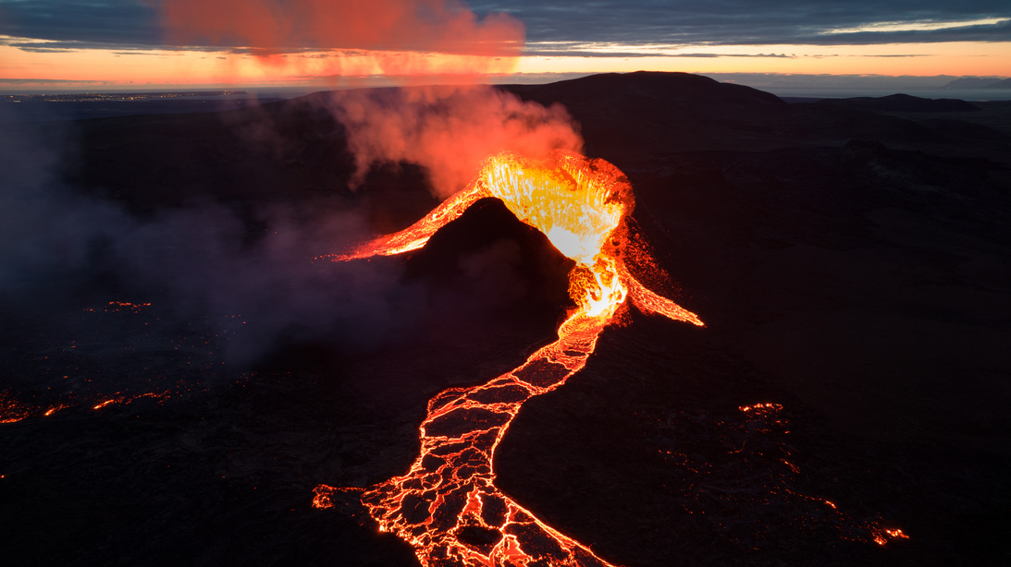
Which is the hottest?
The Sun
asteroid
lava

Slide 23
Answer
The Sun is the hottest.

Slide 24
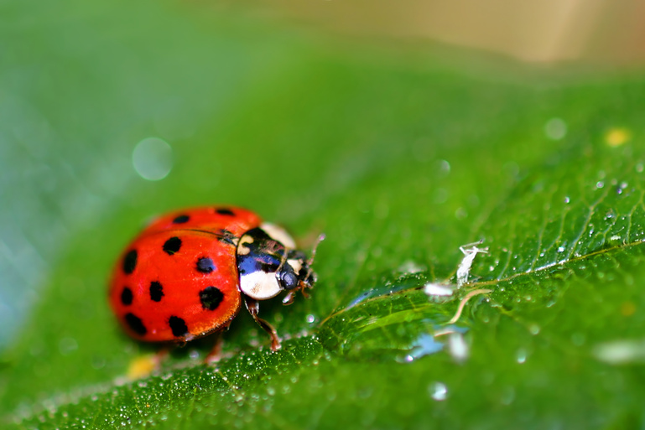
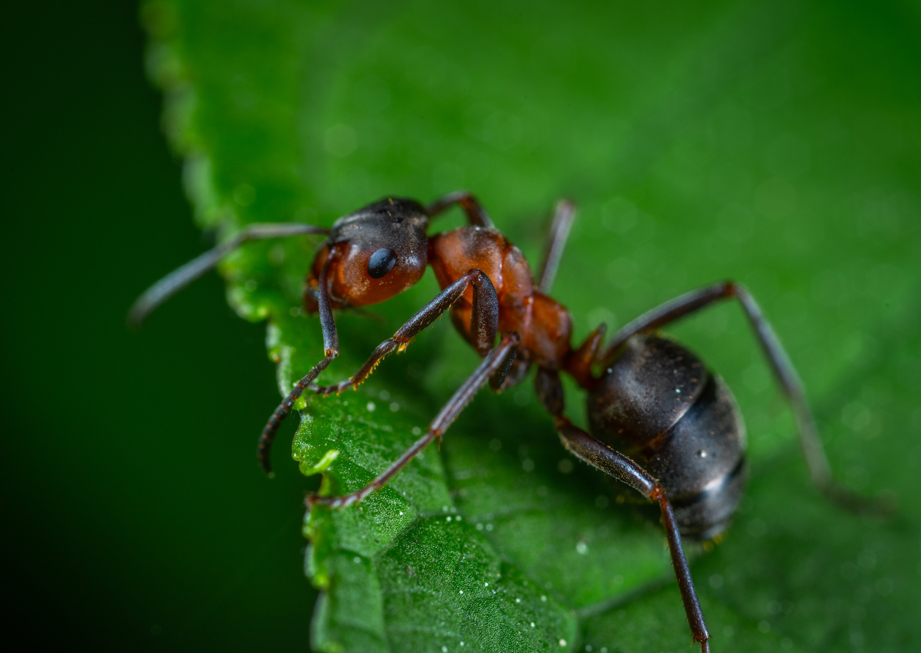
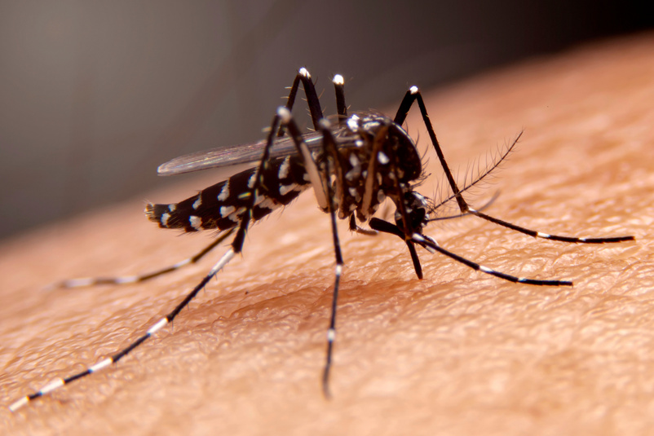
Which insect is the smallest?
ladybug
ant
mosquito

Slide 25
Answer
The ant is the smallest insect.

Slide 26
See you next time!
Thank you
for playing
PLAY

