Slide 1

Séance 11

Slide 2
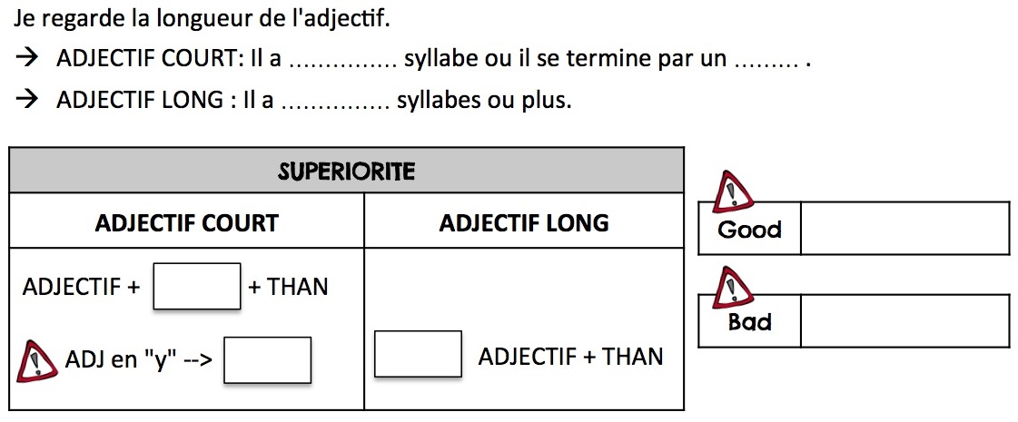
REMEMBER ?
LE COMPARATIF DE SUPÉRIORITÉ
une
Y
deux
BETTER
ER
WORSE
IER
MORE

Slide 3
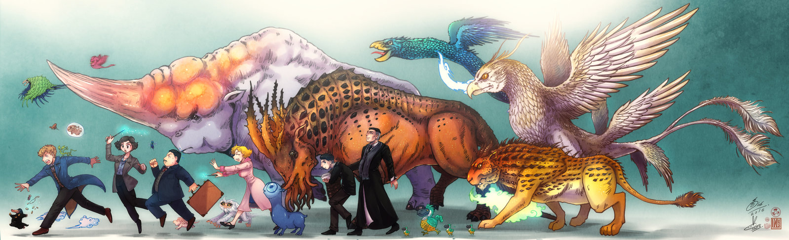
LET'S COMPARE THE BEASTS!

Slide 4
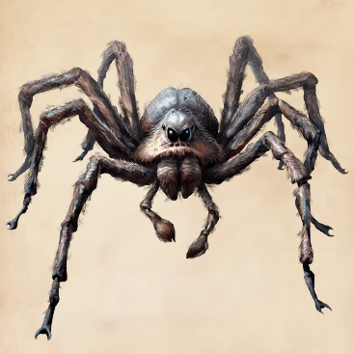
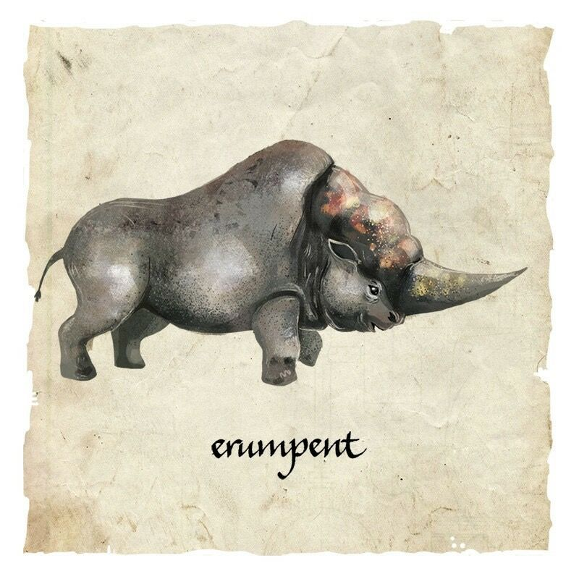
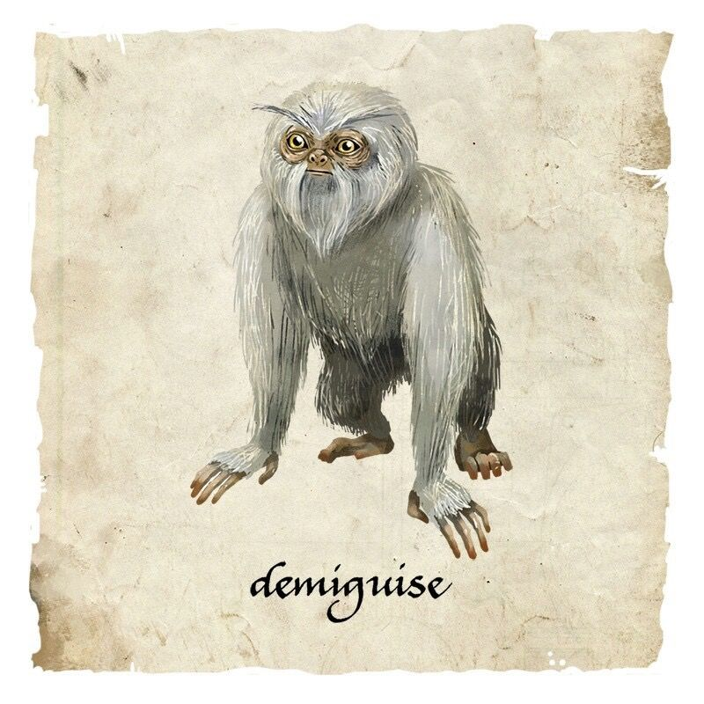

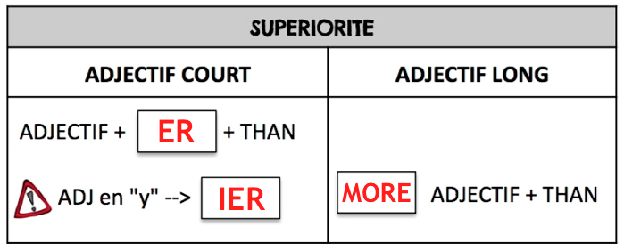
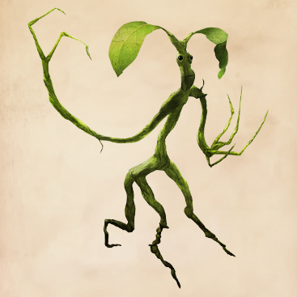
COMPARE THE BEASTS
ADJECTIVE: TALL
ACROMANTULA
ERUMPENT
DEMIGUISE
BOWTRUCKLE

Slide 5
COMPARE THE BEASTS
ADJECTIVE: SMALL
ACROMANTULA
ERUMPENT
DEMIGUISE
BOWTRUCKLE

Slide 6
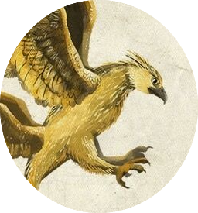
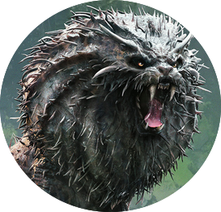
COMPARE THE BEASTS
ADJECTIVE: HEAVY
ERUMPENT
THUNDERBIRD
NUNDU
ACROMANTULA

Slide 7
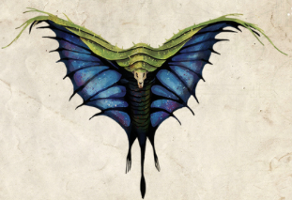
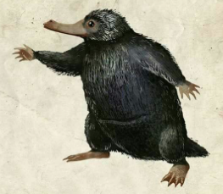
COMPARE THE BEASTS
ADJECTIVE: DANGEROUS
NUNDU
SWOOPING EVIL
NIFFLER
BOWTRUCKLE

Slide 8
COMPARE THE BEASTS
ADJECTIVE: AGGRESSIVE
NUNDU
THUNDERBIRD
DEMIGUISE
NIFFLER

Slide 9
WHAT IS YOUR OPINION ?
I THINK
I SUPPOSE
I GUESS
Acromantula
Nundu
Erumpent
Thunderbird
Niffler
Swooping Evil
Demiguise
Bowtruckle
CUTE
FRIENDLY
BEAUTIFUL
SCARY
SMART
POWERFUL

