Slide 2
№1
№2
№3
№4
№5
№6
№7
№8
№9
№10
№11
№12

Slide 3
№1
13 · 7 =
(10+3) · 7 =
9
1
13 · 5 =
(10+3) · 5 =
6
5
14 · 3 =
4
(10+4) · 3 =
2
19 · 4 =
(20–1) · 4 =
7
6
18 · 3 =
(20–2) · 3 =
5
4
27 · 3 =
(30–3) · 3 =
8
1
1
2
3
4
5
6
7
8
9
0

Slide 4
№2
12 · 7 =
(10+2) · 7 =
8
4
15 · 4 =
(10+5) · 4 =
6
0
13 · 3 =
3
(10+3) · 3 =
9
16 · 6 =
(20–4) · 6 =
9
6
19 · 5 =
(20–1) · 5 =
9
5
17 · 3 =
(20–3) · 3 =
5
1
1
2
3
4
5
6
7
8
9
0

Slide 5
№3
12 · 4 =
(10+2) · 4 =
4
8
15 · 6 =
(10+5) · 6 =
9
0
23 · 4 =
9
(20+3) · 4 =
2
29 · 3 =
(30–1) · 3 =
8
7
19 · 5 =
(20–1) · 5 =
9
5
17 · 5 =
(20–3) · 5 =
8
5
1
2
3
4
5
6
7
8
9
0

Slide 6
№4
14 · 7 =
(10+4) · 7 =
9
8
13 · 6 =
(10+3) · 6 =
7
8
24 · 3 =
7
(20+4) · 3 =
2
16 · 4 =
(20–4) · 4 =
6
4
18 · 4 =
(20–2) · 4 =
7
2
18 · 5 =
9
(20–2) · 5 =
0
1
2
3
4
5
6
7
8
9
0

Slide 7
№5
12 · 8 =
(10+2) · 8 =
9
6
13 · 4 =
(10+3) · 4 =
5
2
14 · 6 =
8
(10+4) · 6 =
4
17 · 4 =
(20–3) · 4 =
6
8
28 · 3 =
(30–2) · 3 =
8
4
19 · 3 =
(20–1) · 3 =
5
7
1
2
3
4
5
6
7
8
9
0

Slide 8
№6
14 · 9 =
(10+4) · 9 =
1
2
6
13 · 8 =
1
0
4
(10+3) · 8 =
23 · 6 =
1
3
8
(20+3) · 6 =
18 · 8 =
1
4
4
(20–2) · 8 =
28 · 5 =
0
(30–2) · 5 =
1
4
17 · 7 =
(20–3) · 7 =
1
1
4
1
2
3
4
5
6
7
8
9
0

Slide 9
№7
13 · 9 =
(10+3) · 9 =
1
1
7
23 · 8 =
(20+3) · 8 =
1
8
4
15 · 7 =
1
0
5
(10+5) · 7 =
19 · 7 =
1
3
3
(20–1) · 7 =
18 · 9 =
(20–2) · 9 =
1
6
2
29 · 5 =
(30–1) · 5 =
1
4
5
1
2
3
4
5
6
7
8
9
0

Slide 10
№8
12 · 9 =
(10+2) · 9 =
1
0
8
22 · 5 =
1
1
(20+2) · 5 =
0
31 · 4 =
1
2
4
(30+1) · 4 =
29 · 7 =
2
0
3
(30–1) · 7 =
38 · 3 =
1
1
4
(40–2) · 3 =
49 · 6 =
(50–1) · 6 =
2
9
4
1
2
3
4
5
6
7
8
9
0

Slide 11
№9
34 · 6 =
(30+4) · 6 =
2
0
4
21 · 8 =
(20+1) · 8 =
1
6
8
33 · 5 =
1
6
5
(30+3) · 5 =
39 · 7 =
2
7
3
(40–1) · 7 =
47 · 4 =
8
(50–3) · 4 =
1
8
58 · 6 =
3
(60–2) · 6 =
4
8
1
2
3
4
5
6
7
8
9
0

Slide 12
№10
24 · 9 =
(20+4) · 9 =
2
1
6
42 · 6 =
(40+2) · 6 =
2
5
2
51 · 7 =
3
5
7
(50+1) · 7 =
49 · 4 =
1
9
6
(50–1) · 4 =
67 · 3 =
2
0
1
(70–3) · 3 =
56 · 5 =
(60–4) · 5 =
2
8
0
1
2
3
4
5
6
7
8
9
0

Slide 13
№11
43 · 8 =
(40+3) · 8 =
3
4
4
62 · 6 =
(60+2) · 6 =
3
7
2
74 · 3 =
2
2
2
(70+4) · 3 =
39 · 9 =
3
5
1
(40–1) · 9 =
57 · 3 =
1
7
1
(60–3) · 3 =
86 · 5 =
(90–4) · 5 =
4
3
0
1
2
3
4
5
6
7
8
9
0

Slide 14
№12
84 · 7 =
(80+4) · 7 =
5
8
8
92 · 6 =
(90+2) · 6 =
5
5
2
72 · 3 =
2
1
6
(70+2) · 3 =
49 · 8 =
3
9
2
(50–1) · 8 =
66 · 9 =
5
9
4
(70–4) · 9 =
88 · 8 =
(90–2) · 8 =
7
0
4
1
2
3
4
5
6
7
8
9
0

Slide 15
ООО
Notes:
Кнопка «ООО» – завершить показ

Slide 16




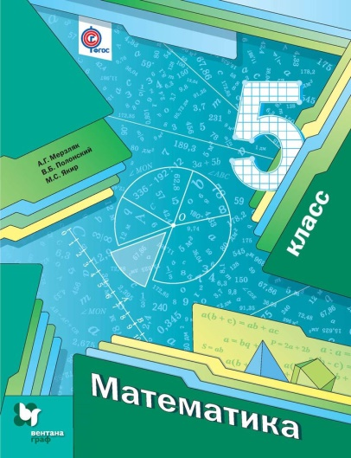
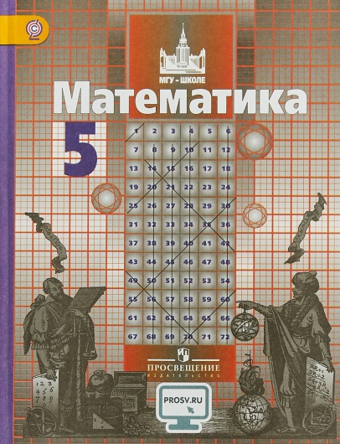
Титульный слайд
Фон слайдов

