Slide 1
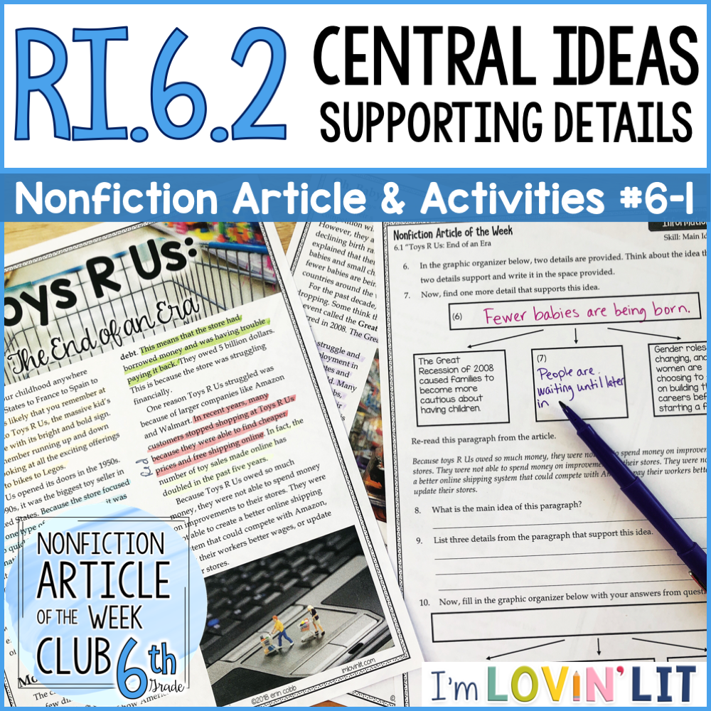
A Note About Editing Files
I have included my editable versions as a convenience for you, the teacher, but I cannot guarantee your ability to be able to edit them. This is completely dependent on your computer, operating system, settings, and/or tech skills.
The clipart included was created by Pam Odd from Keeping Life Creative for exclusive use in this resource. You may not use the clipart or any other part of this resource for any purpose other than your own personal classroom use.
If you find that these activities are opening wonky in your PowerPoint, that is beyond my control and has to do with the settings on your computer versus the ones on mine. The format may look different for you, and this is one reason why most files are sold on TpT as a PDF – because selling files created in editable format presents that problem for the buyer.
Most of the fonts used are native to Microsoft Office products, including Book Antiqua and Avenir. I’ve also used KG She Persisted and KG Miss Kindergarten for some text.

Slide 2

Nonfiction Article of the Week
Informational Text
6.1 “Toys R Us: End of an Era
Comprehension Quiz
Choose the best answer.
The article gives the names of two retailers that were able to compete well against Toys R Us. Who are those retailers?
  Target and Zappos
  Amazon and Walmart
  Macy’s and JC Penney’s
  Dillard's and Sears
Because Toys R Us was in debt, what were they unable to do?
  improve their stores
  close their stores
  fire employees
  help customers
What event in history is credited for a drop in birth rates?
  The Great Depression
  The Baby Boomers
  The Iraq War
  The Great Recession
Where did Toys R Us have stores?
  a small city in New York
  all across the world
  in three U.S. states
  in France only
What kind of company is Toys R Us?
  a furniture company
  an outdoor supply company
  a media company
  a toy store company
Why weren’t other similar companies able to compete with Toys R Us?
  Because Toys R Us had a large selection and low prices.
  Because they were the only store that sold dolls.
  Because they had a small selection but low prices.
  Because Toys R Us could charge customers higher prices.
How did the company struggle?
  low stock
  poor inventory habits
  financial problems
  logistical problems
Which factor made the company struggle?
  slow shipping
  cheap online prices from other retailers
  terrible customer service
  not enough employees
Activity 1
©2018 erin cobb imlovinlit.com

Slide 3
Nonfiction Article of the Week
Informational Text
6.1 “Toys R Us: End of an Era
Skill: Comprehension
Comprehension Questions
Answer each question on the line provided.
Where did Toys R Us have stores?
_______________________________________________________________________________
What kind of company is Toys R Us?
_______________________________________________________________________________
Why weren’t other similar companies able to compete with Toys R Us?
_______________________________________________________________________________
How did the company struggle?
_______________________________________________________________________________
What is a factor that made the company struggle?
______________________________________________________________________________
The article gives the names of two retailers that were able to compete well against Toys R Us. Who are those retailers?
______________________________________________________________________________
Because Toys R Us was in debt, what were they unable to do?
_____________________________________________________________________________
What event in history is credited for a drop in birth rates?
_______________________________________________________________________________
Activity 2
©2018 erin cobb imlovinlit.com

Slide 4
Nonfiction Article of the Week
Informational Text
6.1 “Toys R Us: End of an Era
Skill: Text Evidence
Finding Text Evidence
Find each piece of text evidence in the article and highlight OR underline it with the color specified.
For items 1-4, you’ll be citing textual evidence to support what the text says explicitly.
Find the sentence that explains how Toys R Us was able to quickly become the most popular destination for toys and highlight it in blue.
Find the sentence that defines the word debt for the reader and highlight it in green.
Find the sentence that explains why Americans became more cautious about having children. Highlight it in purple.
Find the sentence that tells how many people lost their jobs when Toys R Us closed. Highlight it in gray.
For items 5-8, you’ll be citing textual evidence to support inferences drawn from the text.
Find a sentence that shows the reader (you) why you can probably connect to this article. Highlight it in orange.
Find the sentence that tells the reader how American shopping trends are changing. Highlight it in red.
Find the sentence that provides evidence that Amazon is doing well in selling toys and highlight it in yellow.
Find the sentence that explains why other companies should worry about the declining birth rates around the world and highlight it in pink.
Activity 3
©2018 erin cobb imlovinlit.com

Slide 5
Nonfiction Article of the Week
Informational Text
6.1 “Toys R Us: End of an Era
Skill: Text Evidence
Finding Text Evidence
Find each piece of text evidence in the article and highlight OR underline it with the color specified.
For items 1-4, you’ll be citing textual evidence to support what the text says explicitly.
Find the sentence that explains how Toys R Us was able to quickly become the most popular destination for toys and highlight it in blue.
Find the sentence that defines the word debt for the reader and highlight it in green.
Find the sentence that explains why Americans became more cautious about having children. Highlight it in purple.
Find the sentence that tells how many people lost their jobs when Toys R Us closed. Highlight it in gray.
For items 5-8, you’ll be citing textual evidence to support inferences drawn from the text.
Find a sentence that shows the reader (you) why you can probably connect to this article. Highlight it in orange.
Find the sentence that tells the reader how American shopping trends are changing. Highlight it in red.
Find the sentence that provides evidence that Amazon is doing well in selling toys and highlight it in yellow.
Find the sentence that explains why other companies should worry about the declining birth rates around the world and highlight it in pink.
In recent years, many customers stopped shopping at Toys R Us because they were able to find cheaper prices and free shipping online. | In fact, the number of toy sales made online has doubled in the past five years.
If you spent your childhood anywhere from the United States to France to Spain to Hong Kong, it is likely that you remember at least one visit to Toys R Us, the massive kid’s toy chain store with its bright and bold sign. | This means that the store had borrowed money and was having trouble paying it back.
The store employed 60,000 people worldwide, and 30,000 just in the United States. | Many companies will have to change their approach to meet the needs of an older population.
Many people lost their jobs, their homes, and their retirement savings. | Because the store focused on just one type of product – toys – it was able to quickly become the most popular destination.
Activity 4
©2018 erin cobb imlovinlit.com

Slide 6
Nonfiction Article of the Week
Informational Text
6.1 “Toys R Us: End of an Era”
Skill: Main Idea & Details
Main Idea & Details
Use the article to answer the questions and complete the graphic organizers.
What was the main idea of the entire article? Write it in the box below.
What are the names of the subheadings in the article? Write them on the lines provided.
What is the first subsection mostly about? Write it in the space provided.
What is the second subsection mostly about? Write it in the space provided.
Toys R Us: The End of an Era
(1)
_______________________
_______________________
(2a)
(2b)
(3)
(4)
According to the article, what factors led Toys R Us to close their doors?
Look at the graph on the second page of the article. Which statement from the article does the graph support? Circle your answer.
Factors that led to the closing of Toys R Us
Toys R Us had a lot of debt
If birth rates continue to drop, there will be economic impacts far beyond the closure of one store.
For the past decade, birth rates have been dropping.
Activity 5
©2018 erin cobb imlovinlit.com

Slide 7
Nonfiction Article of the Week
Informational Text
6.1 “Toys R Us: End of an Era”
Skill: Main Idea & Details
In the graphic organizer below, two details are provided. Think about the idea that these two details support and write it in the space provided.
Now, find one more detail that supports this idea.
(7)
The Great Recession of 2008 caused families to become more cautious about having children.
(8)
Gender roles are changing, and more women are choosing to focus on building their careers before starting a family.
Re-read this paragraph from the article.
Because toys R Us owed so much money, they were not able to spend money on improvements to their stores. They were not able to create a better online shipping system that could compete with Amazon, pay their workers better wages, or update their stores.
What is the main idea of this paragraph?
_______________________________________________________________________________
List three details from the paragraph that support this idea.
_______________________________________________________________________________
_______________________________________________________________________________
______________________________________________________________________________
Now, fill in the graphic organizer below with your answers from questions 8 and 9 above.
Activity 5
©2018 erin cobb imlovinlit.com

Slide 8
Nonfiction Article of the Week
Informational Text
6.1 “Toys R Us: End of an Era
Skill: Integrate Multiple Media Sources
Integrate Information
View the CNBC video clip, “The Rise and Fall of Toys R Us. Then, answer these questions. Review the clip as needed.
As you view the video clip, identify three details that are included in the video clip that are not in the article and write them in the left column. Then, identify three details that are in both the video clip and the article and write them in the right column.
New Details
Common Details
The video clip mentions two other other retailers who also filed for bankruptcy in 2017. Name those retailers. Then, briefly discuss at least two reasons why you think those companies likely found themselves in trouble. Hint: Use the information you learned about Toys R Us in the article and the video clip.
_______________________________________________________________________________
_______________________________________________________________________________
_______________________________________________________________________________
_______________________________________________________________________________
_______________________________________________________________________________
_______________________________________________________________________________
Activity 6
©2018 erin cobb imlovinlit.com

Slide 9
Nonfiction Article of the Week
Informational Text
6.1 “Toys R Us: End of an Era
Skill: Compare and Contrast Advertisements/ Themes
For Fun
Compare and contrast the vintage Toys R Us commercial and the recent Toys R Us commercial.
As you view the video clips, identify at least two obvious differences between the commercials.
Vintage 1980s Commercial
Recent Commercial
Most commercials have a theme, or message, that the advertiser wants to convey to viewers. View each commercial again and write a theme for each one in the spaces below.
Vintage 1980s Commercial
Recent Commercial
Activity 7
©2018 erin cobb imlovinlit.com

Slide 10
Nonfiction Article of the Week
Informational Text
6.1 “Toys R Us: End of an Era
Skills Test
Skills Test
Choose the best answer.
Which statement below is the main idea of the article, “Toys R Us: The End of an Era”?
  Toys R Us is facing tough competition from online retailers.
  Toys R Us is making less money than it used to.
  Toys R Us stores are closing around the world due to financial problems.
  People in the U.S. are having fewer children than they used to.
Which of the following is not a reason that Toys R Us closed its doors?
  Toys R Us had a lot of debt.
  Toys R Us struggled to compete with bigger retailers.
  Fewer babies are being born.
  Toys R Us made expensive improvements to its stores.
According to the article, what is one way that families today have changed?
  Family sizes are bigger today than they ever have been.
  Many people are waiting until they are older to have children.
  Fewer people are choosing to have children today.
  Many people are frustrated with politics today.
Which evidence from the article supports your answer to the previous question?
  This may be the result of changing gender roles– more women are choosing to focus on building their careers before starting a family.
  Toys R Us sells products that are made for babies and small children.
  Many smaller toy shops went out of business because they could not compete with the huge selection and low prices of Toys R Us.
  Toys R Us had 5 billion dollars in debt.
According to the article, when did families become more cautious about having children?
  After Toys R Us announced it was closing its doors.
  After the Great Recession of 2008.
  After some Toys R Us employees lost their jobs.
  After Amazon became the biggest online retailer.
Which sentence from the article provides a detail to support your answer to the previous question?
  Toys R Us has officially closed all of its stores.
  By the 1990s, it was the biggest toy seller in the United States.
  This is because the store was struggling financially.
  Many people lost their jobs, their homes, and their retirement savings.
Activity 8
©2018 erin cobb imlovinlit.com

Slide 11
Nonfiction Article of the Week
Informational Text
6.1 “Toys R Us: End of an Era
Skills Test
Find another detail in the article to support the main idea in the organizer below. Then, write it in the appropriate place.
Based on evidence from the article, what changes do you think that other big retailers like Toys R Us should consider making to their stores in order to compete in today’s market? Discuss one change that you think is important and cite evidence from the article that backs up your opinion.
_______________________________________________________________________________
_______________________________________________________________________________
_______________________________________________________________________________
_______________________________________________________________________________
_______________________________________________________________________________
_______________________________________________________________________________
_______________________________________________________________________________
_______________________________________________________________________________
_______________________________________________________________________________
By the 1990s, Toys R Us was the biggest toy seller in the U.S.
Toys R Us focused on only one type of product – toys.
Activity 8
©2018 erin cobb imlovinlit.com

Slide 12
Nonfiction Article of the Week
Informational Text
6.1 “Toys R Us: End of an Era
Skills Test
Skills Test
Choose the best answer.
Which statement below is the main idea of the article, “Toys R Us: The End of an Era”?
  Toys R Us is facing tough competition from online retailers.
  Toys R Us stores are closing around the world due to financial problems.
Which of the following is not a reason that Toys R Us closed its doors?
  Fewer babies are being born.
  Toys R Us made expensive improvements to its stores.
According to the article, what is one way that families today have changed?
  Family sizes are bigger today than they ever have been.
  Many people are waiting until they are older to have children.
Which evidence from the article supports your answer to the previous question?
  This may be the result of changing gender roles– more women are choosing to focus on building their careers before starting a family.
  Toys R Us sells products that are made for babies and small children.
According to the article, when did families become more cautious about having children?
  After the Great Recession of 2008.
  After some Toys R Us employees lost their jobs.
Which sentence from the article provides a detail to support your answer to the previous question?
  By the 1990s, it was the biggest toy seller in the United States.
  Many people lost their jobs, their homes, and their retirement savings.
Activity 9
©2018 erin cobb imlovinlit.com

Slide 13
Nonfiction Article of the Week
Informational Text
6.1 “Toys R Us: End of an Era
Skills Test
Find another detail in the article to support the main idea in the organizer below. Then, write it in the appropriate place.
Based on evidence from the article, what changes do you think that other big retailers like Toys R Us should consider making to their stores in order to compete in today’s market? Discuss one change that you think is important and cite evidence from the article that backs up your opinion.
_______________________________________________________________________________
_______________________________________________________________________________
_______________________________________________________________________________
_______________________________________________________________________________
_______________________________________________________________________________
_______________________________________________________________________________
_______________________________________________________________________________
_______________________________________________________________________________
_______________________________________________________________________________
By the 1990s, Toys R Us was the biggest toy seller in the U.S.
Toys R Us focused on only one type of product – toys.
Activity 9
©2018 erin cobb imlovinlit.com

