Slide 1


Slide 2

Answers can be revealed by clicking on the smiley.
Advance to next question with the arrow.
360

Slide 3
‘NO PRINT’ Bingo – students to draw their own grid
Using pre-printed Bingo cards
OR
CLICK HERE
CLICK HERE

Slide 4
Draw a 3 by 3 grid with nine squares.

Slide 5
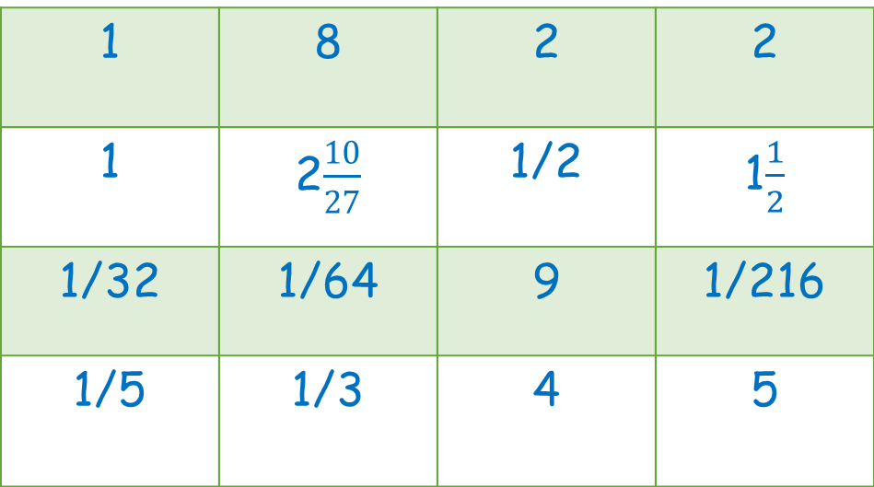
Choose any nine of these numbers and put them in your grid.
1 | 8 | 2 | 2
1 | 2$\frac{10}{27}$ | 1/2 | 1$\frac{1}{2}$
1/32 | 1/64 | 9 | 1/216
1/5 | 1/3 | 4 | 5

Slide 6
BINGO! rules:
If an answer of yours comes up cross it out with a single line so that it can still be read – answers need to be checked if you win.
The first one to get all nine squares (a ‘full house’) and shouts Bingo! is the winner.

Slide 7
Find the value of
2⁻¹
1/2

Slide 8
Find the value of
8⁻²
1/64

Slide 9
Find the value of
2⁻⁵
1/32

Slide 10
Find the value of
10 ⁰
1

Slide 11

Find the value of
${\left(\frac{1}{4}\right)}^{−1}$
4

Slide 12


Find the value of
${\left(\frac{2}{3}\right)}^{−1}$
1$\frac{1}{2}$

Slide 13
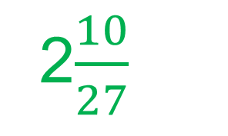

Find the value of
${\left(\frac{3}{4}\right)}^{−3}$
2$\frac{10}{27}$

Slide 14

Find the value of
${\left(\frac{5}{6}\right)}^{0}$
1

Slide 15

Find the value of
${25}^{\frac{1}{2}}$
5

Slide 16

Find the value of
${16}^{\frac{1}{4}}$
2

Slide 17

Find the value of
${32}^{\frac{1}{5}}$
2

Slide 18

Find the value of
${81}^{−\frac{1}{4}}$
1/3

Slide 19

Find the value of
${125}^{−\frac{1}{3}}$
1/5

Slide 20

Find the value of
${27}^{\frac{2}{3}}$
9

Slide 21

Find the value of
${32}^{\frac{3}{5}}$
8

Slide 22

Find the value of
${36}^{−\frac{3}{2}}$
1/216

Slide 23
The End!

Slide 24

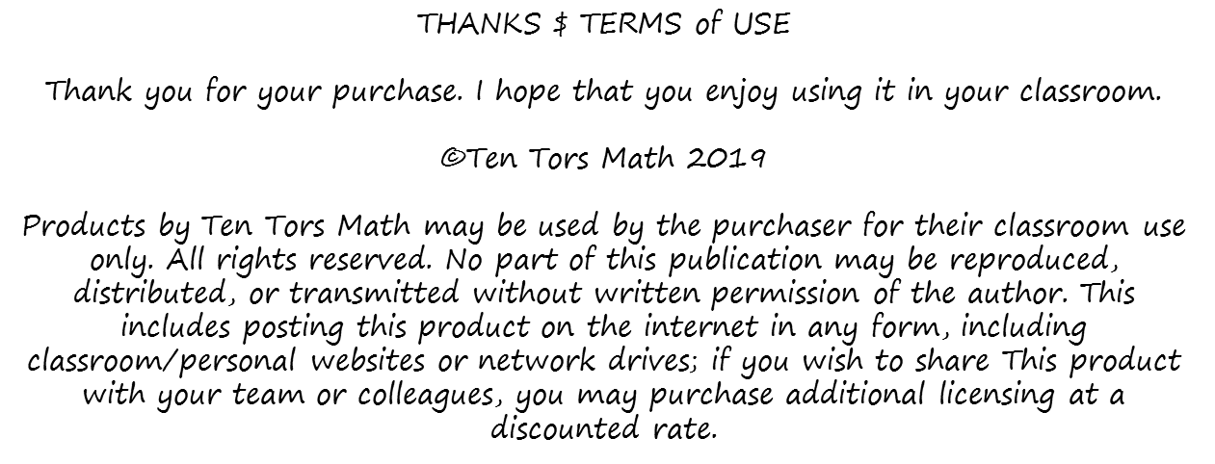


Please feel free to contact me with any questions or suggestions about my products at: Tentorsed@gmail.com
Keep up to date with my free and paid products by following me over at TPT
follow
If you are feeling generous today, leaving your feedback is always appreciated. Plus you get your TPT credits towards a free product.
Follow the link below to leave feedback:
https://www.teacherspayteachers.com/My-Purchases

