Slide 1
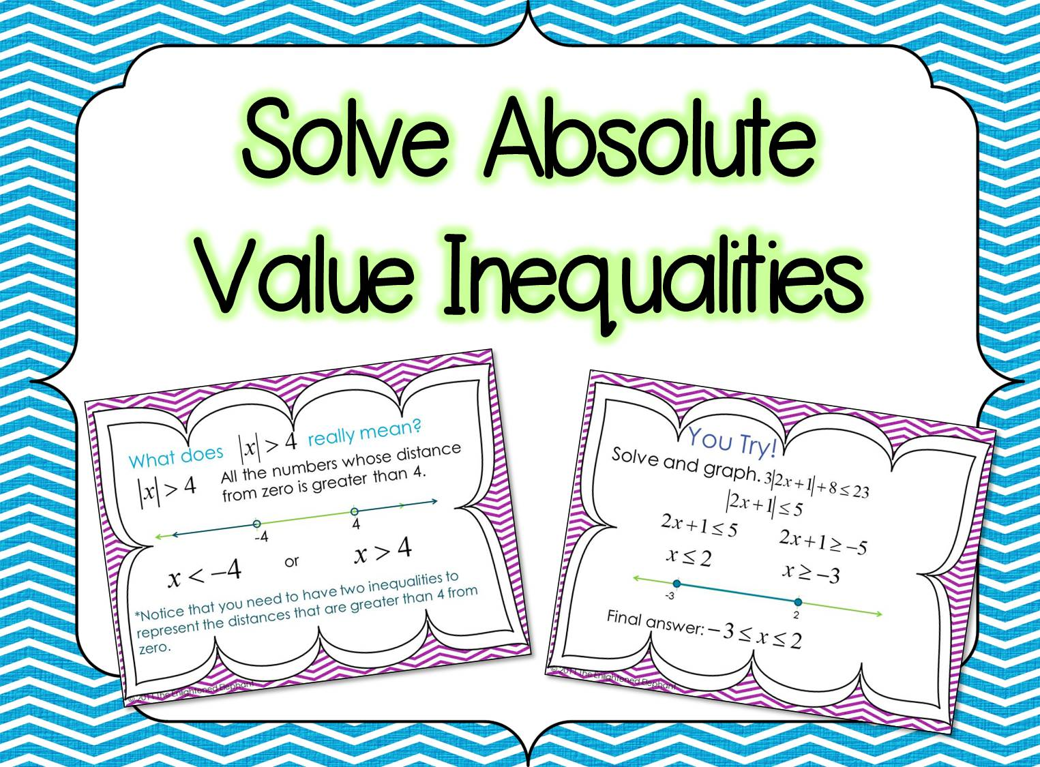

Slide 2
First, let’s think about what absolute value inequalities are really asking us to find!
© 2011 The Enlightened Elephant

Slide 3
What does really mean?
All the numbers whose distance from zero is greater than 4.
-4
4
or
*Notice that you need to have two inequalities to represent the distances that are greater than 4 from zero.
© 2011 The Enlightened Elephant
Notes:
On this slide, convince students about the less than -4 piece by asking them how far -5, -6, -20 etc. are from zero. Then ask if that distance is greater than 4 from zero.

Slide 4
What does really mean?
All the numbers whose distance from zero is less than 4.
-4
4
and
*Notice that you need to have two inequalities to represent the distances that are less than 4 from zero.
However, since these inequalities must happen at the same time, it should be written as
© 2011 The Enlightened Elephant
Notes:
On this slide, convince students about the greater than -4 piece by asking them how far -3, -2 are from zero. Then ask if that distance is less than 4 from zero.

Slide 5
Now let’s see more difficult problems!
© 2011 The Enlightened Elephant

Slide 6
Solve and graph
Step 1: Isolate the absolute value.
Step 2: Set up two inequalities.
Step 3: Solve the inequalities.
Step 4: Graph the solutions.
0
8
© 2011 The Enlightened Elephant

Slide 7
Let’s practice!
© 2011 The Enlightened Elephant

Slide 8
You Try!
Solve and graph.
Step 1:
Step 2:
Step 3:
Step 4:
-5
1
Final answer: -5<x<1
© 2011 The Enlightened Elephant

Slide 9
You Try!
Solve and graph.
-12
6
or
Final answer:
© 2011 The Enlightened Elephant

Slide 10
You Try!
Solve and graph.
-3
4
or
Final answer:
© 2011 The Enlightened Elephant

Slide 11
You Try!
Solve and graph.
-2
6
Final answer:
© 2011 The Enlightened Elephant

Slide 12
You Try!
Solve and graph.
-3
2
Final answer:
© 2011 The Enlightened Elephant

Slide 13
You Try!
Solve and graph.
Final answer: NO SOLUTION!
Absolute values are distances, which cannot be negative.
You can choose any value for x and the left side of the inequality will always be positive.
Positive numbers are NEVER less than negative numbers.
© 2011 The Enlightened Elephant

Slide 14
You Try!
Solve and graph.
Final answer: ALL REAL NUMBERS!
Absolute values are distances, which cannot be negative.
You can choose any value for x and the left side of the inequality will always be positive.
Positive numbers are ALWAYS greater than negative numbers.
© 2011 The Enlightened Elephant

Slide 15
Success!
Nice job!
© 2011 The Enlightened Elephant

Slide 16










Thank you for your purchase!
Stay connected
www.pinterest.com/mcase1
www.facebook.com/theenlightenedelephant
www.theenlightenedelephant.blogspot.com
Contact me: theenlightenedelephant@gmail.com
Follow on TPT: The Enlightened Elephant
Credits

