Slide 1
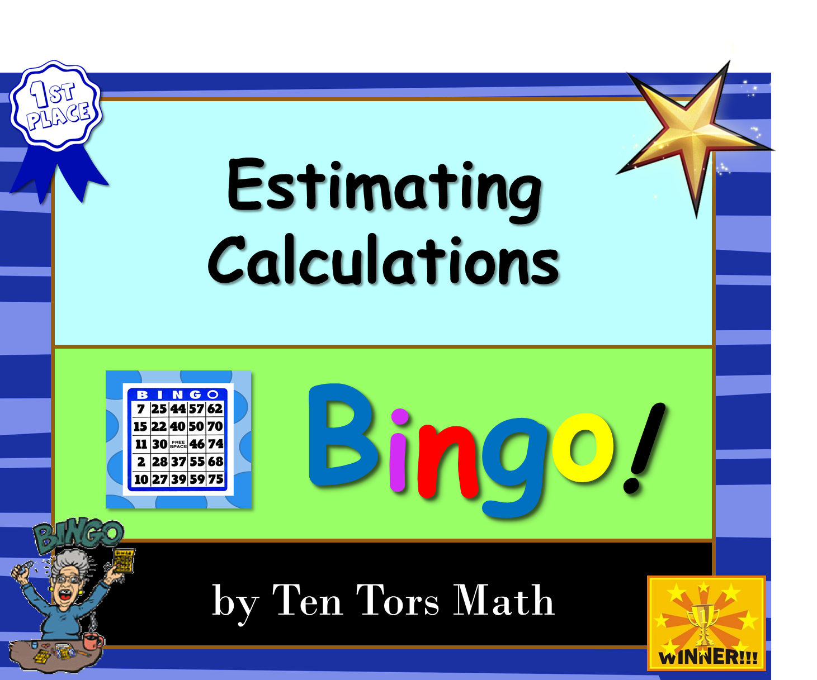

Slide 2

Answers can be revealed by clicking on the smiley.
Advance to next question with the arrow.
360

Slide 3
‘NO PRINT’ Bingo – students to draw their own grid
Using pre-printed Bingo cards
OR
CLICK HERE
CLICK HERE

Slide 4
Draw a 3 by 3 grid with nine squares.

Slide 5
Choose any nine of these numbers and put them in your grid.
5 | 750 | 4 | 25 000
4 800 | 20 | 10 | 500
15 | 1 400 | 1 | 12 000
24 000 | 2 000 | 100 000 | 30 000

Slide 6
BINGO! rules:
If an answer of yours comes up cross it out with a single line so that it can still be read – answers need to be checked if you win.
The first one to get all nine squares (a ‘full house’) and shouts Bingo! is the winner.

Slide 7
By rounding all numbers to 1 significant figure, find an approximate answer to the following
4325 × 6.21
24 000

Slide 8
By rounding all numbers to 1 significant figure, find an approximate answer to the following
6170 × 2.115
12 000

Slide 9
By rounding all numbers to 1 significant figure, find an approximate answer to the following
52.13 × 4.62× 3.174
750

Slide 10
By rounding all numbers to 1 significant figure, find an approximate answer to the following
163 ÷ 38.7
5

Slide 11
By rounding all numbers to 1 significant figure, find an approximate answer to the following
6973 ÷ 4.78
1 400

Slide 12
By rounding all numbers to 1 significant figure, find an approximate answer to the following
209 ÷ 0.367
500

Slide 13

By rounding all numbers to 1 significant figure, find an approximate answer to the following
$$\frac{581×777}{109}$$
4 800

Slide 14

By rounding all numbers to 1 significant figure, find an approximate answer to the following
$$\frac{791−577}{23}$$
10

Slide 15

By rounding all numbers to 1 significant figure, find an approximate answer to the following
$$\frac{314+669}{991}$$
1

Slide 16

By rounding all numbers to 1 significant figure, find an approximate answer to the following
$$\frac{77.2−21.5}{2.78}$$
20

Slide 17

By rounding all numbers to 1 significant figure, find an approximate answer to the following
$$\frac{4.79×7.85}{10.07}$$
4

Slide 18

By rounding all numbers to 1 significant figure, find an approximate answer to the following
$$\frac{12.23×62.1}{42.7}$$
15

Slide 19

By rounding all numbers to 1 significant figure, find an approximate answer to the following
$$\frac{534×77}{0.38}$$
100 000

Slide 20

By rounding all numbers to 1 significant figure, find an approximate answer to the following
$$\frac{592−211}{0.18}$$
2 000

Slide 21

By rounding all numbers to 1 significant figure, find an approximate answer to the following
$$\frac{294×29}{0.275}$$
30 000

Slide 22

By rounding all numbers to 1 significant figure, find an approximate answer to the following
$$\frac{303+699}{0.821−0.413}$$
25 000

Slide 23
The End!

Slide 24




Please feel free to contact me with any questions or suggestions about my products at:
Tentorsed@gmail.com
Keep up to date with my free and paid products by following me over at TPT
follow
If you are feeling generous today, leaving your feedback is always appreciated. Plus you get your TPT credits towards a free product.
Follow the link below to leave feedback:
https://www.teacherspayteachers.com/My-Purchases

