Slide 1
ŞİVLİLİK
A TRADITIONAL CANDY-GIFT FEST IN KONYA,TURKEY

Slide 2
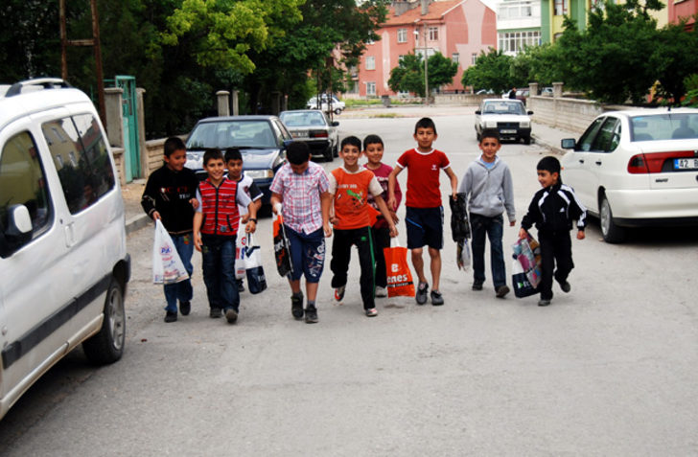
ŞİVLİLİK

Slide 3
The morning of Laylat al-Raghaib is known as the “şivlilik day”- The word “şivli” refers to everything such as sweets,food or gifts that can be given especially to children on this celebration day. Local people of Konya prepare the gifts and lanterns for children a few days before the celebration. You usually see people, shopping for this celebration in bazaars or markets.

Slide 4
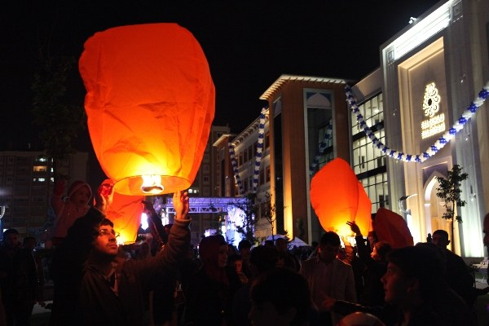
The celebration has two parts. In the first, part, there’s a lantern or torchlight procession the night before the şivlilik celebration.

Slide 5
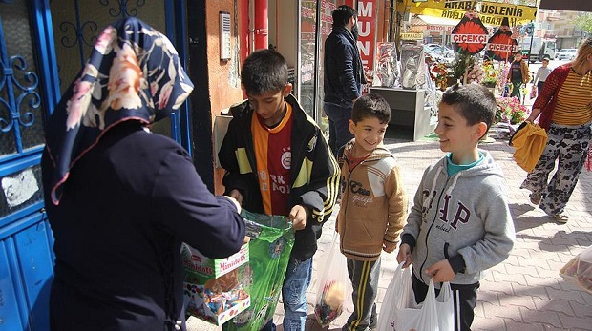
The second part is the gathering of gifts and sweets, candies from the households, in other words, “şivlilik” itself. Children wander around with their lanterns in the evening and go around in groups. Sometimes, they lit very big fires to jump over or play around them. The next day is more exciting. Children take handbags and collect sweets, candies, chocolate, dried fruits or other small gifts from the neighbourhood.

Slide 6
In the previous years, children used to say a very well known tongue twister, but nowadays, the kids most probably have forgotten it, because it is not heard anymore. The original words of this twister can be translated as:
Sweets filled our stomachs
The early ones cooked the sweetest ones,,
Two pies and some s
We need all of these sweets…..

Slide 7
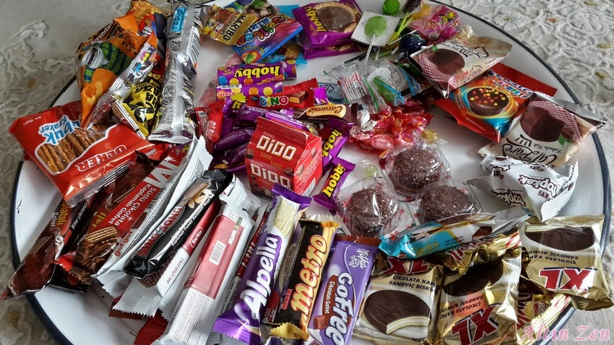
By the way, the women cook delicious biscuits called BİŞİ in Turkish, which are made of yeasted dough and fried in very hot oil, and serve them to thier neighbourhood. The counting of sweets and gifts collected and choosing and eating the most delicious ones is another source of excitement for children (Though some of them have indigestion problems later)

Slide 8
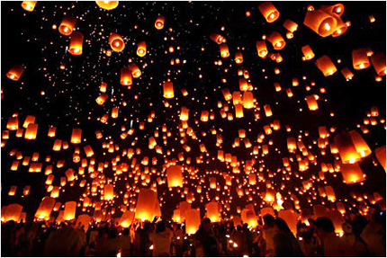
The best side of this is the participation of all children to the celebration, whatever their level of income is. Before the morning of this celebration, torchlight processions enlighten the whole city and the joy and happiness of all the children is worth seeing. Children play different games around the procession fires in different streets. In almost every street of Konya you can see the same scenes, which change the atmosphere and view of the city.

