Slide 1
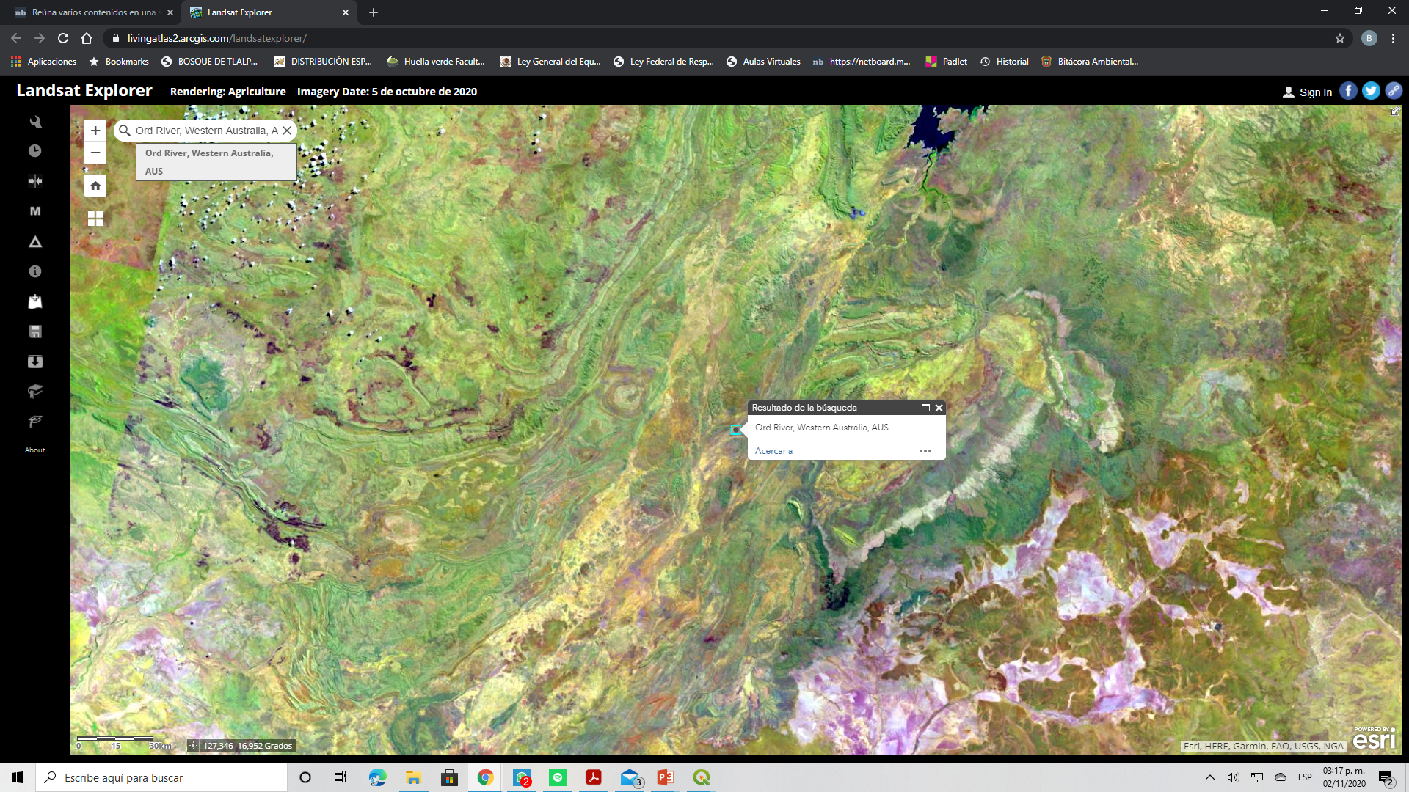
Rio Ord, UAS.

Slide 2
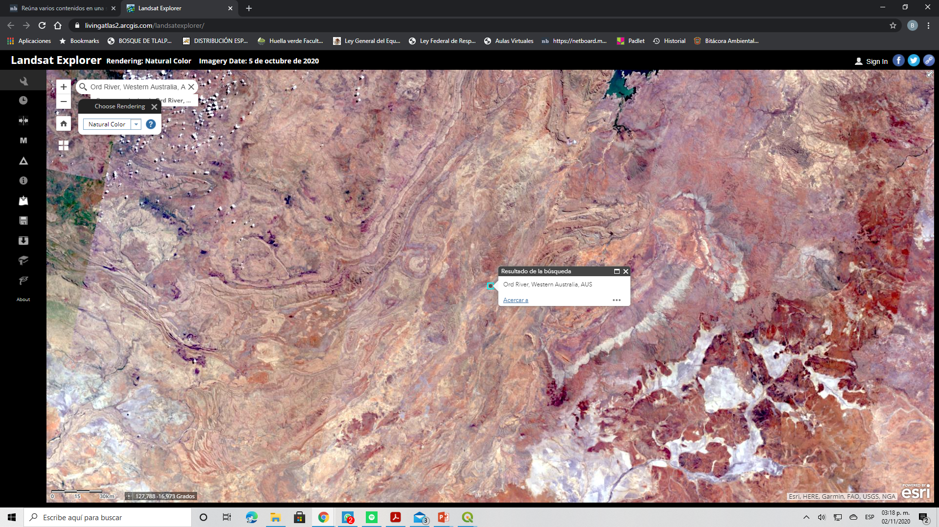
Natural Color Landsat Explorer

Slide 3
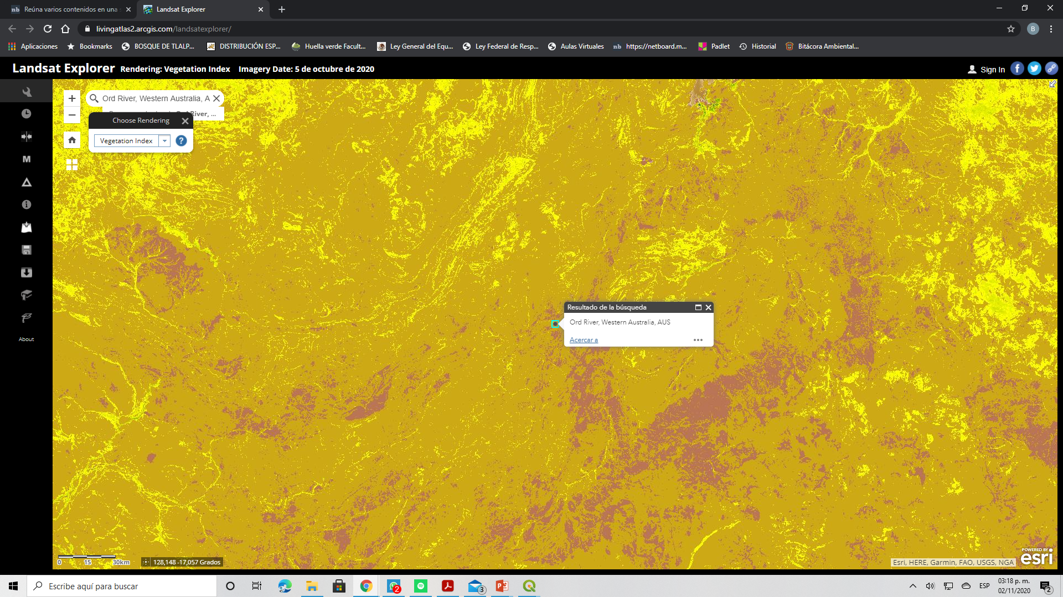
Vegetation Index Landsat Explorer

Slide 4
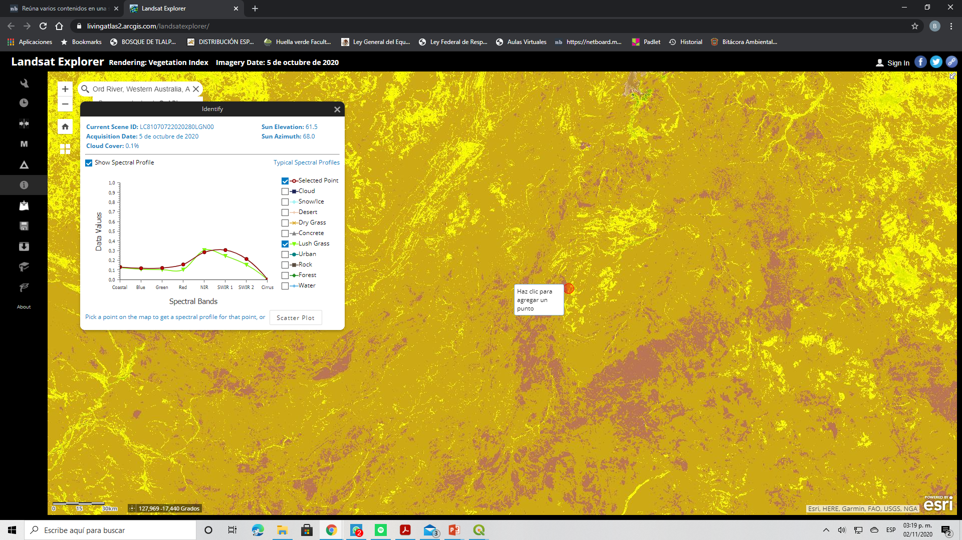
Vegetation Index ArcGIS Online Global Land Cover 1992-2018

Slide 5
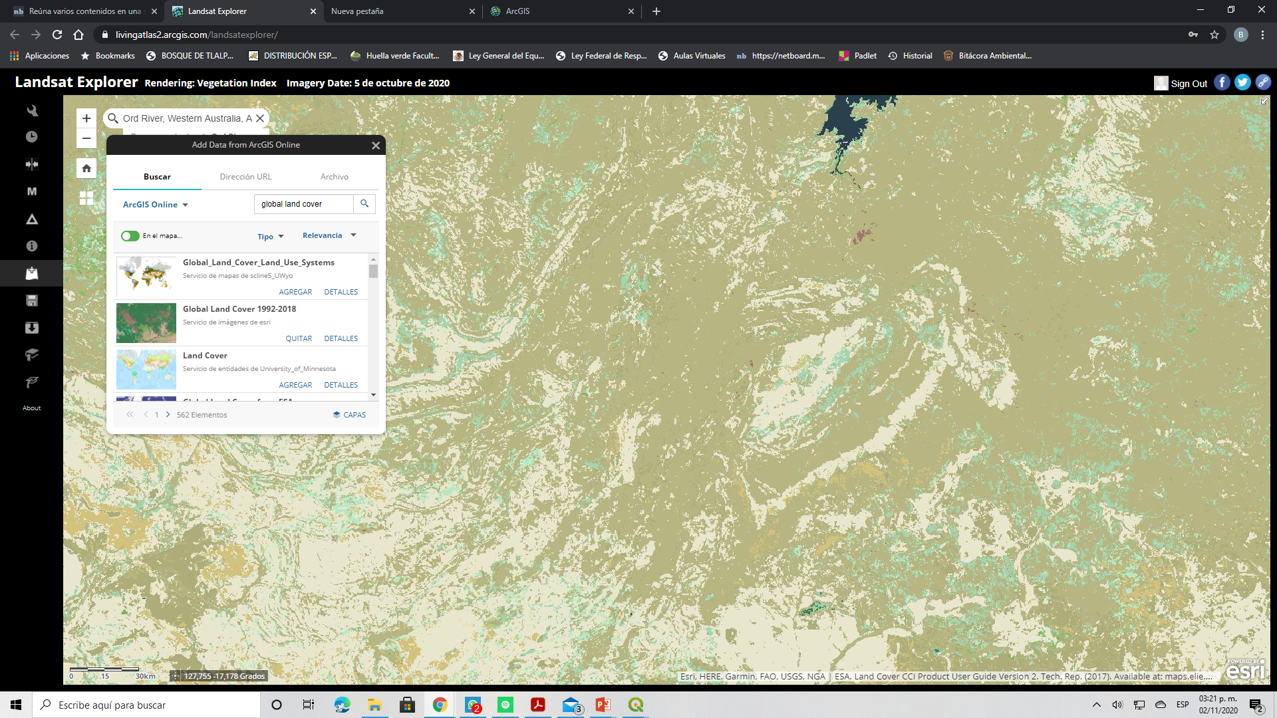
Capa Global Land Cover 1992-2018

Slide 6
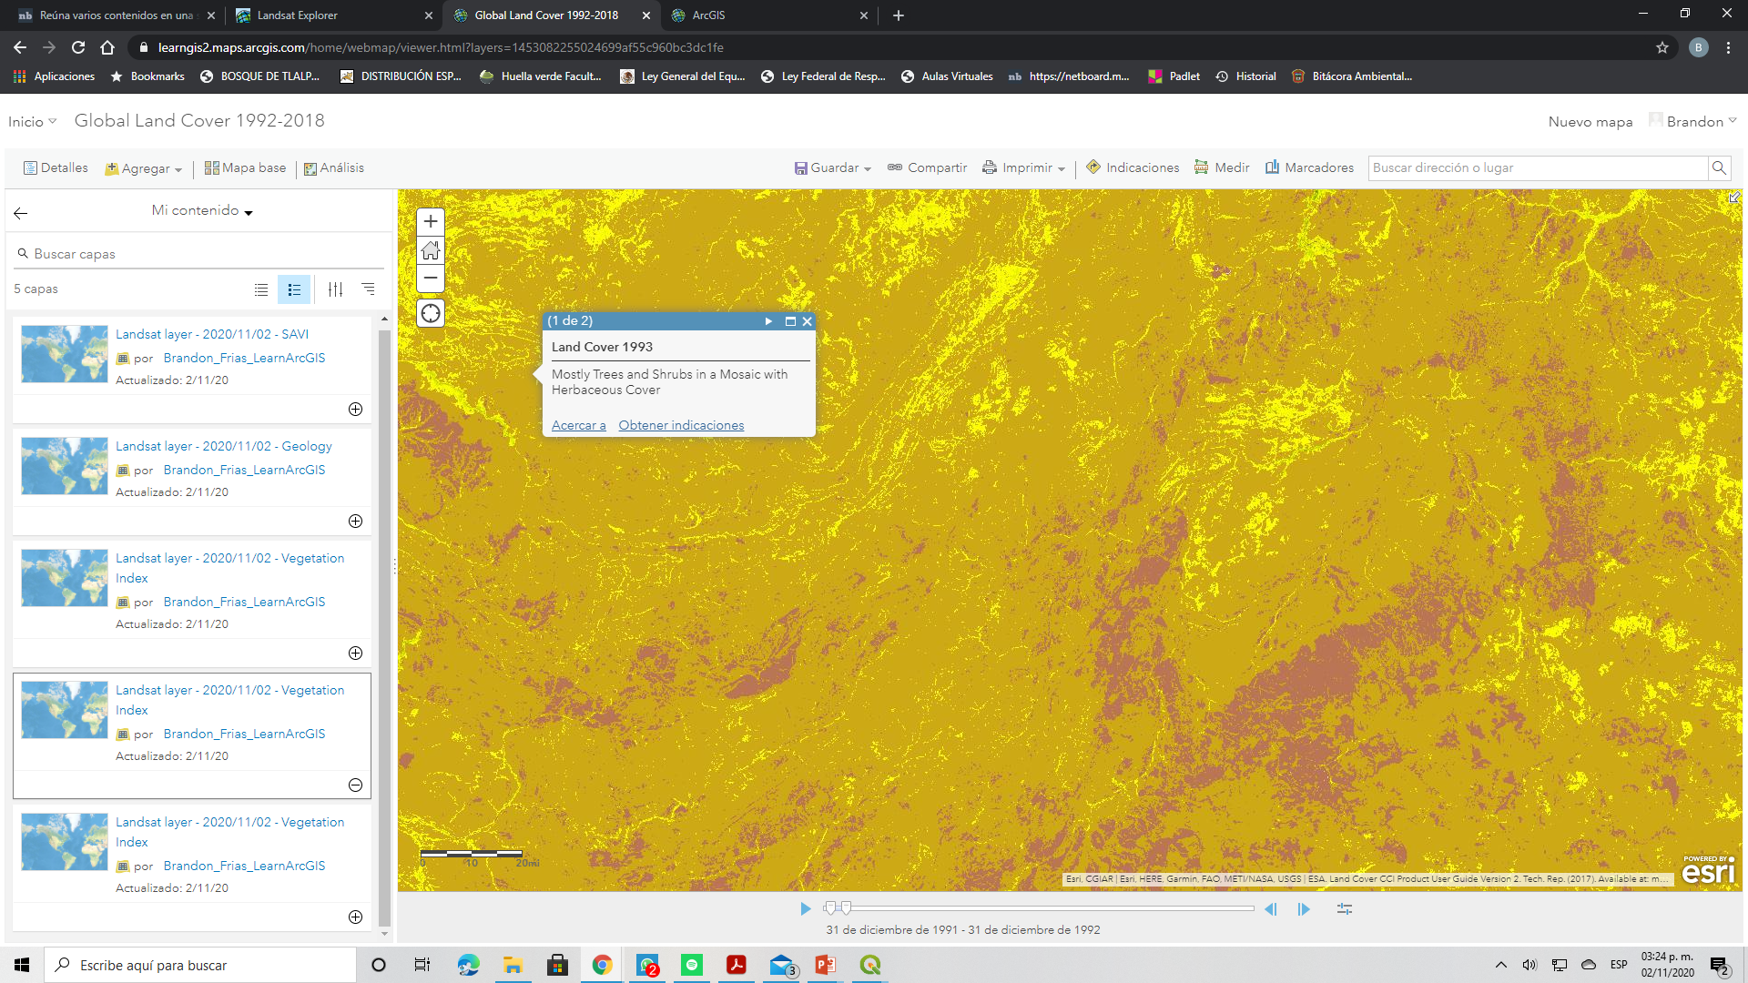
ArcGIS Online

