Slide 1
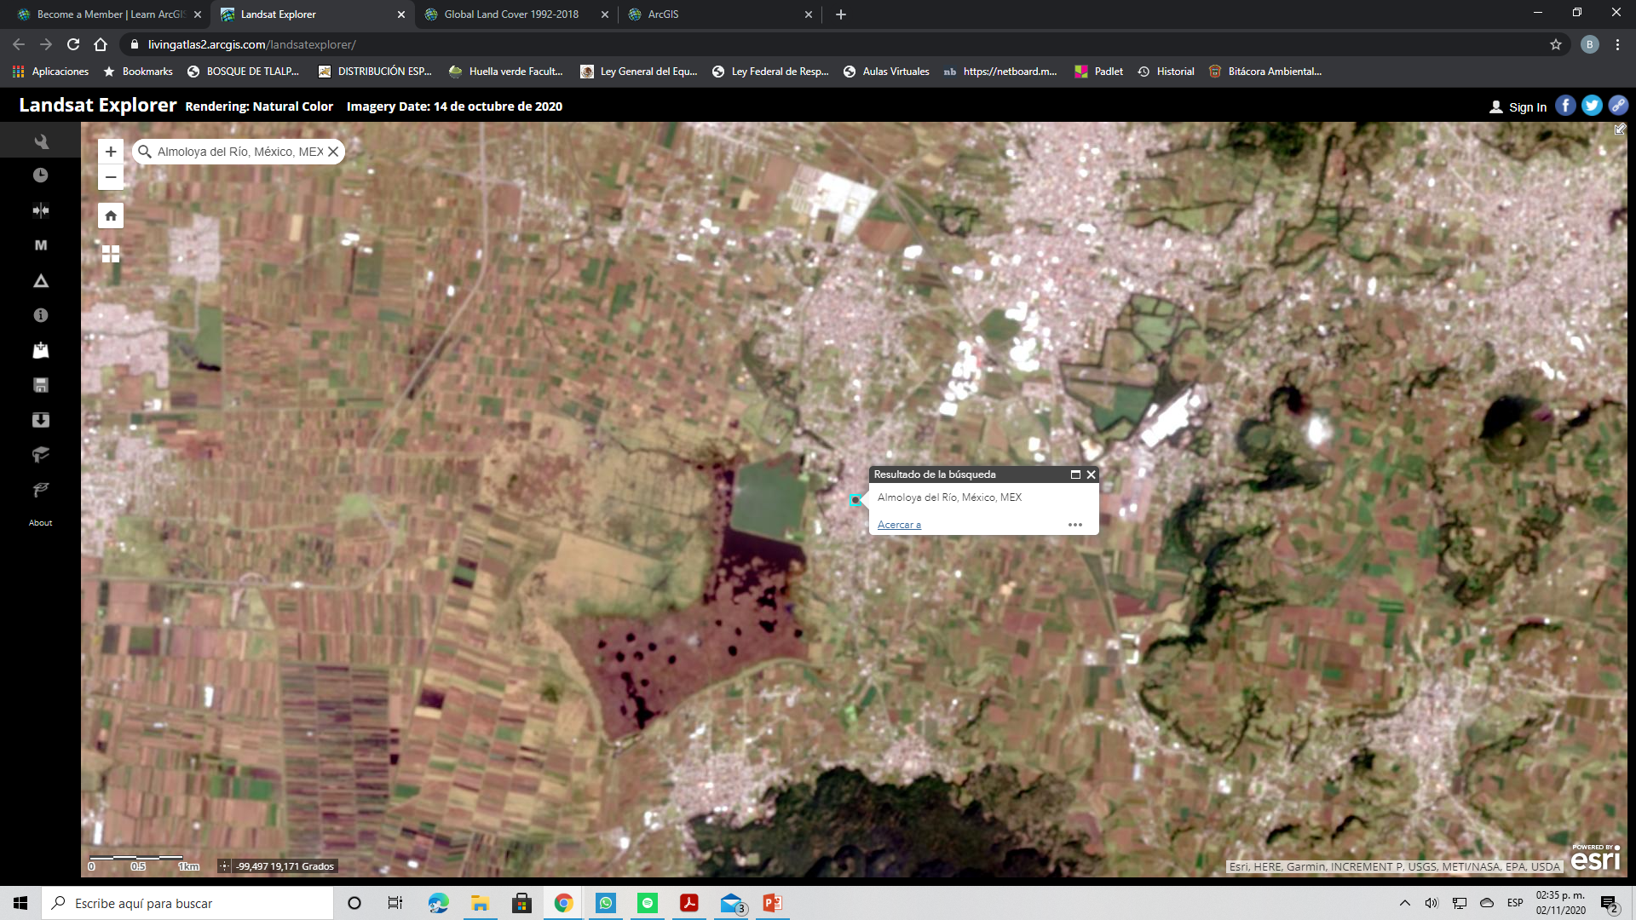
Almoloya del Rio, Estado de Mèxico, MEX.

Slide 2
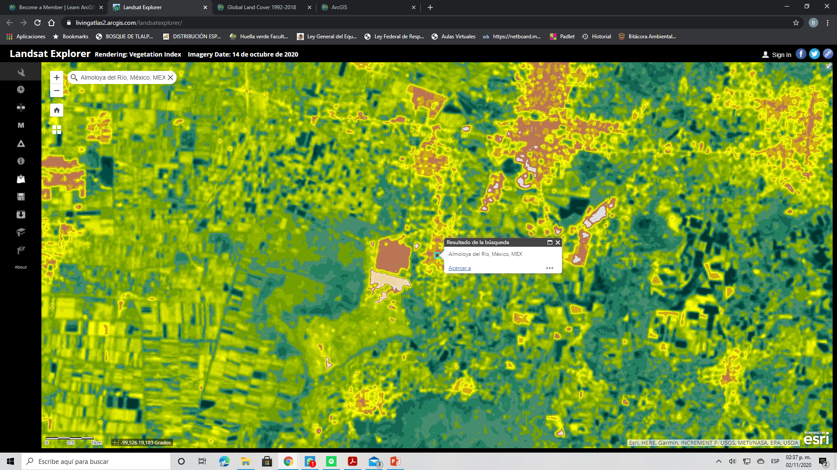
Vegetation Index Landsat Explorer

Slide 3
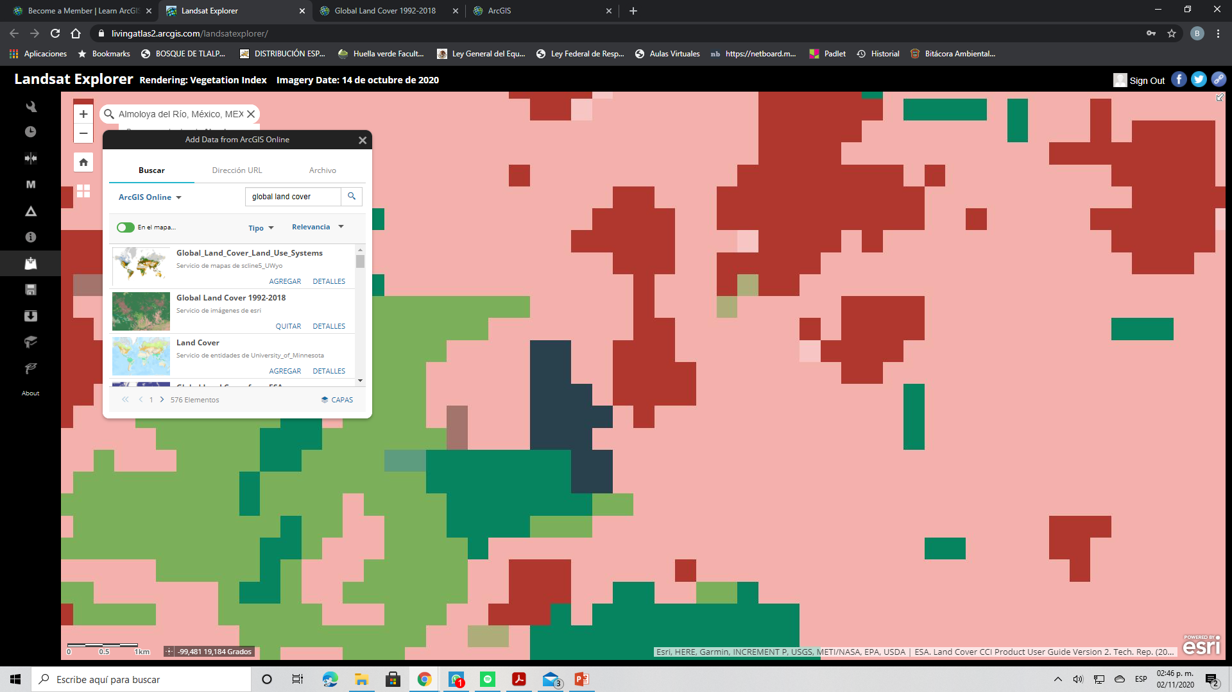
Capa Global Land Cover 1992-2018 Landsat Explorer

Slide 4
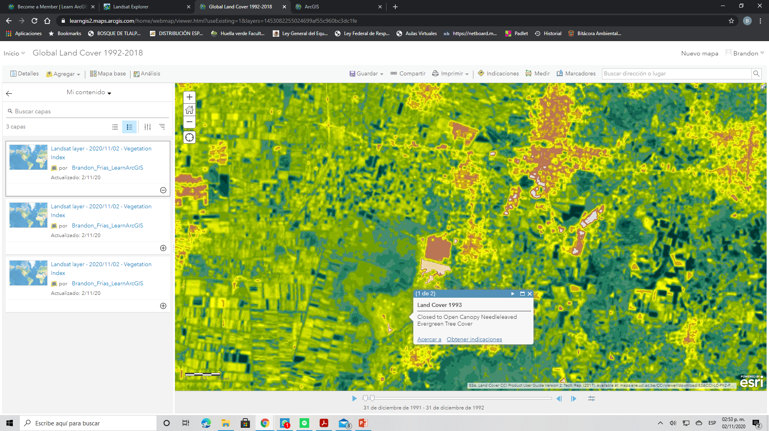
Vegetation Index ArcGIS Online Global Land Cover 1992-2018

Slide 5
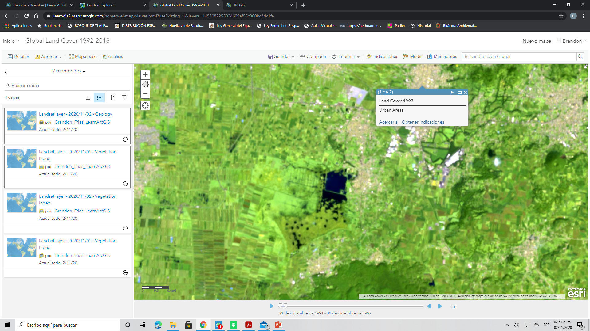
Geologia ArcGIS Online

Slide 6
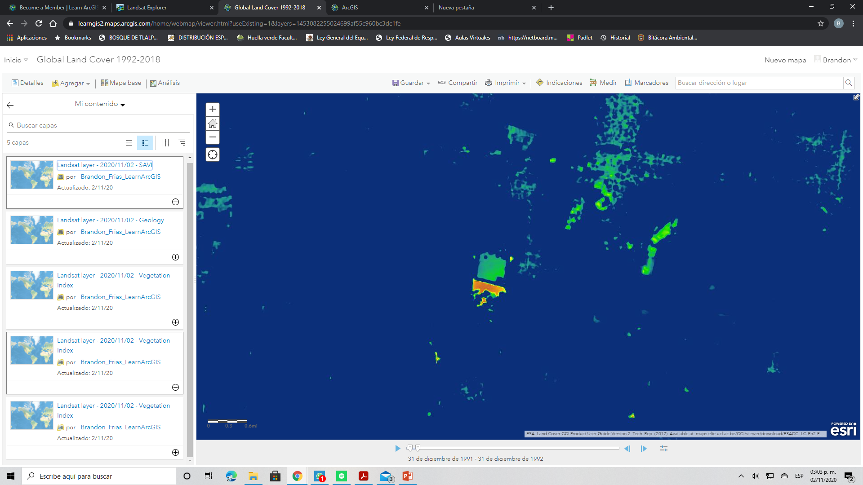
Suelo ArcGIS Online

