Slide 1


What I am ?
Cycle 3
A describing minibeasts game

Slide 2
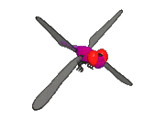

1
I have 6 legs and I can fly.
2
I like to crawl in the grass.
3
I have black spots.
I am a ladybird

Slide 3

1
I lay my eggs on leaves.
2
I have 4 multicoloured wings.
3
I come out of a chrysalis.
I am a butterfly

Slide 4

1
I have 8 legs.
2
I like to eat flies and small insects.
3
I live in a web.
I am a spider.

Slide 5

1
I like to fly from flower to flower.
2
I have 6 legs and a stripy body.
3
I make a buzzing sound.
I am a bee

Slide 6
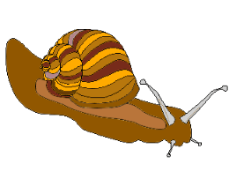
1
I do not have legs
2
I leave a shiny trail as I move along.
3
I carry my home with me.
I am a snail

Slide 7
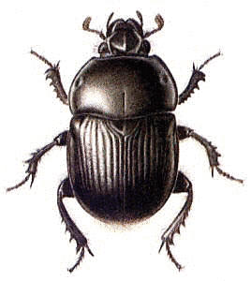
1
I have six legs
2
I am the same shape as a ladybird.
3
I am black and shiny.
I am a beetle

Slide 8
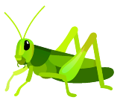
1
I have 2 long legs and 4 short legs.
2
I am green.
3
I like to jump from leaf to leaf.
I am a grasshopper

Slide 9
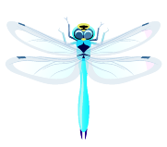
1
I have 6 legs.
2
My 4 wings are almost see through.
3
I like to fly near ponds and rivers.
I am a dragonfly

Slide 10

1
I have lots of little legs
2
I came out of a tiny egg.
3
I will change into a different minibeast.
I am a caterpillar

