Slide 1
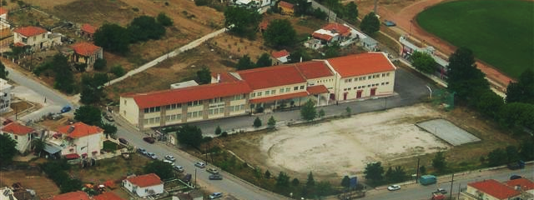

General Lyceum of Nigrita
6/4/2021

Slide 2
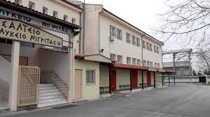
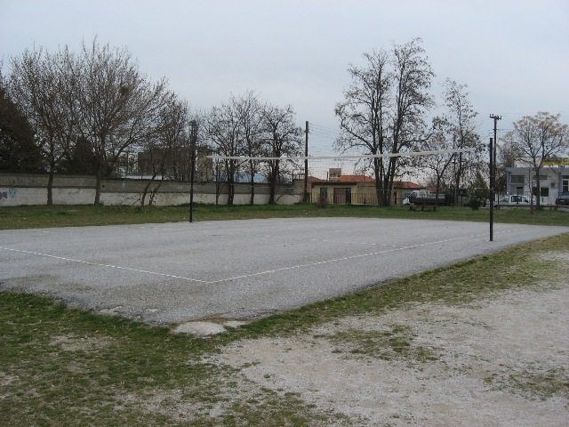

My school is the General Lyceum of Nigrita. It’s large and spacious and its outdoor area consists of a football pitch and a basketball court which are quite large and two volleyball courts. Last but not least, it has a canteen which offers food to students and two access doors to it. Avramoudi Andr.
6/4/2021

Slide 3
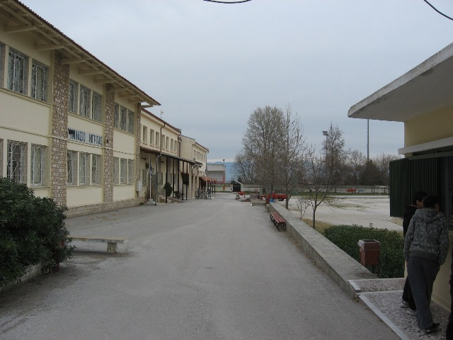
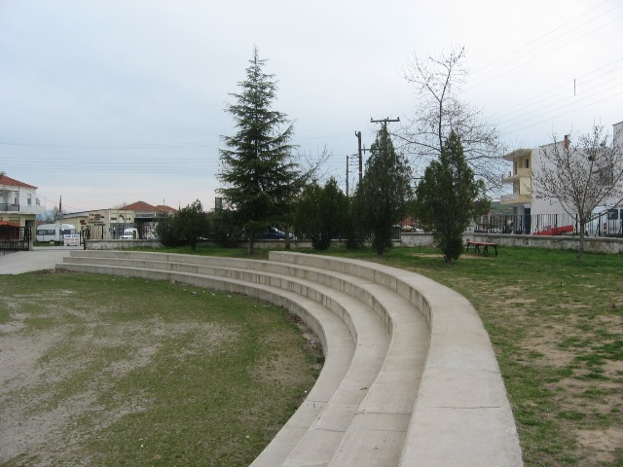
The school building is designed in such a way that provides equal access to all. It’s really attractive and pleasing to the eye Lazaridou El.
6/4/2021

Slide 4
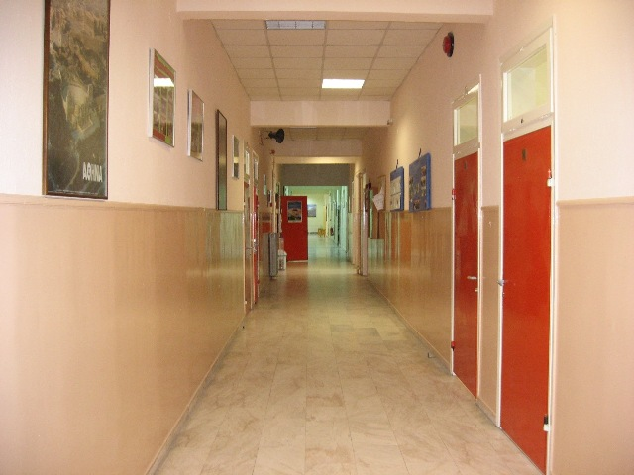
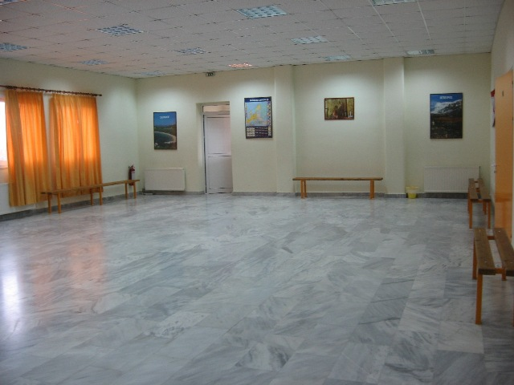
There are nice decorated classrooms with students’ paintings and other educational material. Lazaridou El.
6/4/2021

Slide 5
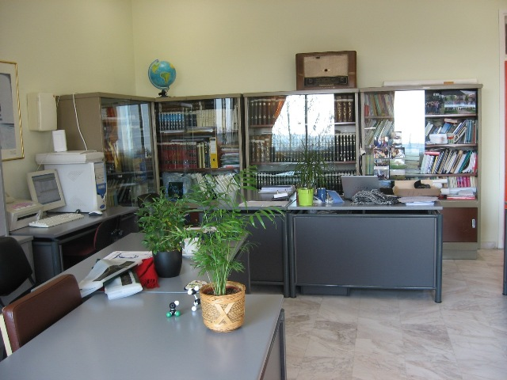
There is a professor’s office near the classes Lazaridou El.
6/4/2021

Slide 6
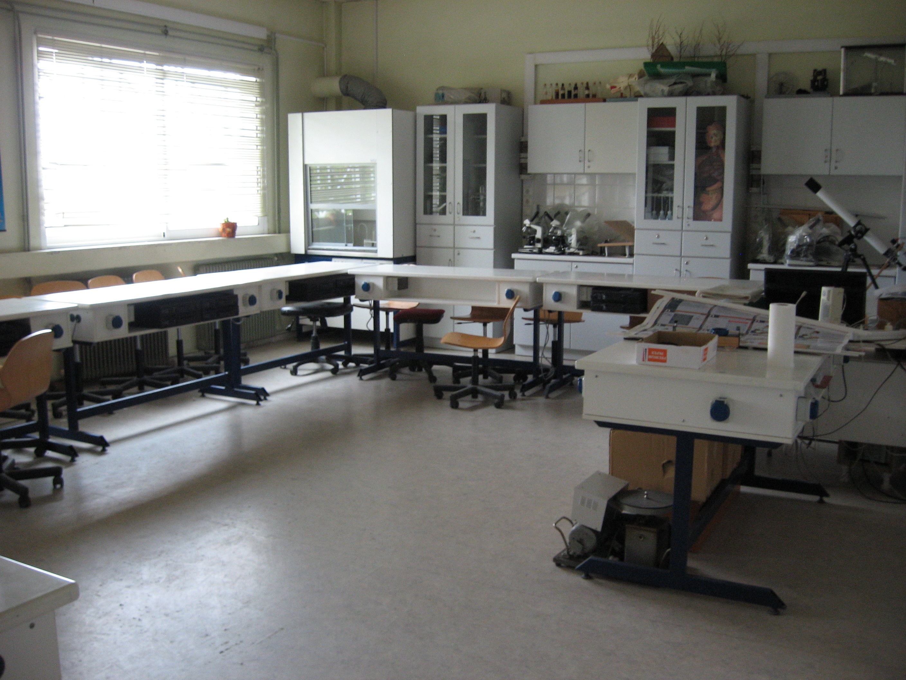
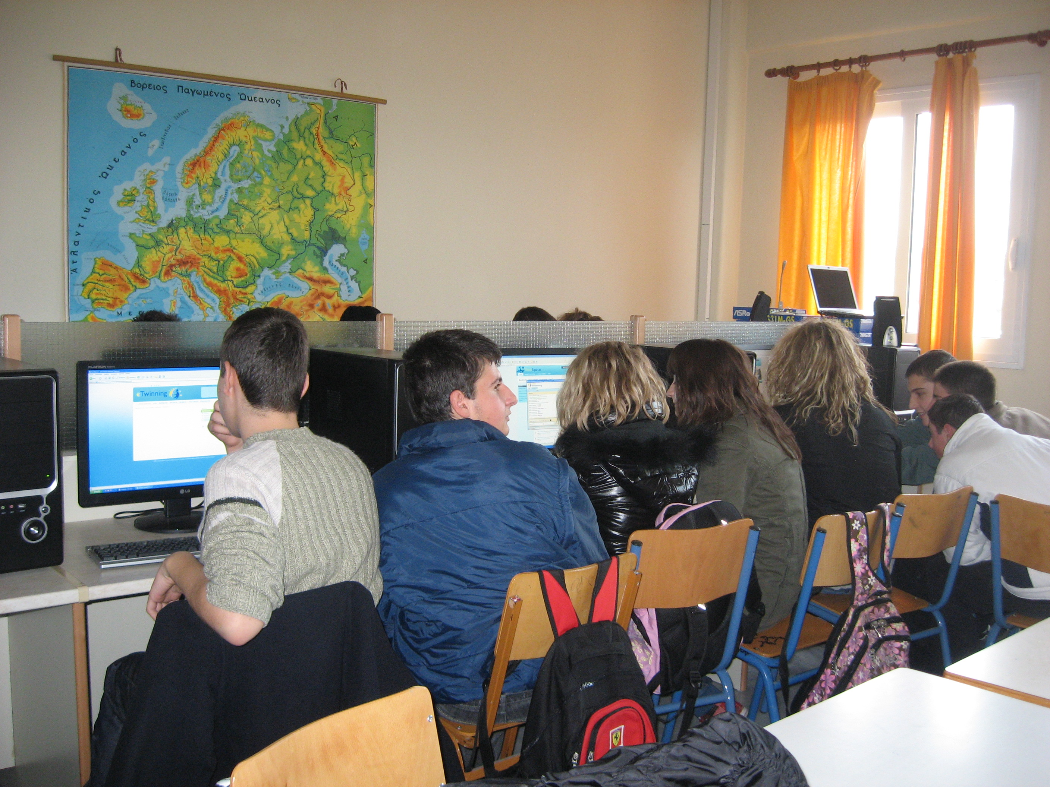
Also the building consists of a natural sciences’ lab and a computer lab Lazaridou El.
6/4/2021

Slide 7
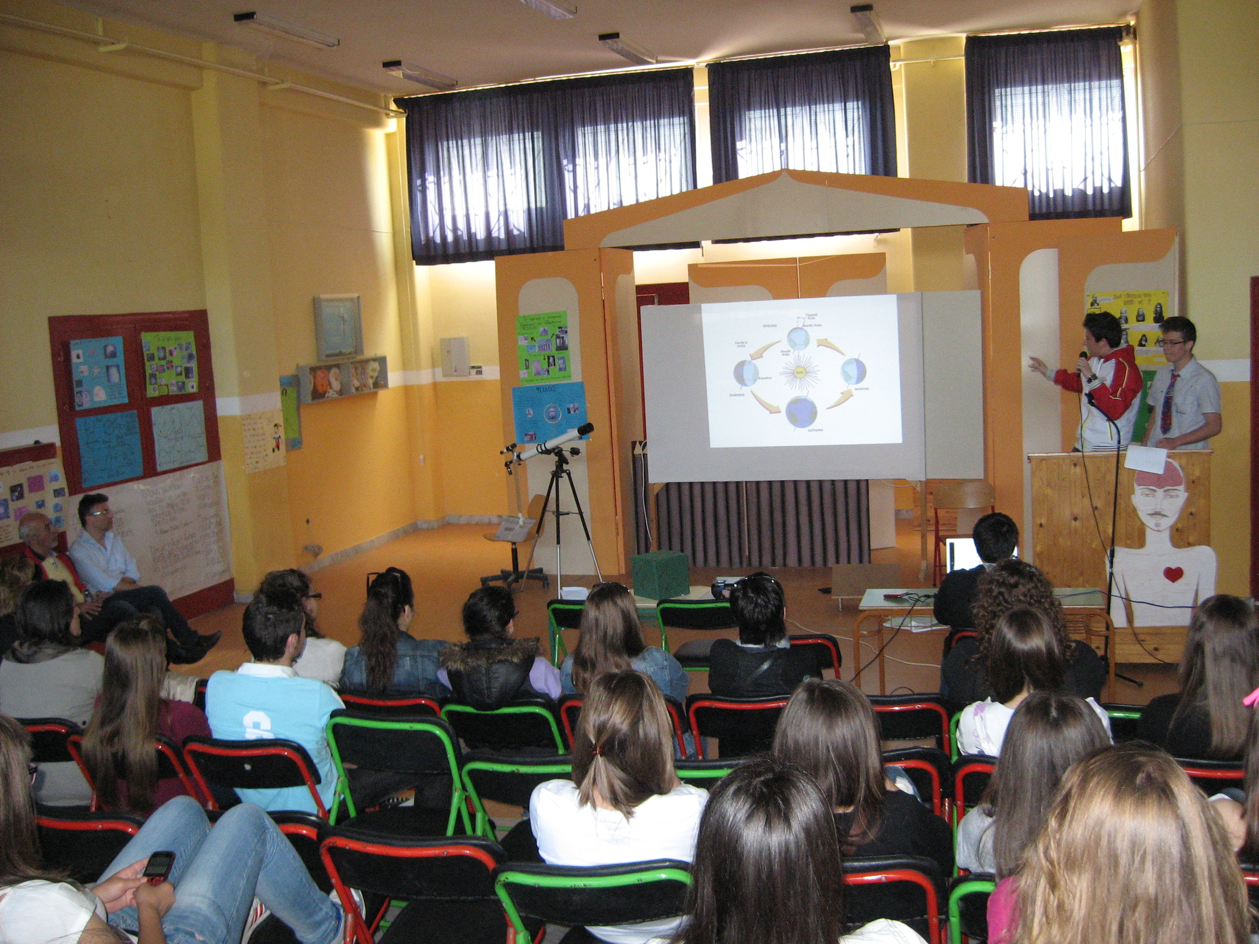
Last but not least there is a spacious room where we organize events, we watch educational films and celebrate holidays Lazaridou El.
6/4/2021

Slide 8

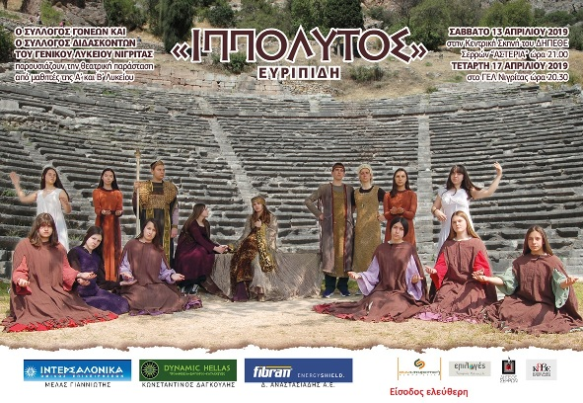
Our school likes projects and competitions! Our students take part in cultural and environmental projects, in athletic and photograph competitions and many other actions! http://lyk-nigrit.ser.sch.gr/autosch/joomla15/index.php/177-diakriseis-tou-gel-nigritas Katartzi Ath.
6/4/2021

Slide 9
Thank you very much for watching our presentation
PowerPoint made by : Music :
1) Giorge verzanlis Dark Piano - Sociopath
2) Nikos Dragatogiannis
3) Stergios Thasitis Professor in charge :
4) Xristos Gravalis Stella Chatzara
Texts made by :
1) Rafail Georgitzikis
2) Andromaxi Avramoudi
3) Athanasia Katartzi
4) Elena Lazaridou
School Website : http://lyk-nigrit.ser.sch.gr/autosch/joomla15/
6/4/2021

