Slide 1

HANDBALL
ENGLISH

Slide 2
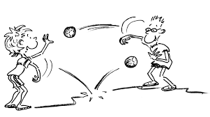
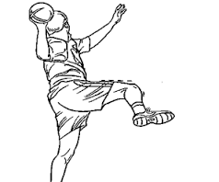

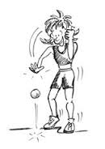


To pass
To shoot
The ball
To run behind
To run forward
The goal
To dribble

