Slide 1
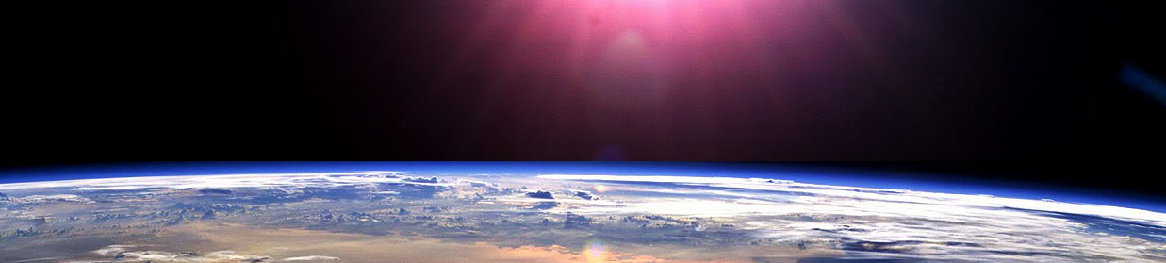
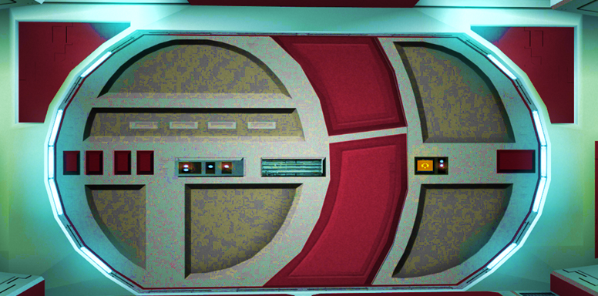


Slide 2

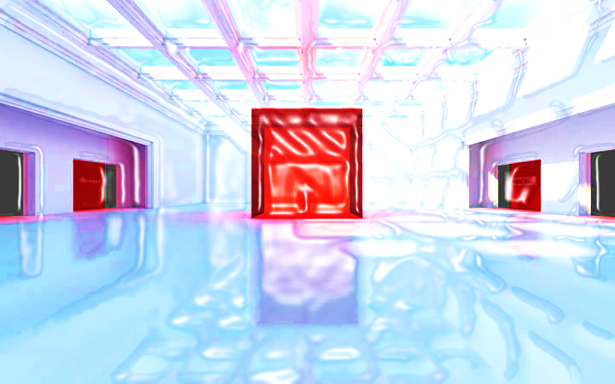





VOLUME: 3D OBJECTS

Slide 3



















Course Content: Choose your topic …
Whole Number and Functions
place
value
negative
numbers
add and
subtract
multiply
divide
round
numbers
ratio
scale
fraction
decimal
numbers
percent
percent
decimal
fraction
MATHS L1 to L2
Parts of a whole
metric
measure
imperial
measure
perimeter
area
volume
formulae
bodmas
charts
data
averages
prob-
ability
Measure and Shape
Handling Data

Slide 4





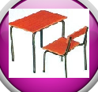





Home Revision Progress Check 1 Video/Discuss Vocab / jobs Lesson Activities Quizzes Topic Answers Progress Check 2 Cont. Learning
Topic Introduction : Volume
The volume of an object tells you how big the object is, how long, wide and high. All objects you can pick up, touch and move around have a volume no matter how thin they might be in any particular direction.
Volume is a measurement of the lengths along the sides of an object and multiplying these numbers tells you how many ‘cubes’ of 3D space fill it. Therefore the index number this time is 3. This method finds simple box shaped volumes but more complicated shapes such as cylinders and sphere require formulas to find their volumes.
Choose an icon to select where to start
V O L U M E

Slide 5



Warm up Exercise 1
Lets start today by revising ! Complete the above sums and multiplication grid

Slide 6


Warm up Exercise 2
Calculate the instruction on the central number
Bubble
maths
2:1
-176
+1999
Round to nearest 10
2014
x73
/12
/1000

Slide 7

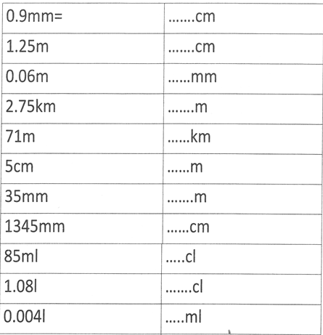
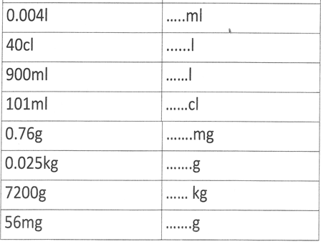
Warm up Exercise 3

Slide 8

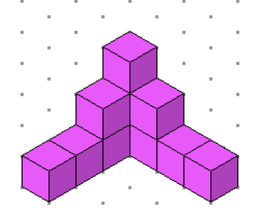
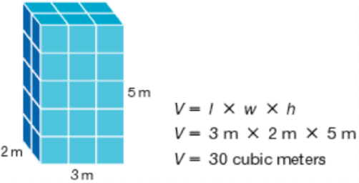

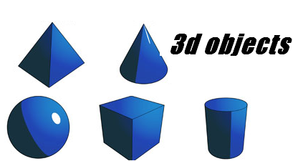
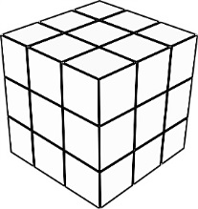
Progress Checker 1
W
What do you already know about Volume ? What did you study this week?
How would you rate your skills in finding Volumes of 3D objects ?
Excellent ability
Good ability, but working to improve
Ok, making a start but I know I have lots to still learn
The day I started stuying is… The ‘Session Aims’ are…
A Find the volume of simple cube and cuboid shaped objects
B Find the volume of pyramids, cones, cylinders and spheres
C Use volume formulae and know the units for volume and solve practical problems

Slide 9

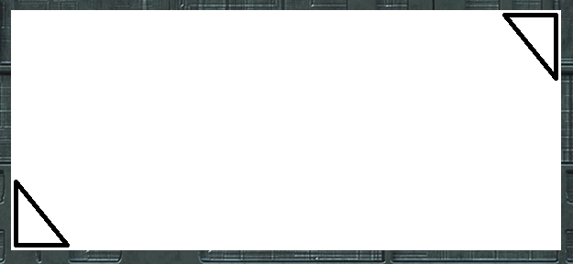
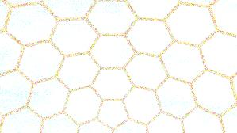

Introductory Video and Discussion
KHTU.
What does ‘Volume’ mean and what is it measuring ?
What are the units for the volume of a shape ?
How do you measure the volume of a liquid (not its capacity ! ) ?
What are ‘Dimensions’ and why are they important in the topic of volume ?
What is a prism and what is it about prisms that make it easier to find their volume ?
How can we find the volume of a sphere such as a planet, star ..?
Watch the introductory video and then discuss the above
Your thoughts..

Slide 10


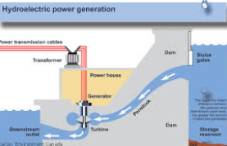
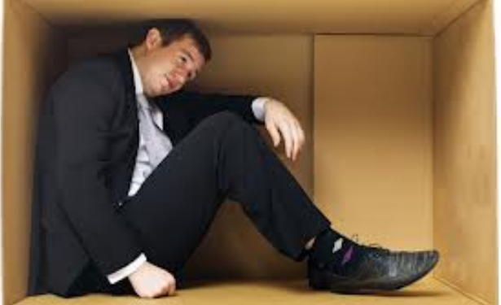
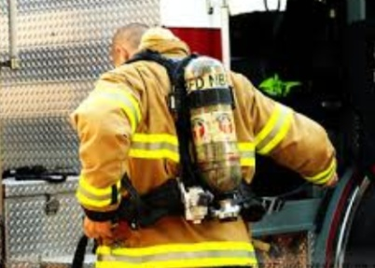

Vocabulary and Jobs
Volume
Space
3 Dimensions (3D)
Depth
Cubed
Cubic
Height
Solid
Net
Interior
Capacity
Formula
CC ml cm³
These are the words you will be using in this topic
Builder
Packaging
Room/building Designer
Scuba Diver
Fireman
Nurse
Car Mechanic
Manufacturer
Water treatment
Powerplant
…. Can you think of more?
…………………………………
…………………………………

Slide 11

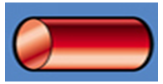
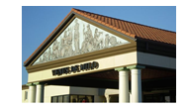
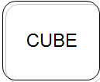

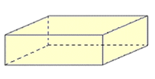
Lesson: Concept Activity
What do you already know…?
Start by matching up the names of 3D objects with their shapes and formulae

Slide 12
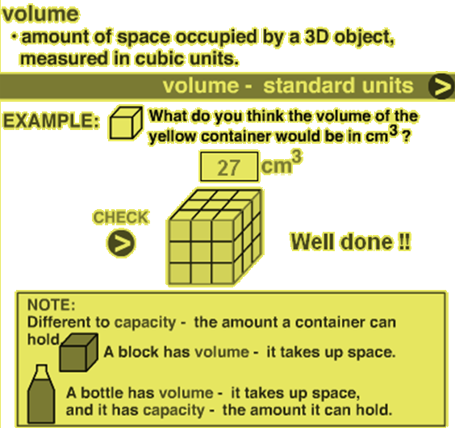

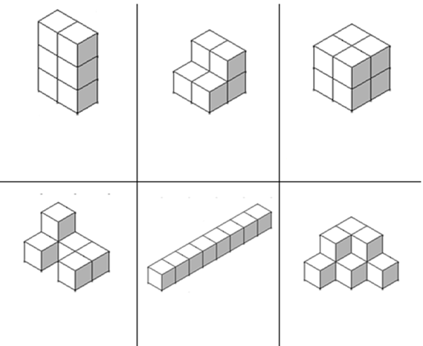
Lesson: Main Teach 1
Volume: how to find volumes
Just count the number of ‘CUBES’ you can see.. this is called the object’s ‘Volume’
Here there are 6 cubes !
Here its 6 again !
Now there are 8 cubes !
How many are here???
Or here …. ??
Or here…??

Slide 13
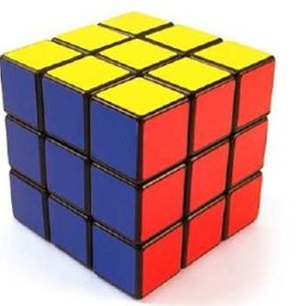
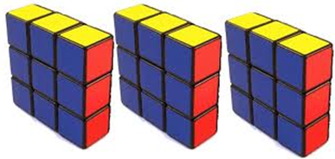
Lesson: Main Teach 2
Volume: how to find volumes
If a 3D object is a cube or cuboid shape it can be easier to find the volume (number of cubes) not by counting them but by multiplying the rows, columns and layers of cubes.
Below is a cube but this is really made up of lots of layers of cubes on top of each other.
There are 3 cubes in a row… there are 3 rows…. There are 3 layers
Therefore the volume is 3 x 3 x 3 = 27 cubes

Slide 14

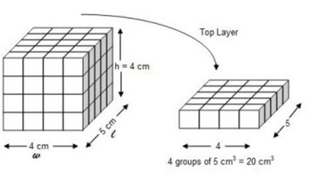
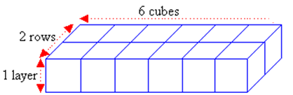
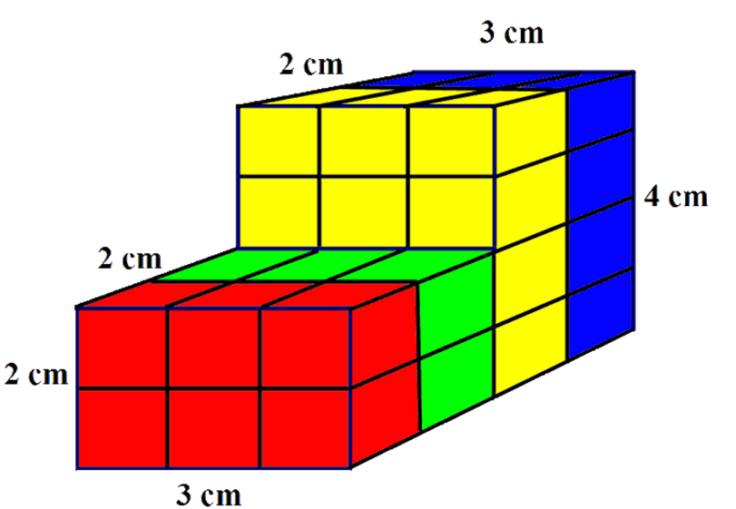
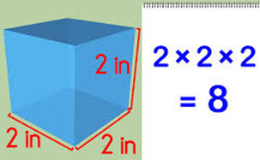
Lesson: Main Teach 3
Volume: cuboid shaped examples V = Volume
Multiply the Rows x Columns x Layers
V = 4 x 5 x 4 = 80
V = 1 x 2 x 6 = 12
V = 2x2x3 + 2x3x4 = 36

Slide 15
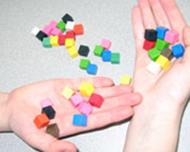

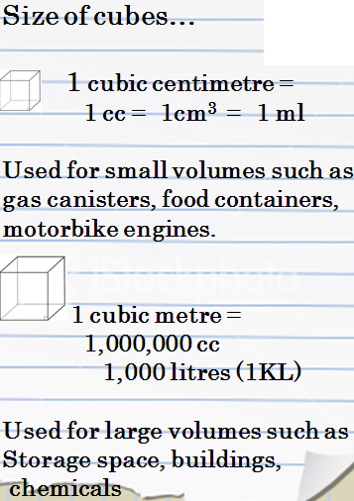


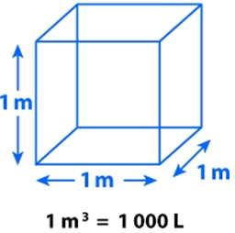
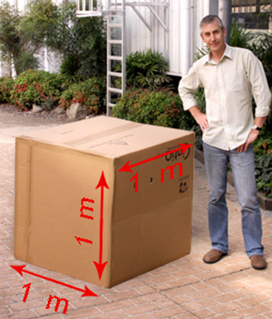
Lesson: Main Teach 4
cm³
^{=1ml}
m³
^{=1000L or 1 KL}

Slide 16
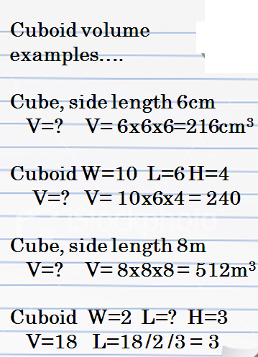
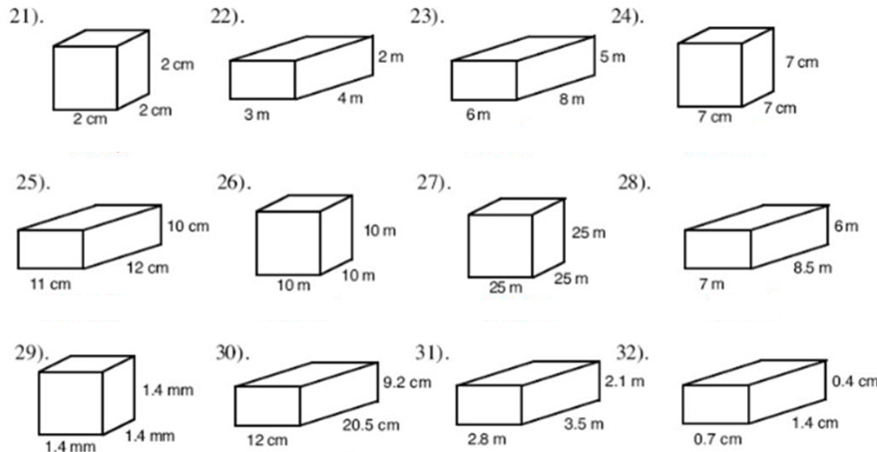
Lesson: Main Teach 5
1
2
3
4
5
6
7
8
9
10
11
12
Can you find the volume of the above cuboid shapes by multiplying their lengths x widths x heights ?
Don’t forget at the end to put the unit (the size of the cube)…either cm³ or m3… or even mm³ !

Slide 17
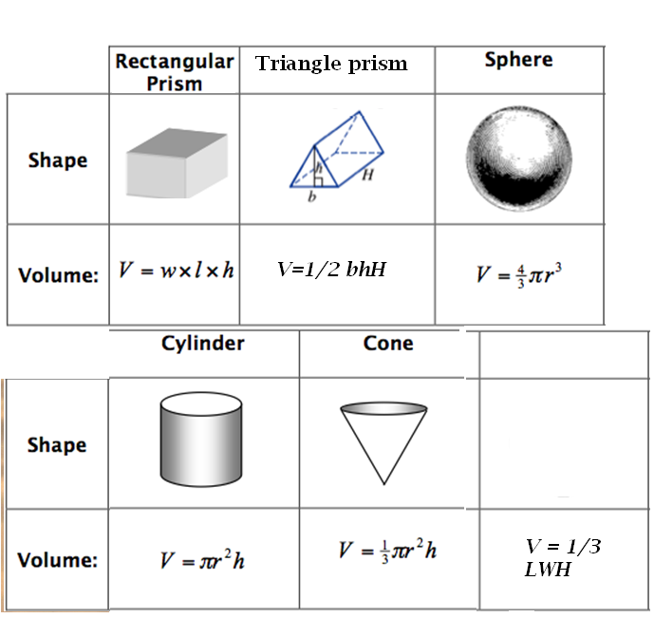
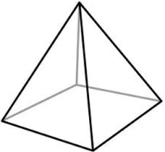
Lesson: Main Teach 6
Other shapes have a formula to be able to find their volume as the area changes through their height and so we cannot just multiply side lengths
To work out these volumes…
Write down their formula
Replace the letters in the formula with the numbers you know
Solve the sum to find V
Add the unit ( eg cm³)
Pyramid

Slide 18

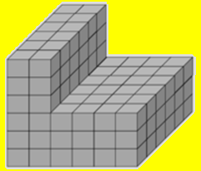

Lesson: Try out
Block 1 : Watch tutor led demo (in class or on video) V = Volume (number of cubes inside a 3D object)
Try these, 1) A cuboid with length 10cm, width 3cm and height 5cm, V=?
2) 14 x 20 x 3 = 3) How many cc?
Block 2 : Watch tutor led demo (in class or on video)
Try these, 4) Which is the largest cube? cm³ M³ mm³ Km³
5) Find the volume L = 2.3 W = 5.7 H = 9.1 6) V = ?
Block 3 : Watch tutor led demo (in class or on video)
Try these, 7) Cylinder volume with r=3cm L=8cm ? 8) Pyramid volume with L=4.5ft W=2 ft H=9ft
9) Cone volume is 30cm³, r=5cm , length = ? 10) Triangle prism L=18, H=20 W=? V= 40
11) Sphere with radius 2,300m, V = ?
L
H
W

Slide 19
Lesson: Websites and links
http://www.sheppardsoftware.com/mathgames/geometry/shapeshoot/VolumeShapesShoot.htm
Volume, shoot the cubes game
Volumes of cuboids, adjust the length
width and height and see cuboids
http://www.mathsisfun.com/flash.php?path=/geometry/images/cuboid-volume.swf&w=750&h=750&col=%23FFFFFF&title=Volume+of+a+Cuboid
Variety of volume videos on web page
with formula and examples
http://www.onlinemathlearning.com/volume-formula.html
3D objects and their volumes web page
http://www.mathwarehouse.com/solid-geometry/
Create and animate cuboids of various
sizes
http://illuminations.nctm.org/ActivityDetail.aspx?ID=6
Video showing how the formula is
derived for a sphere (hard!)
http://www.youtube.com/watch?v=xuPl_8o_j7k
Great website with volume of solids
lessons
http://www.mathexpression.com/volume-of-solids.html

Slide 20
Lesson: Activity A
Volume Link !!
Like a set of dominoes, find the answers to the Volume problems
The answers will be on other cards !
Link them up to create a rectangle
4 cm
20m³
2 cm
6 cm

Slide 21
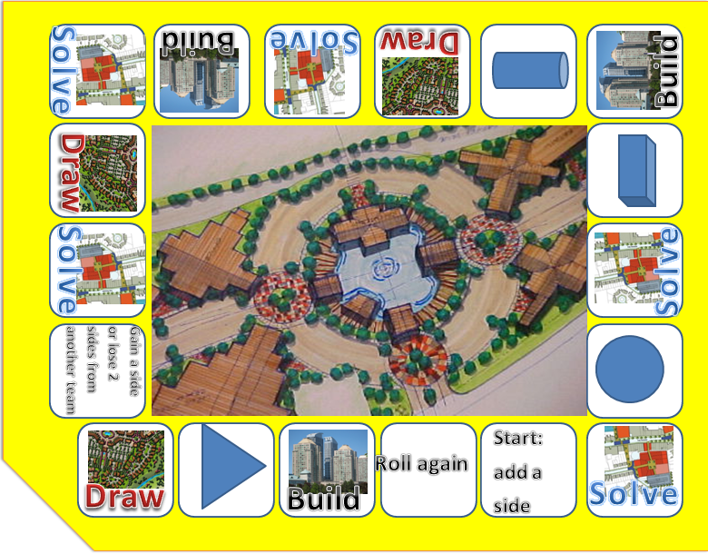

Lesson: Activity B
Play the volume game !
You are attempting to score 20 points to win the game
Key….
Solve : take a card and solve the problem before the others, winner can score a point
Build : take a card and build the shape with the yellow blocks or card etc, winner can score a point
Draw : take a card and draw the shape before the others, winner can score a point
Shape : free space, do nothing
HAVE FUN !!

Slide 22
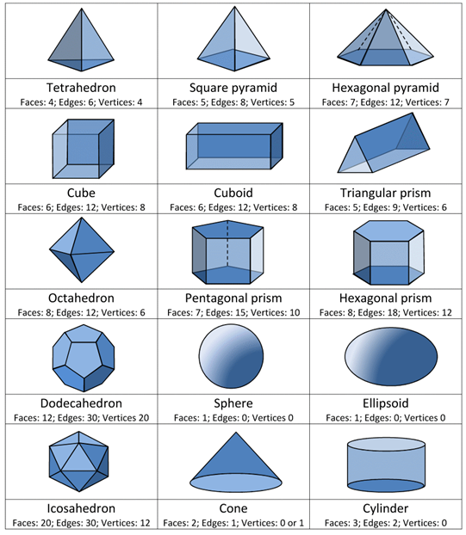

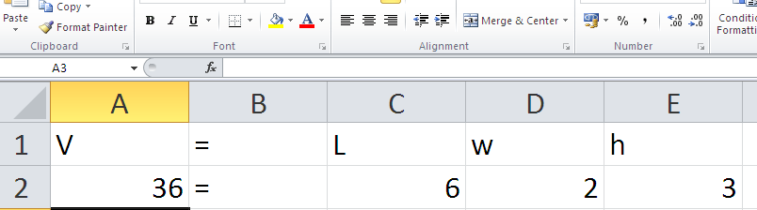
Lesson: Activity C
On an excel spreadsheet, create an input table for various 3d objects that will work out their volumes given the inputted lengths, widths, heights etc

Slide 23
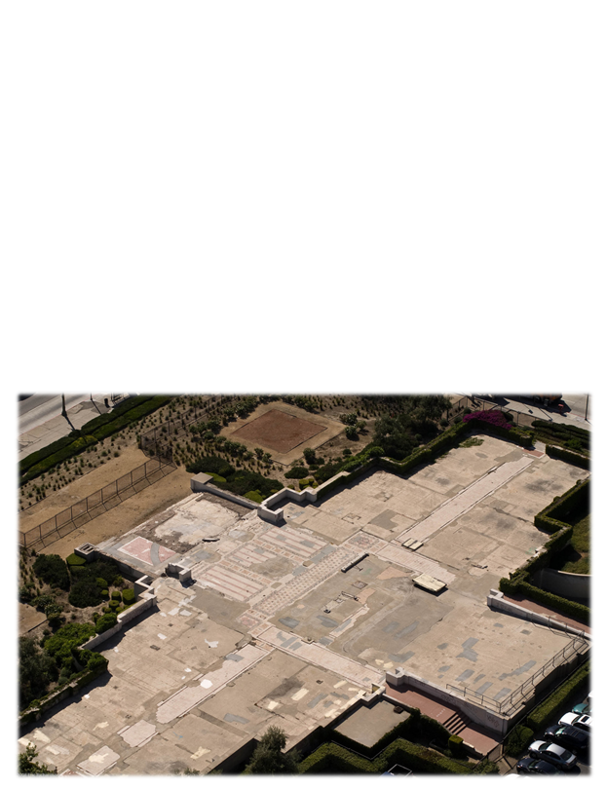

Lesson: Activity D
On the footings, draw plans for a new building then answer the functional questions based on your plans.

Slide 24
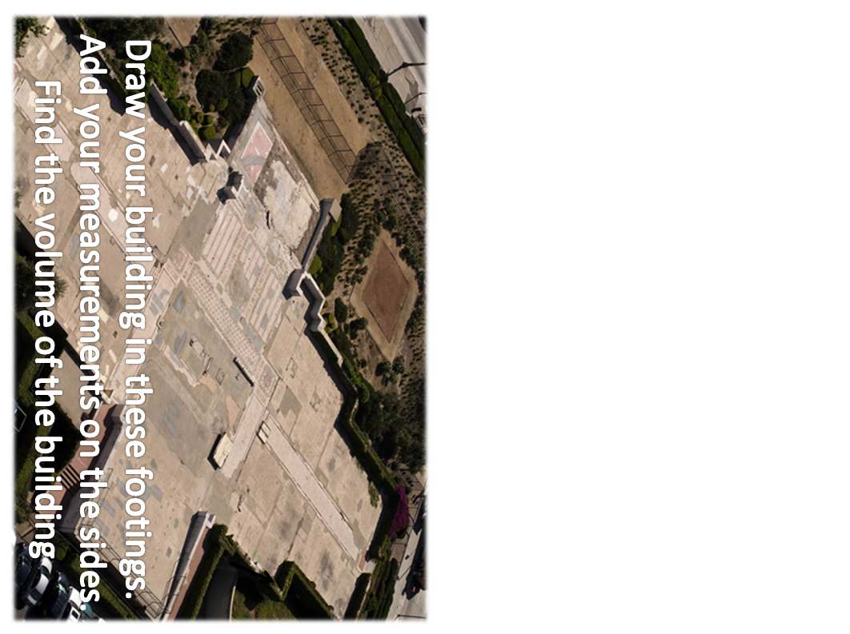

Slide 25



Lesson: Activity D
Functional Questions
1
With a scale on your drawing of 1cm=5m, what are the dimensions of your building?
2
Using the appropriate formula for the shape of the building you have drawn, work out its total volume in m³.
3
If the building designers need the volume of space in the building to be double the size, work out the new dimensions of the building.

Slide 26

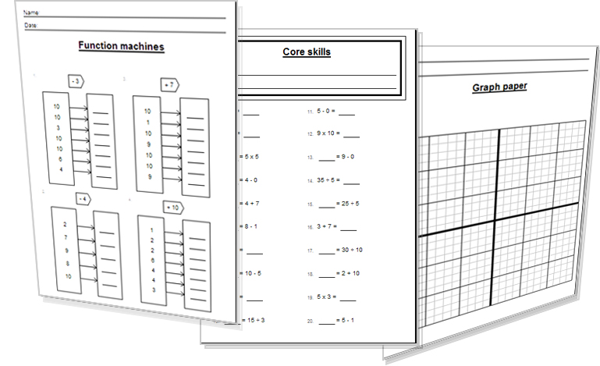
Lesson: Activity E
Try a variety of written practice
Worksheets
Workbooks
Practice Exam Papers
Maths Problems

Slide 27


Lesson: Practice – just the numbers
Find the volume of the Cuboids
L = 8cm, W = 2cm, H = 10cm V = ?
L = 5m, W = 3m, H = 9m V = ?
L = 6km, W = 5km, H = 2km V = ?
L = 11mm, W = 5mm, H = 2mm V = ?
L = 4.5ft, W = 5ft, H = 2ft V = ?
L = 0.1in, W = 5in, H = 2in V = ?
L = 50miles, W = 5miles, H = 2miles V = ?
L = 1/2cm, W = 5cm, H = 2cm V = ?
L = 30m, W = 5m, H = 250cm V = ?
L = 78cm, W = 5cm, H = 2m V = ?
Find the volume of the Cubes
L = 4, W = 4, H = 4 V = ?
L = 9, W = 9, H = 9 V = ?
L = 3in, W = 3in, H = 3in V = ?
L = 1.5m, W = 1.5m, H = 1.5m V = ?
L = 0.2cm, W = 0.2cm, H = 0.2cm V = ?
L = 10km, W = 10km, H = 10km V = ?
Find the volume of the Pyramids
L = 3, W = 2, H = 4 V = ?
L = 7, W = 1, H = 1 V = ?
L = 9, W = 5, H = 8 V = ?
L = 0.5, W = 3, H = 2 V = ?
L = 6, W = 3, H = 2.4 V = ?
L = 800cm, W = 200cm, H = 3m V = ?
L = 1mm, W = 1mm, H = 3mm V = ?
L = 2.3km, W = 1.9km, H = 1km V = ?
L = 6in, W = 2in, H = 1 ft V = ?
Find the volume of the Cones
r=9 L= 3 V = ?
r=0.5 L= 5 V = ?
r=100cm L= 2m V = ?
d=7 L=16 V = ?
d=3.4 in L=8 in V = ?
d=26 L=30 V = ?
Find the volume of the Spheres
r=45cm V = ?
r=1 mile V = ?
r=17in V = ?
r=80ft V = ?
r=20cm V = ?
r=90m V = ?
r=0.5cm V = ?
r=6mm V = ?
r=9.2 ft V = ?
Find the volume of the Cylinders
L = 2cm, r = 5cm V = ?
L = 7m, r = 18m V = ?
L = 5 ft, r = 5 ft V = ?
L = 90, r = 20 V = ?
L = 1 km, r = 4m V = ?
L = 2miles, r = 30ft V = ?
V=Lwh
V=1/3 Lwh
V=4/3 π r³
V=L³
V=1/3 π r²L
V= π r² L

Slide 28

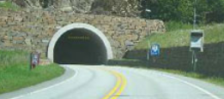
Lesson: Practice – word problems
A tunnel through a mountain is half of a cylinder shape with the tunnel height of seven metres and the tunnel length of half a kilometre long. What is the volume of rock that was removed from the mountain to create the tunnel (in m³) ?
A football is inflated with 6000cm³ of air. What radius does the ball inflate to?
An office block advertises its ‘To-let’ space as having 40,000 ft³. With a building length of 20m and width of 20m, how tall is the building if it is a cuboid shape?
A container crate measures 6m x 3m x 3m. What volume of products can fill a container?
A funnel in a factory is filled with hot, melted chocolate during the production of sweets. If the funnel has a diameter of 2m and contains 2m³ of chocolate, how tall is the funnel?
The pyramids of Egypt are 800m long and wide, having a square base and has a height of 139m. Work out the total volume of the blocks that make up the pyramid.

Slide 29
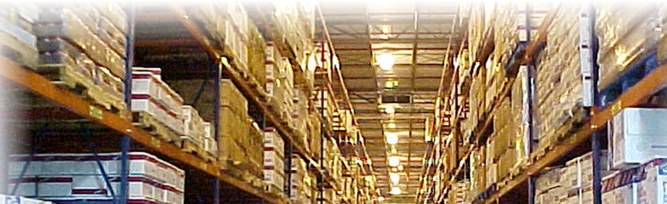

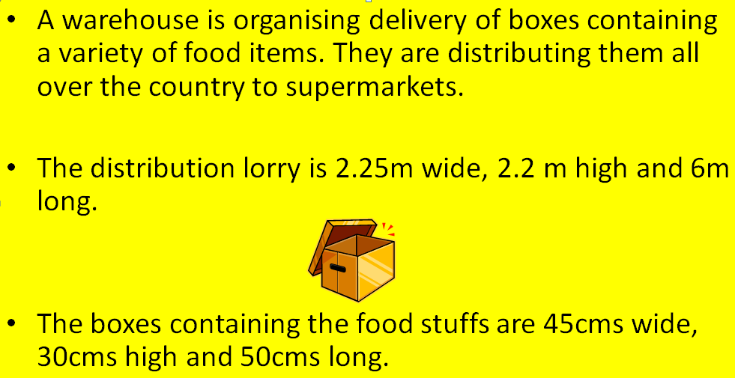
Lesson: Practice – Making it Functional 1
BB

Slide 30
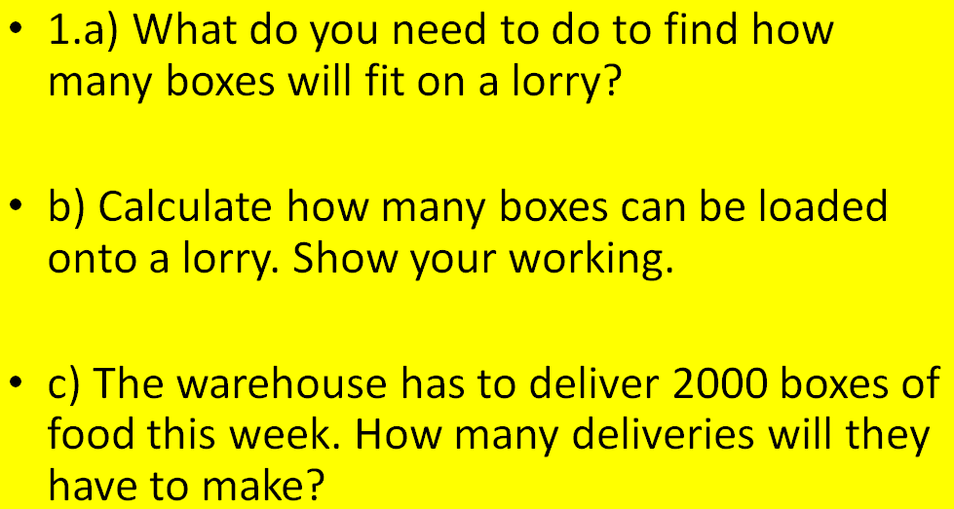
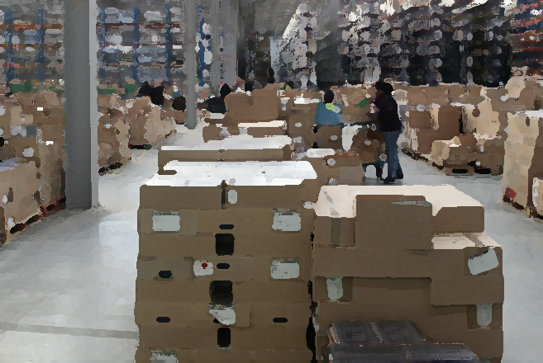
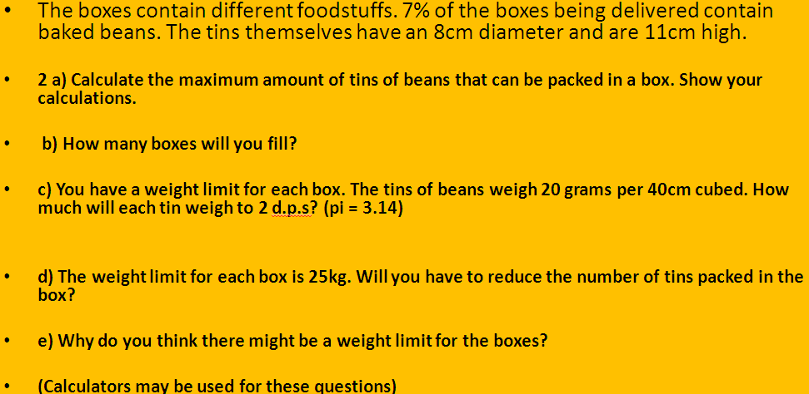
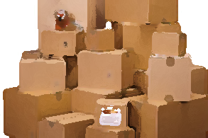
Lesson: Practice – Making it Functional 2
Use the information on the previous page
a

Slide 31
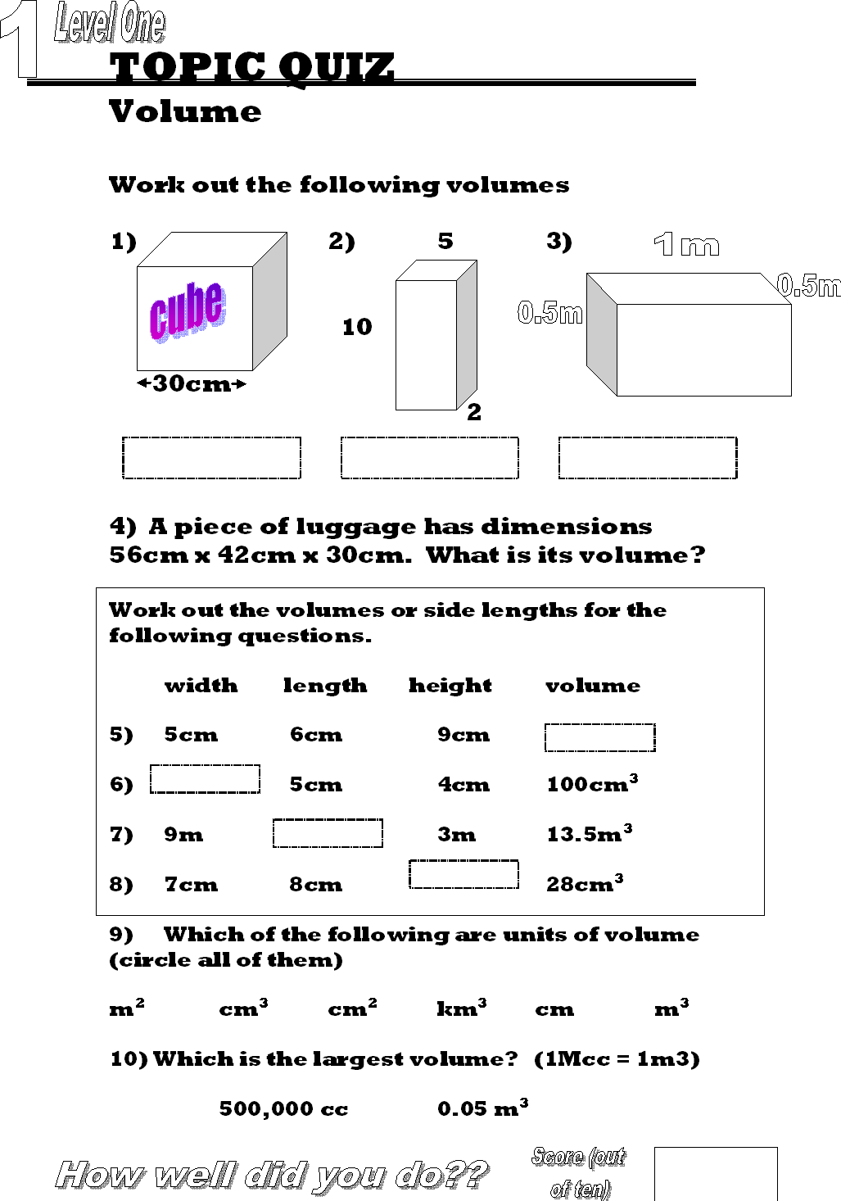


End of Session Quiz LEVEL 1

Slide 32


End of Session Quiz LEVEL 2

Slide 33

TOPIC ANSWERS 1
Block 1 answers
150 cm3
840
9 cc
Block 2 answers
4) km3
5) 119.301
6) 144 cubes
Block 3 answers
7) 226.08 cm3
8) 27 ft3
9) 1.15cm
10) 0.22
11) 50.9 B approx
Find the volume of the Cuboids
answers
160cm3
135 m3
70 km3
110 mm3
45 ft3
1 in3
500 cm3
5 cm3
37.5 m3
780 cm3
Find the volume of the Cuboids
answers
64
729
27 in3
3.375 m3
0.008 cm3
1000 km3
Find the volume of the Pyramids
answers
8
2.33
120
1
14.4
16 m3
1 mm3
1.46 km3
48 in3
Find the volume of the Cones
answers
254.34
1.31
2.09 m3
205.25
24.2 in3
5309.29
Find the volume of the Spheres
381,703.5 cm3 (38.2 m3)
4.2 miles3
20579.5 in3
2,144,660 ft3
33,510 cm3
3,053,628 m3
0.5 cm 3
904.8 mm3
3,261.8 ft3
Find the volume of the Cylinders
62.8 cm3
7125 m3
392.7 ft3
113,097
50,265.5 m3
9,952,565.5 ft3

Slide 34


TOPIC ANSWERS 2
Word Problem
answers
0.5 x 3.14 x r² x L
= 0.5 x 3.14 x 7² x 500m = 38,484.5m³
V=3.14 x r3
so.. 6000= 3.14 x r3
6000/3.14 = r³
³√1910.8 = r
12.4cm = r
40000 = l w h
so.. 40000/20x20 = h
100m = h
4) 6 x 3 x 3 = 54m³
5) V = 3.14 x r² x L x 1/3
so.. 2 = 3.14 x 1² x L x 1/3
2 / 3.14 x (1/3) = L
1.9m = L
800 x 800 x 139 x 1/3
= 29,653,333.3 m³

Slide 35




TOPIC ANSWERS 3

Slide 36



TOPIC ANSWERS 3

Slide 37
Progress Checker 2
W
What do you now know about Volume ? WHAT DID YOU LEARN? Write some examples…
How would you now rate your skills in finding Volumes of 3D objects ?
Excellent ability
Good ability, but working to improve
Ok, making a start but I know I have lots to still learn
I finished studying today.. I have completed these aims…
A Find the volume of simple cube and cuboid shaped objects
B Find the volume of pyramids, cones, cylinders and spheres
C Use volume formulae and know the units for volume and solve practical problems

Slide 38


Continuing to Study and Learn
What else can you do to help yourself to learn and practice? Here are ten suggestions, record which you do each week and also record your progress.
Internet websites
Repeat the lesson, make notes, organise a folder, revise
Own maths workbook
Study together with a friend or family member
Finish activities in this book
Complete class handouts or tasks
Practice exams / past papers
Use maths skills learnt at home or at work in real situations
Play games
Experiment yourself, try new things ask yourself questions
Try making a graph of number of practice methods you use against your progress score in each topic. Are you showing more practice gives better results?

