Slide 1
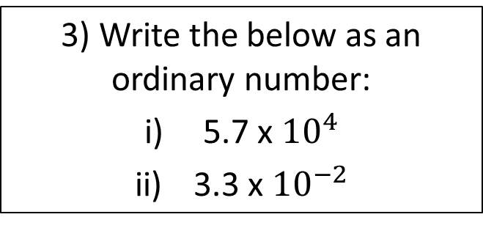
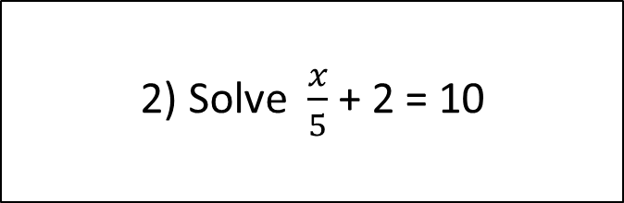

Starter
Find the side x.
3) Write the below as an ordinary number:
5.7 x ${10}^{4}$
3.3 x ${10}^{−2}$
x cm
= 57000
3cm
= 25
= 0.033
4) i) Find the nth term of
4, 9, 14, 19
ii) Find the 25th term
4cm
= ${(n+1)}^{2}$
= 676
2) Solve $\frac{x}{5}$ + 2 = 10
5) Without using a calculator, work out: 1086 ÷ 4
= 40
= 271.5

Slide 2
Linear Graphs
Learning Objectives
To be able to:
Identify and interpret gradients and intercepts of linear functions
Plot graphs of straight-line equations
Recognise and sketch graphs of linear functions
Find the midpoint of a straight line
Solve simultaneous equations using a graph

Slide 3
Equation of a Straight Line
Gradient
y = m x + c
y-intercept

Slide 4
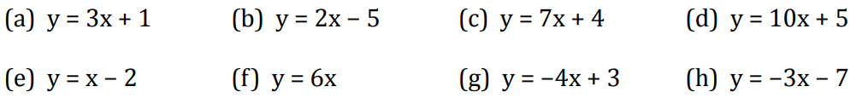
Your Turn . . .
1) Write down the gradient and y-intercept of each of these lines.
2) Are the lines y = 2x + 8 and y = 2x + 5 parallel?

Slide 5
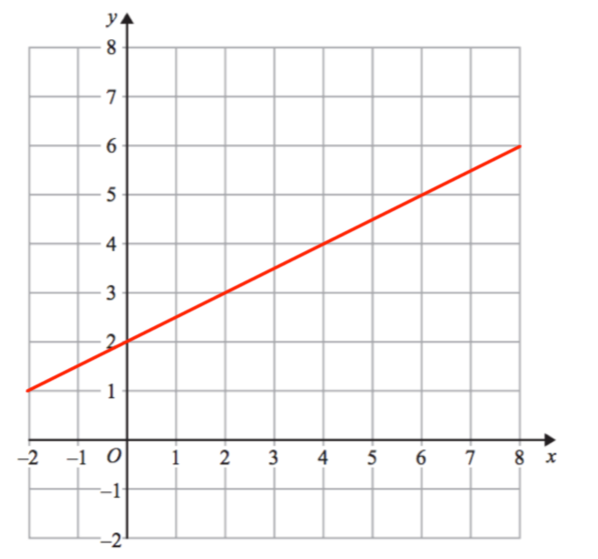
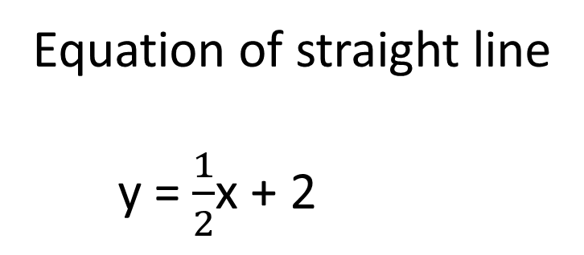
Gradient and y-intercept
Change in y
Change in x
2
4
1
2
Gradient =
=
=
y-intercept = 2
Equation of straight line
y = $\frac{1}{2}$x + 2

Slide 6
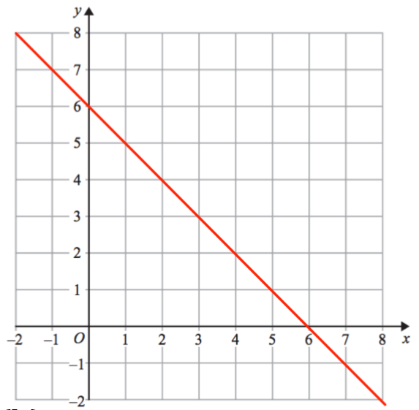
Gradient and y-intercept
Change in y
Change in x
Gradient =
y-intercept =
Equation of straight line

Slide 7
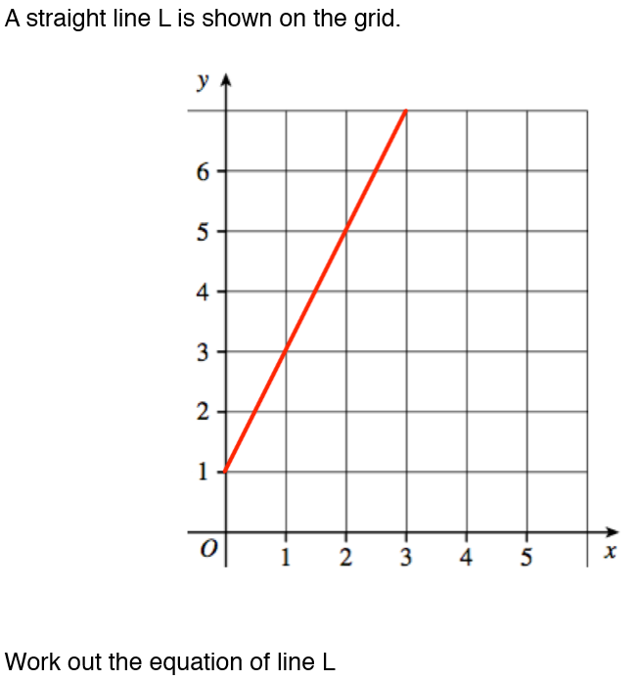
Your turn…

Slide 8
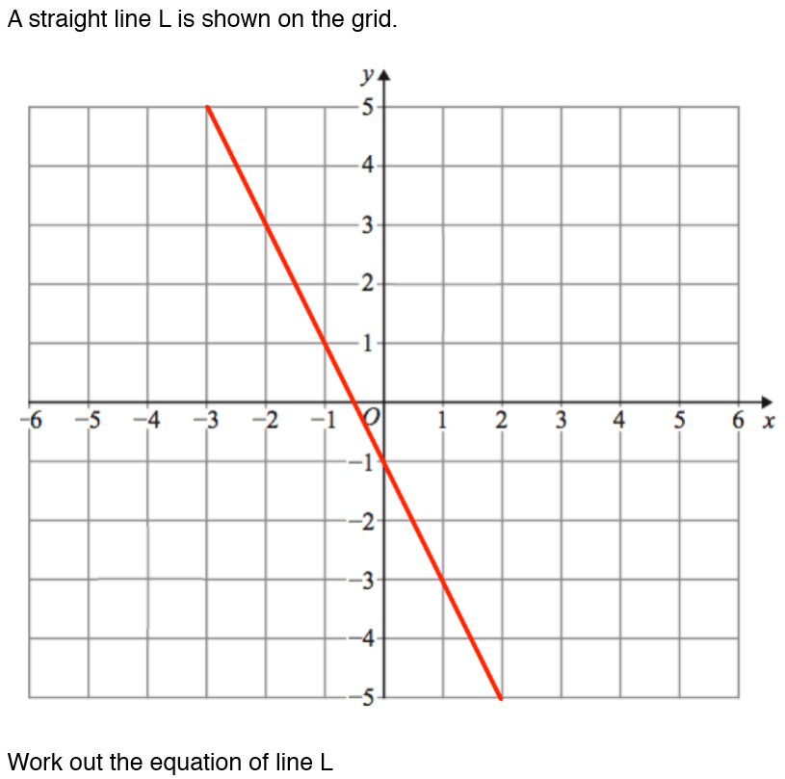

Slide 9
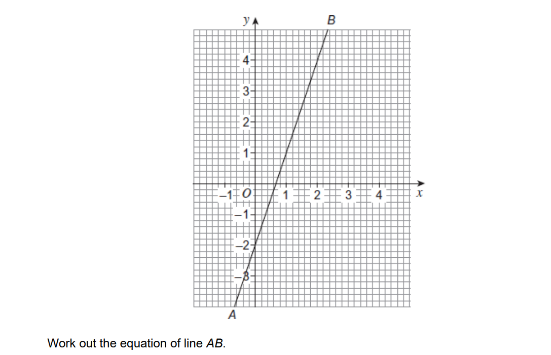
Question…
y = 3x − 2
(Total 3 marks)

Slide 10
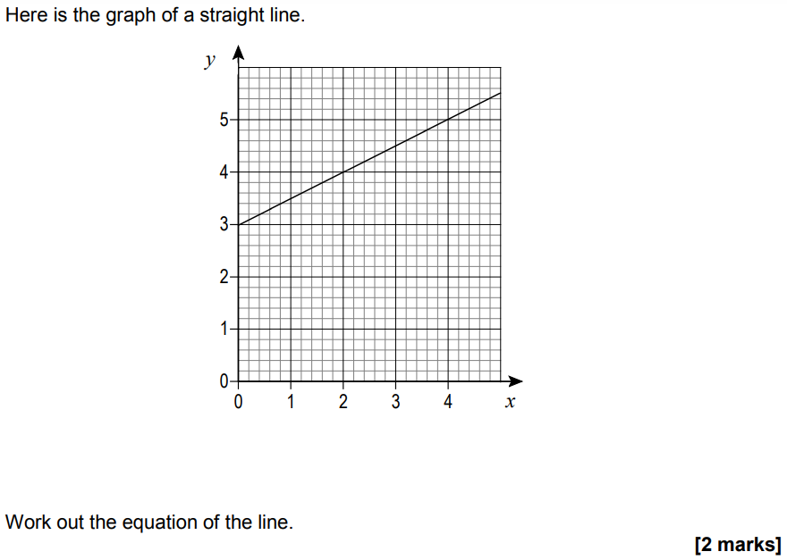
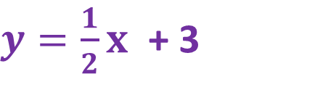
$y=\frac{1}{2}x$ + 3

Slide 11
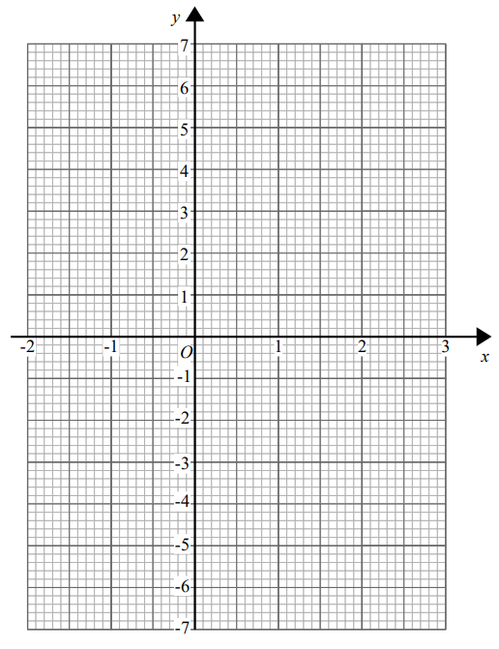
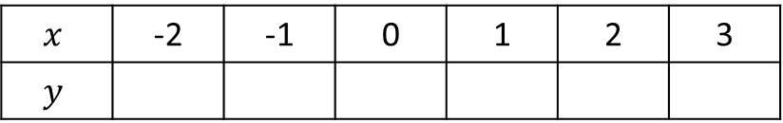
Plotting Graphs of Straight Line Equations
Plotting the graph of y = 3x – 1
$$x$$ | -2 | -1 | 0 | 1 | 2 | 3
$$y$$
-7 -4 -1 2 5 8

Slide 12
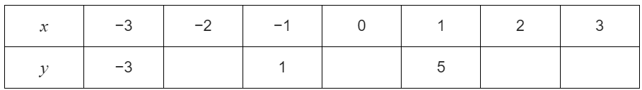
Your Turn
(a) Complete the table for y = 2x + 3
−1
3
7
9
(b) On a grid draw the graph of y = 2x + 3 for values of x from −3 to 3

Slide 13

Your turn…
Draw the graph of $y$ = 2$x$ + 3 for values of $x$ from -2 to 3.
Draw the graph of $y$ = 3$x$ – 2 for values of $x$from -2 to 3.
Draw the graph of $x$+ $y$ = 3 for $x$ values from -2 to 3.

Slide 14
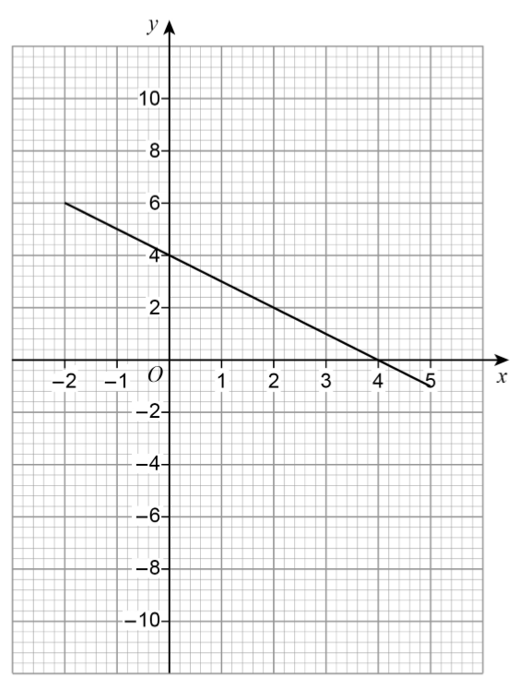
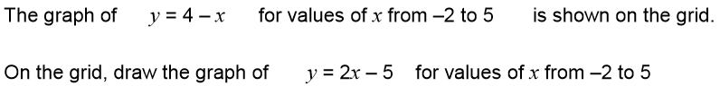

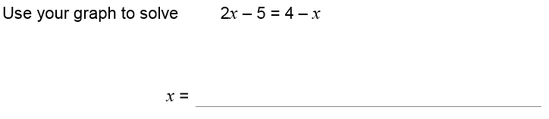


Slide 15
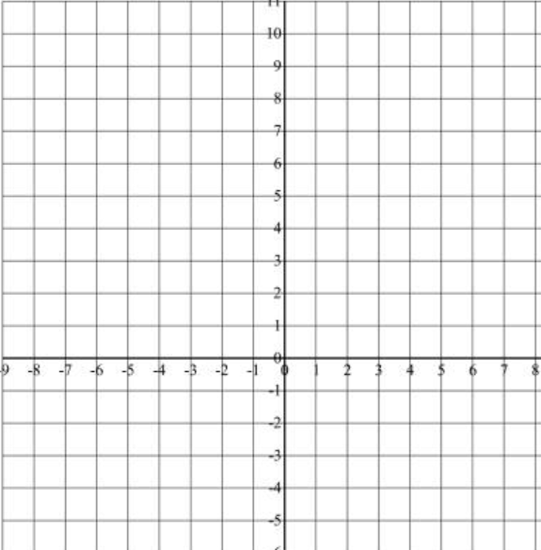
Midpoints
Plot the points (-2, 4) and (8, 10) on the graph.
Find the midpoint of the two co-ordinates:
Midpoint = ( 3 , 7 )
Plot the points (-5, 3) and (1, -3) on the graph.
Find the midpoint of the two co-ordinates:
Midpoint = ( -2 , 0 )

Slide 16
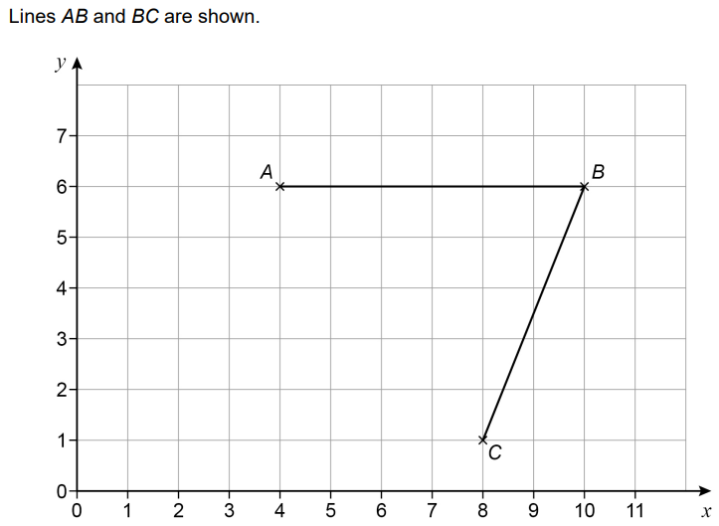
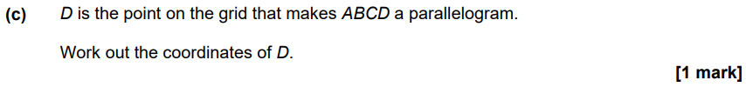
( 8 , 1 )
( 7 , 6 )
( 2 , 1 )

