Slide 1
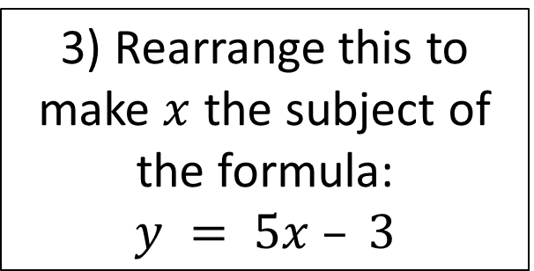
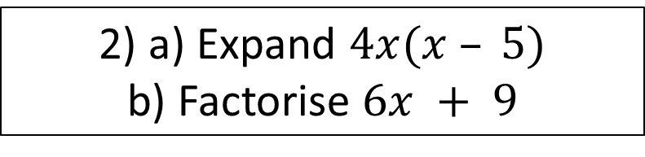
Starter
Find the area of the circle.
3) Rearrange this to make $x$ the subject of the formula:
$$y = 5x – 3$$
10cm
4) a) Find the nth term of
10, 14, 18, 22
b) Find the 35th term
2) a) Expand $4x(x – 5)$
b) Factorise $6x + 9$
5) Without using a calculator solve
581 ÷ 5

Slide 2
SPEED
To calculate the speed of something, you need to divide the distance it has moved by the time it has taken to move that distance.
The formula for calculating speed is: speed = distance ÷ time
Eric drives 180 miles in 3 hours. What is his speed in mph?

Slide 3
Speed
Distance and Time Calculations
1a) A car drives 120 miles in 3 hours.
What is the average speed, in mph, of the car
1b) A helicopter flies 240 miles in 2 hours 30 minutes.
Calculate the average speed, in mph, of the helicopter
1a) A lorry travels 100 miles at an average speed of 25 mph.
Work out how long the journey lasts
1b) Edith leaves her home at 11.50am.
She travels 75 miles at an average speed of 30mph.
At what time does she finish the journey.
Density
1a) A piece of wood has a mass of 8g and a volume of 10cm³. Work out the density of the wood

Slide 4
Your turn…
1) Siobhan runs 9km in 45minutes. What is her speed in km/h?
Hint: you may need convert one or more of the units first to get the correct unit of speed
2) Liam runs 200 m in 25 seconds. What is his speed in m/s?
3) Tina completes a 26-mile marathon in 150 minutes. What was her speed in mph?

Slide 5
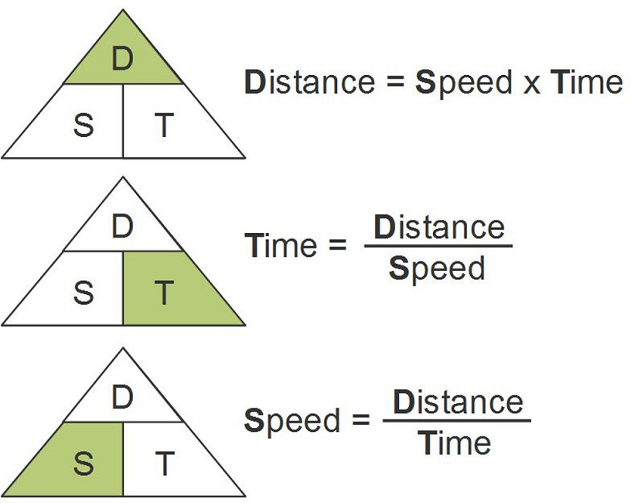
DISTANCE AND TIME CALCULATIONS
A train is moving at a speed of 10 m/s.
How much time does it take for the train to travel 50m?
2) How far does the train travel in 7 seconds?

Slide 6
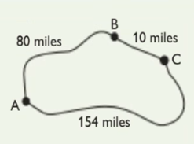
Your turn…
Dimitri is planning a car journey.
He has sketched the roads that he could take.
Dimitri will obey the following speed limits:
The road from A to B has a 50 mph speed limit.
The road from B to C has a 20 mph speed limit.
The road from A to C has a 70 mph speed limit.
What is the fastest route from A to C?
b) Dimitri decides to take the route that passed through B.
He sets off from point A. After 1½ hours, his car breaks down.
If he travels within the speed limit, what is the farthest he could have travelled?

Slide 7

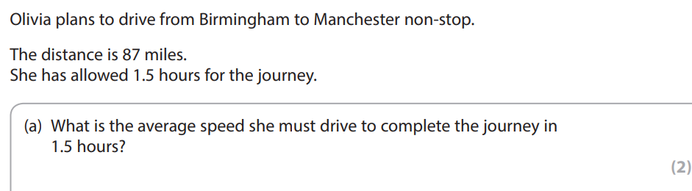

Slide 8
DENSITY
Density is a measurement that relates the weight of something to its volume. Some common units of density are g/cm³ (grams per cubic centimetre) and kg/m³.
density = weight ÷ volume
volume = weight ÷ density
weight = density x volume
Sarah cuts a piece of wood in the shape of a cuboid. It is 3cm long, 2cm wide and 1cm thick. The wood has a density of 0.7 g/cm³.
What is the weight of the piece of wood that Sarah cut?

Slide 9
Your turn…
2) A block of ice weighs 12 400kg. It has the shape of a cylinder with a radius of 1.2m and height of 3m. What is the density of the ice? Give you answer to one decimal place.
1)Diamond has a density of 3.5g/cm³.
What is the weight if a diamond that has a volume of 0.2cm³?

Slide 10
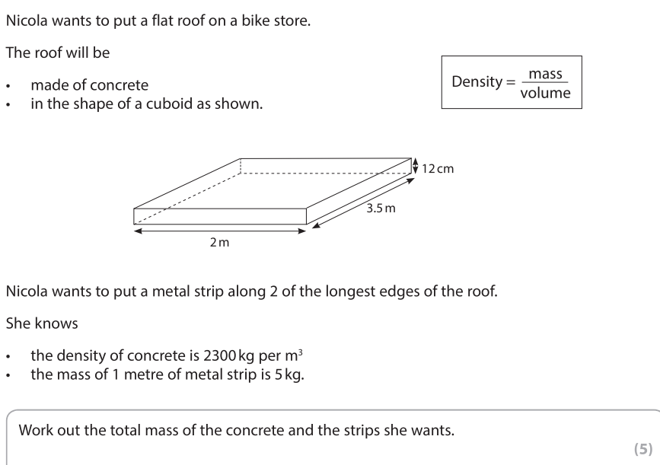

Slide 11
RATES OF PAY
A rate of pay is how much something costs per unit of time. For example, a phone call might cost 5p per minute. If a call lasted for 8 minutes, it would cost 8 x 5p = 40p
Jill is supposed to work 37.5 hours a week and earns £9.62 per hour.
During a busy week, she is asked to work a total of 40 hours.
For the extra hours, her pay is increased to £12.10 per hour.
How much will Jill earn this week?

Slide 12
Your turn…
A premium-rate telephone line charges £3.60 per minute, plus a fixed cost of £1.20. How much would a call lasting half an hour cost?
2) Ahmed has a job that pays £410 a week. How much will Ahmed earn in:
12 weeks?
52 weeks?
3) Ahmed is offered a new job that pays
£22 000 per year.
If Ahmed takes this new job, will he earn more in a year than with his current job?

Slide 13

July 2018 Paper 2
There is a high-speed rail track between London and Manchester.
The length of the track is 210 miles
A train departs London at 11.20 and arrives at Manchester at 13.28.
The train company claims
the average speed of the train is 104 miles per hour
Is the average speed of the train 104 miles per hour?
(4 marks)

Slide 14
November 2017 Paper 2
Barney is cooking a chicken.
He has these instructions.
Cook the chicken at 180 degrees Celsius for 20 mins per 500g plus 15 minutes
Rest the chicken for 10 minutes before serving
The chicken weighs 1.8 kg
Barney wants to serve the chicken at 2pm
What is the latest time Barney should start cooking the chicken?
(5 marks)

