Slide 1
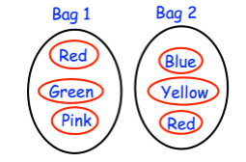
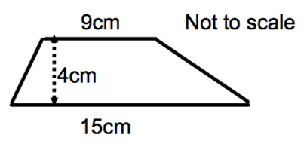

STARTER
Here is a list of quadrilaterals.
Kite rectangle rhombus
square parallelogram
For the following description, chose the correct name from the list.
All four sides are the same length.
There are no right angles.
82⁰
Find w
W⁰
Calculate the area of the trapezium.
Rob takes a counter at random from bag 1 and a counter at random from bag 2.
Write a list of all possible combinations of the two counter=s that Rob can take.
Is the time taken to read a book discrete or continuous data?
Tick a box
Give a reason for your answer.

Slide 2
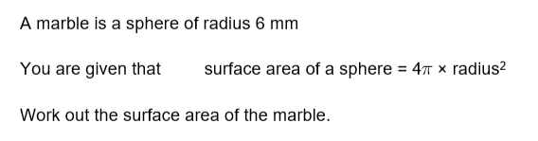
Parallel lines
Learning Objective-
- To be able to understand and use alternate and corresponding angles on parallel lines
Recap

Slide 3
Corresponding angles (follow the F shape)
Corresponding Angles are EQUAL
x
x
x
x
x
x
x
x

Slide 4
Co Interior angles (follow the C shape)
Interior Angles add up to 180
a
a
a + b =180
a + b = 180
b
b

Slide 5
Alternate angles (follow Z shape)
Alternate Angles are EQUAL
x
x
x
x

Slide 6
Examples:
Look at angle a, write down and angle which is:
Corresponding with a
Alternate to a
Co interior with a
h
g
f
e
a
b
d
c

Slide 7
Examples
Find a, b and c giving reasons for each answer.
27°
b
c
a
120°
95 °
75°
b
c
a
45°
110 °

Slide 8
Examples
Find a, b and c giving reasons for each answer.
b
b
55 °
110 °
c
c
b
a
c
a
a
120 °
115 °
25 °
b
c
c
a
b
a
b
a
c
10°

Slide 9
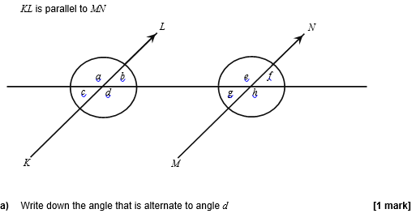
Parallel lines
1

Slide 10
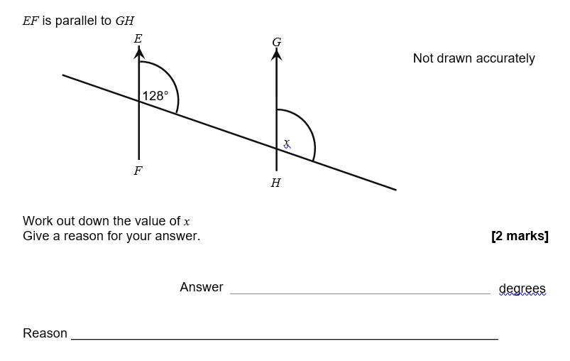
Parallel lines
2

Slide 11
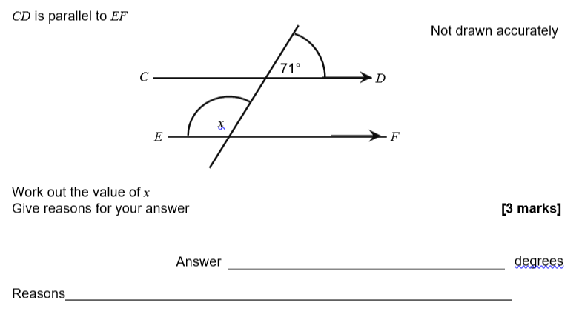
Parallel lines
3

Slide 12
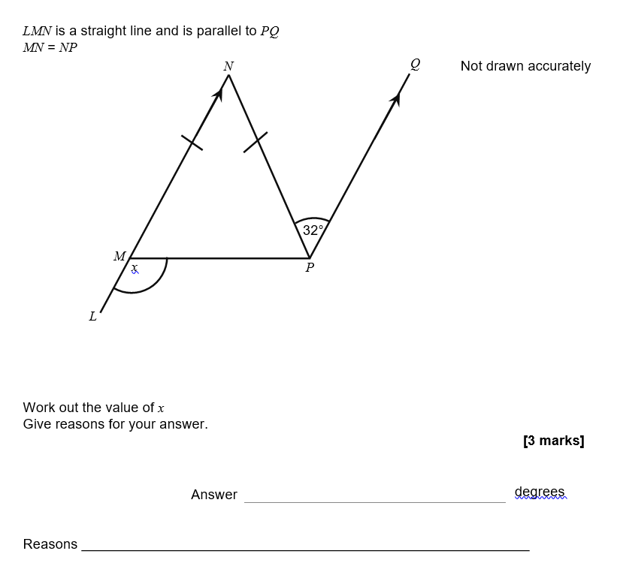
Parallel lines
4

Slide 13
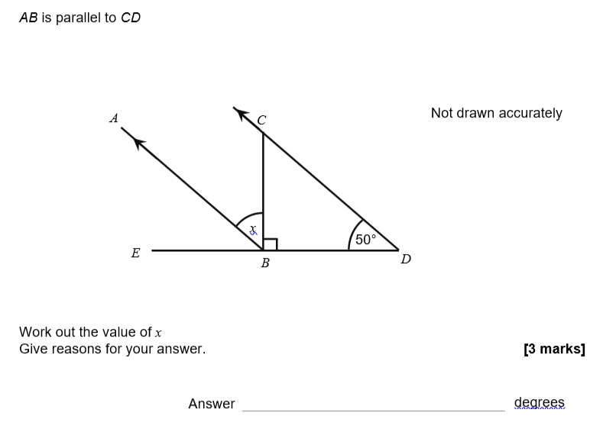
Parallel lines
5

Slide 14
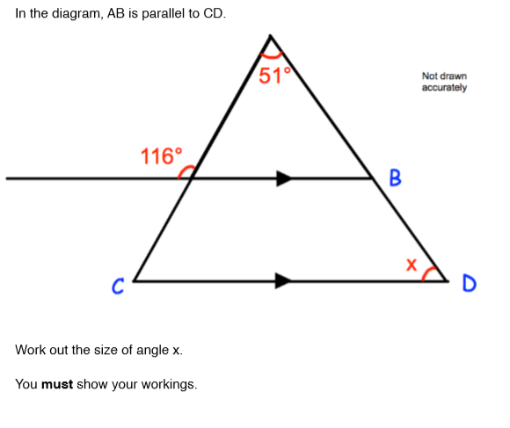
Parallel lines
6
4 marks

Slide 15
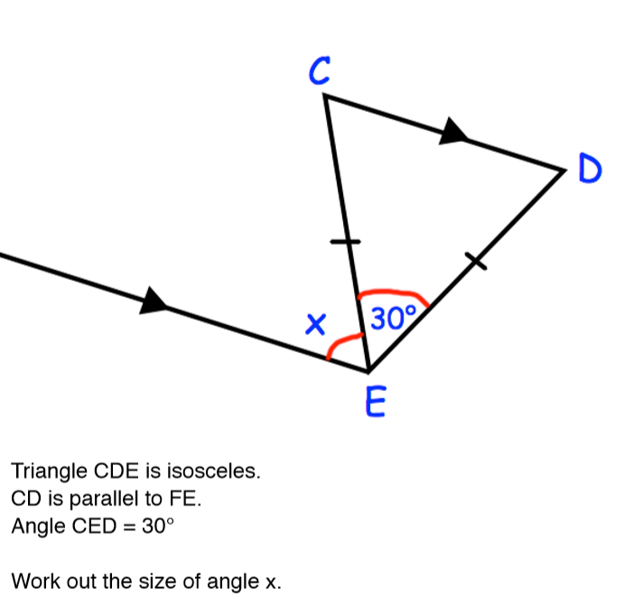
Parallel lines
7
3 marks

Slide 16
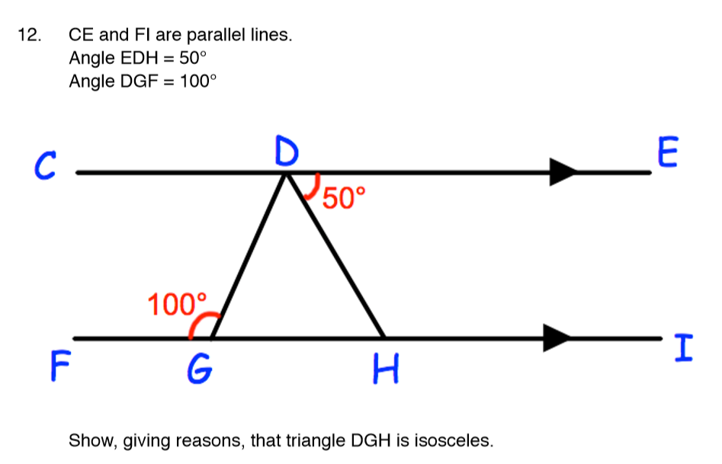
Parallel lines
8
4 marks

Slide 17
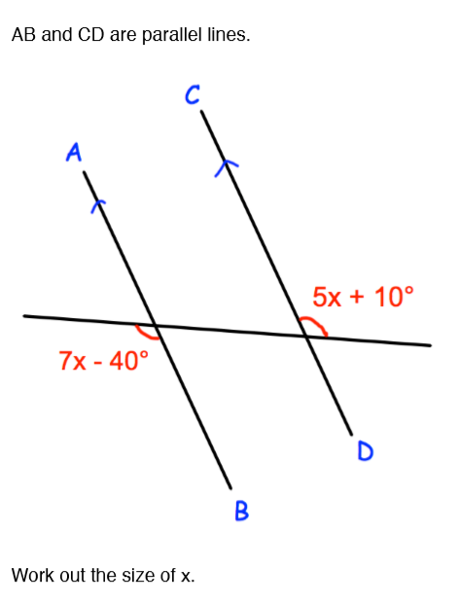
Parallel lines
9
4 marks

