Slide 1
STARTER
1. A pair of trainers cost £64.99, how much do these cost to the nearest:
a) Pound
b) Ten pounds
3. Multiply 465 x 550 and give answer to the nearest hundred
4. Work out 10% of 70
2. A weekly food shop costs £69.00, estimate how much four weeks worth of shopping costs.
5. How many sides does a Hexagon have?

Slide 2
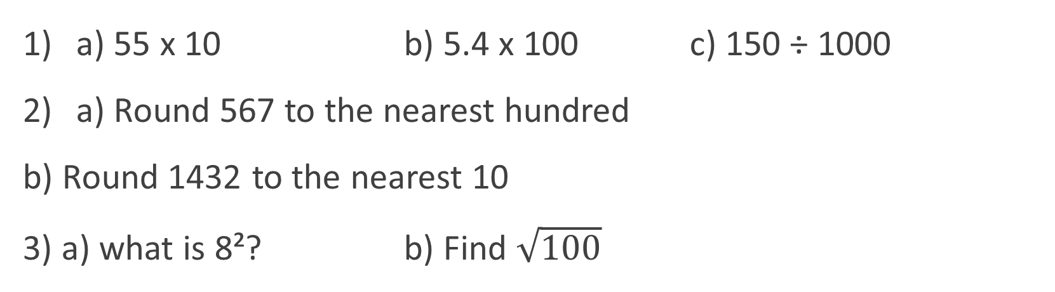
BIDMAS
Learning Objectives
To be able to :
Recognise and use positive and negative numbers
Follow the order of precedence of operators
Recap
a) 55 x 10 b) 5.4 x 100 c) 150 ÷ 1000
a) Round 567 to the nearest hundred
b) Round 1432 to the nearest 10
3) a) what is 8²? b) Find $\sqrt{100}$

Slide 3
ORDER POSITIVE & NEGATIVE NUMBERS
Put these numbers in order from lowest to highest:
a) -39 -33 82 -83 0 9104 -1000 52000
Put these numbers in order from lowest to highest:
6 3.5 -2.5 -1 -1.5
10 -17.5 -177.5 -177

Slide 4
Your turn…
Put these numbers in order from smallest to largest:
10 -23 -33 -23 50 12 -10
-79 -34 -44 55 76 148 -340
-489 -490 -876 -867 398 390
7.5 7 3 2.5 3.5 8.5 -2.5
2. Put these numbers in order from largest to smallest:
a) 88 -37 4 -18 -75 35 52
b) -4 40 -9 -19 22 4
c) 57.5 -62 -57.5 68 -70.5 -71

Slide 5
POSITIVE & NEGATIVE NUMBERS
Example: - 16 + 10
Example: - 8 - 4

Slide 6
Your turn…
-4 + 3
9 + 2
11 – 13
-18 + 5
22 – 5
-48 + 10
-7 - 5
20 – 25
-15 – 7
22 – 23
-85 – 80
-200 + 100

Slide 7
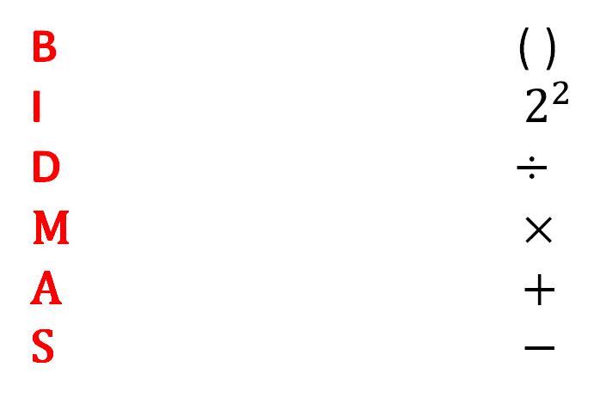
ORDER OF PRECEDENCE
B ( )
I $2^{2}$
D ÷
M ×
A +
S −
a) (3 + 3) x 4 b) 5 - 1 + (7 x 5)

Slide 8

Your turn…
Work out the following:
(4 + 4) x 5
10 - 4 x 2
(5 + 7) ÷ 6
5 + 3 x 5
2 x (6 − 2)²
(5 x 4) + 2²
g) 3 + 10 ÷ 2
h) 4 − 5 x 2
i) 6 − 30 ÷ 5
j) $\sqrt{25 }$ x 5
k) 6² + $\sqrt{9}$
l) $20+ \sqrt{16 }$
m) 4 x 2 + 3²

Slide 9


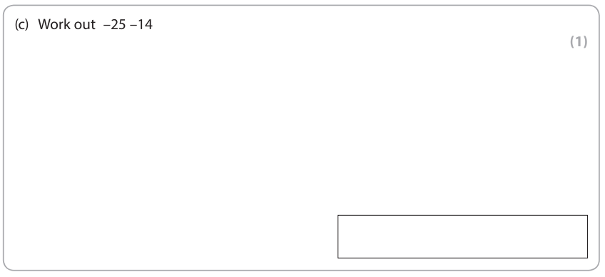

Slide 10




