Slide 1
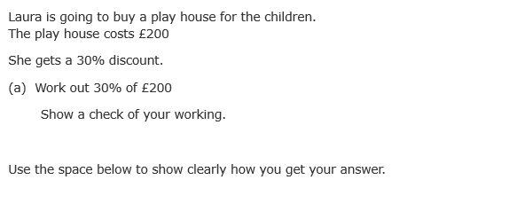
Geometric shapes
Learning Objectives
Draw 2-D shapes and demonstrate an understanding of line symmetry and knowledge of the relevant size of angles
Use angles when describing position and direction, and measure angles in degrees
Recap

Slide 2
2-D and 3-D shapes
What is the difference between a 2d shape and a 3d shape?

Slide 3
Properties of regular 2-D Shapes
Draw the following shapes, and tell me how many of the following each one has:
Equal sides, equal angles, right angles, pairs of parallel lines, lines of symmetry.
Equilateral Triangle
Isosceles Triangle
Pentagon
Hexagon
Parallelogram
Rhombus
Trapezium
Octagon

Slide 4
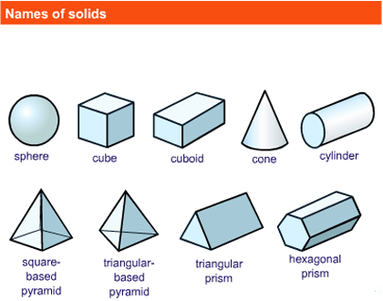
How many 3D shapes can you name?
Name these shapes, and tell me how many faces, vertices and edges each one has.
1
2
3
4
5
Sphere
Cube
Cuboid
Cone
Cylinder
Square based pyramid
6
7
Triangular based pyramid
8
Triangular prism
9
Hexagonal prism

Slide 5

Symmetry
How many lines of symmetry does this shape have?

Slide 6
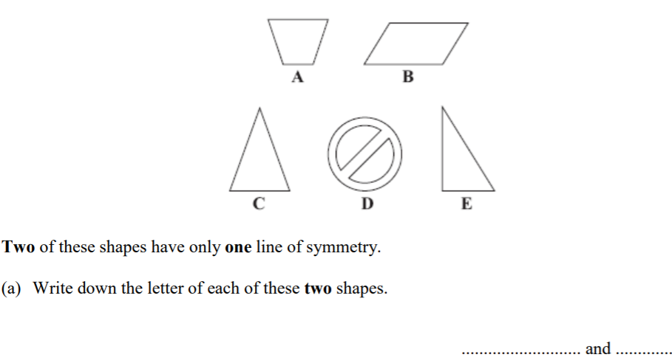
Symmetry…

Slide 7
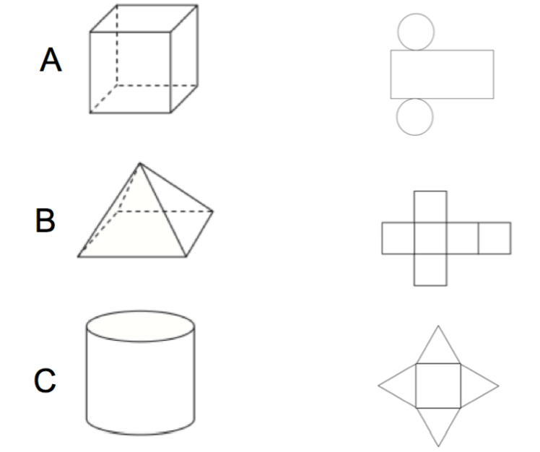
Can you match these shapes to their nets?

Slide 8
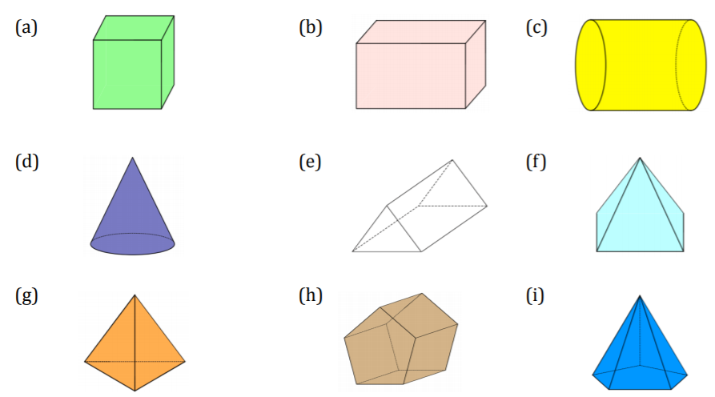
Can you draw the nets of the following 3D Shapes?

Slide 9
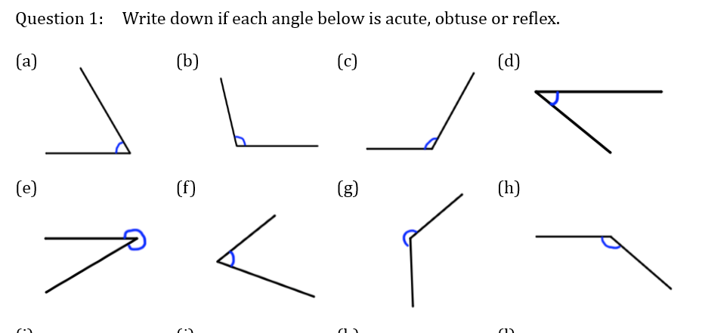
Identifying Angles

Slide 10
Measuring Angles with a Protractor
Mathswatch demo and task?

Slide 11
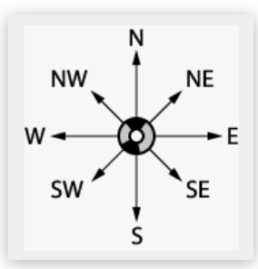
A Compass is used in navigation for showing direction of travel
How many degrees are there between:
N and S
S and W
SW and NE
d) W and NW
e) E and SW
NE and S

Slide 12
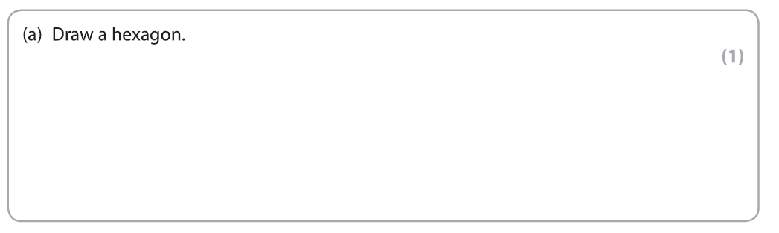

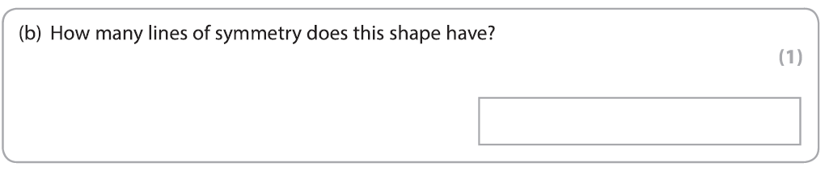
Exam questions

Slide 13
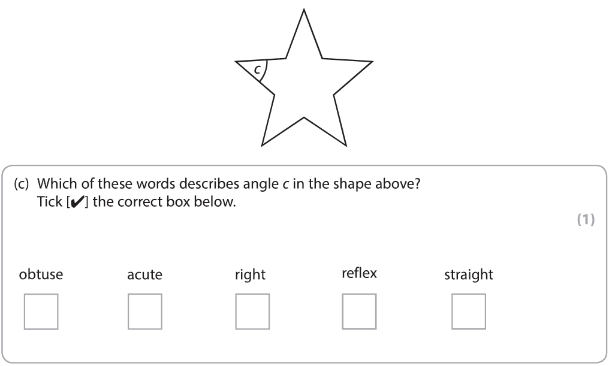
Exam questions

Slide 14
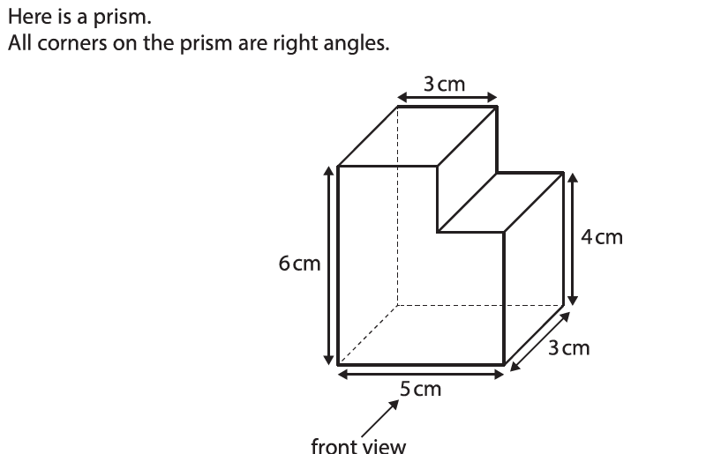
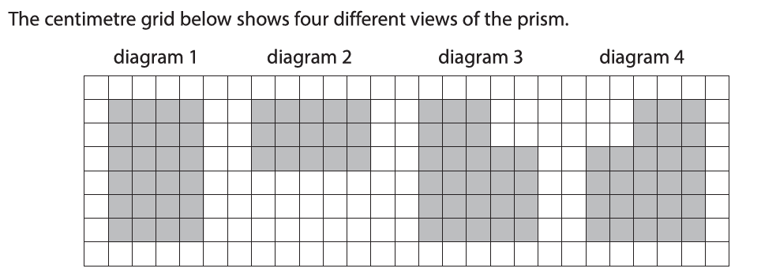


Exam questions

Slide 15
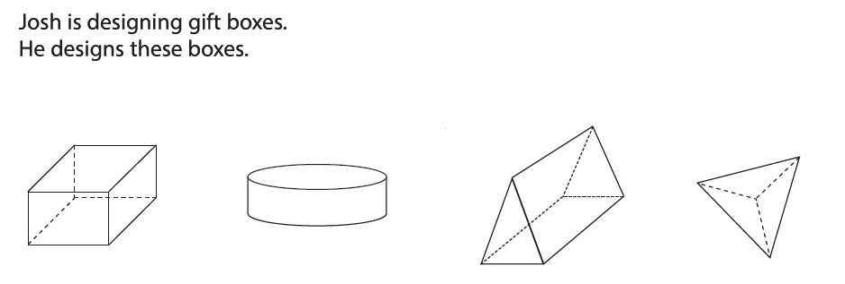
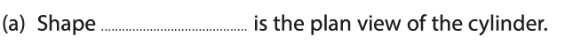
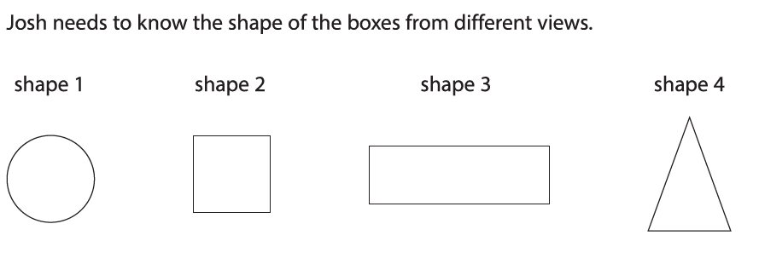
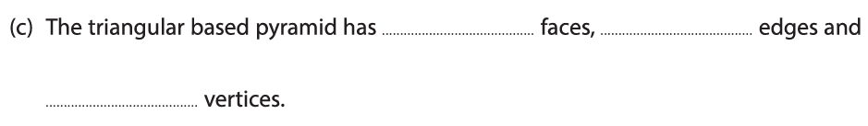
Exam questions

Slide 16
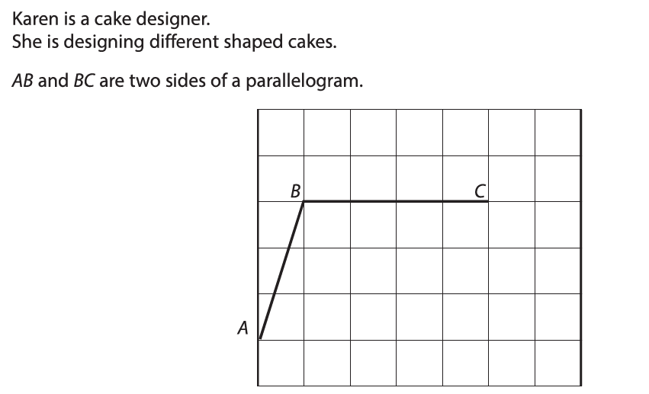
Exam questions
Draw point D to complete the Parallelogram.

Slide 17
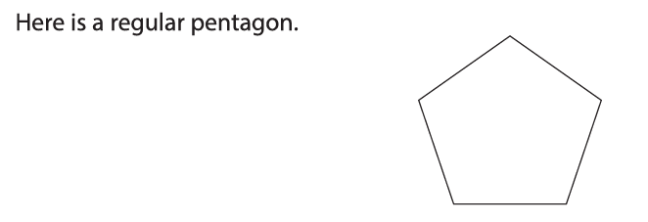
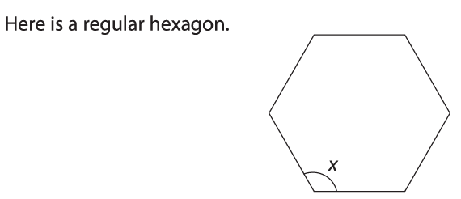
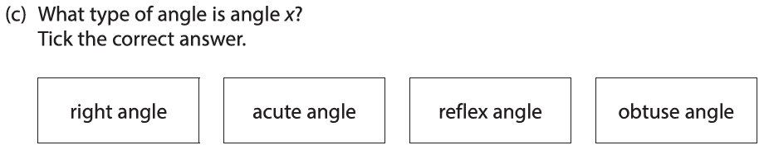
Exam questions

Slide 18
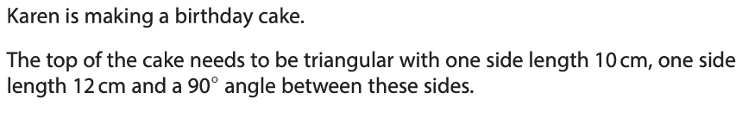
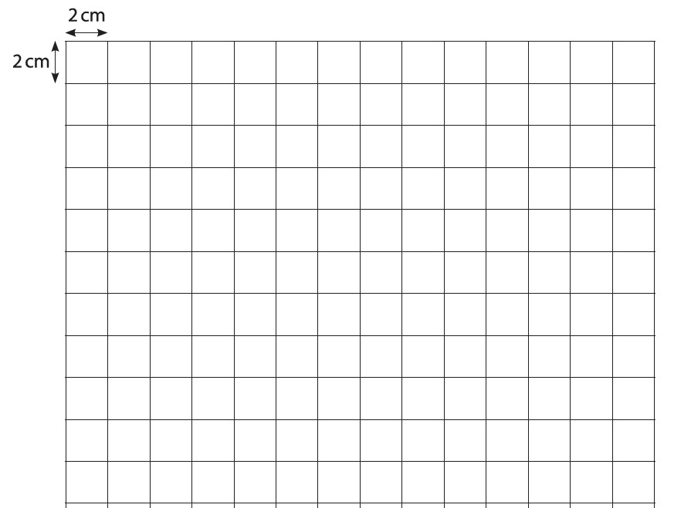

Exam questions

