Slide 1
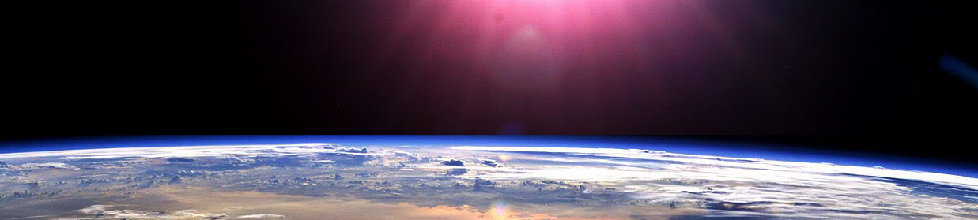
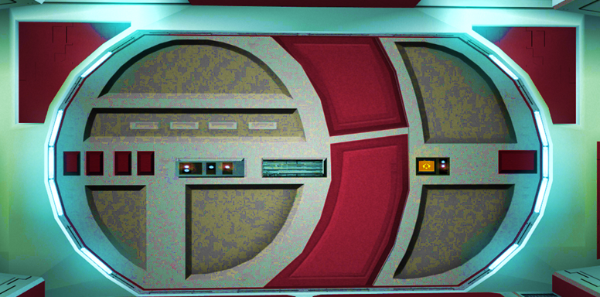


Slide 2

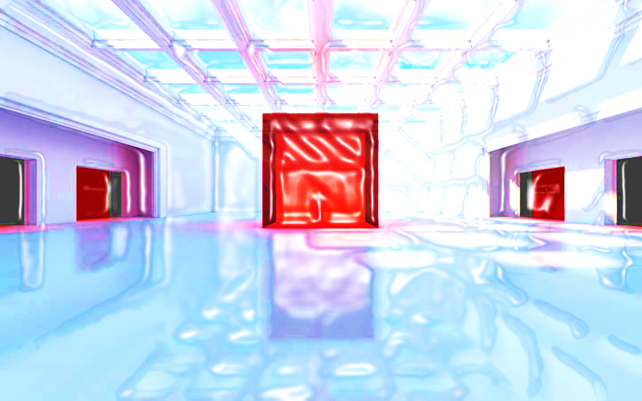





DECIMALS L1/L2

Slide 3



















Course Content: Choose your topic …
Whole Number and Functions
place
value
negative
numbers
add and
subtract
multiply
divide
round
numbers
ratio
scale
fraction
decimal
numbers
percent
percent
decimal
fraction
MATHS L1 to L2
Parts of a whole
metric
measure
imperial
measure
perimeter
area
volume
formulae
bodmas
charts
data
averages
prob-
ability
Measure and Shape
Handling Data

Slide 4





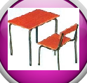







Home Warm up Progress Check 1 Video/Discuss Vocab / jobs Lesson Activities Quizzes Topic Answers Progress Check 2 Cont. Learning
Topic Introduction : Decimal numbers
Just as fractions in the previous topic show a value which is part of a whole amount, ‘Decimals’ also show an amount that is part of one whole. They differ though as decimal values are fractions but only fractions that are multiples of ten. So I could cut up a cake into ten pieces and have a ‘Tenth’ of it, this would be a fraction but would also be a decimal.
You will need to know your place values well to be good at this topic so go back and review if you need. The decimal point becomes a very important part of maths from here on so make sure you fully understand and practice this topic before moving on.
Choose an icon to select where to start
Decimal
Numbers

Slide 5
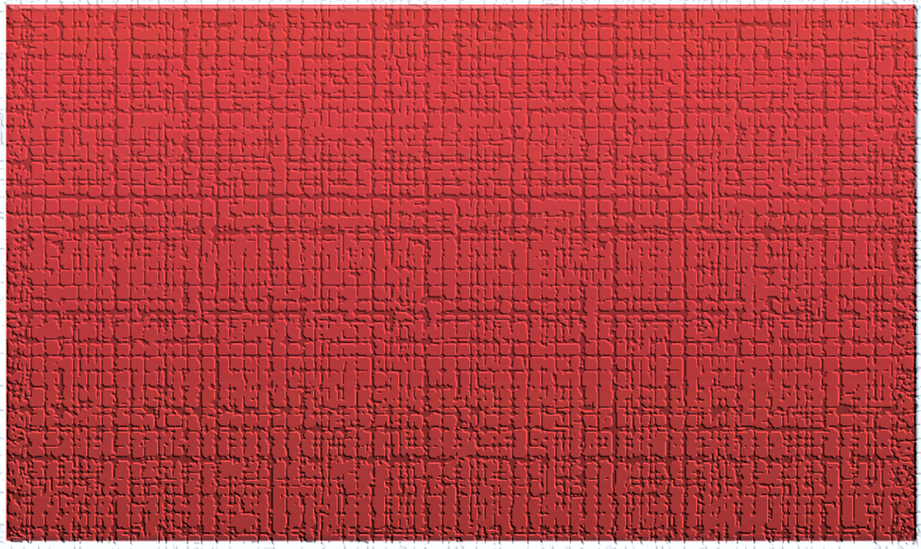
Warm up Exercise 1

Slide 6
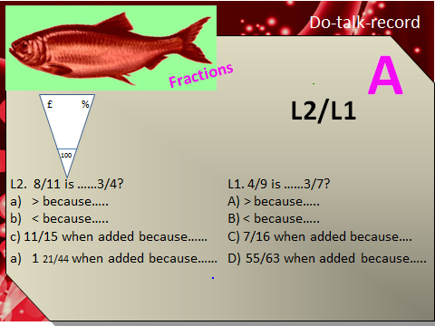
Warm up Exercise 2

Slide 7
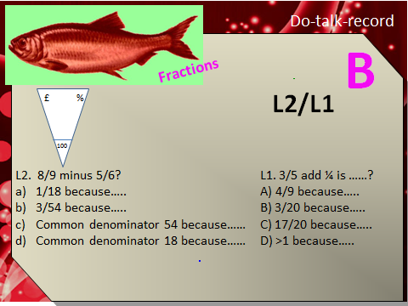
Warm up Exercise 3

Slide 8
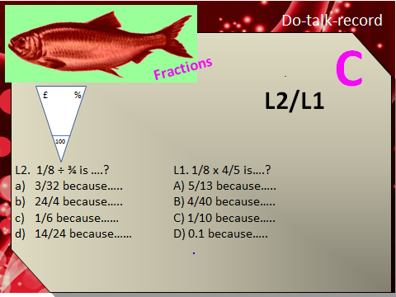
Warm up Exercise 4

Slide 9


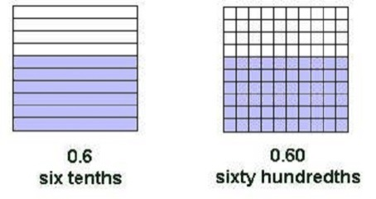
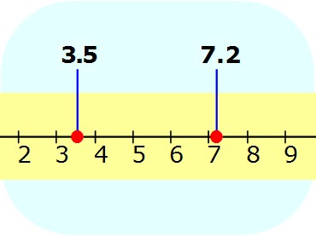
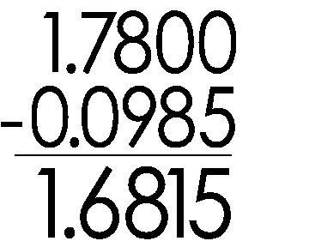
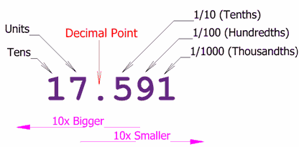
Progress Checker 1
W
What do you already know about ‘Decimals’ ?
How would you rate your skills in using decimals ?
Excellent ability
Good ability, but working to improve
Ok, making a start but I know I have lots to still learn
My aims for today are…
A Know the place values tenth, hundredth, thousandth etc…
B Recognise the affect moving a decimal in a number has to a value
C Use decimals in calculations (add/sub/mult/divide/round)

Slide 10
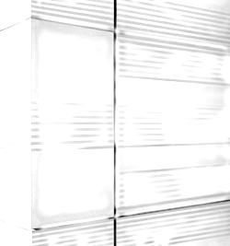
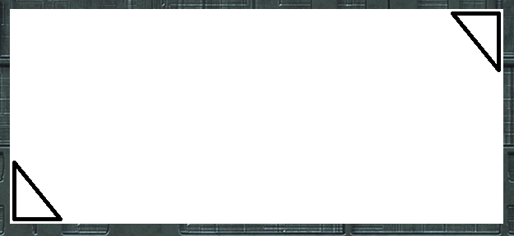
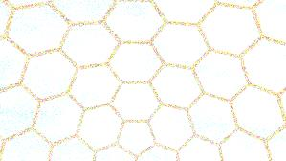

Introductory Video and Discussion
KHTU.
What is halfway between a tenth (0.1) and a hundredth (0.01) ?
What affect does the decimal point have in a number ?
What benefits are there to using a ‘Decimal’ system of counting ?
How are ‘decimal numbers’ different to ‘whole numbers’ ?
When do we use decimal numbers ?
Does a decimal point affect calculations eg. 3.2 x 4 ?
Watch the introductory video and then discuss the above
Your thoughts..

Slide 11
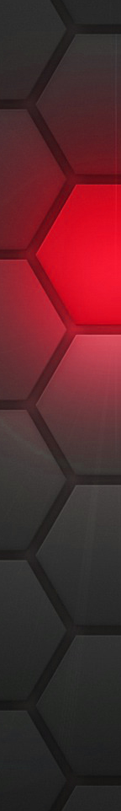



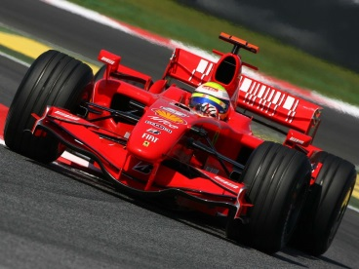

Vocabulary and Jobs
Decimal point
Whole numbers
Part
Decimal places
Tenths
Hundredths
Thousandths
Decimal System
Deca-
Deci-
Centi-
Milli-
These are the words you will be using in this topic
Accountants
Builder
Shops
Chef
Scientist
Car Mechanic
Doctor
Racing Driver
…. Can you think of more?
…………………………………
…………………………………

Slide 12
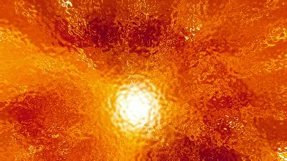
Lesson: Concept Activity
Write a number down that is half way between each of the values shown
0
1
2.6
14.03
26.45
98.037
98.0381
98.038102
Is there a formula for working out the answer ?

Slide 13

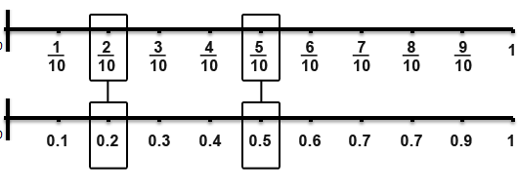
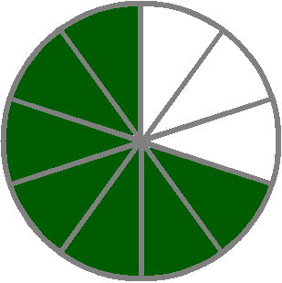
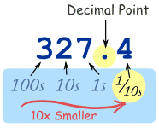
Lesson: Main Teach 1
Tenths
Take a chocolate bar and break it into ten pieces…..
Take a journey and have ten stops…..
Take a pound and split it into ten pence pieces…
What do you get?... TENTHS !!
Tenths are just the numbers 1-10 but show between one and ten steps between the numbers ZERO AND ONE

Slide 14

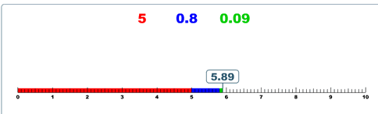
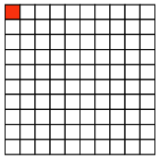
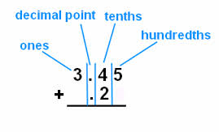
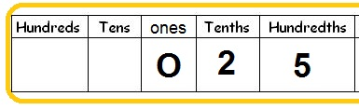
Lesson: Main Teach 2
Hundredths
Take a pound and split it into one hundred pence….
Take a house price and find one percent…
Select one person from a group of one hundred…
What do you get??... HUNDREDTHS !!
Hundredths are just the numbers 1-100 but show how much you have between ZERO AND ONE

Slide 15
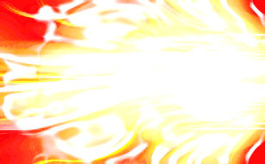
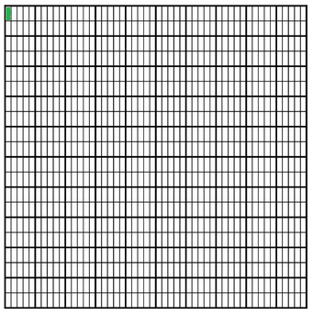

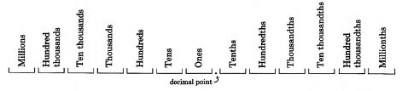
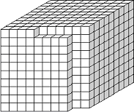
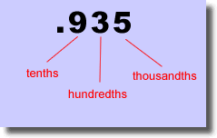
Lesson: Main Teach 3
Thousandths
Take a cruise ship and divide it into a thousand rooms…..
Take a race lap time of one second and cut it into milli seconds…
Take a jug of liquid and split it into a thousand drops…
What do you get?? … THOUSANDTHS!!
Thousandths are just the numbers one to a thousand but show how much you have between ZERO AND ONE.

Slide 16
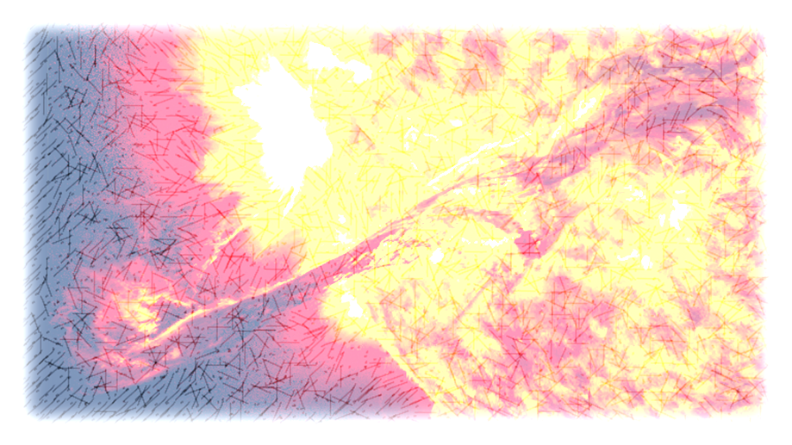
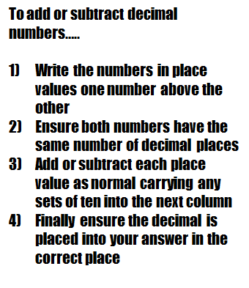
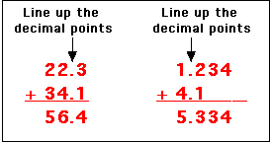
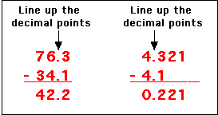
Lesson: Main Teach 4
Adding and Subtracting Decimals

Slide 17

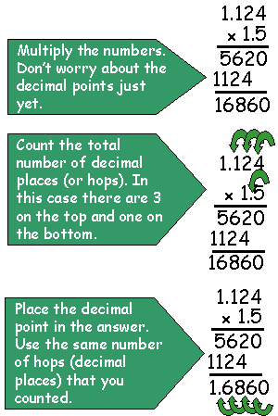
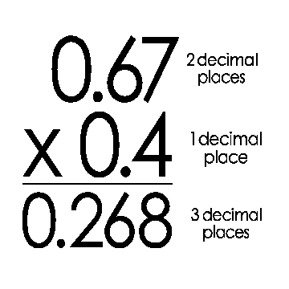
Lesson: Main Teach 5
Multiplying Decimals
Multiplying Decimals

Slide 18
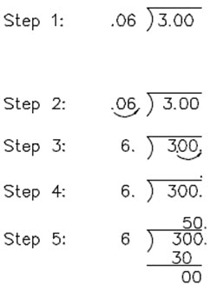
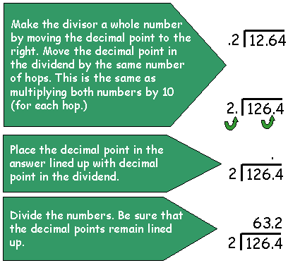
Lesson: Main Teach 6
Dividing Decimals
example

Slide 19
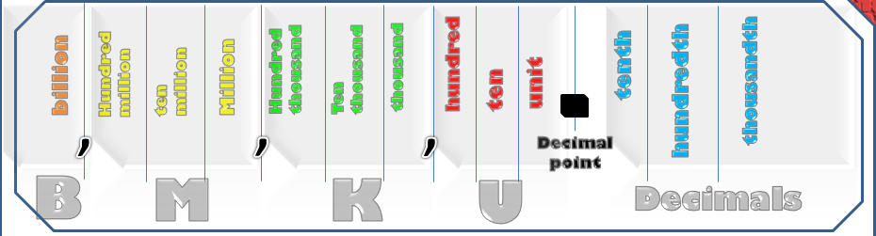

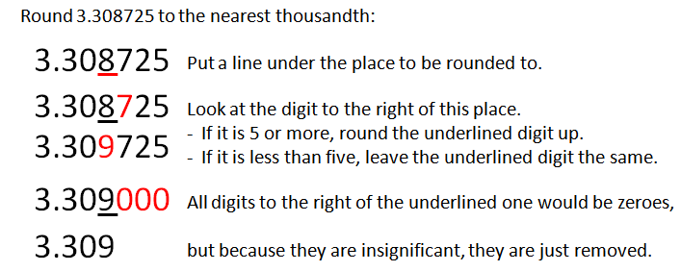
Lesson: Main Teach 7
Rounding Decimals
Rounding decimals is just like rounding of whole numbers.
You need to find which place value you want to keep and then round off the rest.
With decimals, the place values will be on the right of the decimal point rather than on the left
3 3 0 8 7 2 5
Rounding Example :

Slide 20
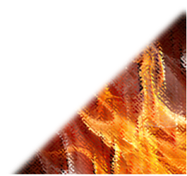

Lesson: Try out
Block 1 : Watch tutor led demo (in class or on video)
Try these, 1) Which is bigger 0.2 or 0.02 ? 2) Which is smaller 1.04 or 1.4040 ?
Count up two more tenths from 0.9, what value do you get?
Put the place values in order largest first 1/100 unit 1/10 thousandth
Block 2 : Watch tutor led demo (in class or on video)
Try these, 5) Add 3.26 to 1.9 6) Subtract 8.403 from 11.05 7) Round £10.43 to 1dps
8) Add £1.325M to £0.76M 9) Round 26.325 seconds to 2dps 10) Subtract another 2.30K from -5.07K 11) Multiply 4.2 by 3.5 12) Divide 150 by 0.3
Block 3 : Watch tutor led demo (in class or on video)
Try these, 13) Add 0.0032500 to 0.02057 14) Subtract 4.7B from 3.042B
15) Round 18.442506 M to the nearest thousand 16) Multiply 0.40503 x -0.076
17) Divide up 1.304 / 0.352

Slide 21
Lesson: Websites and links
Decimal Challenge, find the missing decimal
value by guessing lower or higher
http://www.interactivestuff.org/sums4fun/decchall.html
Visualising decimal numbers on a number
line and showing values in between others
http://rupertcollins.com/educationwebsites/numeracy/numeracy/numeracy4/dec_num_line.swf
Showing decimals as fractions and linking
the previous topic of fractions to decimals
http://www.amblesideprimary.com/ambleweb/mentalmaths/fracto.html
Visualising units, tenths, hundredths and
thousands plus explore 4 rules of decimals
using blocks and grids
http://www.mhhe.com/math/ltbmath/bennett_nelson8e/VMK.html?initManip=decimalSquares
Visualising tenths and other fractions
http://www.mhhe.com/math/ltbmath/bennett_nelson8e/VMK.html?initManip=fractionBars
Seeing Decimals in place value and visualising
them in blocks, explore add and subtract
http://nlvm.usu.edu/en/nav/frames_asid_264_g_2_t_1.html
Web page that explains how to +, -, x, / decimals
then gives you practice questions and answers
http://www.cimt.plymouth.ac.uk/projects/mepres/book8/bk8i4/bk8_4i2.htm

Slide 22
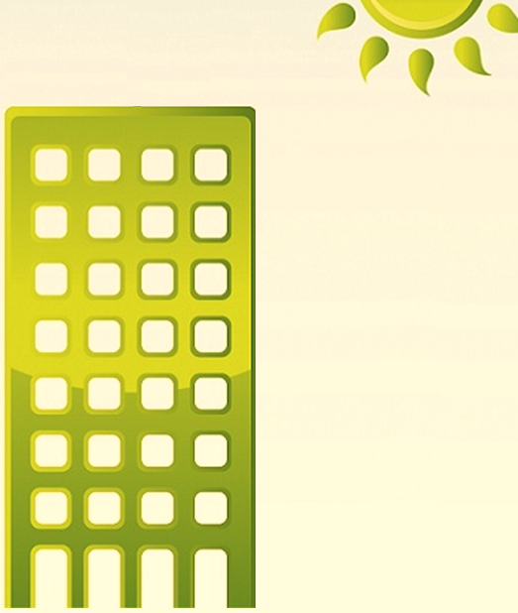
Lesson: Activity A
Place the cards on the number line in the correct place
(at the correct height in the building !)
Extension 1) Find a value that appears in between two
of the cards 2) Add two cards together 3) Subtract
a card from 1.0 4) Multiply a card by another one 5)
Divide a card by another 6) Try rounding the cards to
Either one, two or three decimal places (1,2 or 3dps)
1
0.4
Sixth floor
out of ten
0.016
678th floor
1000 floors
0.18424397
0

Slide 23

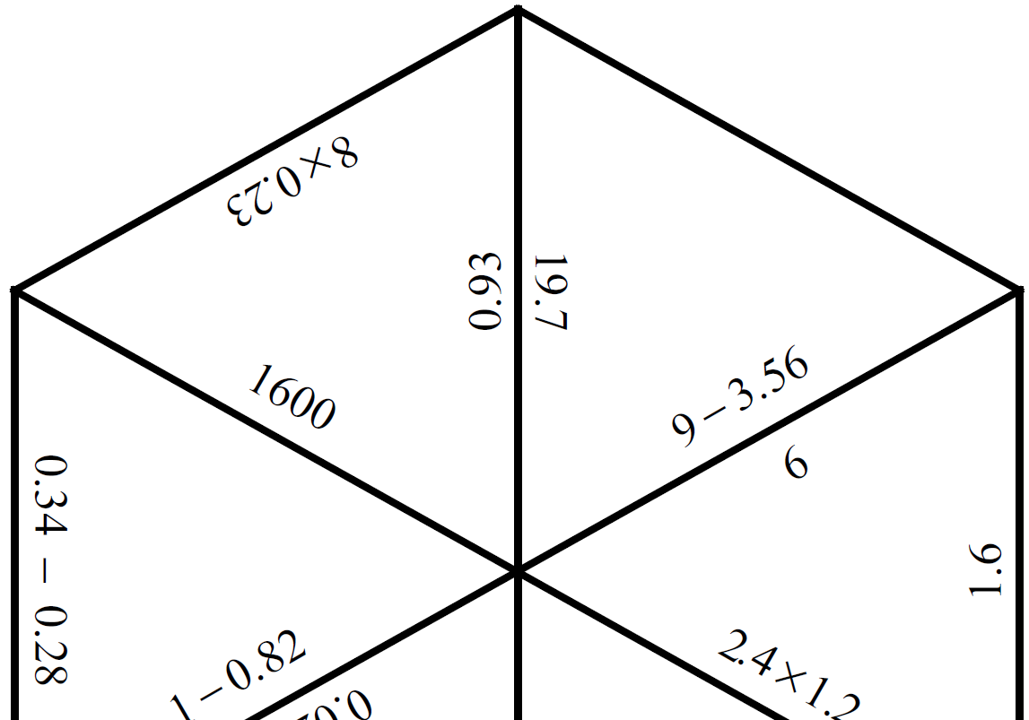

Lesson: Activity B
Decimals Puzzle

Slide 24
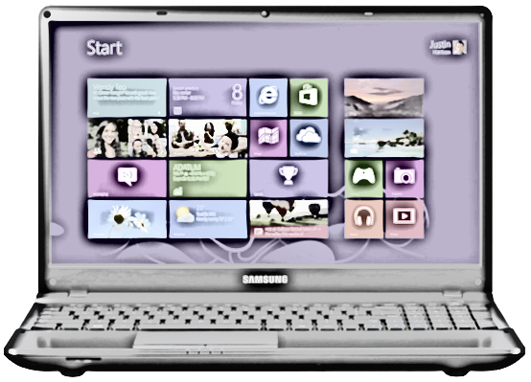
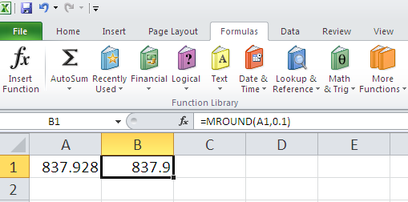
Lesson: Activity C
On a spreadsheet take the following values and round them using the ‘MROUND’ function.
0.62 to 1dp
1.010 to 1dp
5.55 to 1dp
0.6235 to 2dps
0.0459 to 2dps
0.38054 to 2dps
3.048296…. to 3dps
0.040506… to 3dps
120.025555… to 3dps
0.7829384729482746 to 5 dps
138.20103800238740242400…. to 7dps

Slide 25

Lesson: Activity D
Discussion time !
Discuss the situation cards
Find answers
Write examples that prove the statements false or true
Make a poster of your answers for the whole group feedback
0.048
3.80020
14.326 1dps
???
???

Slide 26
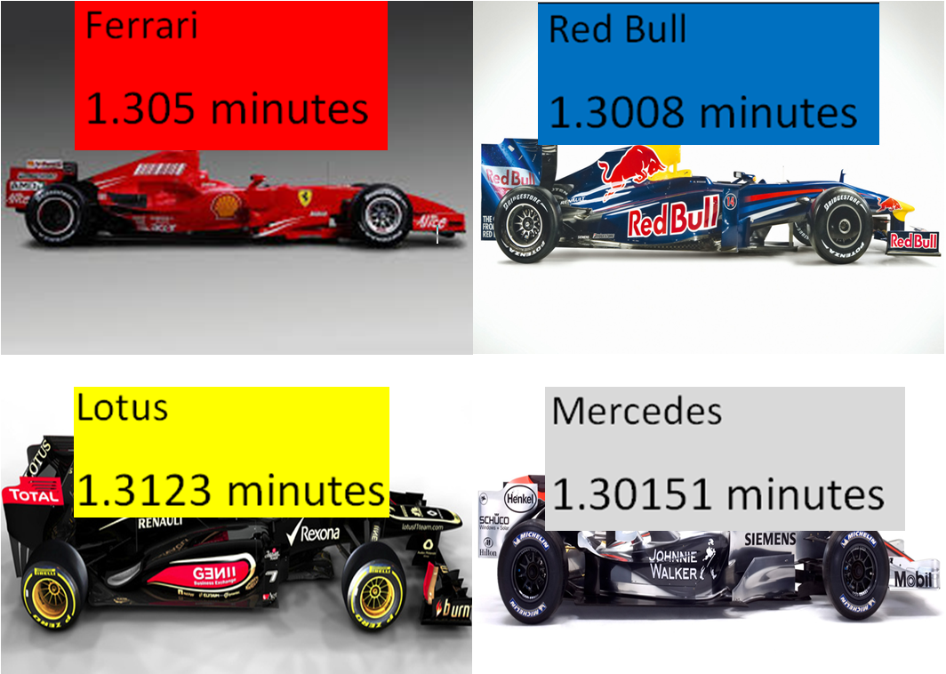
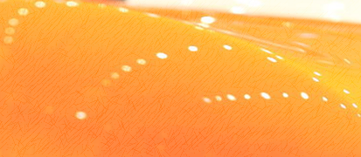

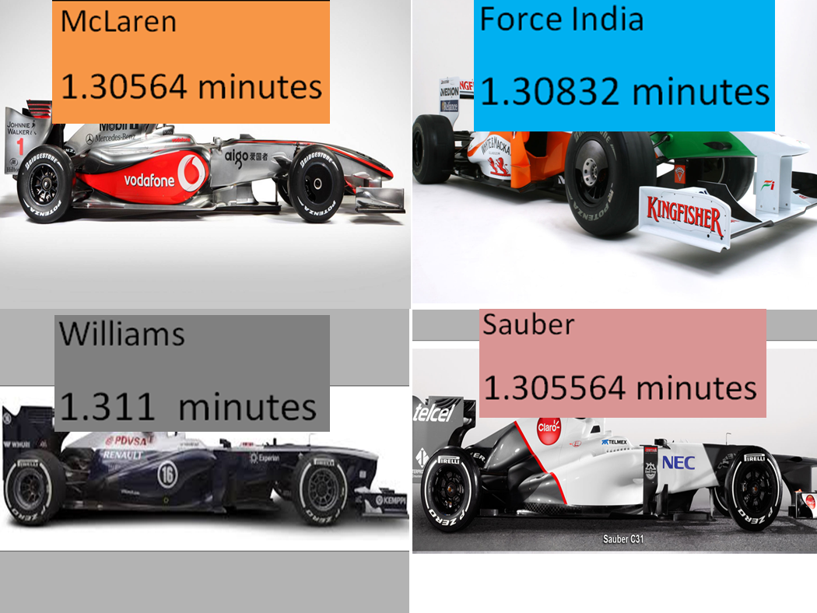
Lesson: Activity D

Slide 27
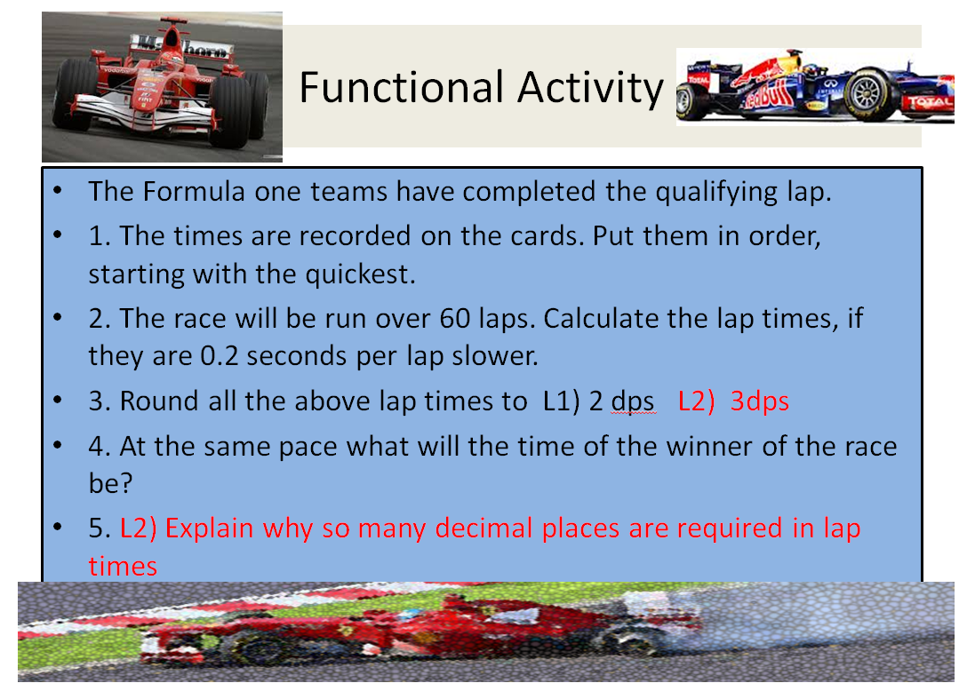
Lesson: Activity D

Slide 28


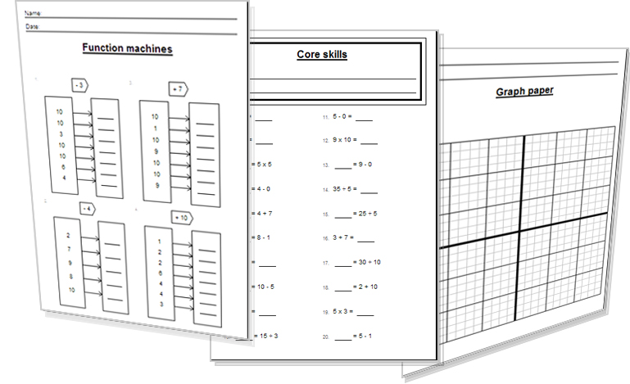
Lesson: Activity E
Try a variety of written practice
Worksheets
Workbooks
Practice Exam Papers
Maths Problems

Slide 29
Lesson: Practice – just the numbers
Write the following decimals
Two tenths
One unit, three hundredths
Zero point nine seven
Eighteen and nineteen hundredths
Three + 2/10 + 4/1000
Eighty thousandths
Order the following decimals
High to low
7) 0.2 0.02
1.303 3.01 1.013
7.04 47.0 4.07
0.0034 0.0304 0.3040
6.3K 6.03K 6.303K 3.66K
0.848 0.4808 .07848
10.06M 0.016B 1601M
1.022 B 8.43B 0.542B
Add the following decimals
2.3 + 5.4
0.7 + 0.2
1.58 + 0.4
6.44 + 2.99
0.00331 + 0.03586
-2.4 + -4.8
7.8M + 3.5M
0.34 B + 1.983B
Subtract the following decimals
7.8 – 3.2
14.08 - 1.6
6.003 - 4.885
0.0402 - 0.0395
-0.3 - (-0.5)
-4.99 - (-5.7)
16.2K - 14.31K
5.050 M - 0.505 M
78.34 B - 59.28 B
Multiply the following decimals
3 x 0.7
2 x 1.5
4.2 x 3.7
13.4 x 0.2
5.5 x 20.1
4.9 x 7.03
1.11 x 3.2
-4.6 x - 3
2.7K x 0.2
71.04 M x 3.4
Divide these decimals
10 / 0.2
0.6 / 3
1.2 / 4
1.6 / 0.4
200 / 1.5
-2.5 / 5
0.2 / 0.4
4 / -0.2
8.004 / 0.240
-3.2K / 16
1.5M / -5
0.00046 B / 0.0002
Round the following decimals
1.2 to the nearest unit
5.42 to one decimal place
14.05 to one decimal place
2.0459 to two decimal places
14.5555 to two decimal places
-0.0327 to three decimal places
8.40562 to 3dps
0.419256 M to 3dps
8.09459 B to 4dps

Slide 30


Lesson: Practice – word problems
Q1) Two suitcases were weighed before a flight, 37.2kg and 15.07kg. What is the total of the two suitcases?
Q2) The rainfall in the UK was 3 times greater than in France. Three point five two inches fell in the UK. How much fell in France?
Q3) A carpet roll has a circumference of 7.2 metres and is folded round 20 times. Find the total length of the roll.
Q4) A runner ran a race in 42.782 seconds, then 42.6153 seconds on the following attempt. How much faster was she?
Q5) A wage is paid at ‘time and a half’ (x1.5). The normal hourly wage should be £7.50. What is the new hourly wage at time and a half
Q6) The gravity on Mars is 3.711 metres per second. On Earth it is 9.8 metres per second. By how many times less is the gravity on Mars?

Slide 31




Lesson: Practice – Making it Functional 1
BB
G

Slide 32


Lesson: Practice – Making it Functional 2
Use the information on the previous page
a

Slide 33

Lesson: Practice – Making it Functional 3
Use the information on the previous pages
a

Slide 34
TOPIC ANSWERS 1
Write the following decimals
0.2
1.03
0.97
18.19
3.204
0.08
Order the following decimals
High to low
7) 0.2 0.02
3.01 1.303 1.013
47.0 7.04 4.07
0.3040 0.0304 0.0034
6.303K 6.3K 6.03K 3.66K
0.848 0.4808 0.07848
1601M 0.016B 10.06M
8.43B 1.022B 0.542B
Add the following decimals
7.7
0.9
1.98
9.43
0.03917
-7.2
11.3 M
2.323 B
Subtract the following decimals
4.6
12.48
1.118
0.0007
0.2
0.71
1.89 K
4.545 M
19.06 B
Multiply the following decimals
2.1
3
15.54
2.68
110.55
34.447
3.552
13.8
0.54 K
241.536 M
Divide these decimals
50
0.2
0.3
4
1.33.3…..
-0.5
0.5
-20
33.35
-200
-0.3
2.3 B
Round the following decimals
1
5.4
14.1
2.05
14.56
-0.033
8.406
0.419 M
8.0946 B
Block 1
0.2
1.04
1.1
Unit, 1/10, 1/100 thousandth
Block 2
5.16
2.647
£10.40
£2.085M
26.33 seconds
£7.37K
14.7
12) 500
Block 3
13) 0.02382
14) -1.658
15) 18.443
16) 0.0081006
17) 3.7 to 1dp

Slide 35

TOPIC ANSWERS 2
Word Problems - ANSWERS
Q1) 52.27 kg
Q2) 1.17.. inches
Q3) 144 metres
Q4) 0.1667 seconds faster
Q5) £11.25
Q6) 2.64… times less (take Earths and divide by Mars , 9.8 / 3.711)

Slide 36

TOPIC ANSWERS 3
1. a) £14.10 + £23 .60 = £37.60
b) £50 - £37.60 = £12.40
c) Eyelash tint = 30 minutes, so can fit in 2 per hour at £11.50. £11.50 x 2 = £23.
Eyebrow tint = 15 minutes, so can fit in 4 per hour at £8.35.
£8.35 x 4 = £33.40. £23 + £33.40 = £56.40
d) £11.50 x 3 = £34.50. £8.35 x 3 = £25.05. Total = £34.50 + £25.05 = £59.55
e) Each person will pay £11.50 + £8.35 = £19.85. It can also be worked out by dividing the total of £59.55 by 3.
2. a) Body exfoliation costs £45 for 35 minutes. To work out the same proportional cost for an hour, multiply £45 by 60 and then divide by 35. Total = £77.14.
b) £11.50/30 = £0.383
£8.35/15 = £0.557
£34.25/75 = £0.457
£14.10/25 = £0.564
£23.60/40 = £0.59
£12.15/10 = £1.215
£24.75/15 = £1.65
£45.00/35 = £1.286
£52.80/70 = £0.754
£77.95/100 = £0.78
C) List the treatments in order of cost using the above calculations.

Slide 37


End of Session Quiz LEVEL 1

Slide 38


End of Session Quiz LEVEL 2

Slide 39



TOPIC ANSWERS 3

Slide 40
Progress Checker 2
W
What do you now know about ‘Decimals’ ?
How would you now rate your skills in using decimals ?
Excellent ability
Good ability, but still working to improve
Ok, make a start but I know I have lots to still learn
My aims for today were…
A Know the place values tenth, hundredth, thousandth etc…
B Recognise the affect moving a decimal in a number has to a value
C Use decimals in calculations

Slide 41


Continuing to Study and Learn
What else can you do to help yourself to learn and practice? Here are ten suggestions, record which you do each week and also record your progress.
Internet websites
Repeat the lesson, make notes, organise a folder, revise
Own maths workbook
Study together with a friend or family member
Finish activities in this book
Complete class handouts or tasks
Practice exams / past papers
Use maths skills learnt at home or at work in real situations
Play games
Experiment yourself, try new things ask yourself questions
Try making a graph of number of practice methods you use against your progress score in each topic. Are you showing more practice gives better results?

