Slide 1

What things are directly proportional?
Can you write down 5 to 10 things/situations where one thing relates and directly affects another?

Slide 2
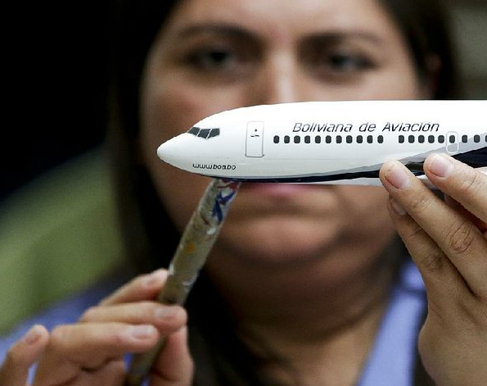

Slide 3


Slide 4


Slide 5


Slide 6
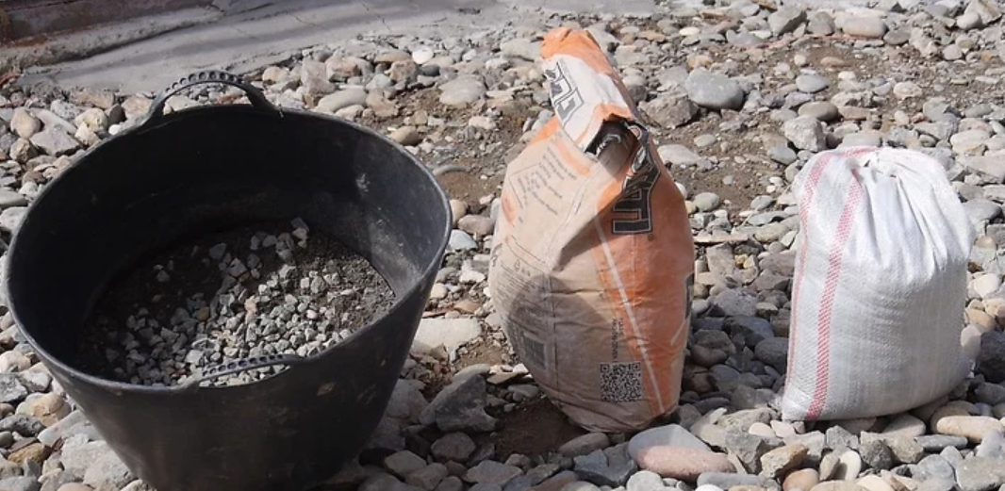

Slide 7
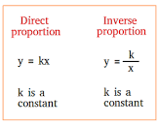

What things are Inversely proportional?
Can you write down 5 to 10 things/situations where one thing relates and inversely affects another?

Slide 8


Slide 9


