Slide 1
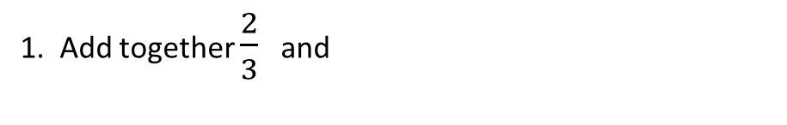
Formula
Learning Objectives
To be able to :
Evaluate expressions and make substitutions in given formulae in words and symbols
Recap
1. Add together $\frac{2}{3}$ and
3. Order the following decimal values..
0.032 0.3052 0.5327 0.0405
Round each value before multiplying
3.52 x 8.6 Do not use a calculator and show your workings.
$$\frac{5}{7}$$
2.
Which deal is better?
Deal A One quarter off £1,200
Deal B Two fifths off £1,400

Slide 2
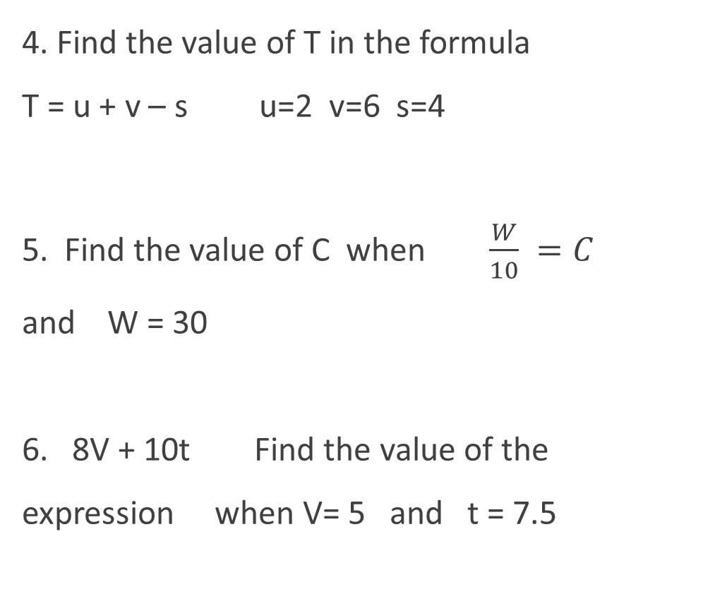
STARTER
Words
Solving Formulae
4. Find the value of T in the formula T = u + v – s u=2 v=6 s=4
5. Find the value of C when $\frac{W}{10} =C$ and W = 30
6. 8V + 10t Find the value of the expression when V= 5 and t = 7.5
Write a simple formula based on the word problem.
Thirty pounds deposit then two hundred pounds a week.
Eighty pounds per box plus delivery fee.
Add together all four lengths, then minus a width.

Slide 3
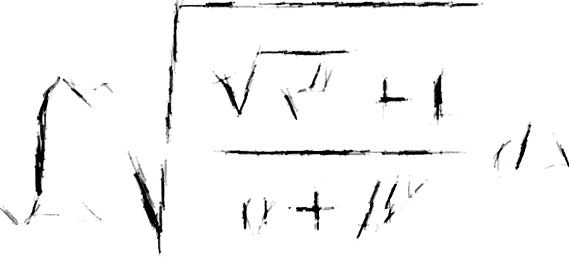
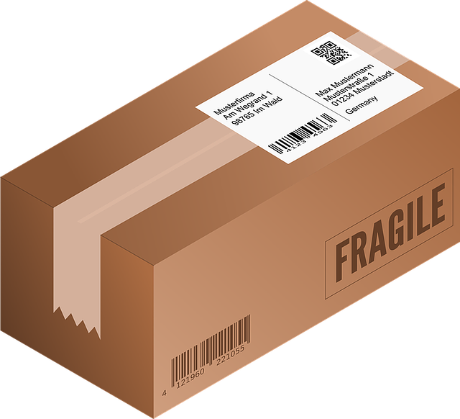
Writing Formulae
Write a formula for this word statement…
‘ An order of units at £ per unit plus packaging at £ ’
Another go…write a formula for this statement.
a) people split between coaches times the ticket price £ , plus £20

Slide 4

Your turn…
1) Write a formula from the word statement. Use any suitable letters.
teas at £ plus coffees at £ minus discount of £
equals the total bill
b) Multiply the length by the width by the height then divide your answer by three, equals the volume
c) The number of people allowed in the club is times greater than sqm floor area plus extra people
d) Multiply the heart rate of by minutes then divide by to get your fitness score

Slide 5
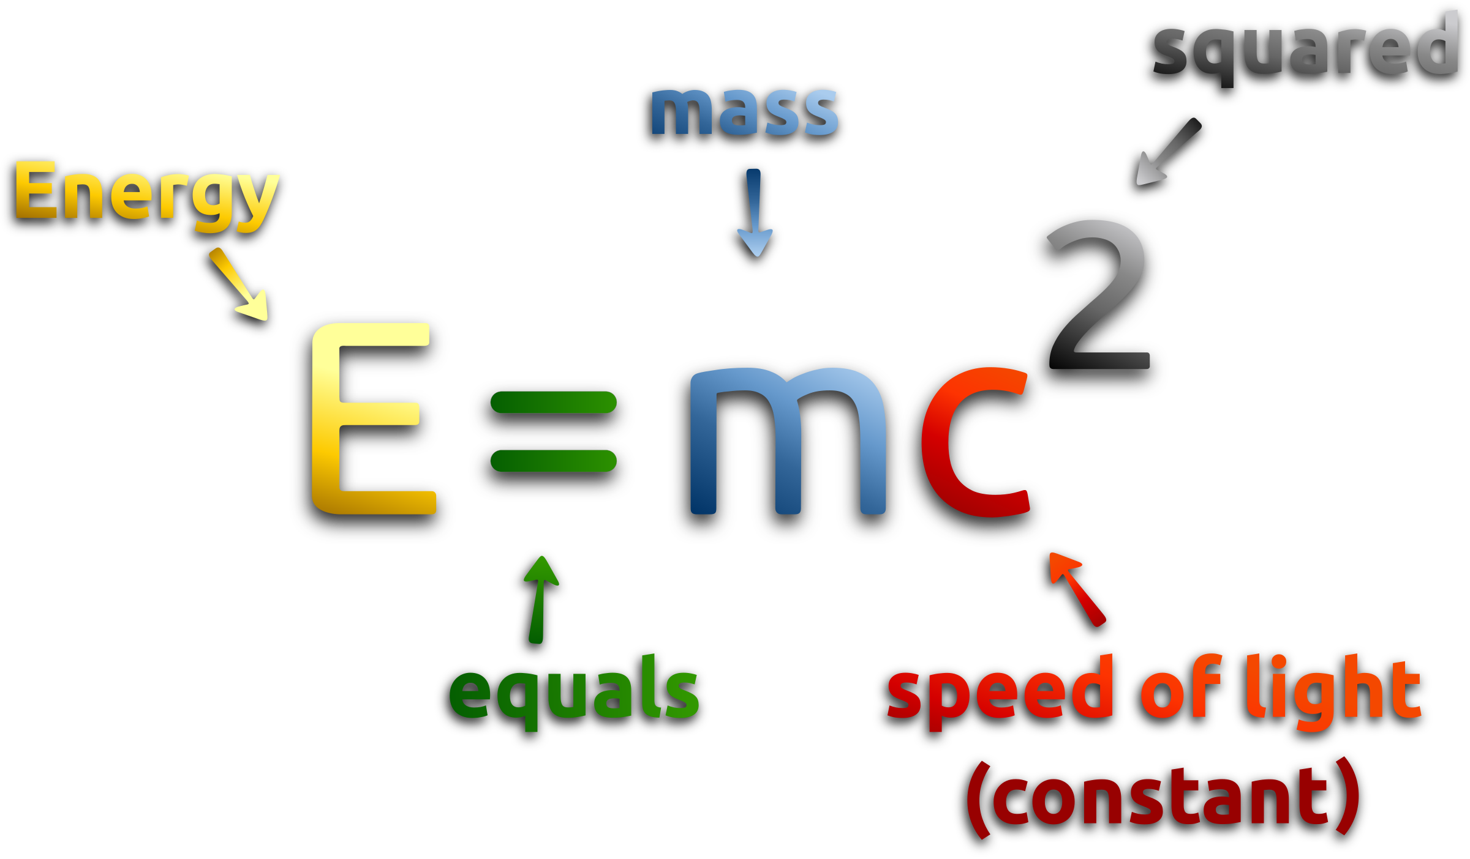
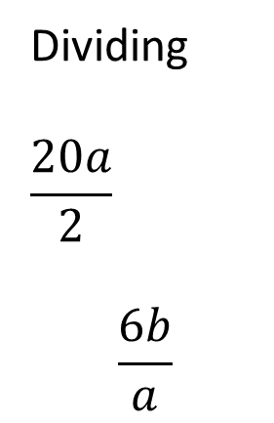
Evaluating Expressions
Evaluate this expression in the example below
Example: 2t – 4 when… a) t = 10, b) t = ½ , c) t = 0.7
Evaluate the following expressions below when we know that a=3 and b=8
Adding
2 + b
a + b
a + a + a
Subtracting
20 - a
b – a – a
- a – (b – a)
Multiplying
5 ( 7 )
b ( a )
a b a
Dividing
$$\frac{20a}{2}$$
$$\frac{6b}{a}$$

Slide 6


Your turn…
Evaluate the following given the values shown:
Find the value of:
3v + 4 v=6
A – 3b + 6A A=8 b=2
8 ( t – v) + v t=7 v=3
$\frac{14f}{7j}$ f=6 j=3
6 + z – 4 + 7z z=5
u + ½ ( 8 + u ) u = 2
g) y² + 4 y=3
h) $a^{2}$ + b² + c² a=2 b=3 c=2
i) U + ½ t² U=20 t² = 100
j) $\frac{m^{2}}{n^{2}}$ m=4 n=7
k) w(80 − 4²) w=2
l) k² − 2³(k) k=4

Slide 7
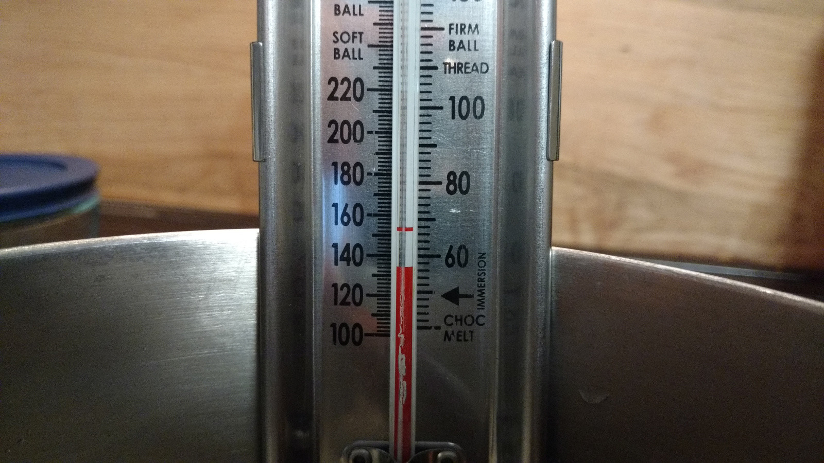
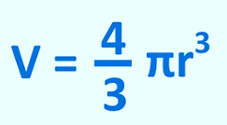




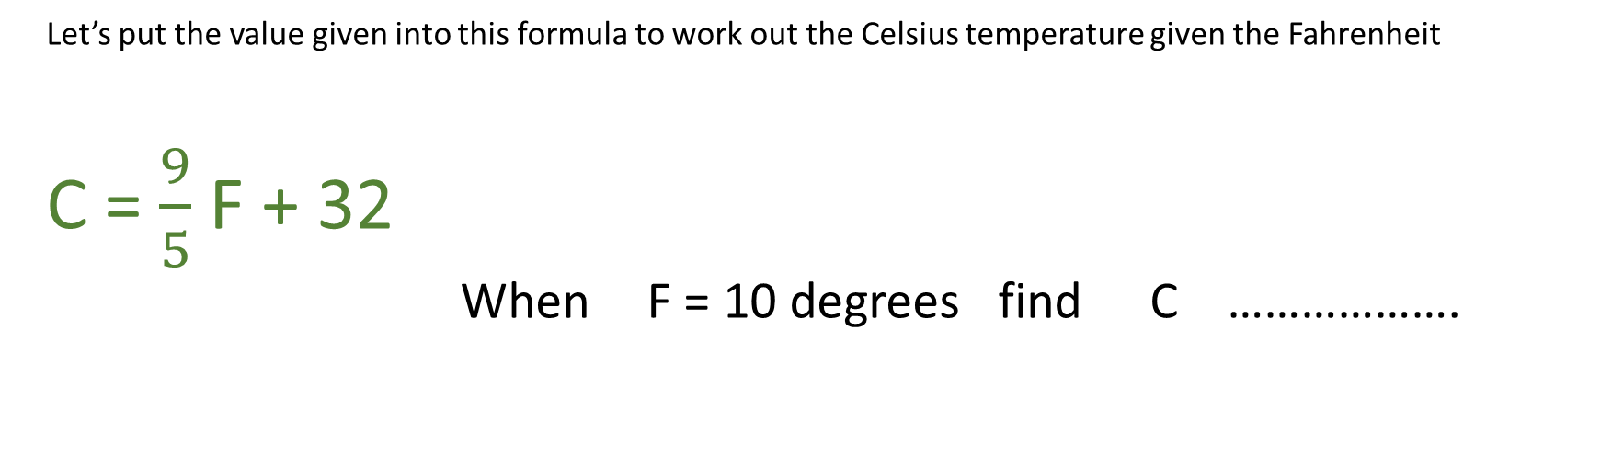
Substituting Values into Formulae
Let’s put the value given into this formula to work out the Celsius temperature given the Fahrenheit
C = $\frac{9}{5}$ F + 32
When F = 10 degrees find C ……………….
Find V
Find C
2
a = 6 b = 10
This Photo by Unknown Author is licensed under CC BY-SA

Slide 8

Your turn…
Find the missing values in the Formulae
Find the missing values in the Formulae
f) y² + 8 = X y=3
g) $a^{2}$ + b² + c² = T a=1 b=2 c=3
h) U + ½ t² = V U=10 t² = 81
i) $\frac{m^{2}}{n^{2}}$ = n + P m=6 n=2
j) X = w(15 − 3²) w=2
k) M = k² − 3³(k) k=4
16 + t = C t=4
80 – 2g = T g=6
X = 3y + 4 y=3
19 –(u + v ) = S u=2 v=7
a + a + 3 + b = M
a=1/2 b=21

Slide 9

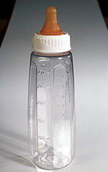
Charmene has a baby called Louis
Louis goes to the nursery.
The nursery staff make up bottles of milk for Louis.
Louis has 2 bottles of milk at the nursery each day.
Each bottle of milk needs 7 scoops of milk powder.
One scoop weighs 4.7g
Write a formula using b for bottles of milk, s for the number of scoops of milk powder and g for the weight of the powder, that will work out the total weight of any number of bottles of milk needed.
[ 3 Marks ]

Slide 10
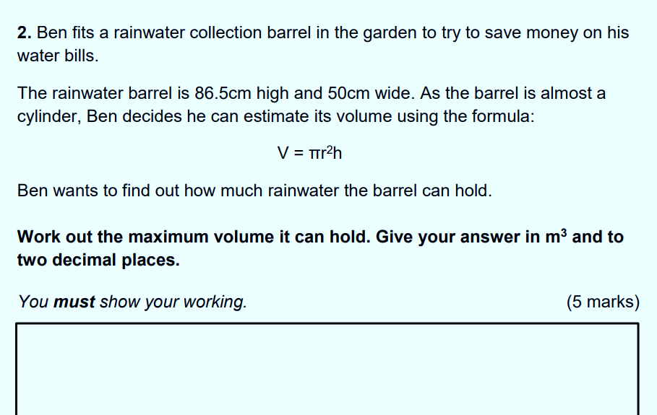


Slide 11
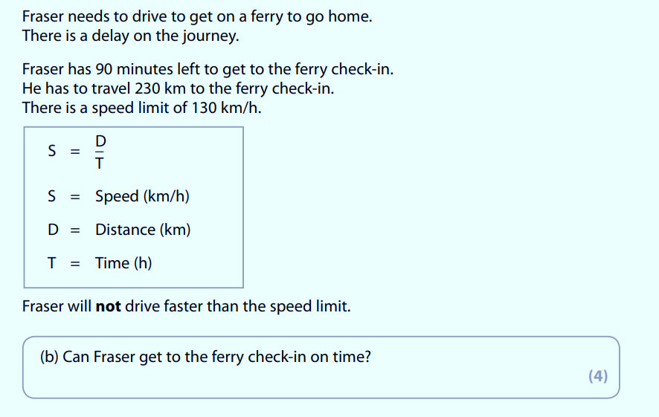
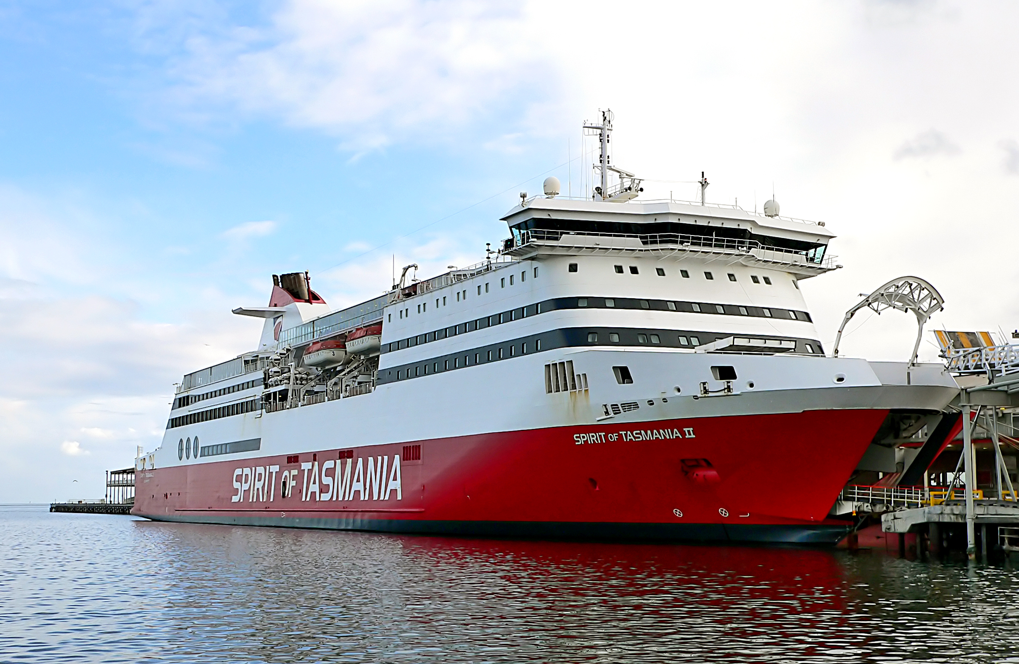

Slide 12
