Slide 1


10.3 Composite Functions
How would you define composite functions?

Slide 2
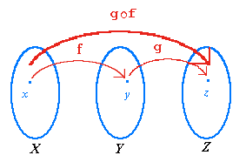

Composition of Two Functions
When two functions are applied in succession,
the resulting function is called the composite
of the two given functions.
(g o f)(x) = g(f(x))
The range of f(x) becomes the domain of g(x).
Evaluate f(x) then use the answer as the input for g(x).
Notice: The function is evaluated from the inside to the outside.
x is the input into the f function to get y
y is the input into the g function to get z

Slide 3
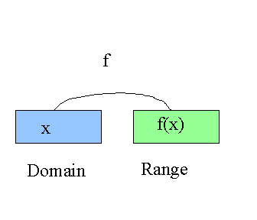

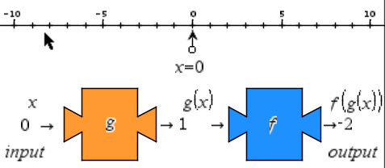
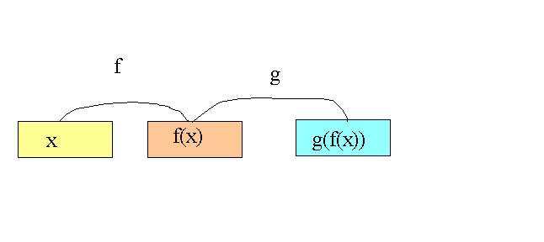
10.3 Function
Composition

Slide 5
Evaluating a Composition of a Functions
Given h(x) = 4x + 3, determine the following:
a) (h ο h)(x)
b) (h ο h)(-3)
(h ο h)(x) = h(h(x))
= h(4(x) + 3)
= h(4x + 3)
h(4x + 3) = 4(4x + 3) + 3
= 16x + 12 + 3
= 16x + 15
(h ο h)(-3) = h(h(-3))
= h(4(-3) + 3)
= h(-9)
h(-9) = 4(-9) + 3
= -33
Note: (h ο h)(x) ≠ (hh)(x)
(hh)(x) = h(x) x h(x)

Slide 6

Given
Determine an expression in simplest form for
Why are there restrictions?

Slide 7
Using the function
determine the value of

Slide 8
Determine the expressions for h(x)= f(g(x)) and k(x) = g(f(x))
The situation when f(g(x)) = g(f(x)) = x indicates that the original
functions are inverses.

Slide 9
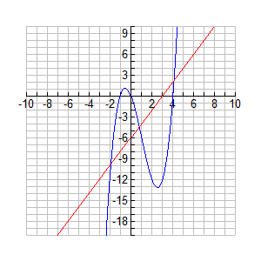
Use the graph to determine the value of

Slide 10
Assignment
Page 507
1a,c, 2a,c, 3c, 4a,d,e, 5b,c, 6, 7, 8, 11, 13, 14, 15, 17
C1, C2

