Slide 1
Q4 I start watching two films at 11am. The first lasts for 1 and 3/4 hours. The second is 95 mins. What time do I finish watching?
Q1 What is the range of
1504, 1202, 2310, 1401, 1074
Q2
Kayne is cooking 4 cakes. For one cake people, Kanye needs 1/2 pint of milk. How many pints for 20 people?
Q5 I’m buying skirting boards for the following room:
3000m
2000cm
S.B costs £11.30 per metre. They are 30% off. How much will it cost me?
Q3
Draw a rectangle in your book that is 3m x 6m when 1 square = 2m.

Slide 2
Conversion
Learning Objectives
To be able to :
Convert between units of length, weight, capacity
Tim has a job paying £6.85 per hour. If he works for 34 hours, one week, how much does he earn?
John takes boxes out of his van. The total weight of the boxes is 4.9 kg. The weight of each box is 0.7 kg Work out the number of boxes in John’s van.

Slide 3
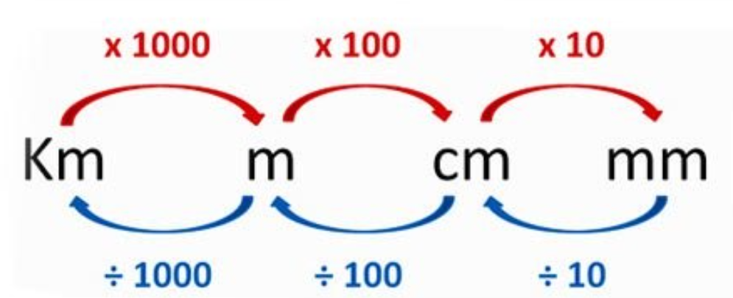

Slide 4
540 ÷ 100 =
398 x 10 =
43.32 x 100 =
0.98 x 100 =
9039 ÷ 1000 =
0.32 x 100 =
0.829 x 1000 =
0.021 x 10 =
6983.89 x 1000 =
5.3 x 100 =
764.32 ÷ 1000 =
0.3 x 100 =
541093 ÷ 100 =
9812.34 x 10 =
0.00342 x 1000 =
0.0124 ÷ 1000

Slide 5
Converting Length
1cm = ………. mm
1m = ………. cm
1km = ………. m
1. Change 5m into cm.
2. Convert 220cm into m.

Slide 6
Your turn…
1. Matthew is 1.74 metres tall.
Write this height in centimetres.
2. Change 55 centimetres into metres.
3. How many millimetres (mm) in 3 metres?
1. A square has sides of 0.6m.
Find the area of the square, giving your answer in cm²
2. Jenny burns 18 calories when she cycles 500m.
How many calories will she burn if she cycles 3km at the same pace?

Slide 7
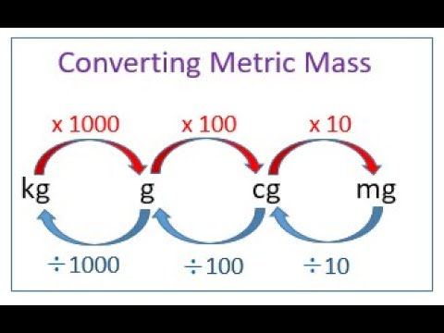
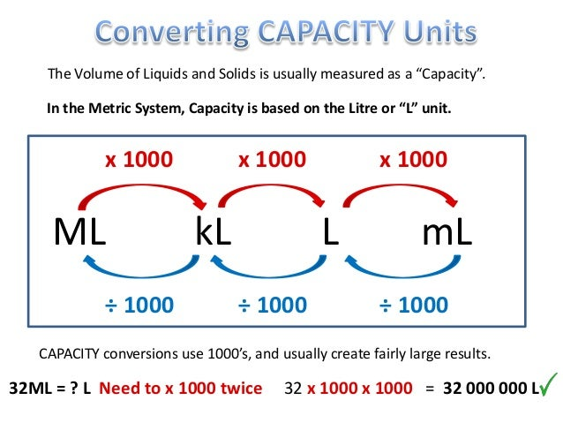
Converting Mass and Capacity
Mass
Capacity

Slide 8
1. Change 3kg into grams.
2. Convert 120g into kg.
1. Change 130ml into litres.
2. Convert 6l into millilitres.
NOTE
l is for litre
6l is not 61

Slide 9
Your turn…
Grapes cost £4.80 per kilogram
Blueberries cost £8 per kilogram
1a. Work out the total cost of 4kg of grapes and 2 kgs of blueberries
1b. Work out the total cost of 250g of grapes and 100g of blueberries
1. A box contains 3kg of rice.
Mario uses 75 grams of rice for each meal.
How many meals did Mario make?
2. Change 30000 grams to kilograms.

Slide 10

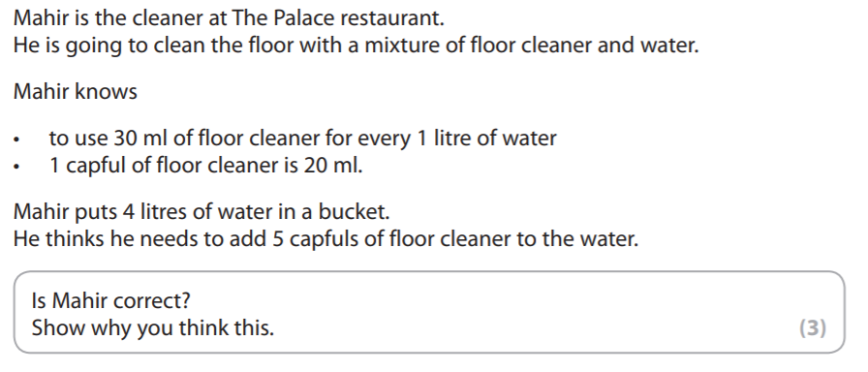

Slide 11
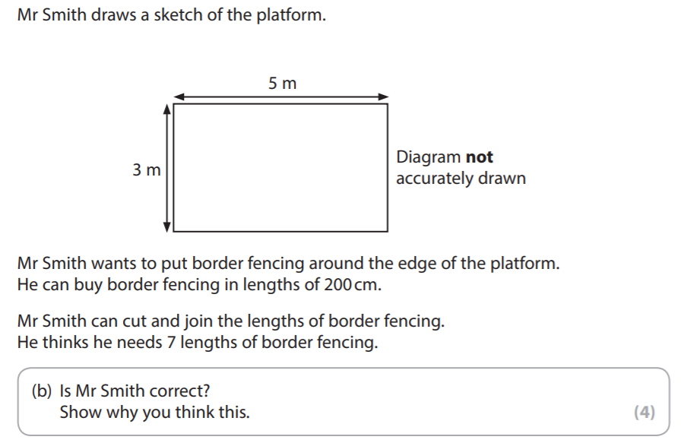

Slide 12
